Slide 1


CuraAssist CareHub
Presented by Team Shark

Slide 2

PROBLEMS IDENTIFIED
Expensive Medicine
Difficulty in Finding Pharmacies
Skipping medicine
Emergency Requirement
Multiple application
Limited understanding
Lack of HealthCare Guidance

Slide 3
our Solutions
Price compromized
Pharmacy Finder
Medicine reminder
Emergency Alert
Single application
Cost Optimization
Healthcare Optimization

Slide 4

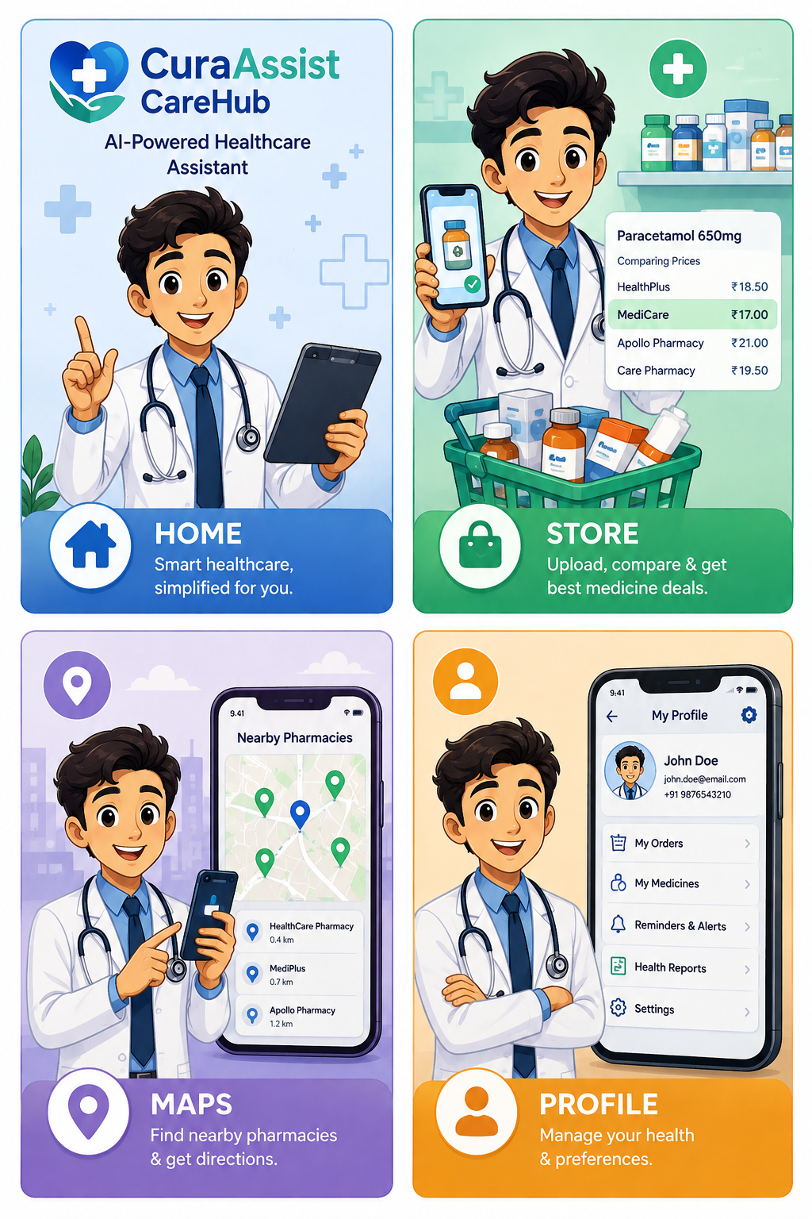
Our solutins
Roles Of Our Application
⬤HOME ⬤STORE ⬤MAPS ⬤PROFILE

Slide 5
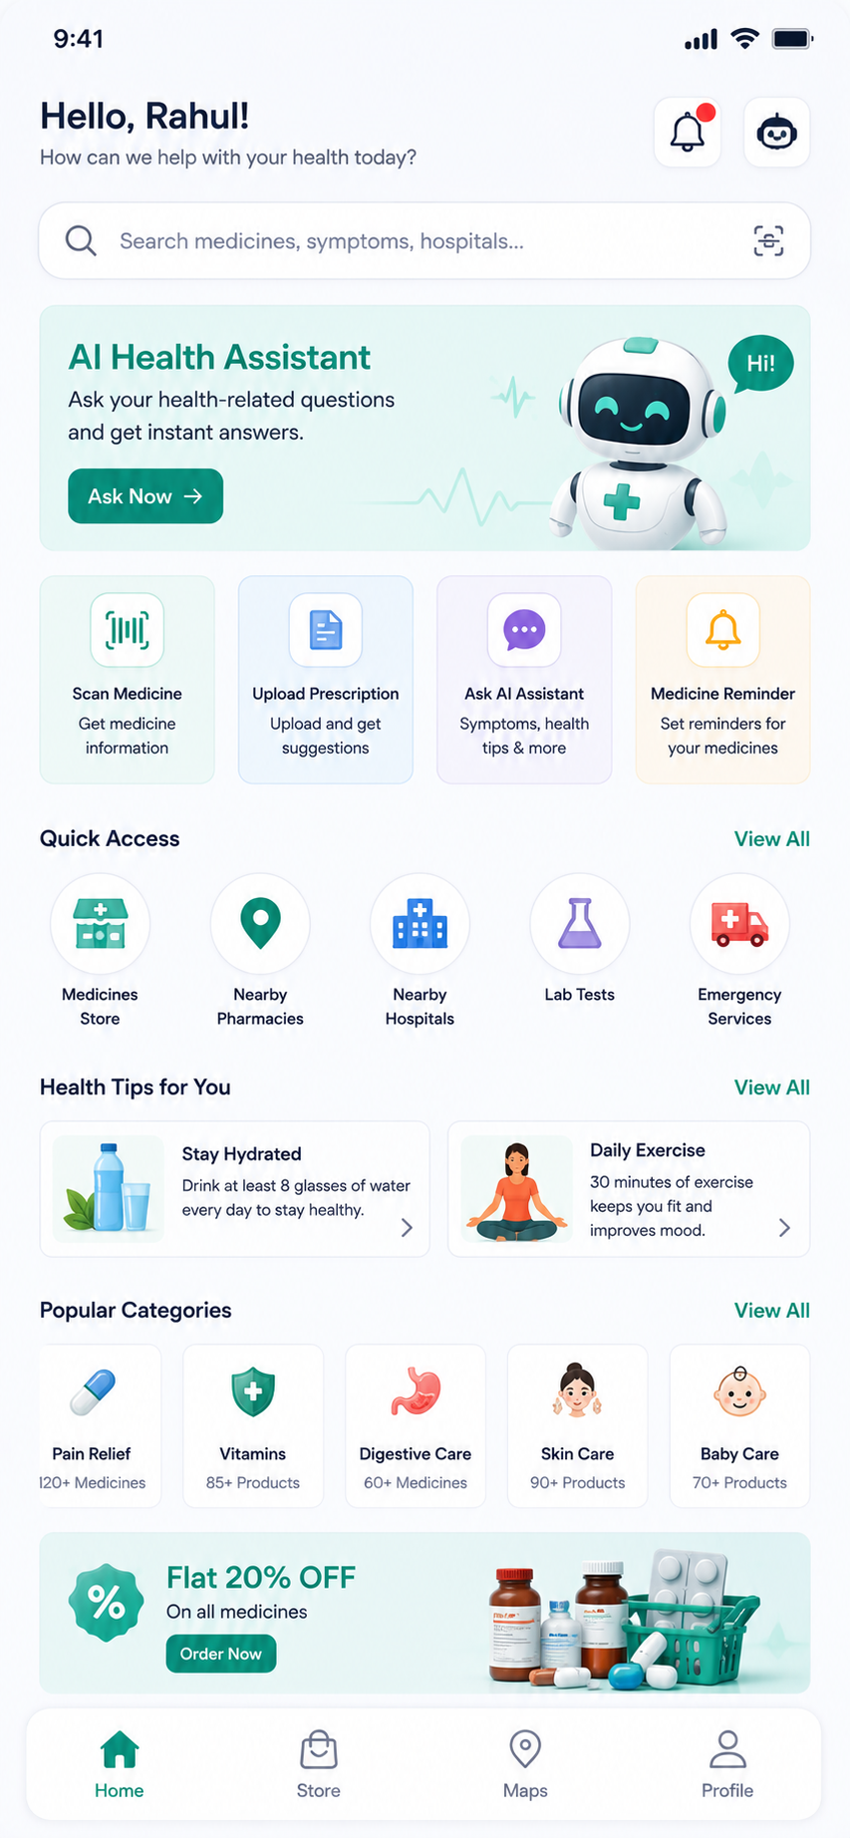
Home
Scan
AI Assistant
Health Dashboard
Medicine Schedule
Health Records
Emergency
Progress

Slide 6
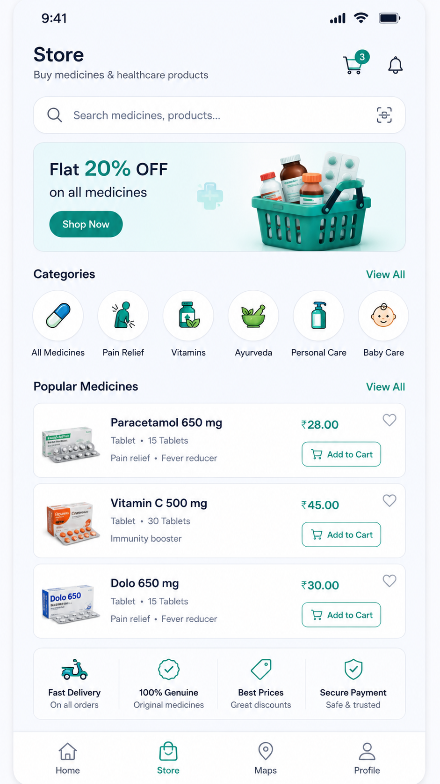
Store
Categories
Cart
Orders
Offers
Generic Alternative
Search Medicine
Customer Reviews

Slide 7
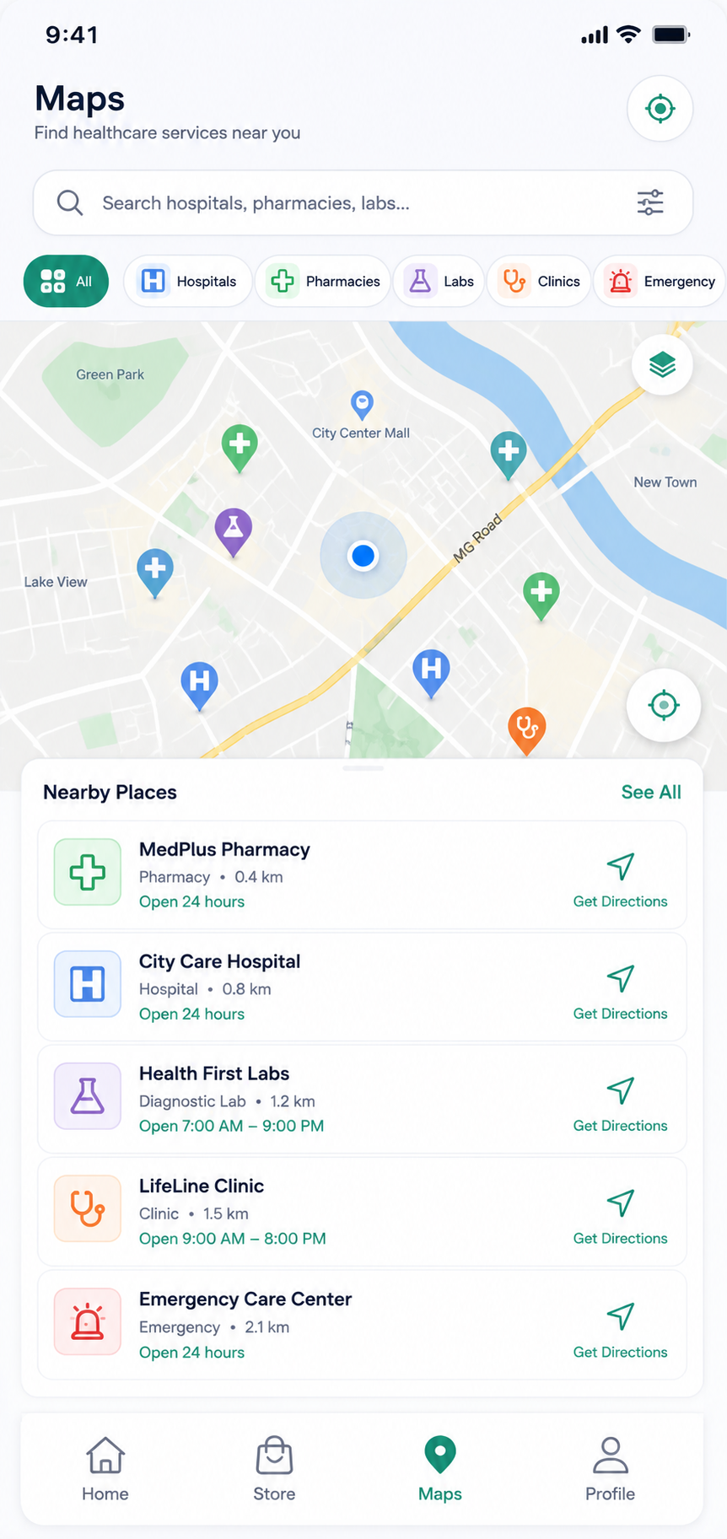
Map
Nearby Pharmacies
Hospitals
Clinics
Labs
Blood Banks
Ambulance
Navigation
Live Availability

Slide 8
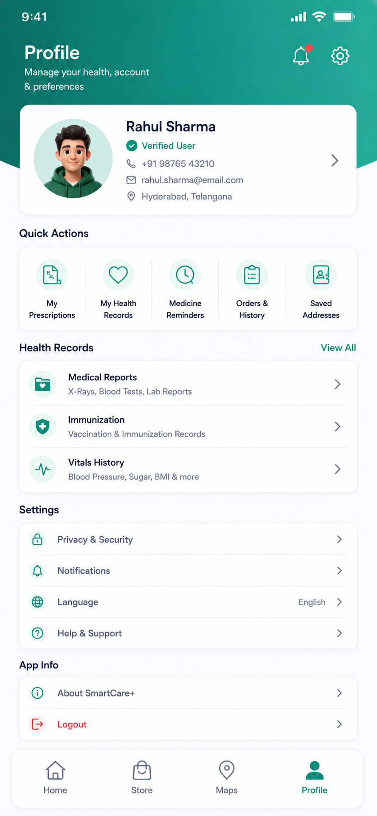
Profile
Personal Information
Medical History
Family Members
Settings
Language
Notifications
Saved Addresses
Emergency Contacts
Privacy
Help & SupportA

Slide 9
CuraAssist CareHub simplifies healthcare by bringing AI assistance, medicine price comparison, nearby pharmacy navigation, and health record management into one smart platform.
Our goal is to make healthcare more accessible, affordable, and convenient for everyone.
Thank you

