Slide 1
Monolith to Microservices
By Rahul Sharma

Slide 2
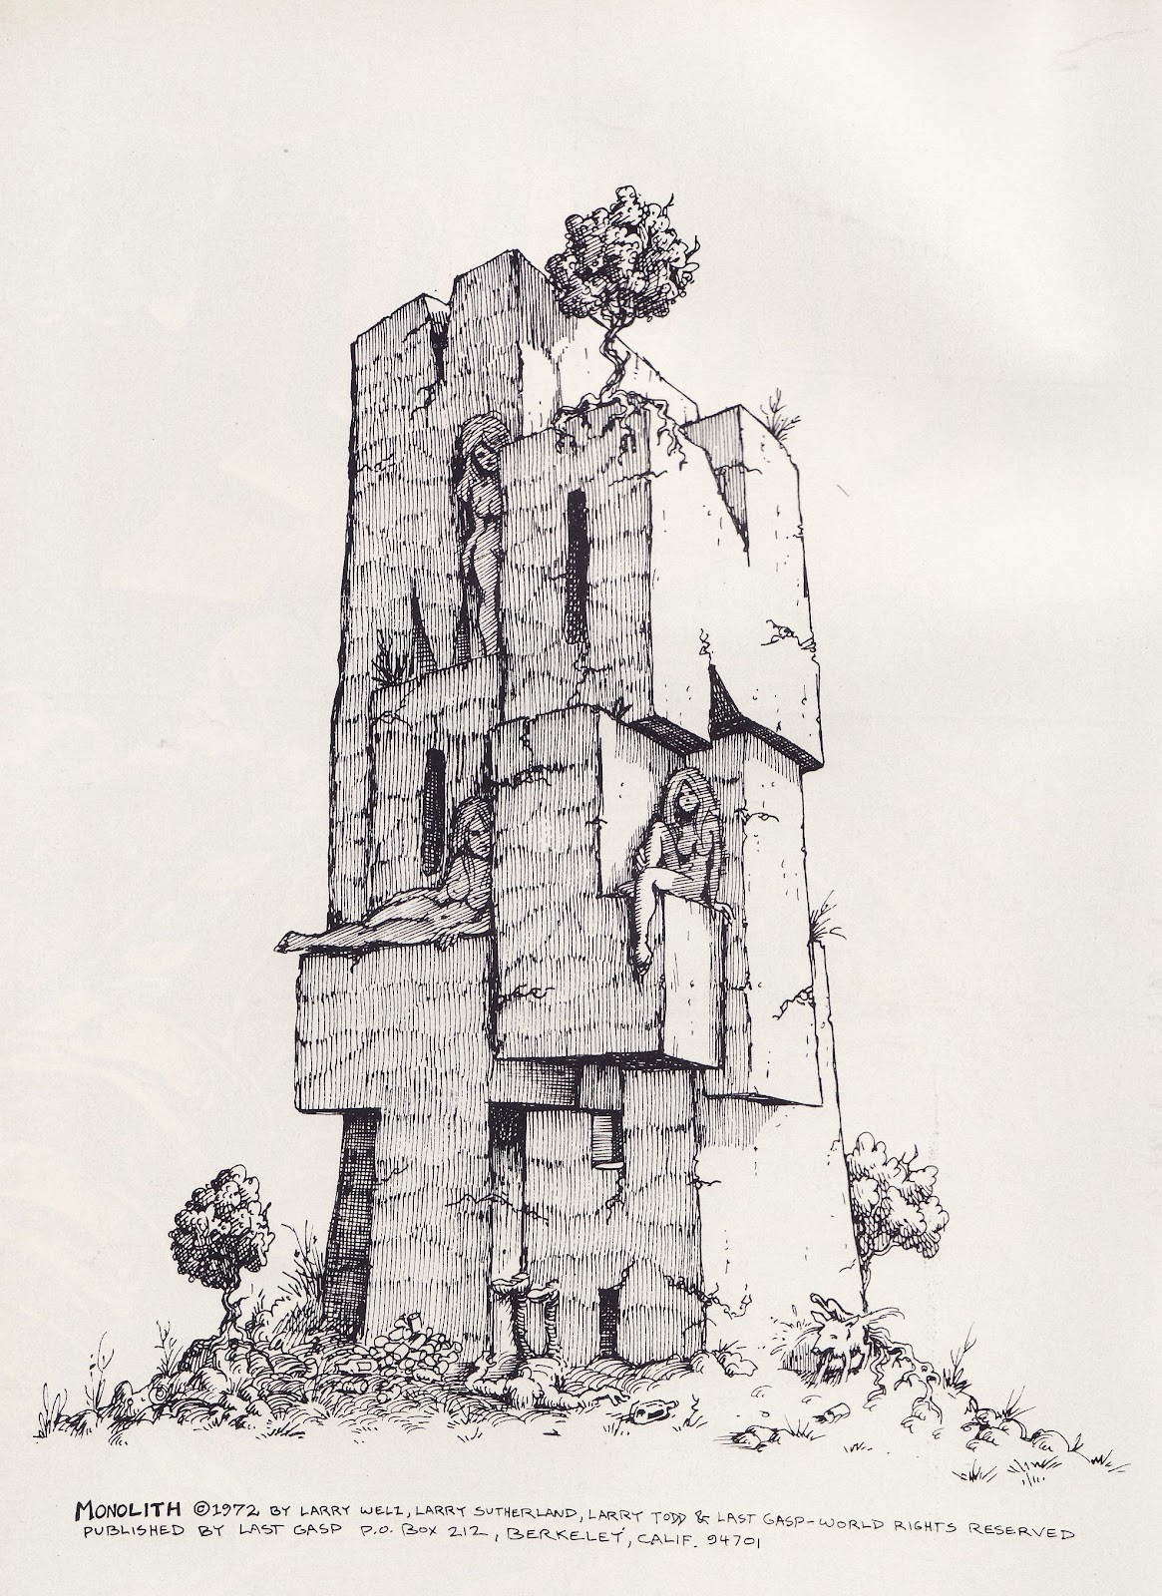
Monolith
Difficult to maintain
Long built times
Difficult to Scale
All-or-Nothing

Slide 3

Microservices
Loosely Coupled elements, Do one thing, and do it well

Slide 4
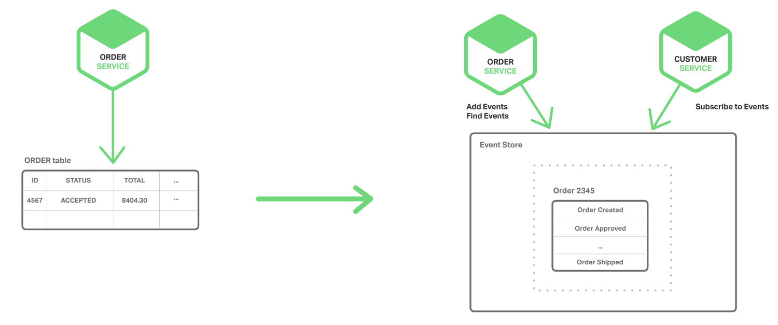
Application State
- No! Schema Sharing
- Eventual Consistancy

Slide 5
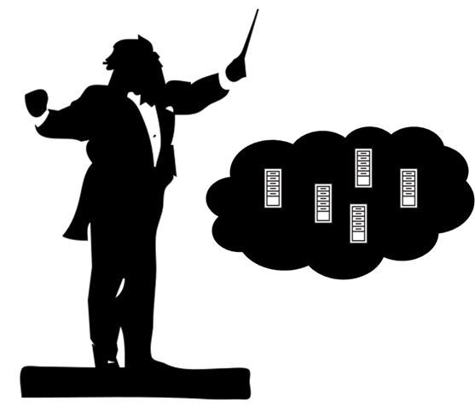

Inter-Service Talk
Any organization that designs a system (defined broadly) will produce a design whose structure is a copy of the organization's communication structure.
- Melvin E. Conway, 1968

Slide 6

Service API
Document API
Versioned API
Backward Compatible

Slide 7
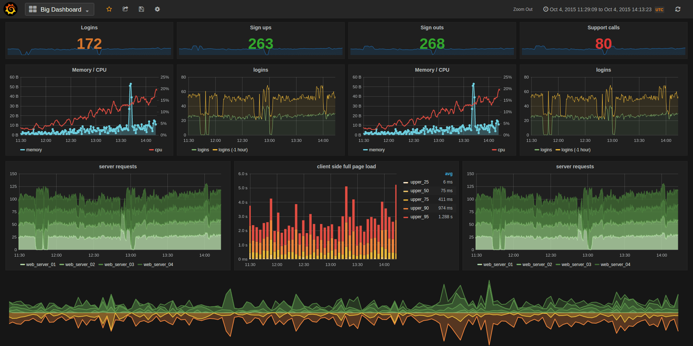


Health & Metrices

Slide 8




Distributed Monitoring & Tracing

Slide 9


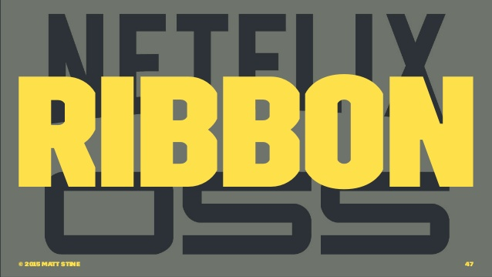
Deployment

Slide 10
Demo

