Slide 1

Intel Unnati Industrial Training 2024 Customized AI Kitchen For India
SAINTGITS
COLLEGE OF ENGINEERING
(AUTONOMOUS)
Presented by: Rahul Krishnan, ECE S4
Abia Abraham, ECE S4
Savio Saju, ECE S4
Belwin Vaniyapurayil Binoj , ECE S4
Ashique Muhammed, ECE S4
Department of Electronics Engineering
Saintgits College of Engineering
Team:
Tech Crafters
Name of the mentor:
Dr. Starlet Ben Alex
LEARN . GROW . EXCEL

Slide 2

Customized AI Kitchen For India
In today's fast-paced world, cooking nutritious and delicious meals can often seem like a daunting task. Busy schedules, diverse dietary preferences, and the challenge of making the most of available ingredients can make meal planning overwhelming. This is where our innovative project, the Smart Recipe Generator, comes into play. This project leverages the power of generative AI to create a unique and interactive tool for culinary enthusiasts. By training a language model on a dataset of popular Indian recipes, this project aims to generate new and customized Indian recipes based on user inputs. The tool is designed to assist users in discovering new dishes and experimenting with various ingredients and cooking techniques, all within the rich and diverse context of Indian cuisine.
LEARN . GROW . EXCEL

Slide 3
Literature Review
Project Aim:
Develop a generative AI model for Indian recipes, leveraging advancements to contribute to AI-driven culinary innovation.
Advancements in AI:
Transformer models like GPT-2 and GPT-3 excel in text generation, replacing traditional rule-based systems.
Challenges:
Ensuring cultural authenticity.
Handling ingredient variability.
Maintaining coherent instructions.
Future Directions:
Improve data collection methods.
Enhance model architectures.
Incorporate user feedback for refining recipe generation.
LEARN . GROW . EXCEL

Slide 4
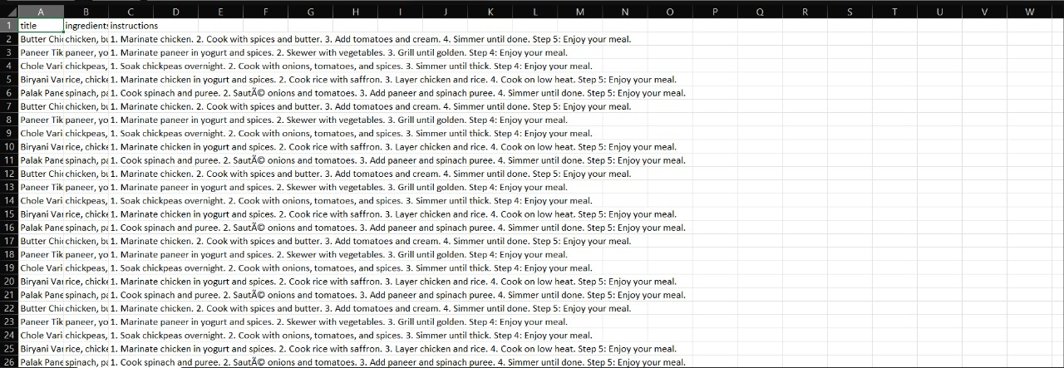
Datasets
The dataset comprises a collection of popular Indian recipes, including ingredients and step-by-step cooking instructions. It captures the rich diversity of Indian cuisine, providing a robust foundation for training the generative AI model.
This is a clean dataset with 1000 data rows and 3 columns a description of the dataset is:
.
LEARN . GROW . EXCEL

Slide 5
Abstract
This project aims to develop a generative AI model specifically designed to create recipes for popular Indian dishes. By leveraging advanced natural language processing techniques and Transformer-based models like GPT-2, the project focuses on generating personalized and coherent recipes based on user input, such as specific ingredients. The implementation involves several key steps: collecting and preprocessing a comprehensive dataset of Indian recipes, fine-tuning a pre-trained model on this dataset, and developing a user-friendly interface for real-time recipe generation. The project not only showcases the rich and diverse culinary heritage of Indian cuisine but also promotes culinary innovation and personalized cooking experiences. Additionally, it addresses practical applications such as reducing food waste, and integrating with smart kitchen appliances, making it a valuable tool for both novice and experienced cooks. Through iterative testing and user feedback, the model will be continuously refined to ensure high-quality recipe generation and an enhanced user experience.
LEARN . GROW . EXCEL

Slide 6
Work Plan
6th June 2024
24th June 2024
EDA
Model selection
Model creation
Model analysis
Finding dataset & literature review
7th July 2024
LEARN . GROW . EXCEL

