Slide 1

Autonomous Stair Climbing Robot
Team Name : LazyBot
Institute Name: IIIT Hyderabad

Slide 2

Team members details
Team Name | LazyBot
Institute Name | International Institute of Information Technology Hyderabad
Team Members > | 1 (Leader) | 2 | 3 | 4 | 5
Name | Vedant Mundheda | Karan Mirakhor | Dipanwita Guhathakurta | Rahul Kashyap Swayampakula | Puppala Avinash Prabhu
Batch | 2023 | 2022 | 2023 | 2022 | 2022
Area of expertise | Design & Vision | Design & Mechanism | Robotics Vision & AI | Design & Sensor Placement | Control & Locomotion

Slide 3
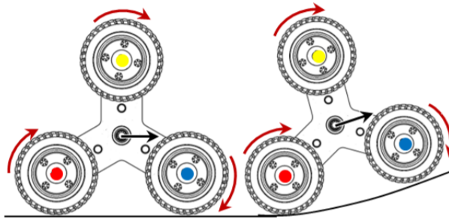
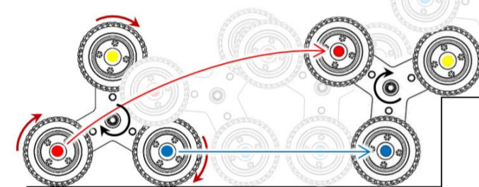
Functionalities of the Robot
Autonomously detects Stairs and Plans Path for climbing up or down the stairs
Fast, Robust, Maneuverable in any terrain, reliable and stable while climbing
Autonomously detects and changes state b/w Climbing Mode and Driving Mode, independently for front and rear wheels.
Are there any things that the robot can do above and beyond the requirement?
Moves effortlessly on an inclined plane in Driving Mode.
Fast and stable on Rough and Rocky terrains.
Carry payload weight upto 25 Kg on a Staircase.
What all can the robot do?
Independently looks for the next Staircase on a landing.
Keeps payload compartment aligned horizontally always. (using linear actuators and gyro)
Adjusts bot orientation to remain centrally aligned during Stair Climbing without use of side walls
Server and an App to track the Bot’s location, sensor data, battery status etc remotely.
Climb up or down even on Curved or Spiral Staircase.
Tri- Wheel Rotational Modes
Driving Mode
Stair Climbing Mode
Are there any out of the box functionalities?
Overcomes scenarios in which only two wheels remain in contact with Ground.
By Toppling the wheel
Passive tumbling of the Tri wheel and Suspensions give extra stability in Driving Mode.
1) Braking mechanism is engaged to cause the entire Tri Wheel to rotate about centroid.
2) Rotation occurs in the same direction as the three spinning wheels which are locked now.
1) Only the three wheels are driven to rotate in this mode.
2) Tri Wheel is able to passively pivot about its centroid to adapt for obstacles and slopes.
Simple, efficient and effective Wheel Mechanism for Stair climbing.
Prevents overload using Separate Batteries for Front and Rear wheels

Slide 4
Robot Specifications
Technical Specs
Ideal operation speed of the bot in Driving Mode: 8 - 10 Km/hr
Ideal operation speed of the bot in Stair Climbing Mode: 2 - 3 Km/hr
Max Obstacle Height it can cross over in Driving Mode: 40 cm
Max Obstacle Height it can cross over in Stair Climbing Mode: 20 cm
Power consumption: 180 - 1415 W
Distance the Bot can go upto on one full charge: 7.5 - 65 Km depending upon the use case
Turning radius: ~0 cm
Ideal Working Scenario Endurance:
22.23 Km (70% time on flat terrain, 15% time on 45° inclined plane, 15% time in Stair Climbing)
Physical Specs
Robot Dimensions : 50x50x96.59 cm (lxbxh)
Ground Clearance : 16.59cm
Chassis dimension : 50x50x20 cm
Payload box dimension : 40x40x60 cm
Wheel design : Tri-Star wheel design
Wheel dimensions :
Each wheel radius: 7.62cm
Spoke Length: 13.97cm
Material used for robot body : Aluminium and plastic.
Weight : 50kgs (without payload)

Slide 5
Robot/Solution Limitations
Limitations other than Requirements
Robot and Tri Wheel system is designed to operate on Staircases of 15-20 cms Height with 24-30 cm of Tread in Stair Climbing Mode.
Speed restricted to 11 Km/hr due to the choice of Geared DC Motors for excess Torque during Stair climbing.
It can carry a maximum payload of upto 25Kg only.
With one full battery charge :
Upto 65 Km in Driving Mode on a flat terrain.
Upto 7.5 Km in Stair Climbing Mode
Software Limitation : Vision algorithm works less efficiently in case of curved stairs.
We rely on Ultrasonic Sensor Data and IMU to climb Curved stairs.
No Limitations compared to the Requirements!!

Slide 6
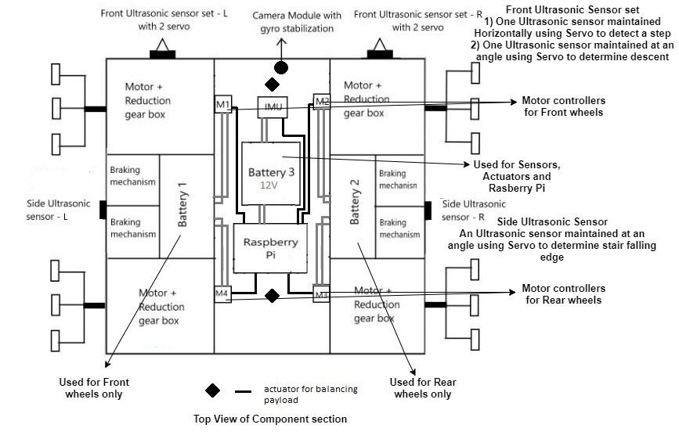
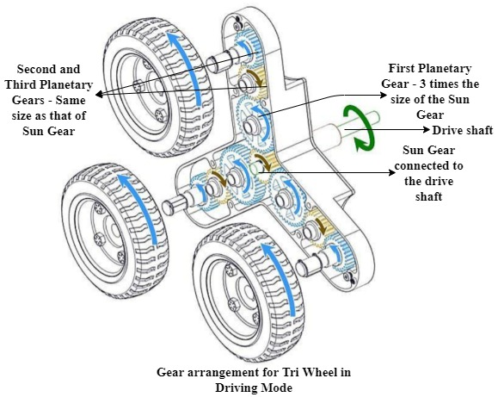
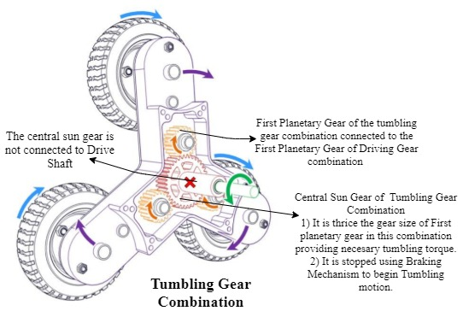
Robot Design
Robot Top View
Wheel Design

Slide 7
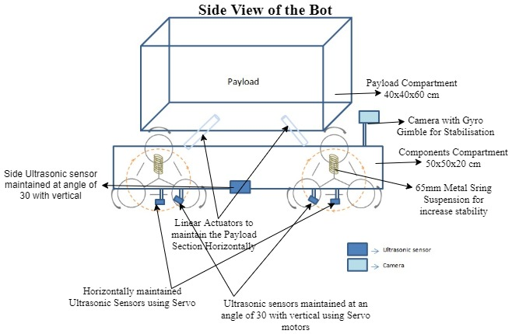
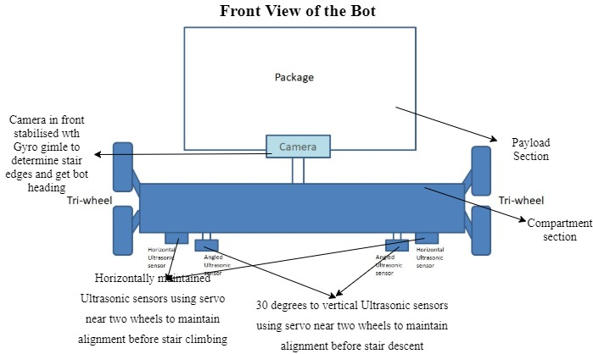
Robot Side View
Robot Front View

Slide 8
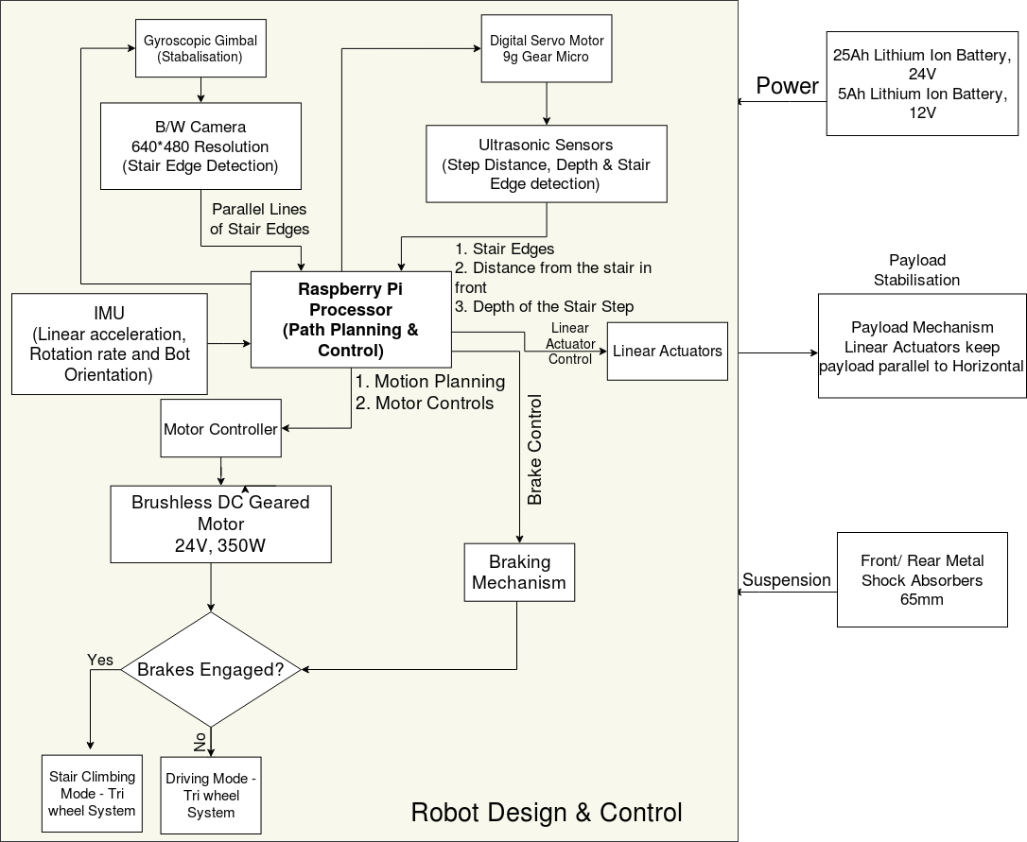
Architecture
The diagram describes how the electrical modules are connected in the bot. And explains the transfer of different signals among the modules at a higher level.
Note: The Motors and brakes are connected to wheels and linear actuators are used to stabilise payload. The power lining is explained in the previous slide.

Slide 9



Brief on Programming Module
Raspberry Pi modules to support hardware:
GPIO support on Raspberry Pi: RPi.GPIO for the HC-SR04 ultrasonic sensor.
Raspberry Pi Camera module: Picamera to capture to get a stream of images of the staircase.
Python Modules to be built (for stair detection through image processing):
Gabor filter: using OpenCV’s inbuilt getGaborKernel, filter2D.
Edge detector: using OpenCV ’s inbuilt Canny edge detector.
Edge linking: to be coded from scratch using Python.
RANSAC: using skimage’s inbuilt ransac.
Estimated overtime of the system is less than 60 ms
Programming language used:
Python
Custom built modules to control the various hardware components:
Program to control the various states(rolling, ascending, descending) by processing the inputs from the ultrasonic sensor, IMU and gyroscope and controlling the brakes.
Program in the Microcontroller which will control the wheels (taking turns) based on the current state and path plan.
Program for the autonomous orientation of robot in the direction of the next stairway by processing distance inputs from lateral ultrasonic sensors at the quarter-landing.

Slide 10
Execution Plan
Exploring various solutions based on cost, feasibility, etc.
(July 1-2)
Making a list of the requirements for a particular solution.
(July 3-4)
Drawing a rough sketch sketch of the bot and the algorithm flowchart
(July 5-7)
Making CAD model of proposed Design using Solidworks and developing code.
(July 8-17)
Testing the robot in simulation
(July 18-25)
Assemble the hardware
Order the parts required for the robot.
Improving the algorithm and design based on the results
(July 26-29)
Cost Estimation
Brushless DC Motor 350W 4 x ₹ 3,600
Motor Controller - 350W 4 x ₹ 800
25Ah 24V Li ion Battery 2 x ₹ 7,500
5Ah 12V Li ion Battery 1 x ₹ 500
Chassis Assembly ₹ 1,500
Wheel Assembly 4 x ₹ 2,500
Raspberry Pi 3 ₹ 3,000
Camera Module ₹ 600
Sensors and Actuators ₹ 6,000
Suspension system ₹ 2,500
Total ₹ 56,200
Testing the Algorithm on the board and verifying the commands without body.
Testing the hypothesis on the bot
Improving the results
Done
Final submission
Note:
Tentative Timeline
In Progress
Yet to start

Slide 11
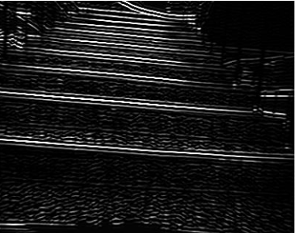
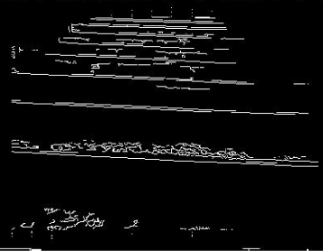
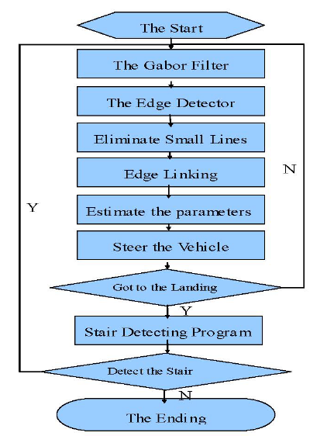

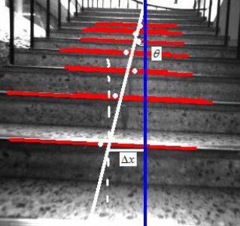
Autonomous climbing using Vision Algorithms
Gabor Filter used:
Eliminate influence of illumination
Keep Stair Edges
Generic edge detector on filtered image:
Removes small, vertical edges.
Remainder adjacent edges linked into horizontal parallel edges (Stair edges)
Midpoints of horizontal lines estimated.
A line is fitted joining centres of detected stair edges by RANSAC method (white line in Fig 4) and 2 offset parameters are estimated w.r.t robot orientation (blue line in Fig 4):
𝜃 = angle b/w bot orientation and the line joining centres of detected edges
𝚫𝑥 = distance b/w bot orientation and line joining centres of detected edges
If 𝜃 and 𝚫𝑥 are less than a fixed threshold, maintain previous orientation, else change direction to minimise 𝜃.
Fig1
Fig2
Fig3
Fig4
Fig 1: Output of Gabor filter
Fig 2: Output after eliminating small vertical edges
Fig 3: Output after edge-linking
Fig 4: Demonstration of calculating offset parameters
These are references ref_1, ref_2, ref_3

Slide 12
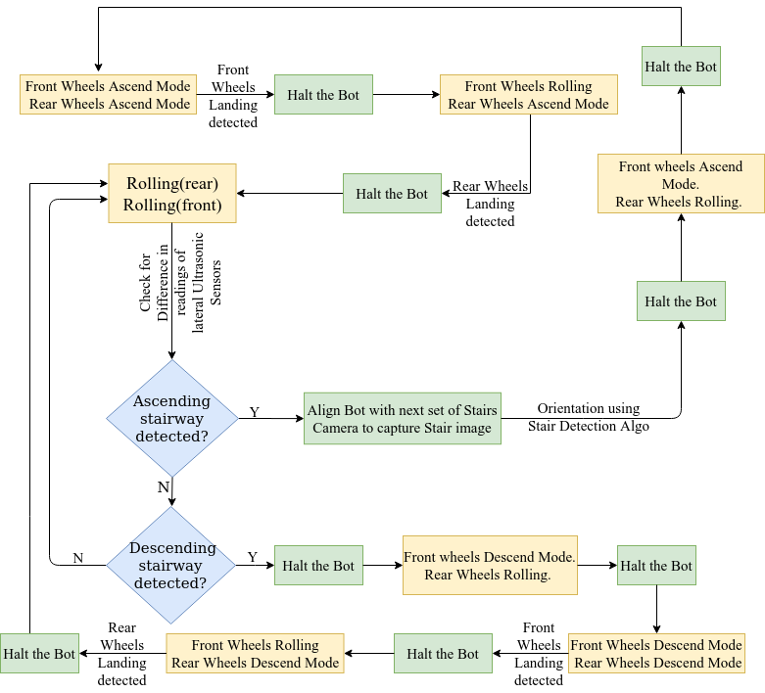
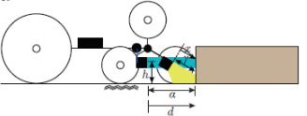
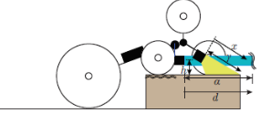
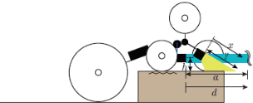
Control flow
𝜃= 0 degrees
d <= a
x <=y
Increase power
Rolling
Ascending
𝜃= 120 degrees
d > a
x <=y
Normal power
State transitions for each set of wheels
Ascending
Rolling
𝜃= 0/120 degrees
d > a
x > y
Decrease power
Rolling
Descending
𝜃: gyroscope reading to get angle above horizontal
d: Distance in front through ultrasonic sensor
x: Inclined distance through ultrasonic sensor
State switching logic for wheels

Slide 13


