Slide 1

#LifeKoKaroLift
Python
Program

Slide 2



Course : Python Program
Lecture On : API
Instructor : Rahul Kumar

Slide 3
Today’s Agenda
1.) What is an API?
2.) REST vs SOAP API
3.) Endpoints of and API
4.) Using Weather API to fetch data

Slide 4
API
“In computer programming, an application programming interface (API) is a set of subroutine definitions, protocols, and tools for building application software. In general terms, it is a set of clearly defined methods of communication between various software components”.

Slide 5
REST & SOAP
REST : REST(Representational state transfer) is an architectural style, unlike SOAP which is a standardized protocol. REST makes use of existing and widely adopted technologies, specifically HTTP, and does not create any new standards. REST is very data-driven, compared to SOAP, which is strongly function-driven.
SOAP : SOAP( Simple Object Access Protocol) relies heavily on XML, and together with schema, defines a very strongly typed messaging framework.it is a mature protocol with a complete spec and is designed to expose individual operations – or pieces of operations – as web services. One of the most important characteristics of SOAP is that it uses XML rather than HTTP to define the content of the message.

Slide 6
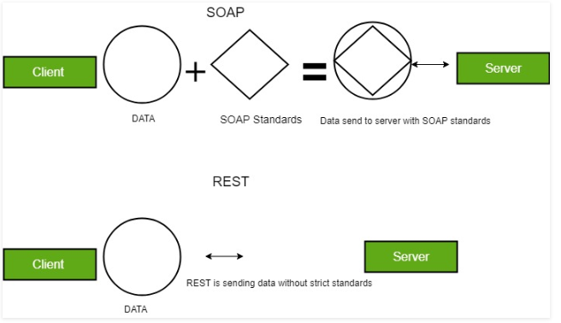
REST & SOAP

Slide 7
REST & SOAP
HTTP verbs: Some of the common HTTP methods/verbs are described below:
GET: Retrieves one or more resources identified by the request URI and it can cache the information receive.
POST: Create a resource from the submission of a request and response is not cacheable in this case. This method is unsafe if no security is applied to the endpoint as it would allow anyone to create a random resource by submission.
PUT: Update an existing resource on the server specified by the request URI.
DELETE: Delete an existing resource on the server specified by the request URI. It always return an appropriate HTTP status for every request.
GET, PUT, DELETE methods are also known as Idempotent methods. Applying an operation once or applying it multiple times has the same effect. Example: Delete any resource from the server and it succeeds with 200 OK and then try again to delete that resource than it will display an error message 410 GONE.

Slide 8
Conclusion
The best way to choose in between REST and SOAP depends on their usage. HTTP standard makes REST a very attractive option for public APIs. Coupled together with JSON, which makes something like adding an optional parameter very simple, makes it very flexible and allows for frequent releases without any impacting .

Slide 9
End Point of API
An endpoint is one end of a communication channel. Very often it would be represented as the URL of a server or service.
In REST APIs, the resource typically refers to some object or set of objects that are exposed at an API endpoint. An endpoint by itself is just a reference to a URL that accepts web requests that may or may not be RESTful.

Slide 10
#LifeKoKaroLift
Thank You!

