Slide 1


802.11
DEAUTHENTICATION &
EVIL TWIN ATTACKS
How they work — and how to stop them
CYBERSECURITY
802.11
WIRELESS
Mahi Jaiswal | Pratikshya Dash | Rahul Sinha | Rohit Sinha | NMIMS Indore

Slide 2

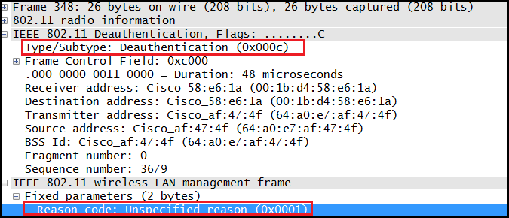
THE FOUNDATIONAL FLAW
802.11 Management Frames — Signed or Unsigned?
Deauth Frame Structure
What are Management Frames?
Frame Control
Type: Management / Subtype: 0x0C (Deauth)
Destination MAC
Target client (or FF:FF:FF:FF:FF:FF = broadcast)
Wi-Fi communication is split into three frame types:
Data Frames — carry actual traffic (websites, videos, etc.)
Control Frames — low-level channel management
Management Frames — connection lifecycle (associate, probe, authenticate, DEAUTHENTICATE)
The critical flaw:
In 802.11 (up to WPA2), management frames carry NO cryptographic signature. There is nothing preventing anyone from forging them.
A Deauthentication frame is simply the router saying to a client: "you are disconnected." Since it's unsigned, anyone can send one.
Source MAC
Spoofed — copied from real AP's BSSID
BSSID
Also spoofed to match AP
Reason Code
e.g. 0x0007 = 'Class 3 frame from unassoc station'
⚠ No Signature
Nothing to verify who sent this frame

Slide 3
ATTACK #1
Deauthentication Attack — Attack Flow
1
Monitor Mode
2
Passive Scan
3
Select Targets
airmon-ng start wlan0
NIC listens to all traffic
airodump-ng wlan0mon
Capture beacon frames
Pick AP BSSID
and Client MAC
6
Client Drops
5
Inject Frames
4
Forge Deauth
Victim disconnects
Cannot reconnect
aireplay-ng -0 0
Continuous flood
Craft frame with
spoofed source MAC
Command: sudo aireplay-ng -0 0 -a [AP_BSSID] -c [CLIENT_MAC] wlan0mon

Slide 4



ATTACK #2
The Evil Twin — A Rogue Access Point
Core Concept
Real AP vs Evil Twin
An Evil Twin is a rogue Wi-Fi access point that impersonates a legitimate network by broadcasting the same SSID (network name).
Why it works:
Devices auto-connect to known SSIDs. If two networks have the same name, the device picks the one with the stronger signal. The attacker can boost their radio power to win.
What the attacker gains:
Once connected, the victim's traffic goes through the attacker's AP. This enables:
  Traffic interception (MITM)
  Captive portal — fake login page harvesting credentials
  DNS spoofing — redirect to phishing sites
  SSL stripping (if HSTS not enforced)
REAL AP
EVIL TWIN
VS
SSID: HomeNet
Auth: WPA2
SSID: HomeNet
Auth: Open/WPA2
CLIENT DEVICE
Sees two "HomeNet"
Connects to stronger signal (Our Evil Twin)

Slide 5
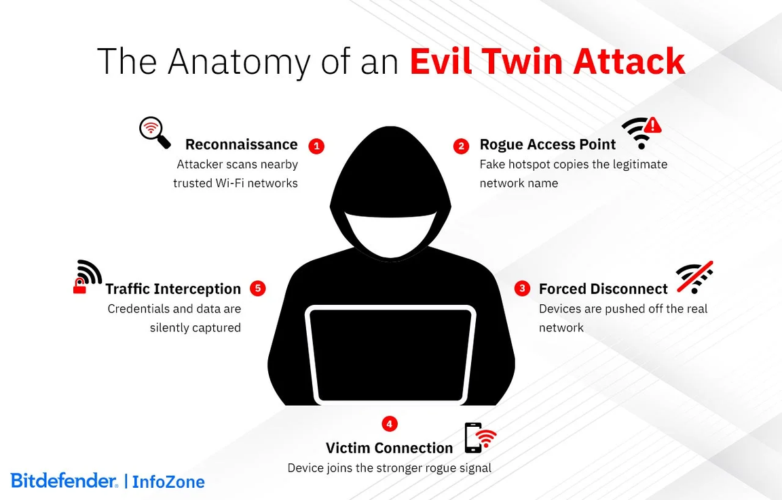
ATTACK #2 — FLOW
Evil Twin Attack — Step by Step Flow
1
Clone SSID
2
Broadcast Beacons
3
Deauth Real AP
ESP8266 configured
with same SSID
Rogue AP advertises
cloned network
Force disconnect
from legitimate AP
6
Captive Portal
5
Auto-Reconnect
4
Victim Scans
Fake login page
harvests credentials
Connects to evil twin
(stronger signal)
Disconnected client
searches for networks
ESP8266 Implementation:
Custom firmware flashed on ESP8266 creates a fake SSID matching the original AP. When victims connect, they are served a captive portal replica of the legitimate login page. Any credentials entered are captured and logged by the ESP8266.

Slide 6
COMBINED ATTACK CHAIN
How Deauth + Evil Twin Work Together
Monitor Mode
Attack Impact
airmon-ng start wlan0
→ Victim forcibly disconnected from legitimate AP
Scan Networks
airodump-ng wlan0mon
→ Device scans and finds evil twin with same SSID
→ Auto-reconnect to rogue AP (stronger signal)
Deauth Client
→ Captive portal mimics legitimate login page
aireplay-ng -0 0 -a <BSSID> -c <CLIENT>
→ Credentials captured in plain text
Evil Twin AP
→ Attacker now has Wi-Fi password
ESP8266 broadcasts cloned SSID
Credential Harvest
Deauth works mainly because:
→ management frames were historically NOT protected
Evil twin works because:
→ humans trust names, not identity (BSSID/certificates)
Victim enters password in captive portal

Slide 7




DEFENSES
How to Protect Against These Attacks
802.11w PMF
WPA3-Personal
Protected Management Frames encrypts management frames including deauth packets. Forged frames fail signature verification and are silently dropped — deauth attack becomes impossible.
Mandates PMF by default. Replaces PSK with SAE (Simultaneous Authentication of Equals) preventing offline brute-force attacks on captured handshakes.
VPN
HTTPS + HSTS
Encrypts all traffic end-to-end. Even if connected to evil twin, attacker sees only ciphertext. Essential for public Wi-Fi usage.
Encrypts web traffic and prevents downgrade attacks. Certificate pinning in apps rejects fake certificates from MITM attackers.
Best protection: WPA3 router + PMF-enabled clients + VPN on untrusted networks

