Slide 1

Development of Explainable AI (XAI) based model for prediction of heavy / high impact rain events using satellite data
Team Name : CryptoVault, PS ID : 1521
Team Lead : Rahul B
Team Members
Kamal Raj P
Shafwaan Ahmed T
Vadepeer M
Zaheer Abbas M
Vahitha H

Slide 2



introduction
❖ Machine Learning (ML) –based models such as Random Forest (RF), Support Vector Machine (SVM) and deep Convolutional Neural Network (CNN) will yield good result on rain prediction.
❖ The high impact assigned to 1 and low impact assigned to 0.
❖ Explanations for AI model predictions can be given using trust building Explainable AI (XAI) model like Shapley Additive Explanations (SHAP) and Local Interpretable Model-Agnostic Explanations (LIME).
❖ A web application can be developed with Python and Java Script that provides a user-friendly interface for users to interact with the AI model and XAI module. The application can be furnished with key features to allow users to submit satellite data and receive rain predictions and displaying explainable components for knowing how they interact with each other.

Slide 3
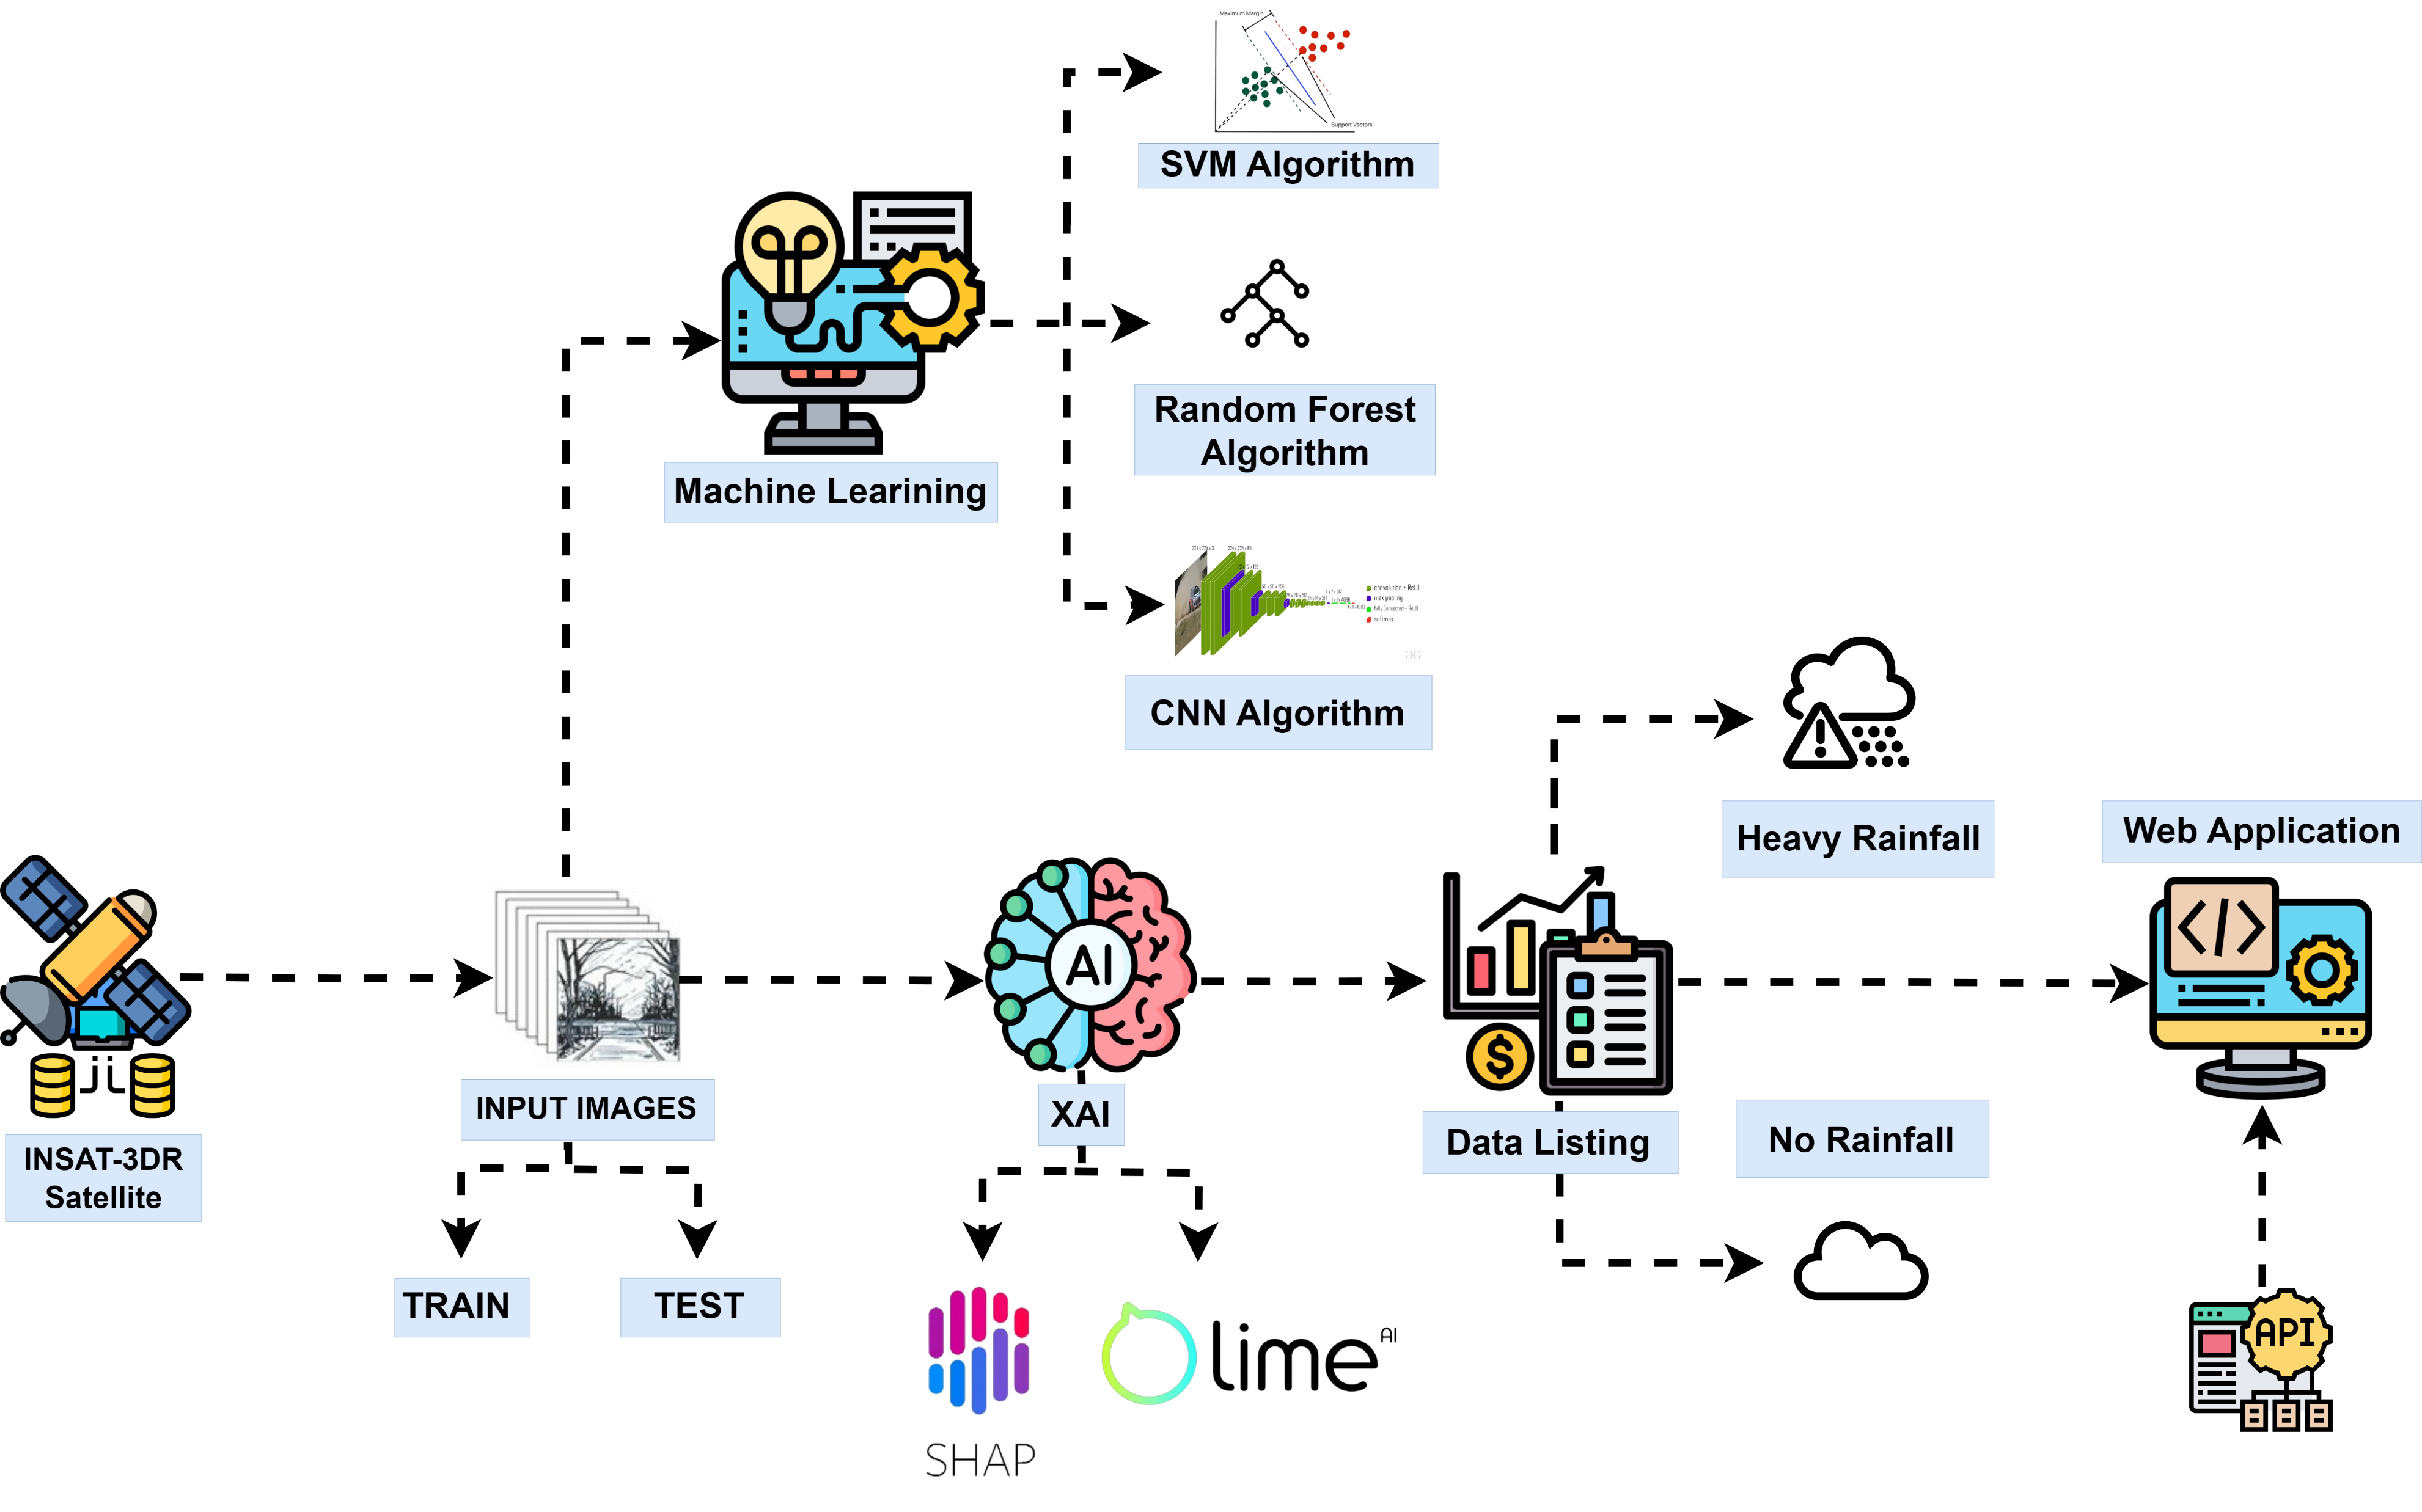
architecture

Slide 4
working
Data Preparation:
Collect and preprocess satellite data, addressing missing values and normalizing features for consistency.
Feature Engineering:
Extract temporal and spatial features, integrating meteorological indices to enhance model performance.
Model Selection:
Choose an explainable model such as decision trees or random forests, prioritizing interpretability.
Interpretability Techniques:
Apply techniques like SHAP values and feature importance scores to elucidate model predictions.
Validation and Deployment:
Validate the model using cross-validation, ensuring robustness and deploy it for real-time predictions with a user-friendly interface.

Slide 5
Market research
Identify Stakeholders:
Conduct market research to identify key stakeholders such as meteorological agencies, disaster response teams and industries vulnerable to heavy rain impacts.
Assess Current Solutions:
Evaluate existing weather prediction models and technologies to understand their strengths, limitations.
User Needs Analysis:
Engage with potential end-users through surveys or interviews to gather insights into their specific needs, preferences and challenges related to heavy rain prediction.
Competitive Landscape:
Analyze competitors offering AI-based weather prediction solutions, examining their features, pricing models and user feedback.
Regulatory and Compliance Considerations:
Investigate regulatory requirements and compliance standards relevant to weather prediction technologies, ensuring the model aligns with industry standards and legal frameworks.

Slide 6
conclusion
The creation of an Explainable AI model for heavy rain prediction using satellite data holds significant promise for enhancing forecasting accuracy. The incorporation of explainable algorithms ensures transparency in decision-making, fostering trust among users and stakeholders. With continuous monitoring and feedback mechanisms, this model can contribute to proactive measures in response to heavy rain events, thus improving resilience in the face of unpredictable weather patterns. Overall, the project signifies a critical step toward effective and transparent risk management in the realm of weather prediction.

