Slide 1

Breast Cancer Detection using Machine Learning Techniques
BIO 543 – Big Data Mining in Healthcare
Presented by Group 35
Rahul Maheshwari (MT19027)
Surbhi (MT19055)
Nikunj Agarwal (MT19093)
Sumedha Bhatia (MT19129)

Slide 2
Introduction
Breast Cancer affects nearly 10% of the women across the world and is listed among the top 10 cause of deaths in women by the World Health Organization(WHO).
It is claimed as the second highest cause of death in women in the US by the American Society of Clinical Oncology (ASCO).
Major studies have proved that the rate of survival in breast cancer is nearly 91% five years after it was first diagnosed and nearly 84% ten years after its diagnosis. (Reference)
The high survival rates hence provide the importance for its early detection.

Slide 3
Breast Cancer detection involves classification of tumor as Benign or Malignant.
3 different diagnosis methods are present – Mammography, Ultrasound, MRI.
Existing inaccurate and time consuming detection procedures lead to the use of novel machine learning and data mining techniques to be applied for the detection of breast cancer with the help of patient’s records.
The fast and accurate results of such techniques are evident of their usefulness.

Slide 4
Existing Methods
Many research papers have performed similar task in order to achieve high accuracy on the UCI Wisconsin Diagnostic Breast Cancer data set (WDBC).
One such existing system used SVM and KNN and reported that SVM performed better with an accuracy of 92.7% [1].
One approach using Decision Tree (C4.5), Radial basis neural networks, SVM using WEKA was performed and reported highest accuracy of 95.7% with SVM [2].
Mandeep Rana et. Al worked on the diagnosis and the prediction of recurrence of breast cancer by applying KNN, SVM, Naïve Bayes and Logistic Regression techniques, programmed in MATLAB with 94.96% and 72% accuracies for detection and prediction of recurrence respectively. [3].

Slide 5
Clustering methods were also mentioned in some of the researches which classifies benign and malignant tumour based on some clusters created using K means and other clustering algorithms [4].
Another research paper implemented AdaBoost, Gaussian Naïve Bayes, LDA, QDA, etc. and achieved highest accuracy of 96.5% [5].
Detection of breast cancer was also performed using diagnostic images using CNN and ensemble networks. Best accuracy observed was 90.8% [6].
Another research paper used 2 different benchmark datasets and reported 98.80% and 96.63% accuracies respectively [7].

Slide 6
Research base paper
Prediction of Breast Cancer Using Supervised
Machine Learning Techniques
Published under IJITEE
ISSN: 2278-3075, Volume-8 Issue-6, April 2019
By
Ch. Shravya, K. Pravalika , Shaik Subhani
Research base paper used the UCI Wisconsin Diagnostic Breast Cancer Data set (WDBC) for all their experiments.
Methodology involves use of classification techniques like Support Vector Machine (SVM), K-Nearest Neighbor (K-NN), Logistic Regression, with Dimensionality Reduction technique i.e. Principal Component Analysis (PCA).

Slide 7
Feature selection and feature projection was performed based on the analysis of correlation between features.
Supervised Classification models were applied as the task was to perform binary classification. Therefore following models were applied –
1. Logistic Regression
2. Nearest Neighbor
3. Support Vector Machines
With all the models they got almost similar accuracies with highest of 92.78% with Support Vector Machines (SVM).

Slide 8
The use of machine learning techniques along with sophisticated dimensionality reduction methods such as PCA (Principal Component Analysis) resulted in highly accurate results.
Future research suggested in the research paper was to include novel techniques to achieve even higher accuracy.
The research was done on a data set containing only numerical features but can be combined with images of the patients’ so as to give better predictions.

Slide 9
Materials and Methods
The data set was obtained from UCI repository of open source data sets.
Wisconsin Diagnostic Breast Cancer (WDBC) data set is used as it is one of the most popular data set to be used in similar tasks performed in various research papers.
The dataset mentioned consists of 569 data points with 32 attributes each. Out of these 32 attributes, one of them is the classifier output, Benign(B) or Malignant(M).
The given data has been analyzed so that relationship between various attributes can be determined. Thereafter, data preprocessing has been done to normalize the data. Finally, attribute selection and dimensionality reduction has been performed.

Slide 10
For model training and testing purposes, the entire data has been split into a ratio of 75:25 train-test data and normalized with the help of MinMaxScaler.
Correlation between features were analyzed and based on that PPS (Predictive Power Score) and PCA (Principal Component Analysis) was performed.
Methodology involved application of sophisticated machine learning models such as LR (Logistic Regression), SVM (Support Vector Machine), RF (Random Forest), KNN (K-Nearest Neighbor) which are known to give better results with classification tasks.
We also applied novel Neural Network architectures such as FastAI and Multilayer Perceptron to achieve better accurate prediction models.

Slide 11
Results
For the purpose of detection and prediction of Breast Cancer, ML Models were applied on the normalized data. RF (Random Forest), SVM (Support Vector Machine), KNN (K-Nearest Neighbor), LR (Logistic Regression), were applied.
We presented MLP (Multilayer Perceptron) and FastAI as the novel method for classification of breast cancer.
We have compared results for each model, and within each model four variations have been presented.
• model without feature selection without cross validation
• model without feature selection with cross validation
• model with feature selection without cross validation
• model with feature selection with cross validation

Slide 12
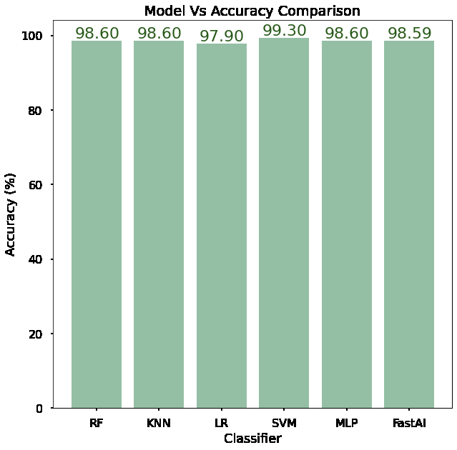
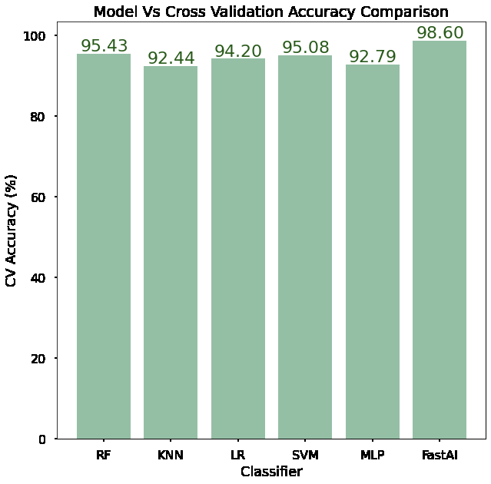
Accuracy Plots
Fig 1 shows the results obtained by a comparison plot between all the models and their respective accuracy, these accuracies were obtained after fine tuning each and every model. Split ratio was 75:25.
Fig 2 shows the results obtained after performing 5-fold cross validation (for unbiased results) by splitting data set into 80:20 for training and testing.
Best accuracy for 1st variation was reported by SVM.
Best accuracy for 2nd variation was reported by FastAI.
Fig 1
Fig 2

Slide 13
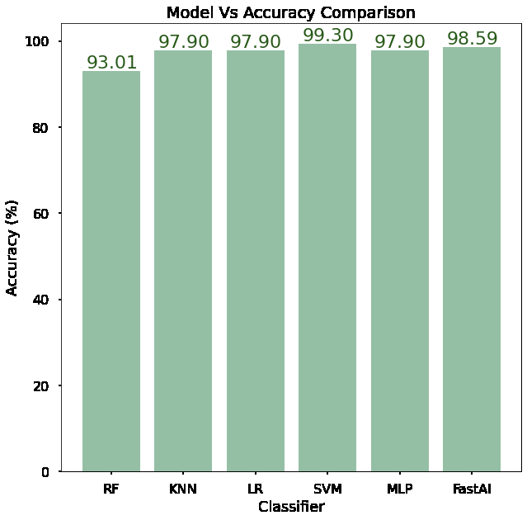
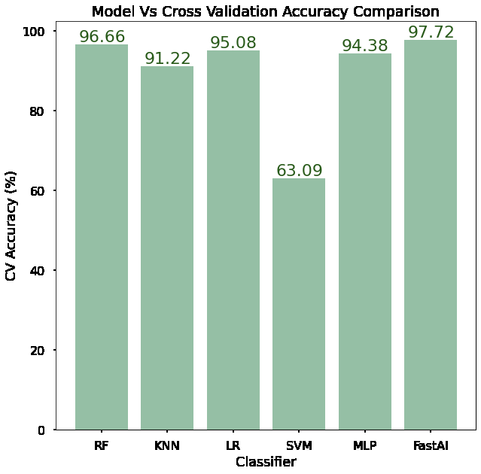
Accuracy Plots
Fig 1 shows the results obtained by a comparison plot between all the models and their respective accuracy, these accuracies were obtained after applying feature selection and fine tuning each and every model. Split ratio was 75:25.
Fig 2 shows the results obtained after performing 5-fold cross validation (for unbiased results) by splitting data set into 80:20 for training and testing.
Best accuracy for 3rd variation was reported by SVM.
Best accuracy for 4th variation was reported by FastAI.
Feature selection negatively impacted SVM’s cross validation accuracy.
Fig 1
Fig 2

Slide 14
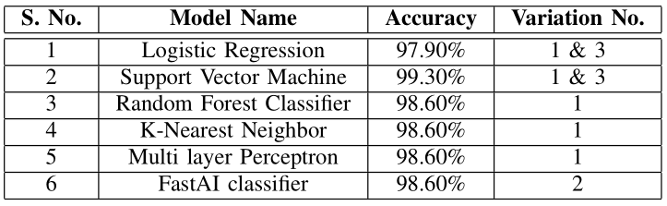
Discussions/Conclusion
A tabular collection of the results produced in the experiment is presented which states which model performed the best and for which variation.
The highest accuracy of SVM is a clear indication of the potential of SVM to be used for such medical testing purposes.
The cross-validation models used here belong to variation 2 & 4, and the only model performing good in these is the FastAI classifier. FastAI gives a constant and almost similar accuracy for single training and Cross validation training.

Slide 15
However, the FastAI model could also have been improvised using the Optuna framework for hyper-parameter optimization.
Few of the critical attributes like S-phase fraction and DNA index were not available in the dataset [2]. Their inclusion in the dataset may enhance the predictive capabilities of the machine learning models which can be considered as the future scope of this study.
Overall, the studies discussed in this paper have focused on development and advancement of predictive models using supervised machine and deep leaning techniques that can be used by medical experts for early detection of breast cancer in patients in a more economical manner than the conventional diagnosis methods.

Slide 16
References
[1] Ch. Shravya, K. Pravalika, Shaik Subhani, ”Prediction of Breast Cancer Using Supervised Machine Learning Techniques”, International Journal of Innovative Technology and Exploring Engineering (IJITEE) ISSN:2278-3075, Volume-8 Issue-6, April 2019.
[2] Eshlaghy, A.T. Pourebrahimi, Alireza Ebrahimi, Mansour Razavi, A.R. Ghasem Ahmad, Leila. (2013). Using three machine learning techniques for predicting breast cancer recurrence. Journal of Health Medical Informatics. 4. 124-130.
[3] Mandeep Rana, et. Al, “Breast Cancer Diagnosis and Recurrence Prediction using Machine Learning Techniques”, IJRET ISSN: 2321-7308, Volume: 04 Issue: 04, April 2015.
[4] Jain, A. K., Murty, M. N., and Flynn, P. J., 1999, “Data Clustering: A Review,” ACM Computing Surveys (CSUR), 31(3), 264-323.
[5] Habib Dhahri, et. Al, “Automated Breast Cancer Diagnosis Based on Machine Learning Algorithms”, Journal of Healthcare Engineering, Volume 2019, Article ID 4253641, February 2019.
[6] Shahnorbanun Sahran, et. Al, ”Machine Learning Methods for Breast Cancer Diagnostic”, IntechOpen, November 2018.
[7] AlirezaOsarech, BitaShadgar,”A Computer Aided Diagnosis System for Breast Cancer”,International Journal of Computer Science Issues, Vol. 8, Issue 2, March 2011

