Slide 1
Embedded Stereo Vision
Rahul Bhartari
Autonomous Vehicles Engineer

Slide 2
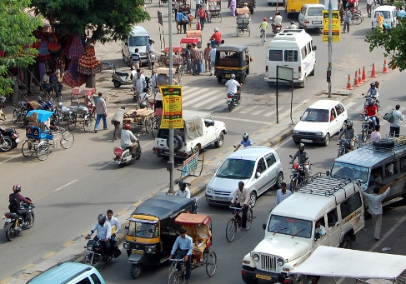
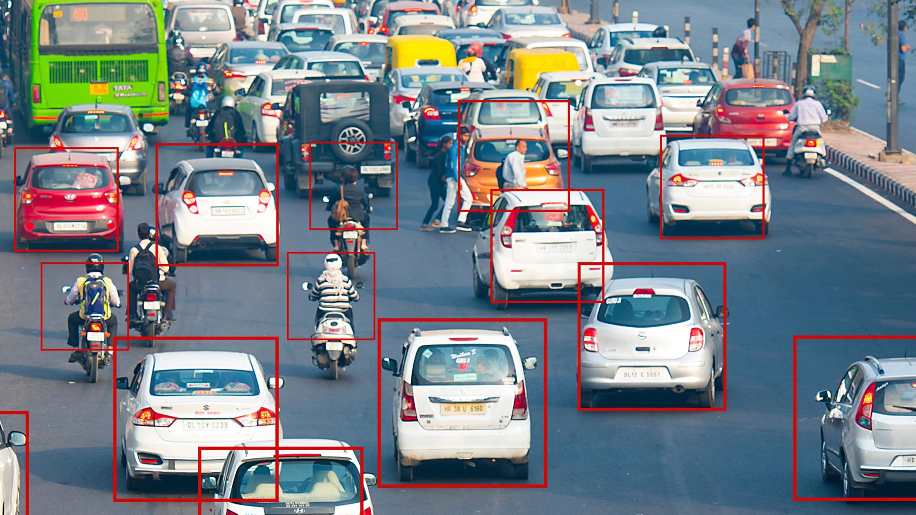
Object Detection and Tracking for ADAS
In next generation vehicles, Emergency Brake Assist and Automatic Braking System will be crucial components of Advanced Driver Assistance Systems (ADAS). These systems need an object detection and tracking system for efficient functioning due to highly unpredictable traffic in India. At the same time, cost of the system must be low enough to be sold in Indian market.
Figure 1: Chaotic situation of traffic on Indian roads
Source: https://www.indiandrives.com/tag/tips-for-driving-on-indian-roads/
Figure 2: Object detection on Indian roads dataset
Source: https://factordaily.com/india-driving-dataset-iiit-hyderabad/

Slide 3
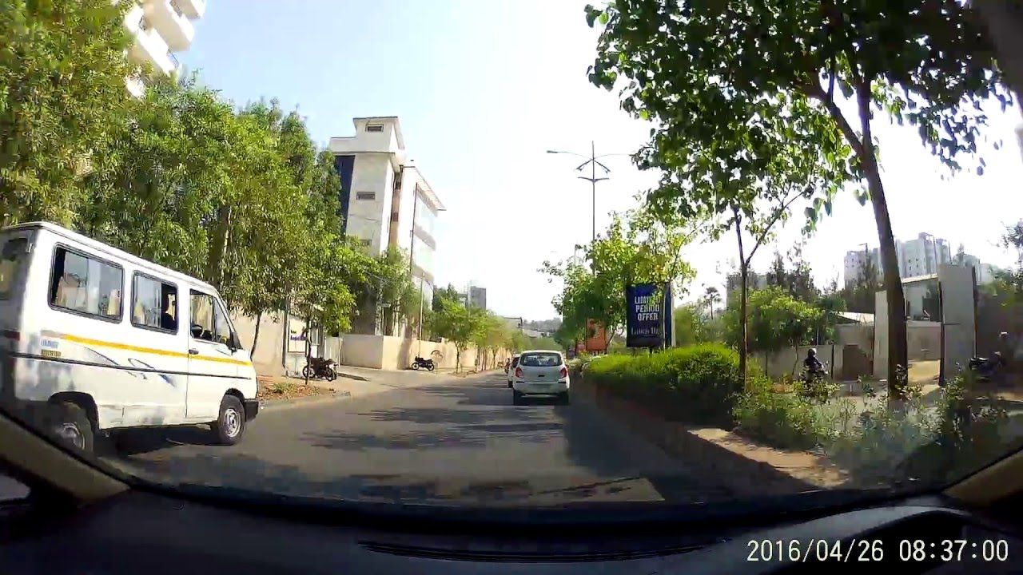
My Role and proposed system
Role : Solely Responsible for R&D Problem : Stereo matching algorithm on ARM SOC
Real Time Object Detection and Tracking using Stereo Vision
Stereo Camera
Left Camera
Calibrated Images
Right Camera
Stereo Disparity Calculation
Disparity Clustering
Source: https://www.youtube.com/watch?v=bdLL73ZHdak
Vehicle Control System
Collision Warning
Object Tracking
Object Detection
Figure 3: Proposed System which needs to be run on a low cost and low power ARM SOCs

Slide 4
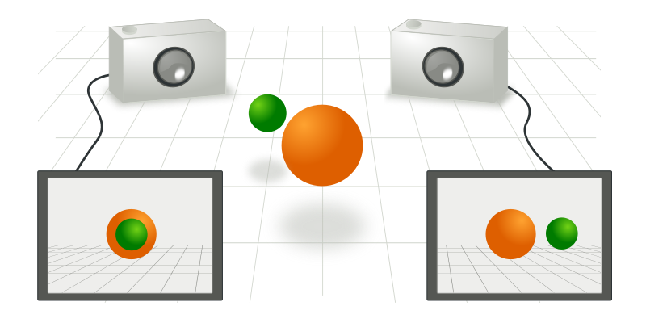
Stereo correspondence and disparity
Stereo Vision refers to extraction of 3D information from two images taken by two horizontally displaced cameras by finding correspondence between pixels in these images.
Stereo Correspondence Algorithms
Local:
Semi-Global Matching (OpenCV)
Semi-Global Block Matching (OpenCV)
Fast Segment Based Stereo
Adaptive Support Weights
Fast Bilateral Stereo
Global:
Stereo matching using Graph cuts
Stereo matching using Belief Propagation
Figure 4: Two cameras taking picture of a scene from different points of view.
Source: Wikipedia
Number of pixels by which a pixel in one image appears shifted in the other image is called disparity.

Slide 5
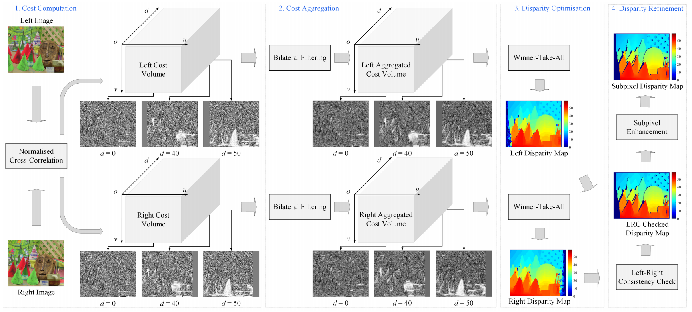
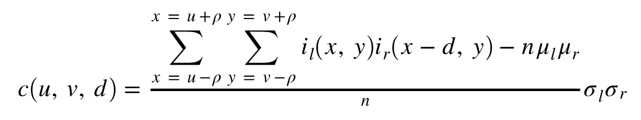



Fast Bilateral Stereo
For cost calculation, Normalised Cross-Correlation works independently of different lighting in left and right scenes.
Cost calculation: NCC
Where,
is mean of pixels in the square block
is standard deviation for the block
is the block size
u, v is current pixel’s x-y index
d is disparity where NCC is calculation
n is the number of pixels in the block
(2 +1)
Figure 5: Fast Bilateral Stereo stages
Source: https://arxiv.org/pdf/1807.01874

Slide 6
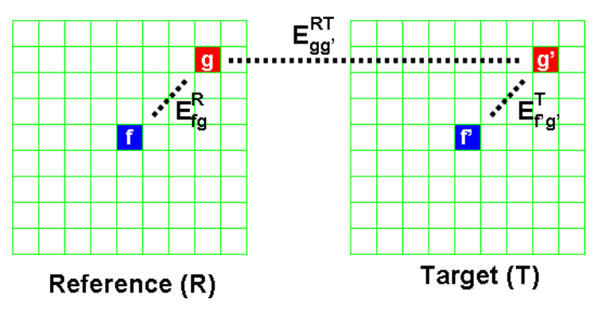
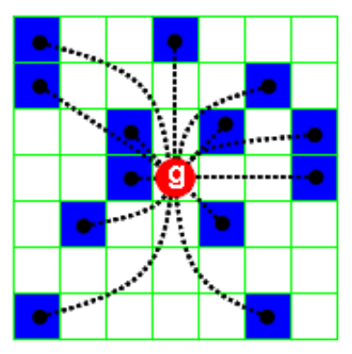
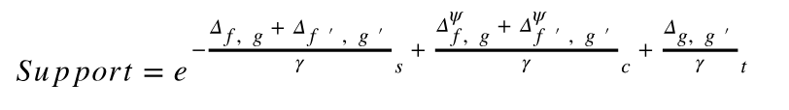

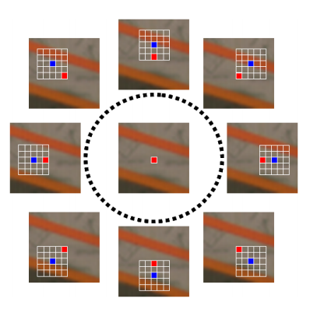



Aggregation using Locally Consistent Stereo
This aggregation technique defines a plausibility function that explicitly captures the geometric and photometric constraints implicitly and independently enforced within the neighboring pixels.
Support probability calculation
Figure 6: Central pixel ‘f’ and supporting pixel ‘g’ in reference and target images.
Figure 7: Pixels in the reference image block supporting the disparity assumption.
Where and are empirically derived.
Figure 8: The same red point is included by the supports deployed to determine the correspondences of different blue points.
Source: https://ieeexplore.ieee.org/document/5457496

Slide 7
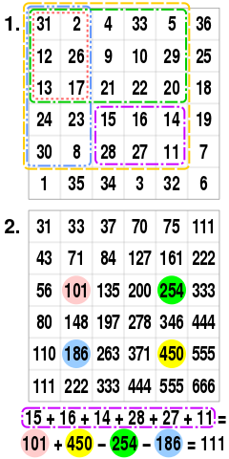
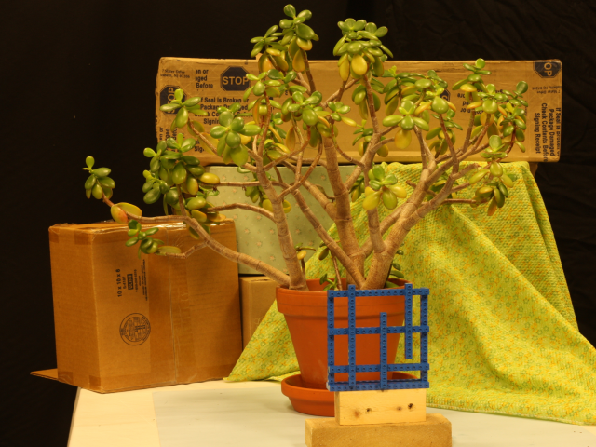

Compute Optimization
Full fledged stereo matching disparity calculation is a compute intensive process, especially when working with huge cost volumes.
Thread 1
Loop Unrolling
Thread 2
Thread 3
Heterogeneous
Multi-threading
SIMD
Compute Optimizations
Thread 4
Avoid extra computations
Image divided into multiple parts for parallel processing
Sparse Computations
Ensures max efficiency
Pipelined Execution
Cost is calculated only for 3 out of 5 pixels
Summed area table.
Source: Wikipedia
Figure 9: Different techniques used for compute optimizations resulting in better performance.

Slide 8
Memory Optimizations for performance
Stereo Vision demands a lot of memory if done in usual manner. 3D Cost volumes cost a lot in terms of memory at higher resolutions. Accessing such huge memory can create performance bottlenecks.
Memory design for easy vectorization
Memory Required for single NCC Cost volume
Image Resolution | 640x480
Disparity Levels | 144 pixels
Data type for values | 32-bit Float
Memory required | 169 MB
No memory leaks
Improves Cache hits
Quick access
One Time Allocation
Memory Optimizations
Lookup Tables
Table 1: Memory required for NCC cost volume.
The requirement becomes almost 5 times for a 720p image.
Reduces overall required memory
Data Type Selection
Figure 10: Different techniques used for memory optimizations resulting in low memory consumption with better performance.

Slide 9
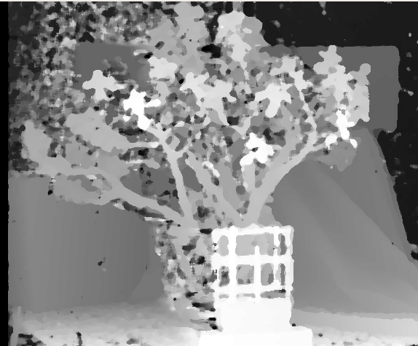
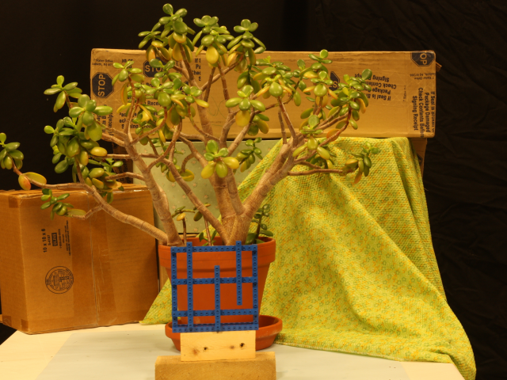
Results
Normalised cross-correlation as cost function, produces good results even when used without any aggregation stage.
Figure 12: Output disparity map generated using NCC as cost.
Figure 11: Input left(top) and right(bottom) camera images.

Slide 10
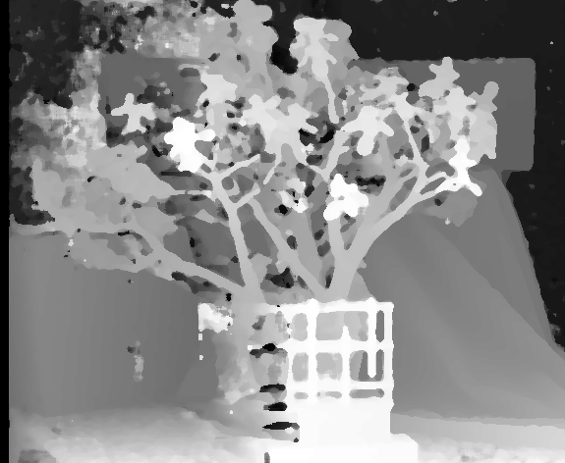
Results
Locally consistent stereo aggregation significantly improves the quality of disparity map, but takes significant amount of time for calculation.
Time taken for processing a Frame | Intel Core i7 @4.2GHz (1 Thread) | Intel Core i7 @4.2GHz (4 Threads) | ARM Cortex A72 @1.9GHz
Plain NCC @320x240 | -- | -- | 134 ms (8fps)
Plain NCC @426x240 | 66 ms | 16 ms (60fps) | 231 ms
Plain NCC @480x272 | 96 ms | 24 ms (41fps) | 324 ms
Plain NCC @640x480 | 268 ms | 67 ms (15fps) | 971 ms
NCC + LC @480x272 | 2.8 s | 720 ms | 9.6 s
NCC + LC @640x480 | 6.9 s | 1.8 s | 22 s
Figure 12: NCC+LC disparity map.
Table 2: Processing time for single frame (left-right) disparity calculation on Intel and ARM CPUs.

Slide 11
Stereo Depth Perception Video Pipeline
This is a unique pipeline for stereo video stream, which can save a lot of computation and memory.
Output Disparity Map
Stereo Images @720p
Post Processing
Patch
Scheduler
Resize to 240p
Stage 2: NCC + LC
Previous frame (NCC)
Stage 1: NCC only
Disparity Upsampling to 720p
Figure 13: Pipeline for processing stereo video stream.

Slide 12

Work in Progress ...
Stereo video pipeline can save approximately 84% of computations and memory required.
Tasks to be completed:
Stereo video pipeline
Pipeline testing on ARM
This project can be further improved by:
Using OpenCL for using ARM Mali GPU for computations.
Using NEON intrinsics or ARM Compute Library.

Slide 13
Thank You

