Slide 1
Last Week
Zynq Board bring-up
Zynq PS running ubuntu desktop
PS-PL communication through AXI-Lite (register based) interface

Slide 2
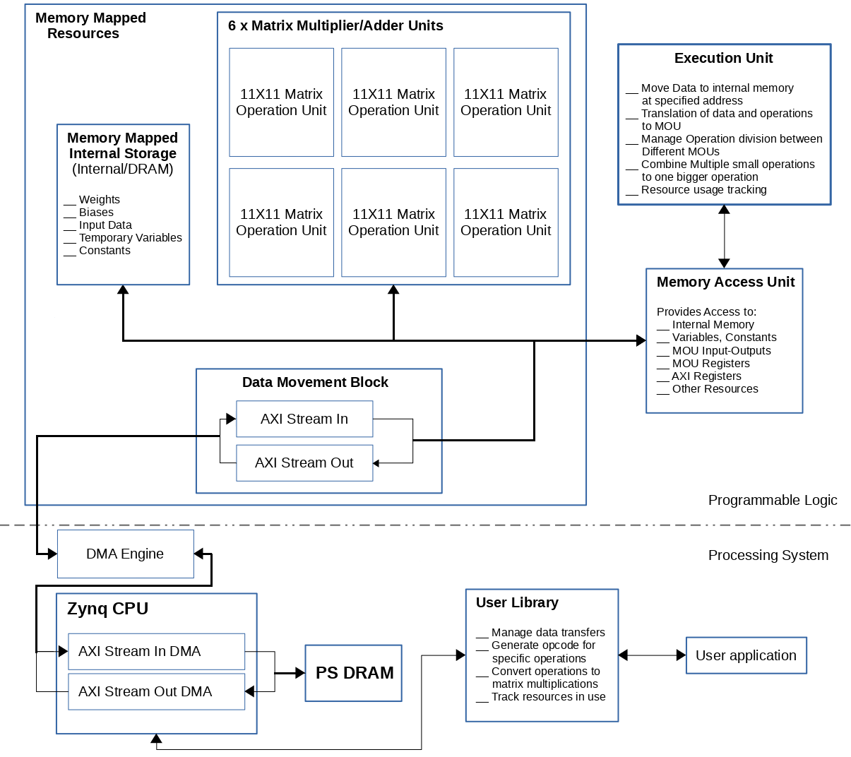
Matrix Operation Unit
Divide single big matrix operation into multiple smaller operations
Combine small matrix operations into one bigger operation
Perform elementwise array operations
Perform convolution as matrix multiplication or elementwise array operation

Slide 3
Block Matrix multiplication
Break a big matrix into sub-matrices and multiply. Later combine results to get the bigger output matrix.
A11 | A12
A21 | A22
B11 | B12
B21 | B22
A =
B =
Here Aij denotes the sub-matrix or block matrix.
A11B11 + A12B21 | A11B11 + A11B11
A11B11 + A11B11 | A11B11 + A11B11
A x B =
Perform matrix multiplication for block matrices and combine the result to form the final output.

Slide 4
Club smaller matrices as single matrix for multiplication
1 | 2
3 | 4
5 | 6
1 | 2 | 3
4 | 5 | 6
7 | 8 | 9
1 | 1 | 1 | 1
1 | 0 | 1 | 2
1 | 1 | 0 | 1
1 | 1 | 1
2 | 1 | 1
A =
F1 =
B =
F2 =
1 | 2 | 0 | 0 | 0
3 | 4 | 0 | 0 | 0
5 | 6 | 0 | 0 | 0
0 | 0 | 1 | 2 | 3
0 | 0 | 4 | 5 | 6
0 | 0 | 7 | 8 | 9
1 | 1 | 1 | 0 | 0 | 0 | 0
2 | 1 | 1 | 0 | 0 | 0 | 0
0 | 0 | 0 | 1 | 1 | 1 | 1
0 | 0 | 0 | 1 | 0 | 1 | 2
0 | 0 | 0 | 1 | 1 | 0 | 1
5 | 3 | 3 | 0 | 0 | 0 | 0
11 | 7 | 7 | 0 | 0 | 0 | 0
17 | 11 | 11 | 0 | 0 | 0 | 0
0 | 0 | 0 | 6 | 4 | 3 | 8
0 | 0 | 0 | 15 | 10 | 9 | 20
0 | 0 | 0 | 24 | 16 | 15 | 32
Ab =
F12 =
Ab x F12 =
A | 0
0 | B
F1 | 0
0 | F2
A x F1 | 0
0 | B x F2
Ab =
F12 =
Ab x F12 =

Slide 5
Convolution as matrix multiplication
Op11 = 1+2+3 + 4+10+6 +7+8+9
1 | 2 | 3 | 4 | 5 | 6 | 7
4 | 5 | 6 | 7 | 5 | 6 | 7
7 | 8 | 9 | 10 | 3 | 3 | 3
4 | 5 | 6 | 4 | 5 | 6 | 7
5 | 6 | 7 | 4 | 5 | 6 | 7
1 | 1 | 1
1 | 2 | 1
1 | 1 | 1
50
A =
F =
Op =
1
1
1
1
2
1
1
1
1
A11 =
1 | 2 | 3 | 4 | 5 | 6 | 7 | 8 | 9
F =
Op11 = A11 x F = [50]

Slide 6
This Week
Explore AXI-Stream and AXI-Full interfaces with DMA
Explore DRAM interface
Prepare detailed design of Matrix Operation Unit

