Slide 1
Embedded Stereo Vision
Rahul Bhartari
Autonomous Vehicles Engineer

Slide 2
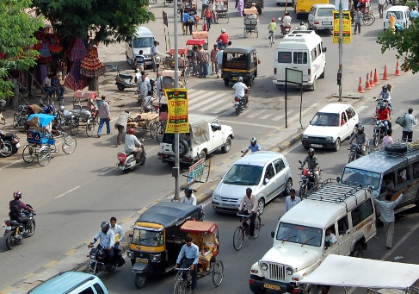
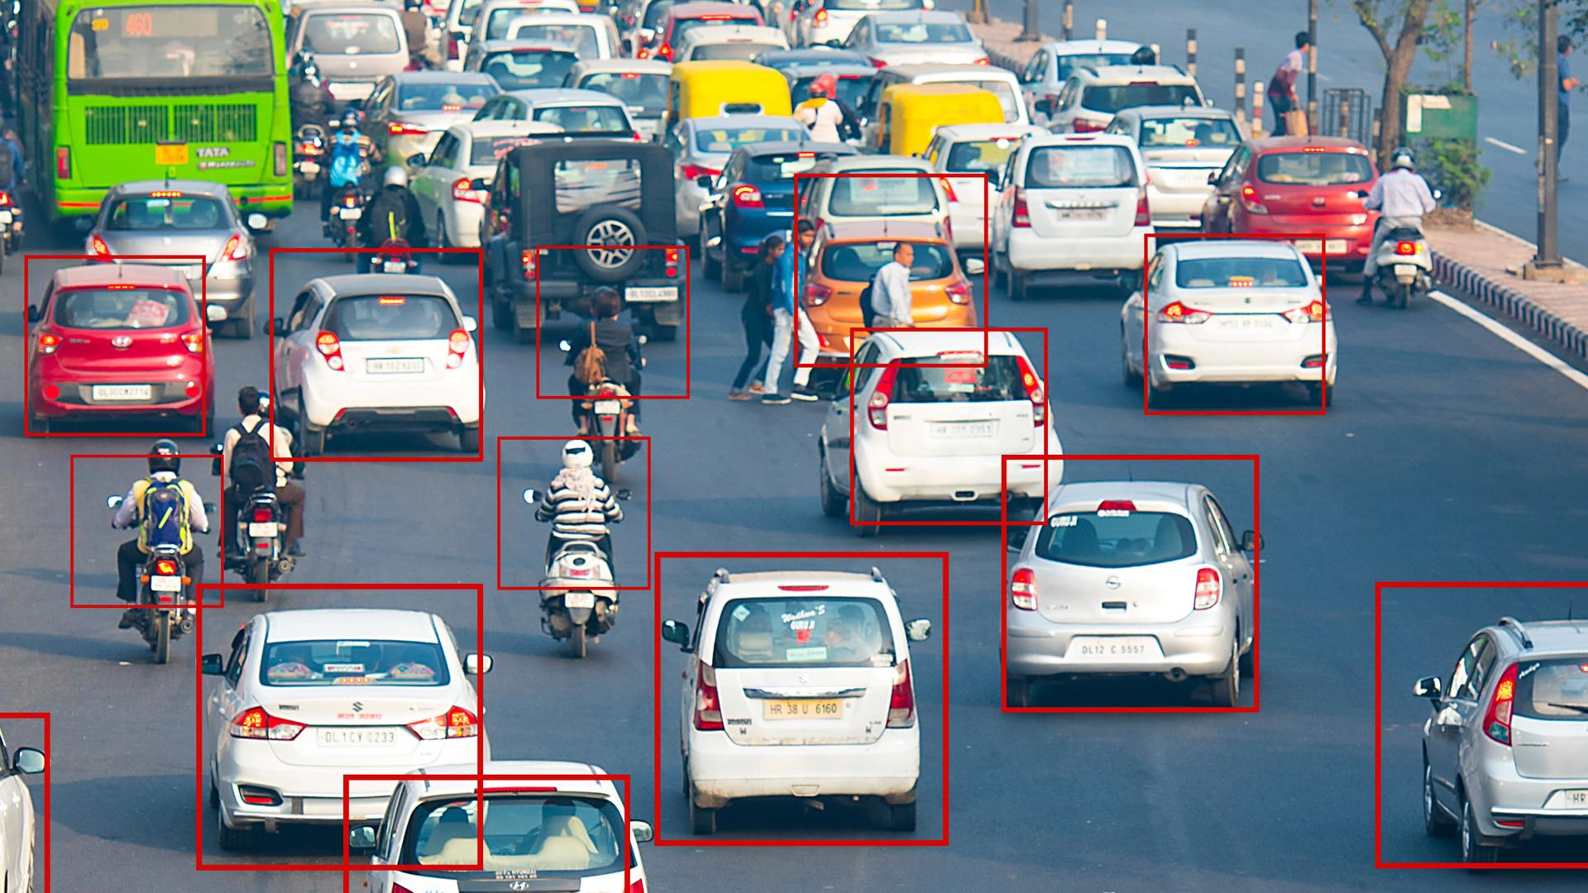
Object Detection and Tracking for ADAS
In next generation vehicles, Emergency Brake Assist and Automatic Braking System will be crucial components of Advanced Driver Assistance Systems (ADAS). These systems need an object detection and tracking system for efficient functioning due to highly unpredictable traffic in India. At the same time, cost of the system must be low enough to make it a viable product.
Figure 1: Chaotic situation of traffic on Indian roads
Source: https://www.indiandrives.com/tag/tips-for-driving-on-indian-roads/
Figure 2: Object detection on Indian roads dataset
Source: https://factordaily.com/india-driving-dataset-iiit-hyderabad/

Slide 3
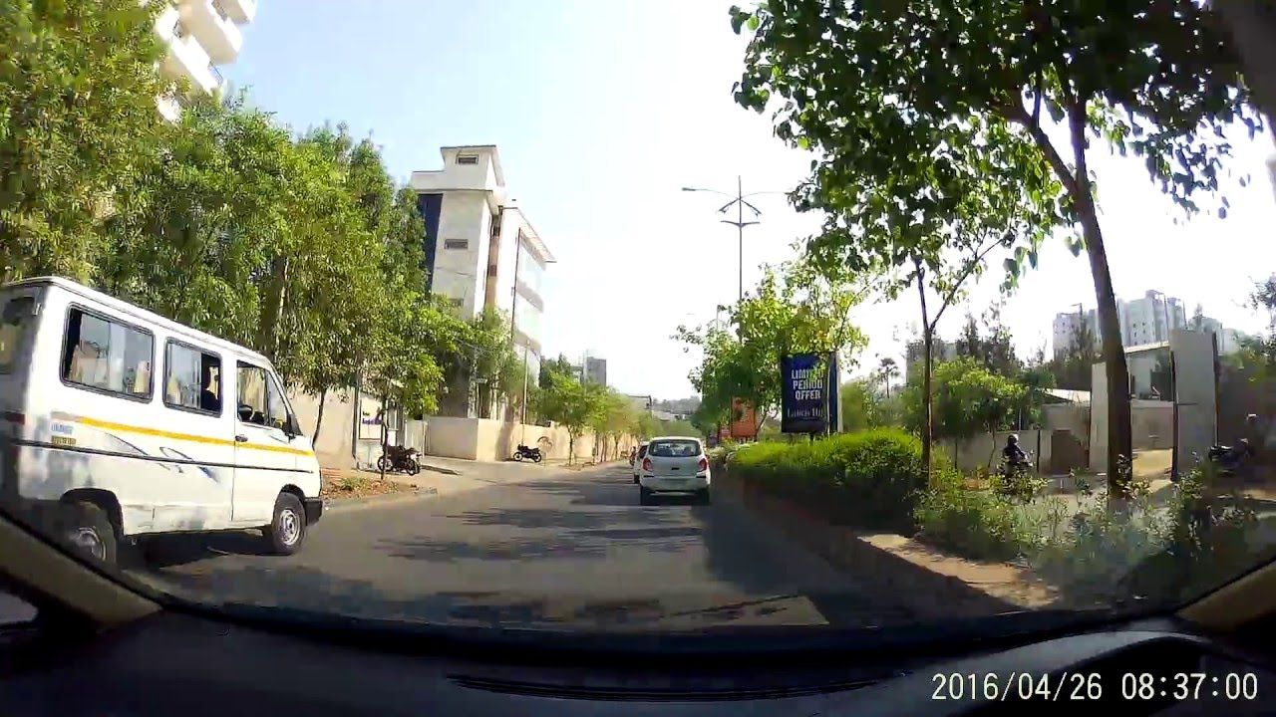
My role in proposed system
Role : R&D for Stereo algorithm development
Real Time Object Detection and Tracking using Stereo Vision
Stereo Camera
Left Camera
Calibrated Images
Right Camera
Stereo Disparity Calculation
Disparity Clustering
Source: https://www.youtube.com/watch?v=bdLL73ZHdak
Vehicle Control System
Collision Warning
Object Tracking
Object Detection
Figure 3: Proposed System which needs to be run on a low cost and low power ARM SOCs

Slide 4
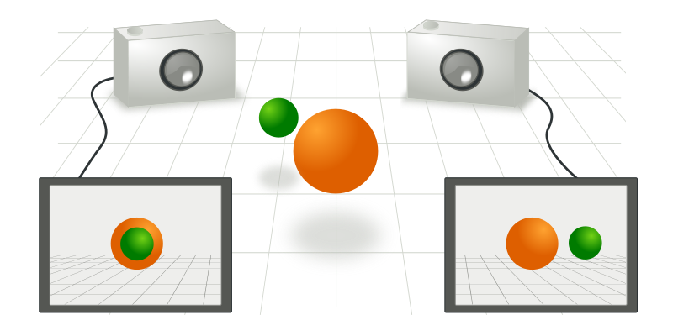
Stereo Vision
Stereo Vision refers to extraction of 3D information from two images taken by two horizontally displaced cameras by finding correspondence between pixels in these images.
Stereo Correspondence Algorithms
Local:
Semi-Global Matching (OpenCV)
Semi-Global Block Matching (OpenCV)
Fast Segment Based Stereo
Adaptive Support Weights
Fast Bilateral Stereo
Global:
Stereo matching using Graph cuts
Stereo matching using Belief Propagation
Figure 4: Two cameras taking picture of a scene from different points of view.
Source: Wikipedia
Disparity is the horizontal displacement in position of an object in the source and target images.

Slide 5
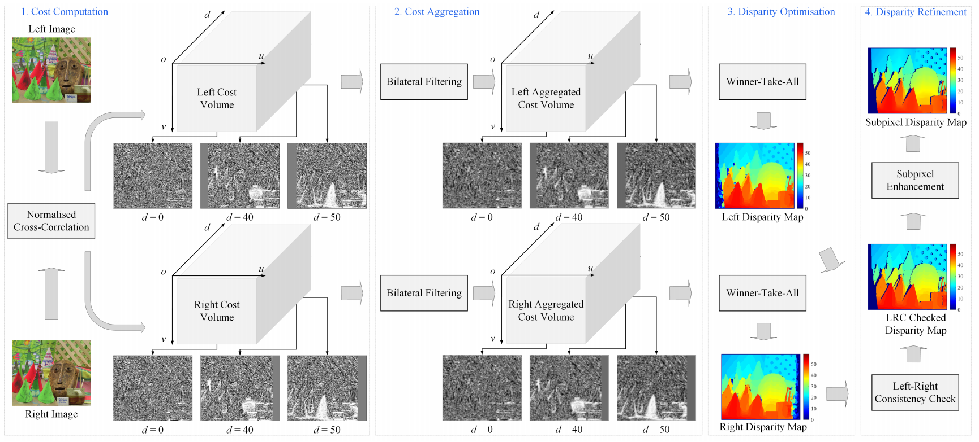
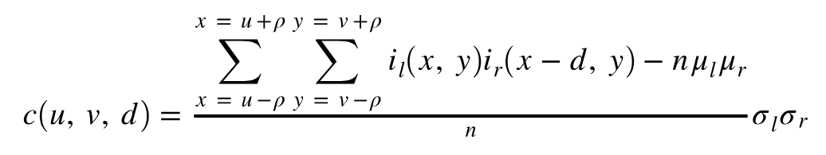



Fast Bilateral Stereo algorithm
Implemented Normalised Cross-Correlation for cost calculation because it works independently of different lighting in left and right scenes.
Cost calculation: NCC
Where,
is mean of pixels in the square block
is standard deviation for the block
is the block size
u, v is current pixel’s x-y index
d is disparity where NCC is calculation
n is the number of pixels in the block
(2 +1)
Figure 5: Fast Bilateral Stereo stages
Source: https://arxiv.org/pdf/1807.01874

Slide 6
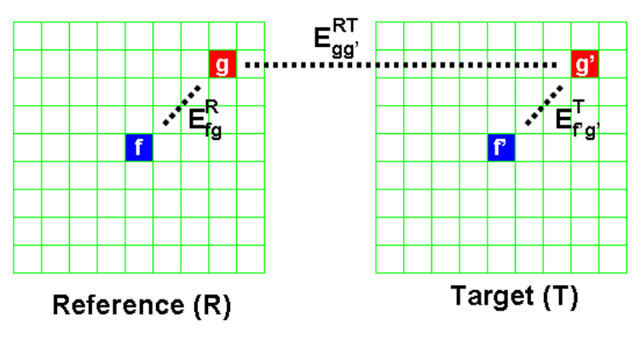
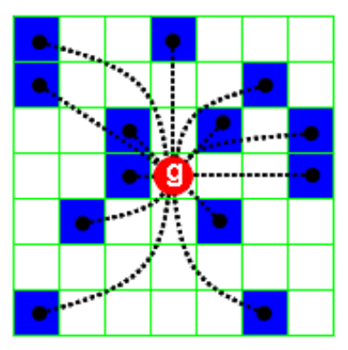
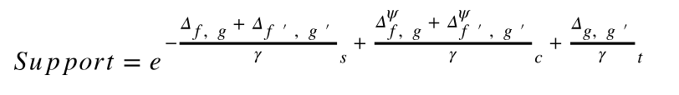

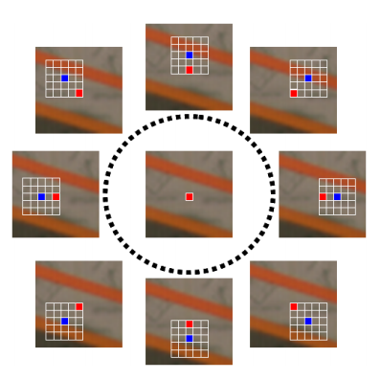



Aggregation using Locally Consistent Stereo
Implemented an aggregation technique defining a plausibility function that captures the geometric and photometric constraints and independently enforcing within the neighboring pixels.
Support probability calculation
Figure 6: Central pixel ‘f’ and supporting pixel ‘g’ in reference and target images.
Figure 7: Pixels in the reference image block supporting the disparity assumption.
Where and are empirically derived.
Figure 8: The same red point is included by the supports deployed to determine the correspondences of different blue points.
Source: https://ieeexplore.ieee.org/document/5457496

Slide 7
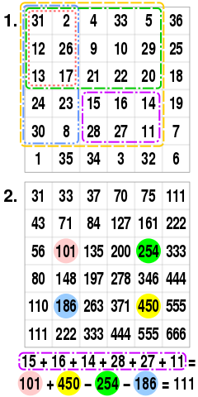
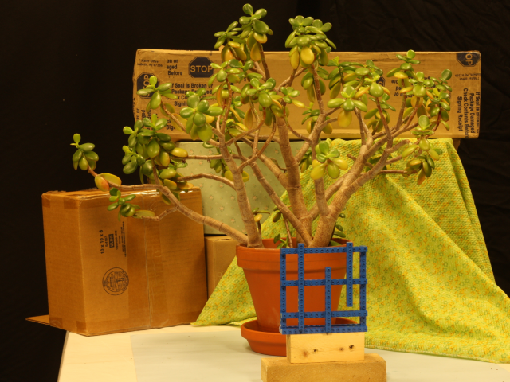

Compute Optimization
Full fledged stereo matching disparity calculation is a compute intensive process, especially when working with huge cost volumes.
Thread 1
Loop Unrolling
Thread 2
Thread 3
Heterogeneous
Multi-threading
SIMD
Compute Optimizations
Thread 4
Avoid extra computations
Image divided into multiple parts for parallel processing
Sparse Computations
Ensures max efficiency
Pipelined Execution
Cost is calculated only for 3 out of 5 pixels
Summed area table.
Source: Wikipedia
Figure 9: Different techniques used for compute optimizations resulting in better performance.

Slide 8
Memory Optimizations for performance
Stereo Vision demands a lot of memory if done in usual manner. 3D Cost volumes cost a lot in terms of memory at higher resolutions. Accessing such huge memory can create performance bottlenecks.
Memory design for easy vectorization
Memory Required for single NCC Cost volume
Image Resolution | 640x480
Disparity Levels | 144 pixels
Data type for values | 32-bit Float
Memory required | 169 MB
No memory leaks
Improves Cache hits
Quick access
One Time Allocation
Memory Optimizations
Lookup Tables
Reduces overall required memory
Data Type Selection
Table 1: Memory required for NCC cost volume.
Memory requirement becomes almost its 5 times for a 720p image.
Figure 10: Different techniques used for memory optimizations resulting in low memory consumption with better performance.

Slide 9
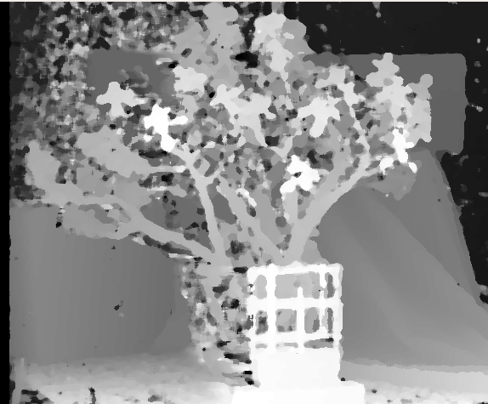
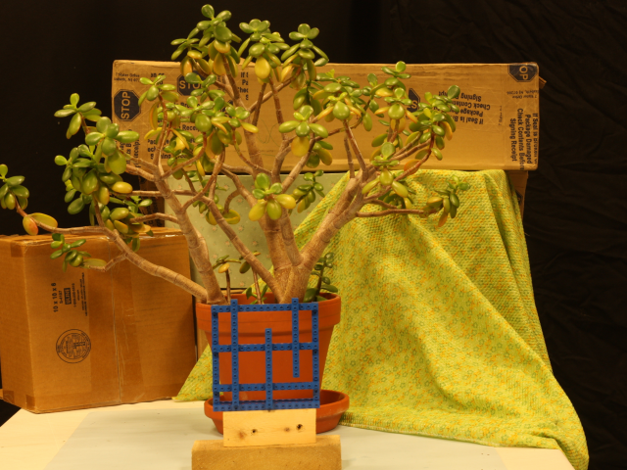
Results
Normalised cross-correlation as cost function, produces good results even when used without any aggregation stage.
Figure 12: Output disparity map generated using NCC as cost.
Figure 11: Input left(top) and right(bottom) camera images.

Slide 10
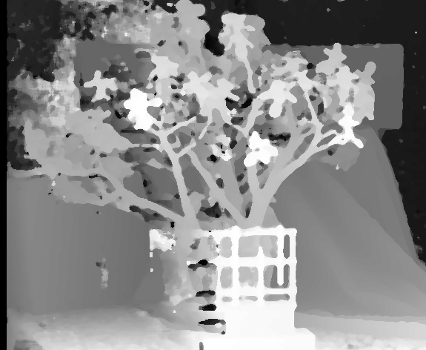
Results
Locally consistent stereo aggregation significantly improved the quality of disparity map.
Improvements Achieved | Intel Core i7 @4.2GHz | ARM Cortex A72 @1.9GHz
Loop Unrolling | 500% | 500%
Memory Optimizations | 15-20% | 15-20%
Multi-threading (2-threads) | 200% | 200%
Sparse Computations | 30 - 40% | 0%
Table 2: Improvements in disparity calculation on Intel and ARM CPUs as compared to code which does not use the mentioned techniques.
Figure 12: NCC+LC disparity map.

Slide 11
Stereo Depth Perception Video Pipeline
This is a unique pipeline for stereo video stream processing, which can save a lot of computation and memory.
Output Disparity Map
Stereo Images @720p
Post Processing
Resize to 240p
Scheduler
Stage 2: NCC + LC
Stage 1: NCC only
Disparity Upsampling to 720p
Figure 13: Pipeline for processing stereo video stream.

Slide 12

Work in progress ...
Stereo video pipeline can save approximately 84% of computations and memory required.
Tasks to be completed:
Stereo video pipeline
Pipeline testing on ARM
This project can be further improved by:
Using OpenCL for using ARM Mali GPU for computations.
Using NEON intrinsics or ARM Compute Library.

Slide 13
Thank You

