Slide 1

SSK DEVCON PVT LTD
RO- RO SERVICE

Slide 2
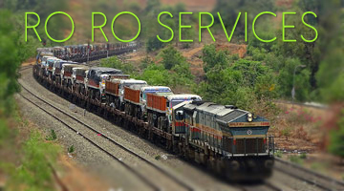
RO-RO SERVICE
Indian Railways has taken a substantial leap towards providing sustainable service to Truckers by offering ROLL ON - ROLL OFF(RO-RO) service through its subsidiary Dedicated Freight Corridor Corporation of India Limited(DFCCIL) for first of its kind on Western Freight Corridor between New Rewari (Haryana) - New Palanpur (Gujrat).

Slide 3
Why RO-RO Service ?

Slide 4



Fast Transport
Distance between two points (New Rewari (HR)-
New Palanpur (Guj.) is 730 km . By road it takes time
to cover 30 hrs. to 45 hrs.
With RO-RO Service distance cover time reduce to
13-15 hrs(including loading and unloading ) , which lead save time of 17 hrs- 30 hrs , increase nos of trips between two points , enhance efficiency of driver and life of truck etc.
Tip
Ro-Ro Service is daily service so count of trips of truck can increase to 2-4 in 40 hrs which was not possible in road transportation.

Slide 5

Safety
Train is safest and fastest transport mode as compare to transport via road. RO -RO service avoid road accident.
Given long hours on the road, increases health related issues in truck driver like fatigue, sleeplessness, obesity, backache, joint and neck pain, problematic sight, breathlessness/breathing issues and stress.
For driver, refreshment service on start and end point, so they can refreshmed and continue transport withot any stress.

Slide 6

Fuel and Pollution
Carriage of road truck will reduce diesel consumption, air pollution and noise pollution.
Reduction in consumption of Diesel reduce transportation
cost and reduce carbon footprint.
Saving diesel fuel will
save the country's import bill.

Slide 7
Other Advantage of RO-RO Service
Providing Door to Door service to the rail customers for very long leads.
Elimination of multiple handling
Less congestion on roads, public safety, faster movement, reduction in inventory cost.
Less wear and tear of the trucks and improved working life of the trucks.
Proper rest to the driver and attendant and better quality time to them.
No Tolls barrier , RTO barrier and less document burden.
Fixed Cost for entire journey.
No Fuel No Engine Running.

Slide 8
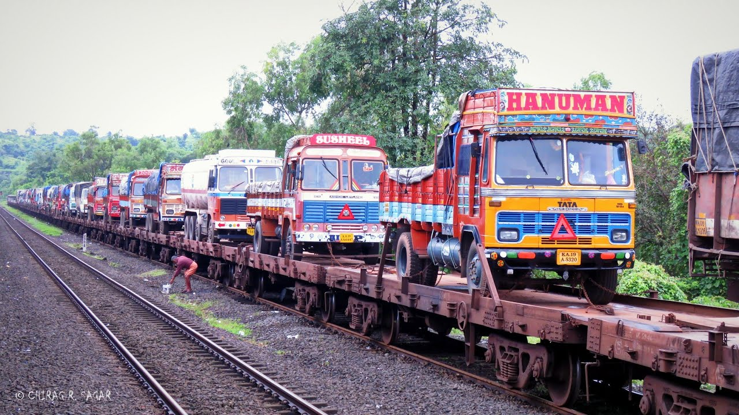
Features & Facilities of Service.
Daily Service from New Rewari and New Palanpur Terminals.
High Speed 45 Wagon.
We have 2 types of weagon
1. Length -13.5 m(44 feet), width upto 3.60 m(12 feet), height upto 5.5m( 18 feet), load carry capacity upto 62 MT.
2.Length -17 m(56 feet) apor., width upto 3.60 m ( 12 feet), height upto 5.5m ( 18 feet), load carry capacity upto 55 MT.
Assured transit time.

Slide 9
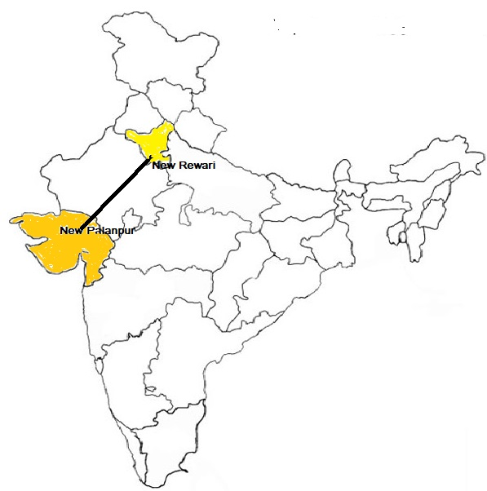
Market Cover
New Palanpur will serve the traffic originated from the industrial hubs of Ahmedabad, Vadodara, Bhuj,Mundra, Kandla, Ghandhidham and Surat.
On the other hand,
New Rewari will serve the traffic originated from the industrial hubs of Delhi NCR, Agra, Ludhiana,Haridwar,Rudrapur, Panipat, Maneshar, Sonipat Rohatak etc.

Slide 10
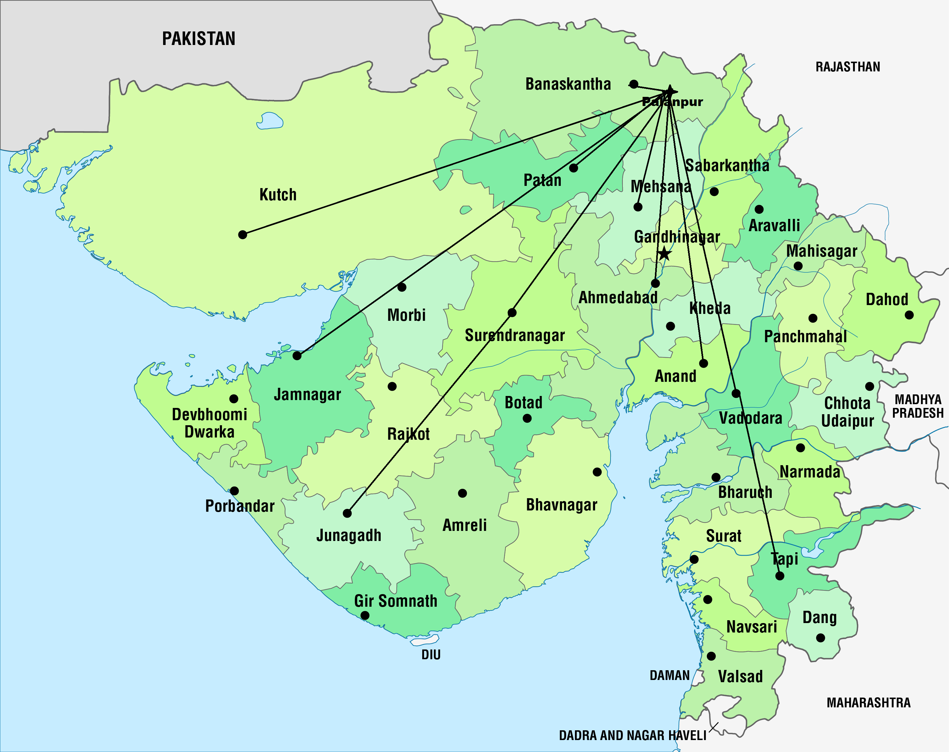

Slide 11
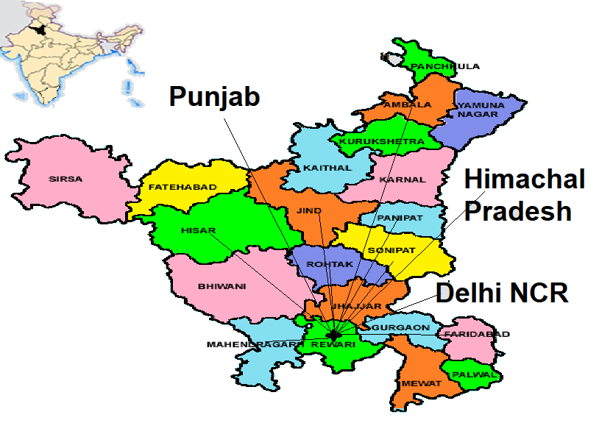

Slide 12
RO-RO Service will be Start from 2nd Week of June 2021 Contact Details Address Head Office – FH-446, Deen Daya l Nagar, Gwalior(M.P)-474020. Palanpur Branch – 305, Sthaptya Complex, Opp.SBI , Abu Highway Palanur Gujarat-385001 Call on (MD) +91 9926925660; 9425110758; (CEO) +91 9179000007; 9329736367 Operation/ Marketing :- +91 9702259270; 7748094462 ; 8770554335 Official E-mail – ROROsales@sskdevcon.com

Slide 13
THANK YOU

