Slide 1
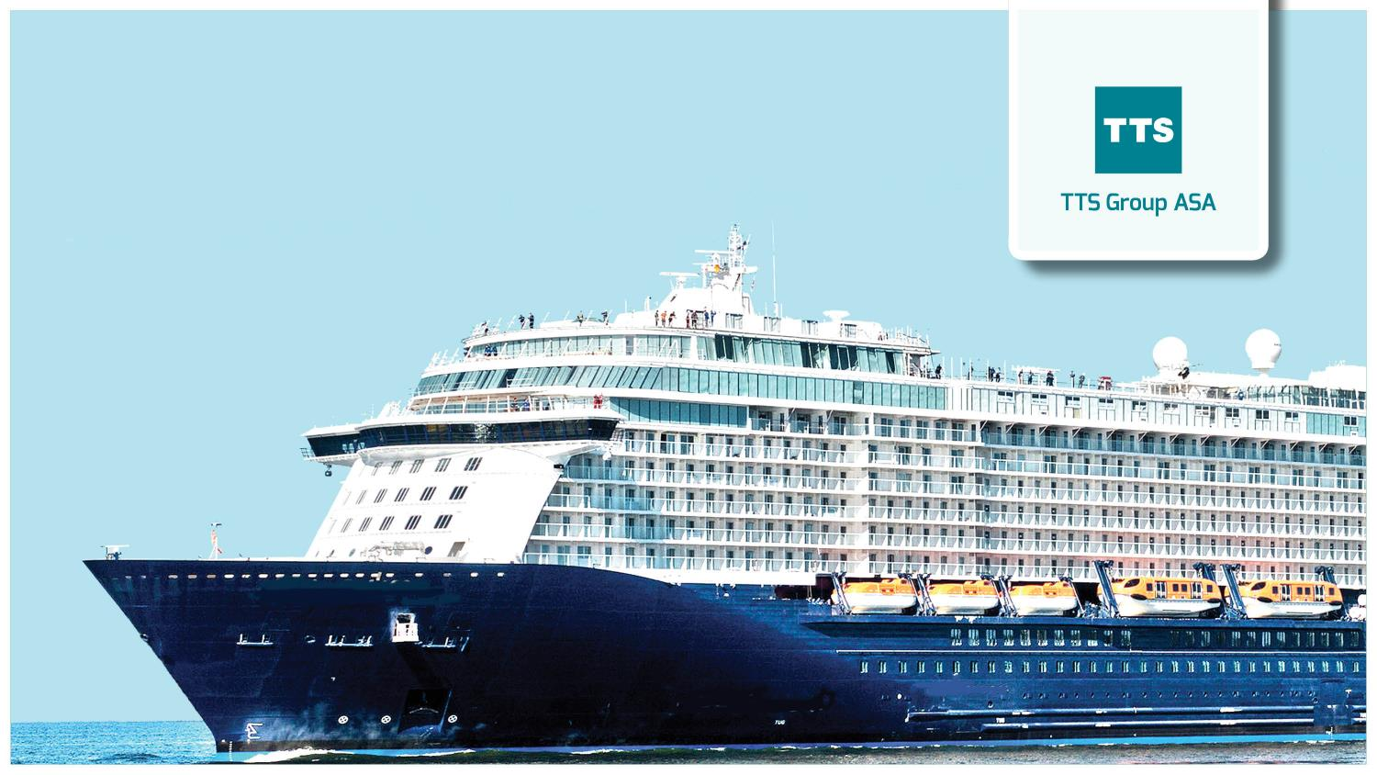
Raising efficiency

Slide 2
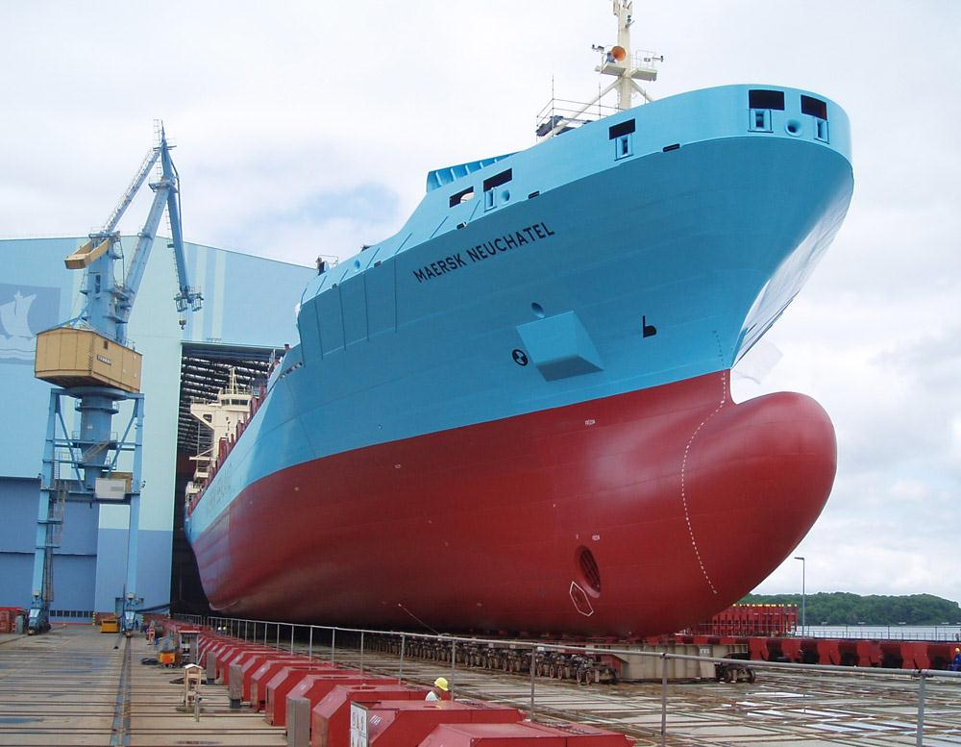
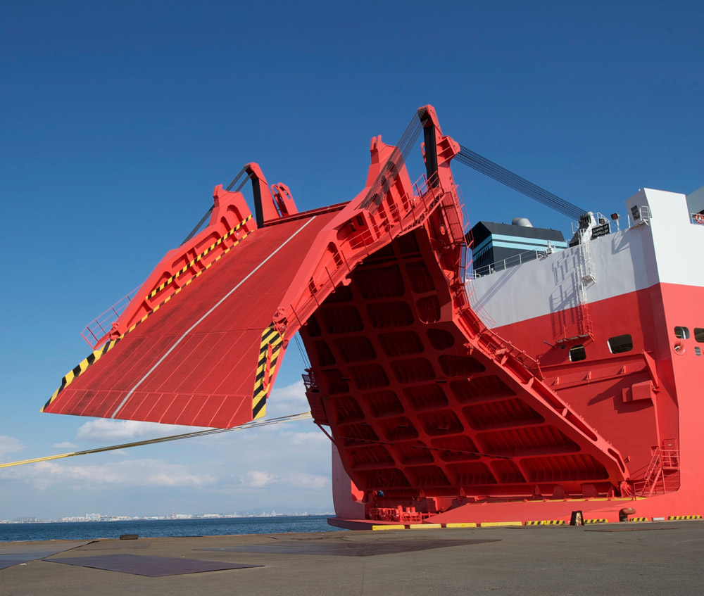
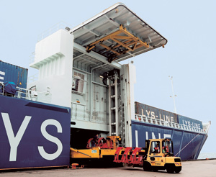
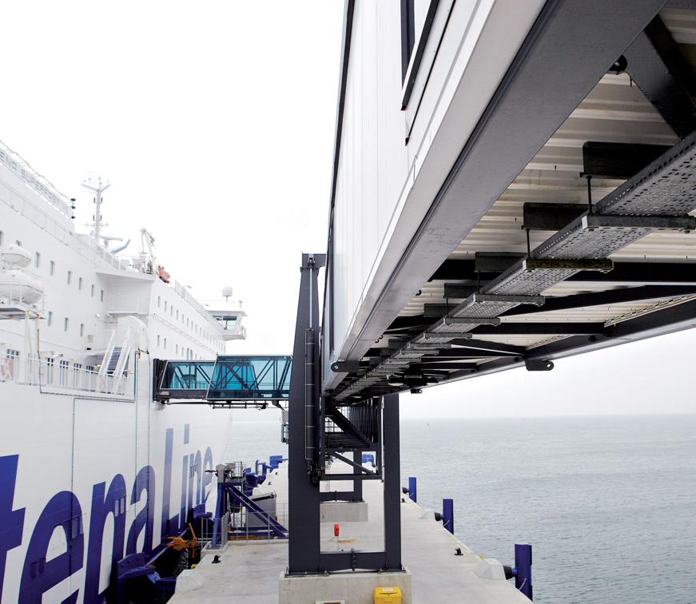
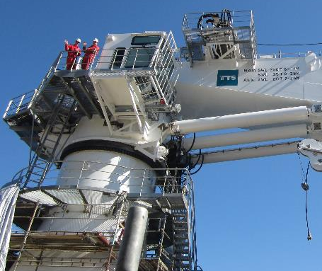
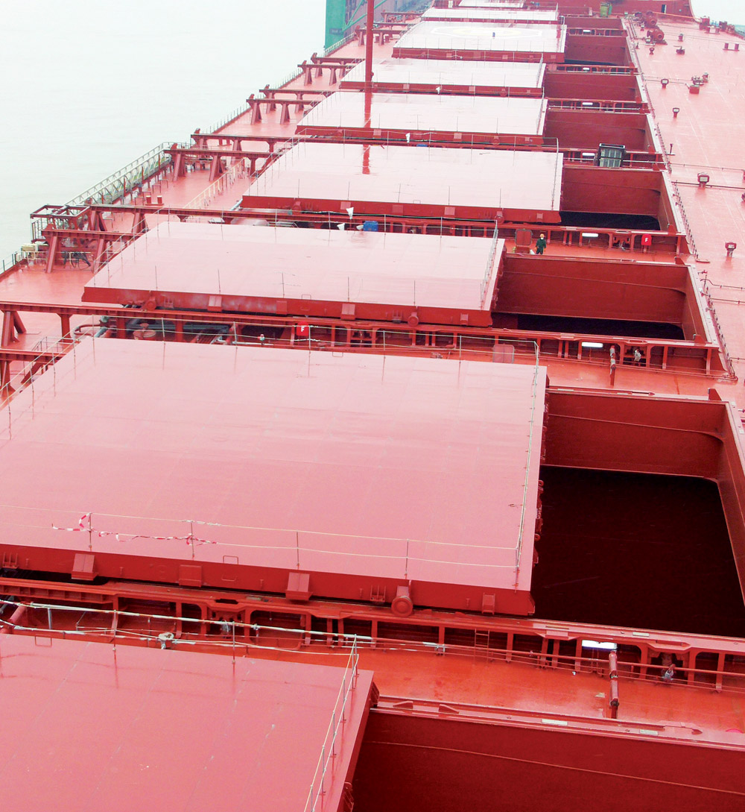
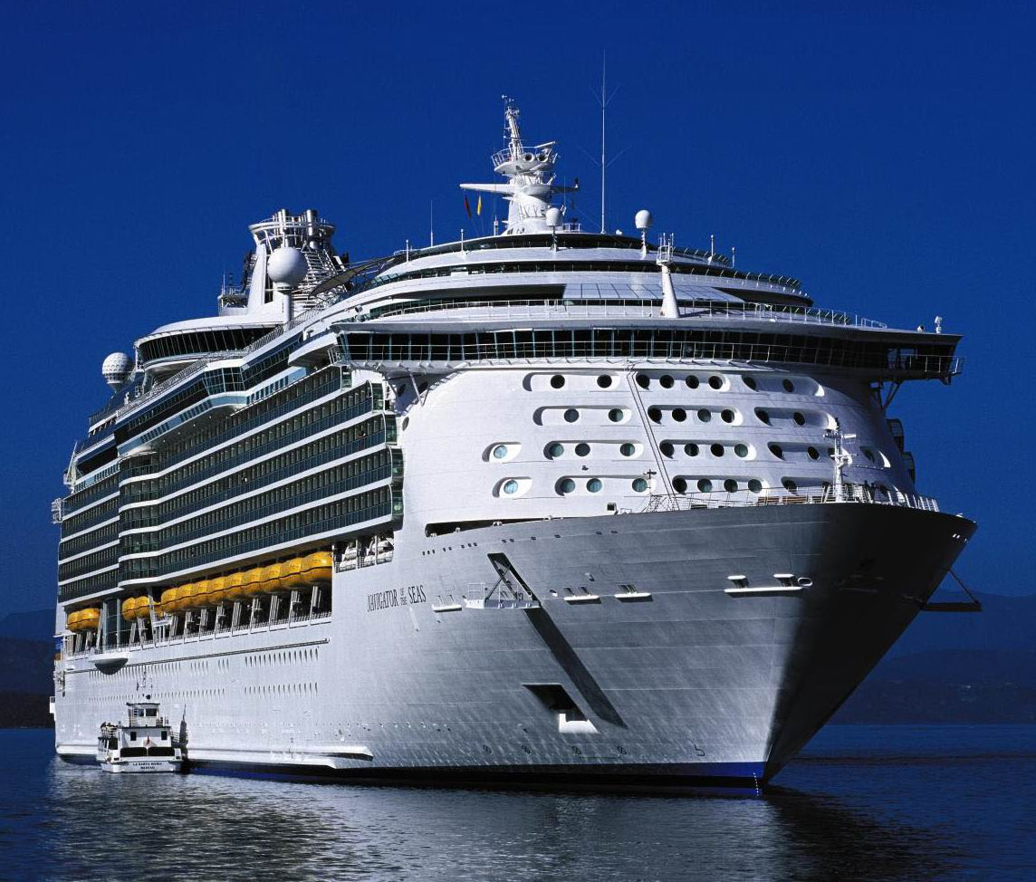
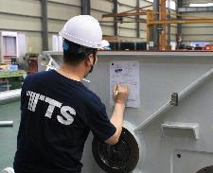
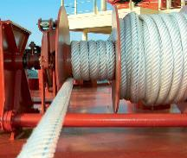
The TTS Group
TTS provides cargo handling solutions and access systems to the international marine and offshore industries.
TTS’ resources are focused on design and engineering, assembly and testing.
Headquarters is in Bergen, Norway.
Listed on Oslo Stock Exchange since 1995.
2

Slide 3
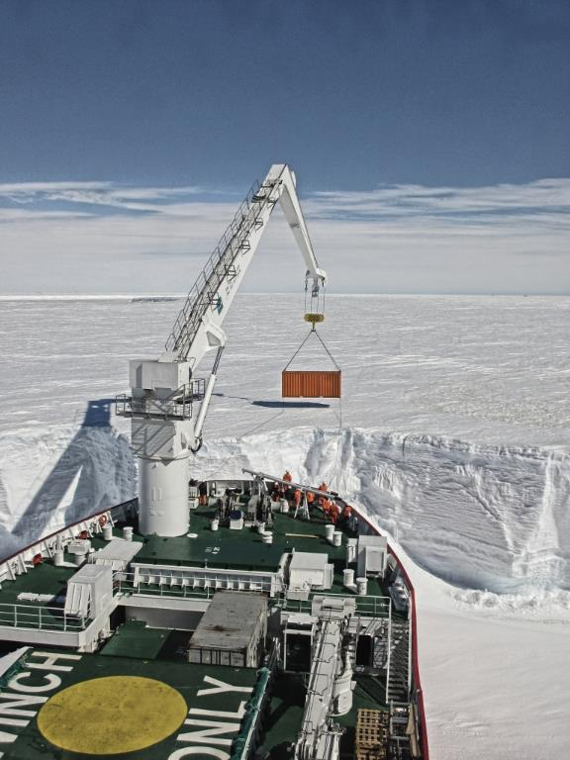
TTS’ vision
To be the global supplier of handling systems to the marine and offshore industry that has the strongest focus on end user satisfaction.
A preferred global supplier
Market-oriented approach.
Complete ship-type solutions and a life-time approach.

Slide 4
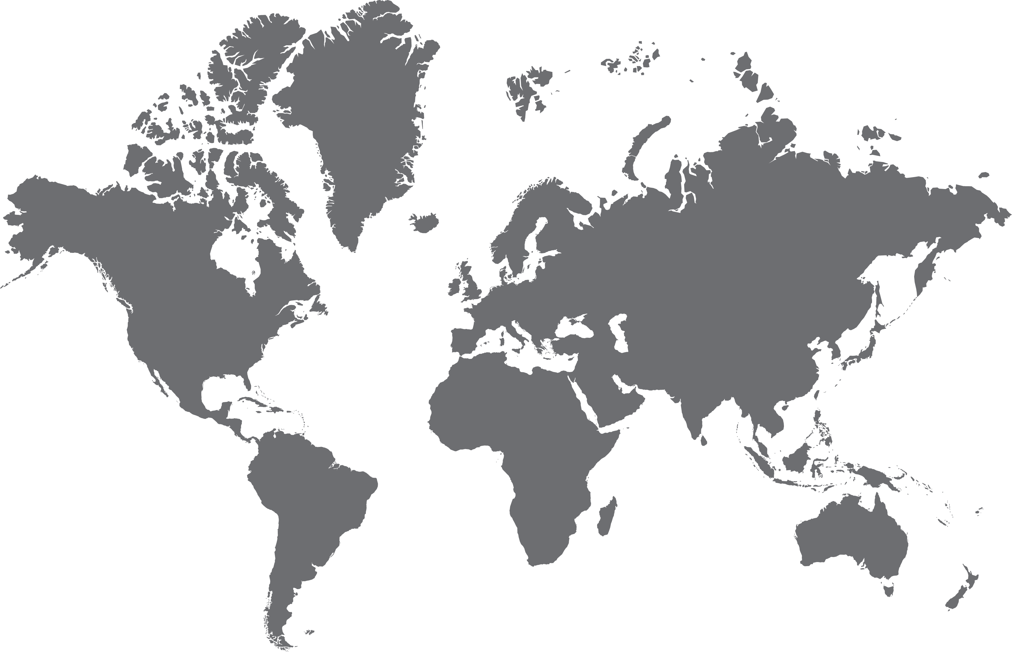

Global solutions. Worldwide opportunities.
TTS is a global company with subsidiaries in 14 countries.
Worldwide workforce of approximately 1,000 specialists in their field.
More than 50 years of engineering experience.
Long history of organic growth and acquisition.
4

Slide 5
TTS Group ASA
Historical turnover development 2006-2016
MNOK

Slide 6
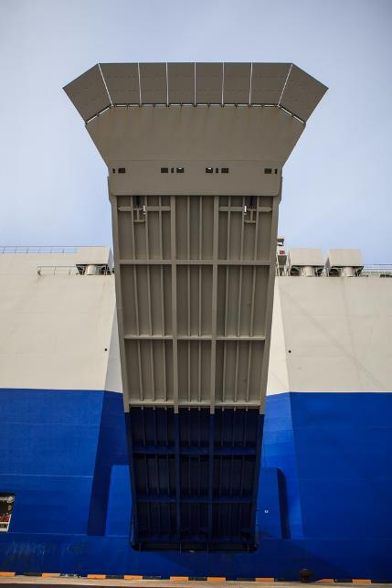
Industry leading products
TTS offers solutions that increase profitability and competitiveness by improving productivity, quality and system capacities.
TTS Group's growth and success originates from our dedicated focus on product and execution, quality and customer-oriented services across the entire organization.
To support our customers' high demands and profitability, we will deliver industry-leading products and services, and continue to stay in front with our technology.

Slide 7

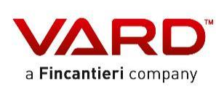




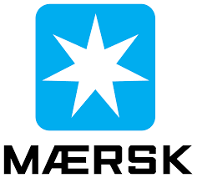







Key Client relations
Long and strong partnership with blue-chip clients.
Comprehensive support to customers during project development, ship design and building phases.
First class life-time service and after-sale support, world-wide and 24/7.

Slide 8
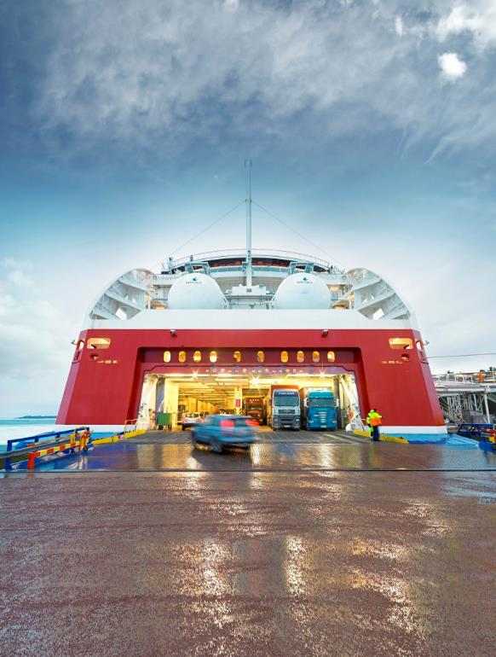
One of Top Three
TTS is one of the top three largest suppliers in its specialized market segments.
Our organization is customer oriented, and we are organized to have a sharp focus on these ship type segments:
RoRo, Cruise, Navy
Container, Bulk, Tank
Multipurpose, General Cargo
TTS also offer the best solutions within the areas of
Offshore
Shipyard solutions
Services

Slide 9
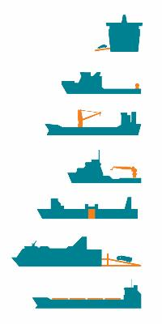
More than 9,200 vessels equipped by TTS
9,280 current ships sailing with TTS equipment
Another 320 deliveries on order
73% of ships built after the millennium

Slide 10
..with more than 11,000 TTS deliveries
RoRo Equipment:
487
Winches:
1654
Marine Cranes
4484
Offshore Cranes/Equipment:
115
Side Loading Systems:
28
Linkspans/Gangways:
29
Hatch covers:
3178
Other:
1082

Slide 11
TTS Organization
TTS Group ASA
Hubs
RoRo/Cruise/Navy
Container/Bulk/
Tank
Offshore
Multipurpose/
General Cargo
Shipyard Solutions
Services
Last update: 3 January 2017

Slide 12
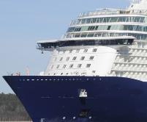
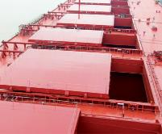
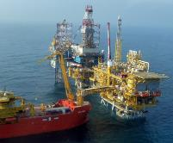
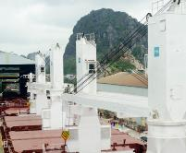
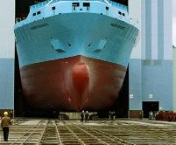
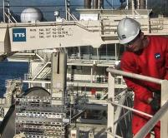
TTS’ Business Units
RoRo/Cruise/Navy
Container/Bulk/
Tank
Offshore
Multipurpose/
General Cargo
Shipyard Solutions
Services
Complete cargo handling solutions to RoRo, PCTC, cruise and navy vessels. Including terminal loading and passenger systems.
Large portfolio of deck equipment for general shipping vessels.
Marine cranes
Weatherdeck hatch covers
Rescue boat davits
Anchor/mooring winches
Solutions for subsea load handling in rough and deep waters.
Heavy lift cranes
Offshore cranes, incl. active heave compensated
Offshore ship equipment
Davits
Training
Heavy Lift cranes, mooring winches, hatch covers and side loading system for
Multipurpose vessels
Cargo ships
Solution provider to shipyards worldwide.
Docking solutions, incl. Syncrolift ® shiplifts
Transfer systems
Fast docking tools
Global service network to help clients boost productivity and profitability.
Worldwide network of strategically located service stations

Slide 13
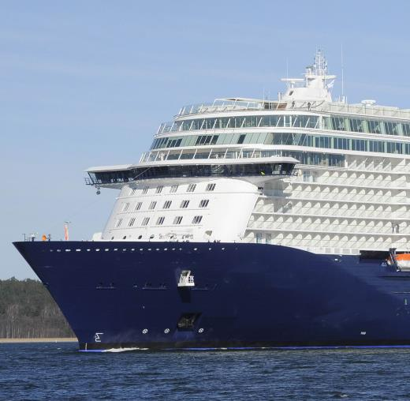
Business unit: RoRo, Cruise, Navy
Cargo handling solutions to RoRo, car carriers, cruise and navy vessel, including terminal loading and passenger systems.
Product range includes: External and internal ramps, covers and doors, liftable decks, passenger gangways and linkspan systems.
RoRo/Cruise/Navy
TTS Marine AB
(Gothenburg, Sweden)
Center of Excellence
BU percentage of TTS revenue
Roll-on/roll-off (RoRo) ships are vessels designed to carry wheeled cargo such as cars, trucks, trailers and railroad cars.
A cruise ship or cruise liner is a passenger ship used for pleasure voyages.
A naval ship is a ship used by a navy, generally damage resilient.

Slide 14
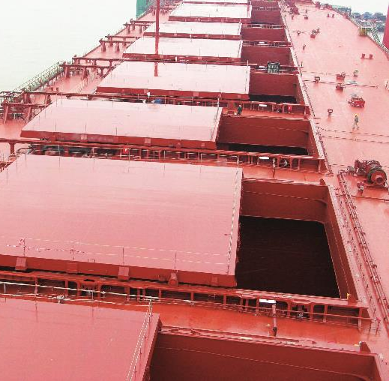
Business unit: Container, Bulk, Tank
Cargo handling solutions to container, tanker and bulk vessels.
Product range includes: 10-40 t winches, 15-50 t cranes and specialized hatch covers designs.
Container/Bulk/Tank
TTS Marine GmbH
(Bremen, Germany)
Center of Excellence
TTS Marine
(Busan, Korea)
TTS Marine
(Dalian, China)
TTS Hua Hai
(Shanghai, China) *)
TTS Bohai
(Dalian, China) *)
BU percentage of TTS revenue
Container ships are cargo ships that carry their entire load in truck-size intermodal containers.
A bulk carrier is a merchant ship specially designed to transport unpackaged bulk cargo, such as grains, coal, ore, and cement in its cargo holds.
A tanker is a merchant vessel designed to transport liquids or gases in bulk.

Slide 15
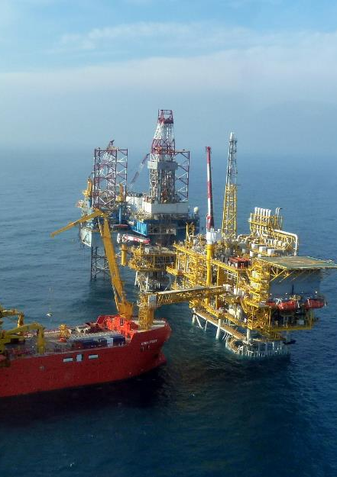
Business unit: Offshore
Support solutions to the offshore based oil industry and the supporting oil service industry.
Product range includes: 15-50 t offshore cranes, 40-400 t heave compensated cranes, mooring winches, internal and external covers and doors.
Offshore
TTS Offshore Solutions
(Bergen, Norway)
Center of Excellence
BU percentage of TTS revenue

Slide 16
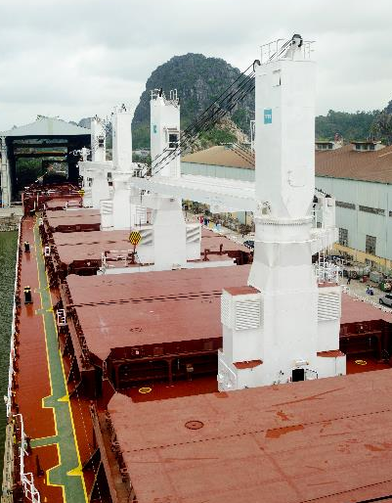
Business unit: Multipurpose, General Cargo
Supporting solutions to the vessels which is designed to operate in the multipurpose or general cargo market, requiring specialized operating capabilities.
Product range includes: 40-2500 t heavy lift cranes, side loading systems, hatch covers and mooring winches.
Multipurpose/
General Cargo
TTS NMF
(Hamburg, Germany)
Center of Excellence
TTS-SCM
(Guangzhou, China) *)
BU percentage of TTS revenue
Multipurpose vessels carry different classes of cargo – e.g. liquid and general cargo – at the same time.
General cargo vessels carry packaged items like chemicals, foods, furniture, machinery, vehicles, footwear, garments, etc.

Slide 17
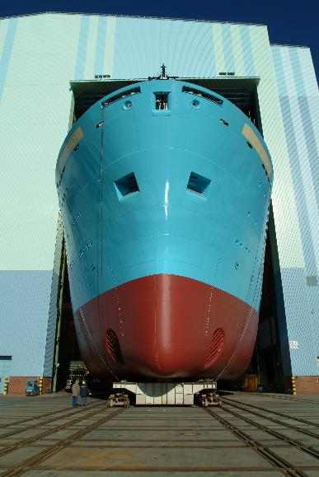
Business unit: Shipyard Solutions
Solutions for navy yards, commercial repair yards, newbuilding yards.
Docking solutions and transfer systems, fast docking tools.
Product range includes: Syncrolift ® (shiplift), slipway/wedged slipway, floating dock, docklift, ship transfer systems.
Shipyard Solutions
TTS Syncrolift
(Drøbak, Norway)
Center of Excellence
BU percentage of TTS revenue

Slide 18
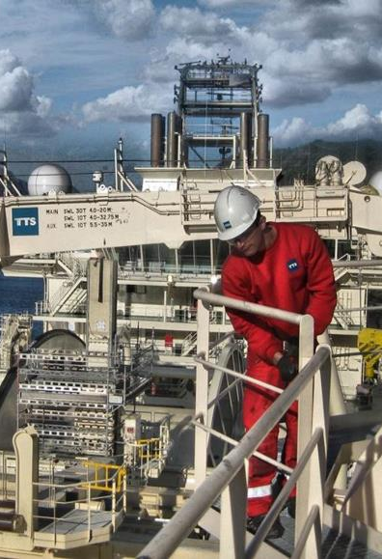
Business unit: Services
Services
The Services business unit offers service and after sales activities for equipment delivered by TTS and former brand names.
Repairs and maintenance, service agreements, installation and commissioning, training and support, modernizations, inspections.
Genuine OEM spare parts delivery.
TTS Marine AB
TTS Marine GmbH
TTS NMF
TTS Syncrolift
TTS Liftec
TTS Marine Korea
TTS Shanghai
TTS Hua Hai
TTS Bohai
TTS Marine AS
(Kristiansand, Norway)
Center of Excellence
Service stations
TTS Benelux
TTS Brazil Serviços
TTS Marine Dubai
TTS Greece
TTS Marine (Italy)
TTS Singapore
TTS Marine (USA)
BU percentage of TTS revenue

Slide 19
Far East Operations
TTS Bohai Machinery (Dalian)
TTS Marine Equipment (Dalian)
TTS Korea (Busan)
TTS Marine Equipment JiangNan (Nantong)
CHINA
KOREA
TTS Hua Hai Ships Equipment (Shanghai)
TTS Marine (Shanghai)
VIETNAM
TTS-SCM (Guangzhou)
SINGAPORE
TTS Vietnam (Haiphong)
TTS Singapore

Slide 20



Unique position in China
Long history of successful business
Unique position in China
China is a “home market”
Early mover, valuable experiences and strong position
Business based on more than 15 years of successful joint venture cooperation
50/50 ownership with leading state owned corporations: CSSC (China State Shipbuilding Corporation) and DSIC (Dalian Shipbuilding Industry Corporation)
Contributions: TTS brings technology, Chinese partners provides valuable market access
20-65% market share in China for selected marine products.

Slide 21
For further information, please visit
www.ttsgroup.com

