Slide 1
Angular

Slide 2
Contents
Introduction
Setup
CLI Commands
Component
@component decorator
Component lifecycle
View Encapsulation
Component Style
Component Interaction
Content Projection
Dynamic Components

Slide 3
Contents
Template
Template Interpolation
Template Expression
Pipes
Property, Event, Two-way bindings
Attribute, Style and Class bindings
Directives
Built-in directives
Attribute directives
Structural directives
Dependency Injection
Routing
Forms
Reactive Forms
Template Driven Forms
Observables
Rxjs
Promises vs observables
operators

Slide 4
Introduction
Angular is a open-source front-end web development JavaScript framework which makes you able to create reactive Single Page Applications (SPAs).
Developed by google, built on typescript.
Angular is a Component based Framework.
Angular supports multiple platforms Desktop, Native, PWA.

Slide 5
Setup
To install the Angular CLI,
npm install -g @angular/cli
To create a new workspace and initial starter app:
ng new my-app //ng comes from angular
Run the application
cd my-app
ng serve –open
Project Flow: https://medium.com/siam-vit/how-an-angular-app-work-behind-the-scenes-angular-flow-dcc4d1df27bd
File Explanation : https://www.javatpoint.com/angular-7-files-explanation

Slide 6
CLI Commands
ng build - It compiles an Angular app into an output directory named dist/ .
--buildOptimizer=true|false : Enables '@angular-devkit/build-optimizer' optimizations when using the 'aot' option. Default: false.
Splits into bundle, and reduce loading time and size.
ng v or ng version - shows the Angular CLI version installed.
ng help – lists the available commands.
ng serve – to run the application.
--aot=true|false : Build using Ahead of Time compilation.
--baseHref=baseHref : Base url for the application being built.
--deployUrl=deployUrl : URL where files will be deployed.
--host=host, --port=port, --open=true|false
--liveReload=true|false, --prod=true|false

Slide 7
CLI Commands
ng lint - It checks the code quality of angular project specified. It uses TSLint as default linting tool and uses the default configuration available in tslint.json file.
ng test - run the unit test cases on angular app code.
ng doc - (angular.io) in a browser.
ng update - updates the application and its dependencies.
ng generate – can generate module, component, service and more…

Slide 8
Typescript vs Javascript
Typescript is

Slide 9
Modules
@NgModule({
declaration:[]
imports:[],
providers:[],
entryComponents:[],
bootsrap:[] })

Slide 10
AOT Compilation
JIT – Just In Time Compilation
AOT – Ahead of Time Compilation
ng build –aot
ng serve –aot

Slide 11
Components
Components are the main building block for Angular applications.
To create a component using the Angular CLI:
ng generate component <component-name>
By default, this command creates the following:
A folder named after the component
A component file, <component-name>.component.ts
A template file, <component-name>.component.html
A CSS file, <component-name>.component.css
A testing specification file, <component-name>.component.spec.ts

Slide 12
@component decorator
import { Component } from '@angular/core';
@Component({
selector: 'app-component-overview',
templateUrl: './component-overview.component.html’ or
template: '<h1>Hello World!</h1>’ //here we can also give template string,
styleUrls: ['./component-overview.component.css’] or
styles: ['h1 { font-weight: normal; }']
})
export class ComponentOverviewComponent { …code}

Slide 13
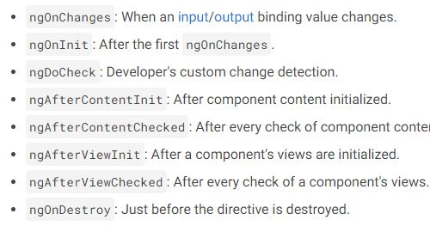
Component Lifecycle : 8

Slide 14
View Encapsulation
ShadowDom – shadow DOM, style encapsulation
Emulated – default, no shadow DOM, style encapsulation
None – no shadow DOM, no style encapsulation
https://dzone.com/articles/what-is-viewencapsulation-in-angular

Slide 15
Component Style
By setting styles or styleUrls metadata
inside @component decorator.
We can also use sass or less files in styleUrls
Inline in the template HTML.
<style></style> or
<link rel="stylesheet" href=“/component.css">
With CSS imports.
@import './hero-details-box.css’;

Slide 16
Component Interaction
Component Interaction in angular done in 4 ways,
@Input
@output
@ViewChild
Service file
Reference https://medium.com/@halleshwar141/component-interaction-in-angular-4644b3180c6e

Slide 17
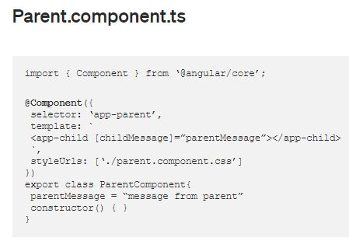
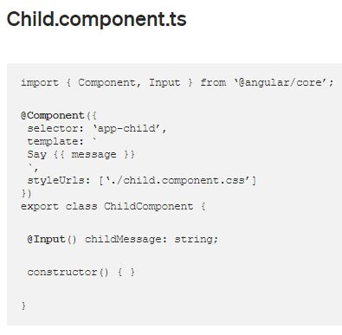
@Input : Parent to Child

Slide 18
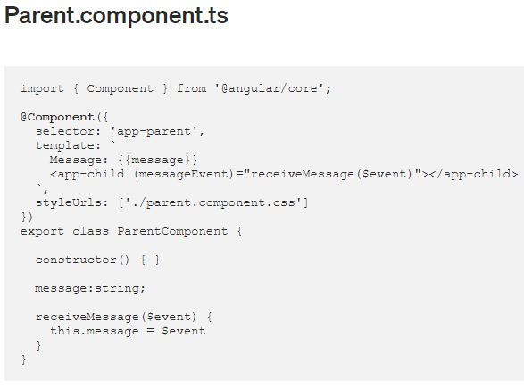
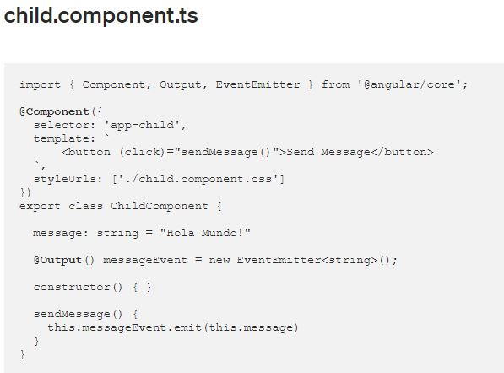
@output : Child to Parent

Slide 19
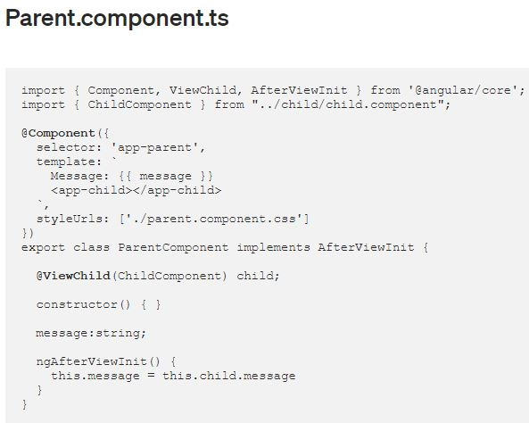
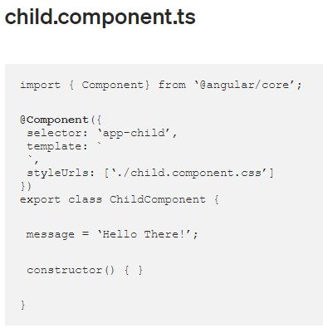
@ViewChild : Accessing Child values

Slide 20
Content Projection
Single slot content projection
Multi-slot content projection
Conditional content projection
Program:
https://stackblitz.com/angular/ldeplxylvaj?file=src%2Fapp%2Fapp.component.html
https://dzone.com/articles/simplifying-content-projection-in-angular
https://www.freecodecamp.org/news/everything-you-need-to-know-about-ng-template-ng-content-ng-container-and-ngtemplateoutlet-4b7b51223691/

Slide 21
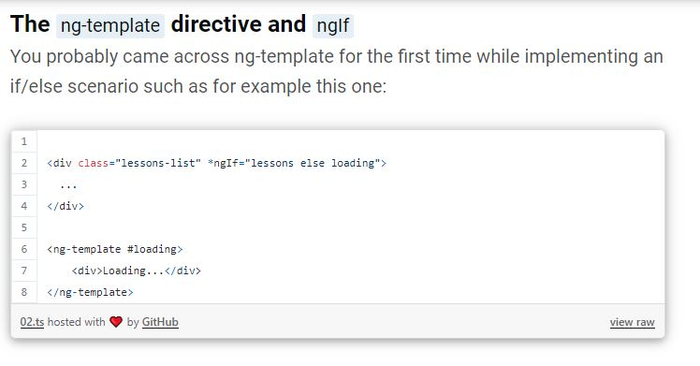
Content Projection : Cont

Slide 22
Dynamic Component
ComponentFactoryResolver
https://stackblitz.com/edit/angular-componentfactoryresolver-example?file=src%2Fapp%2Fapp.component.ts
https://stackblitz.com/edit/angular-dynamic-components-example?file=src%2Fapp%2Fapp.component.ts

Slide 23
Template
Reference :
https://stackblitz.com/angular/ymrdylabkpo?file=src%2Fapp%2Fapp.component.html
Template Interpolation:
interpolation uses the double curly braces {{ and }} as delimiters.
currentCustomer = 'Maria’;
<h3>Current customer: {{ currentCustomer }}</h3>
Template expressions:
<p>The sum of 1 + 1 is {{1 + 1}}.</p>

Slide 24
Templates
Pipe
uppercase, lowercase, currency, decimal, percent, slice, json
Property Binding
<img [src]="itemImageUrl">
@input is used, <app-sample [color]=“primary”>
But here interpolation and property binding produce same result.
<img src="{{itemImageUrl}}">
<img [src]="itemImageUrl">
Attribute bindings:
Starts with attr.
<p [attr.title]="true ? 'Remove' : 'Add’”>attribute</p>

Slide 25
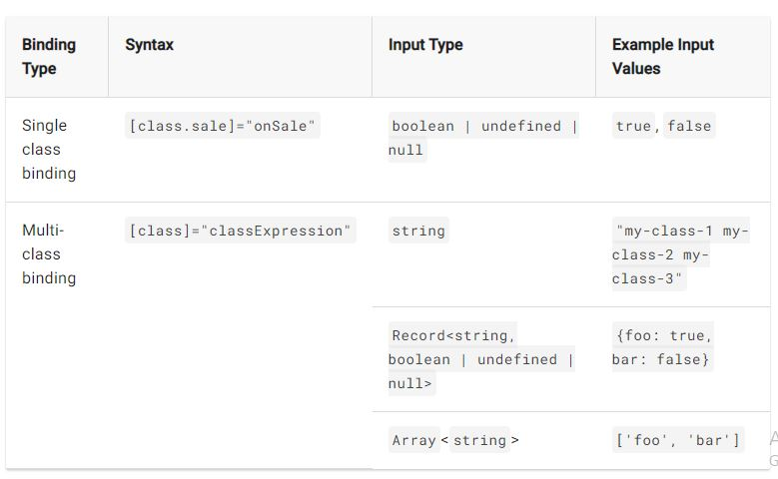
Templates
Class bindings:

Slide 26
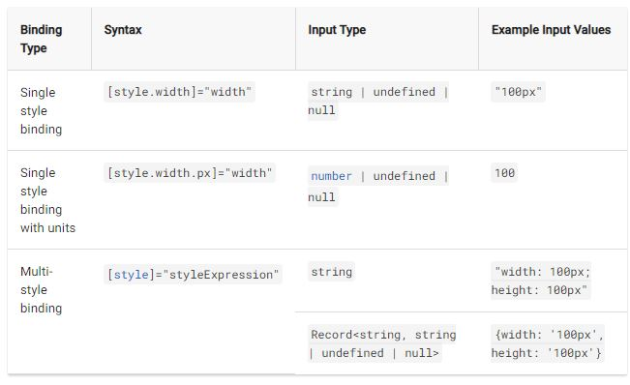
Templates
Style bindings:

Slide 27
Templates
Event Binding
<button (click)="onSave()">Save</button>
@output is used, <app-sample [delete]=“deleteItem($event)”>
@Output() delete = new EventEmitter<Item>();
this.delete.emit(this.item);
Two way Binding
<app-sizer [(size)]="fontSizePx"></app-sizer>
Both property and event binding
@Input() size!: number | string;
@Output() sizeChange = new EventEmitter<number>()

Slide 28
Built-in directives
Attribute directives
NgClass—adds and removes a set of CSS classes.
NgStyle—adds and removes a set of HTML styles.
NgModel - adds two-way data binding to an HTML form element.
Structural directives
*ngIf - conditionally creates or disposes of subviews from the template.
*ngFor - repeat a node for each item in a list.
ngSwitch - a set of directives that switch among alternative views.

Slide 29
Directives
Directive is Attribute directives
https://angular.io/guide/attribute-directives
ng generate directive highlight
Using CLI Commands
<p appHighlight>hello</p>
Structural directives
Creating own structural directives,
<p *appUnless=“condition”>hello</p>

Slide 30
Dependency injection
Dependencies are services or objects that a class needs to perform its function.
Dependency injection, or DI, is a design pattern in which a class requests dependencies from external sources rather than creating them.
hero.service.ts
import { Injectable } from '@angular/core’;
@Injectable({ providedIn: 'root’, //visible throughout the application })
export class HeroService {
getHeroes() { return true; }
}
hero.component.ts
constructor(heroService: HeroService) //Dependency Injection

Slide 31
Angular Routing
In a single-page app, you change what the user sees by showing or hiding portions of the display that correspond to particular components, rather than going out to the server to get a new page.
To handle the navigation from one view to the next, you use the Angular Router.
ng new routing-app –routing // create new app with routing
The routed views render in the <router-outlet>
<router-outlet></router-outlet>
To Navigate from one view to another
<li><a routerLink="/first-component“> First Component</a></li>

Slide 32
const routes: Routes = [
{ path: 'first-component', component: FirstComponent },
children: [
{path: 'child-a', component: ChildAComponent,},
{path: 'child-b’, component: ChildBComponent,},
],
{
path: 'heroes',
component: HeroListComponent,
data: { title: 'Heroes List' }
},
{ path: '', redirectTo: '/first-component', pathMatch: 'full' },
{ path: '**', component: PageNotFoundComponent },
{
path: 'admin’,
loadChildren: () => import('./admin/admin.module').then(m => m.AdminModule), // lazy loading
canLoad: [AuthGuard] // authguard
},
];

Slide 33
Router Gaurds :
CanActivate: Controls if a route can be activated.
CanActivateChild: Controls if children of a route can be activated.
CanLoad: Controls if a route can even be loaded. This becomes useful for feature modules that are lazy-loaded. They won’t even load if the guard returns false.
CanDeactivate: Controls if the user can leave a route. Note that this guard doesn’t prevent the user from closing the browser tab or navigating to a different address. It only prevents actions from within the application itself.
Resolve:
CanActive:
https://stackblitz.com/edit/angular-route-guards?file=src%2Fapp%2Fapp.module.ts
https://codeburst.io/understanding-angular-guards-347b452e1892

Slide 34
Forms:
Reactive Forms, Template Driven Forms

Slide 35
MVVM – model view view model
Tsconfig will fix angular file erro
Package.json – will fix npm errors
Server side rendering vs Client Side rendering

