Slide 1

CROP CHALLENGE
In this project, we focus on agricultural data for corn crops, to identify the best hybrids of corn maximizing yield
Rahul Agrawal

Slide 2
ABSTRACT
DATA
Soil, Geography and Weather data
OBJECTIVE 1
Develop stress metrics : Heat & Drought
OBJECTIVE 2
Find resistant Hybrids

Slide 3
Overview of the Challenge
Every Year this Company hosts an open Analytics Competition
In 2019 they wanted to classify hybrids which were resistant to Heat & Drought
They validate each submission with their in-house scientific understanding of the hybrids
Compare internal knowledge of hybrid stress tolerance with Data driven analysis of empirical data

Slide 4
Datasets
Performance - 2452 hybrids
HYBRID_ID, ENV_ID, Yield
Lat-Long, Yield, Plant/Harvest Date
Elevation, Soil Properties, Irrigation
Weather - 1560 environments
Daylight, Temperature, Precipitation, Vapor Pressure
Spread over 365 days for each Environment

Slide 5

Performance Data
Unique Identifier is HYBRID_ID
Each Hybrid has 8 to 50 Environments that it has been grown in
ENV_ID is unique to a year
Maturity Grade
Latitude Longitude
Soil Properties
Irrigation
Elevation

Slide 6
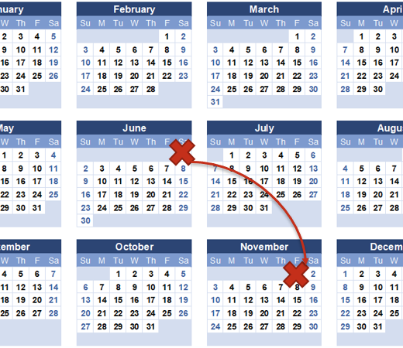

Weather Data
Unique Identifier is ENV_ID
Temperature and Rainfall Data
Spread over 365 Days
For the weather data set, we aggregated the features only between the plant and harvest date for each environment.
Pg 27 Appendix

Slide 7
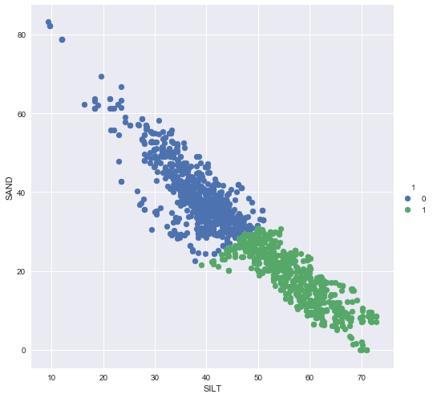
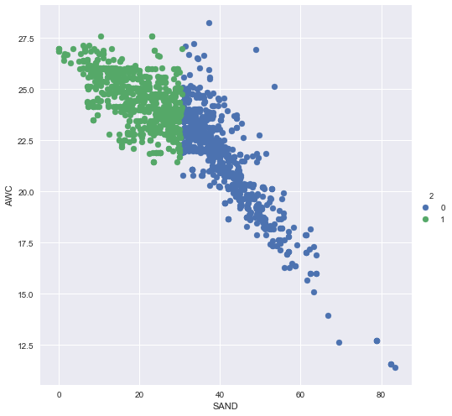
Distributions
No Discernable Trend in Scatter plots with Yield
All Continuous Distributions were Normal
QQ Plots
Shapiro Wilkes Test
Trends Between Variables

Slide 8
What is a Stress Metric ?
Quantify amount of stress a certain environment faces with respect to Heat, Drought by virtue of its…
Soil Quality
Weather
Irrigation
The Mean Yield of the Environment can be used as a surrogate for stress.
The higher the mean yield the lower the stress

Slide 9
Objective 1
6 = f(3,4,5)
7 = f(1,5)
Domain Knowledge
Feature Engineering
Feature (Selection)
Unsupervised Clustering of important features specific to Heat, Drought, Heat & Drought
Clustering
1 2 3 4 5
RF Feature Importance – Permutation and Impurity This has its drawback but they were overcome
Random Forest Feature Importance
1 – 50%
2 – 30%
3- 10%
4 – 8%
5- 2%

Slide 10
Objective 1
Domain Knowledge
8 = f(2,7)
Feature Engineering
Feature (Selection)
Unsupervised Clustering of important features specific to Heat, Drought, Heat & Drought
Clustering
1 2 6 7
RF Feature Importance – Permutation and Impurity This has its drawback but they were overcome
Random Forest Feature Importance
1 – 30%
2 – 10%
6- 50%
7 – 10%

Slide 11
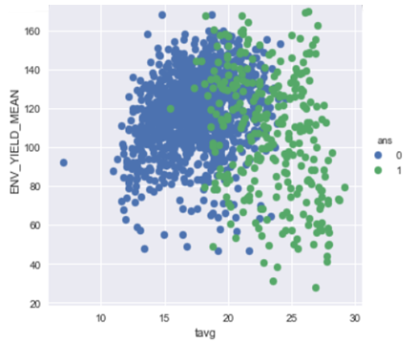
Objective 1
Domain Knowledge
Feature Engineering
Feature (Selection)
1,8
Clustering
1 6 8
Random Forest Feature Importance

Slide 12
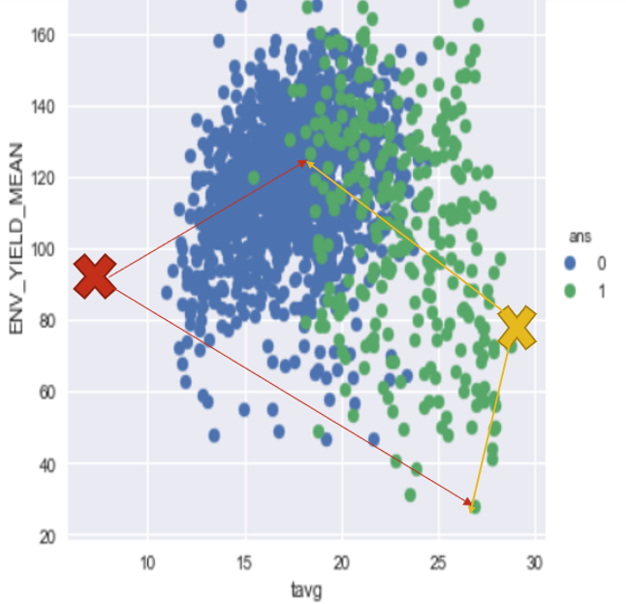
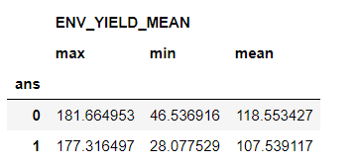
Creating Stress Metrics

Slide 13
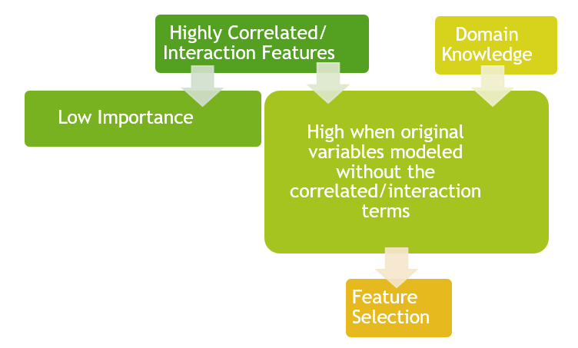
Feature Importance
When there are interaction terms along with the original features or correlated variables…
Important Features Underestimated
Feature importance gets split over correlated features
Impossible Permuted Observations
(Eg:- High precipitation, low precipitation*irrigation)

Slide 14
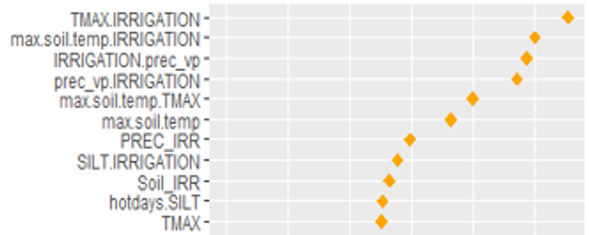
Feature Importance
IRRIGATION

Slide 15
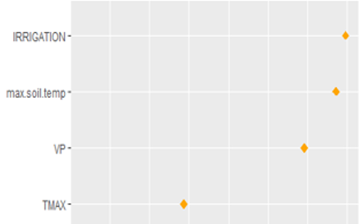
Feature Importance
Pg 28 Appendix

Slide 16
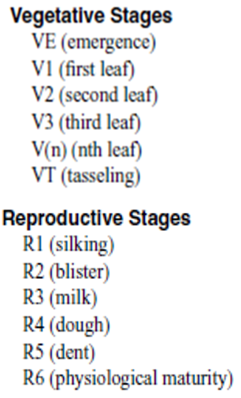
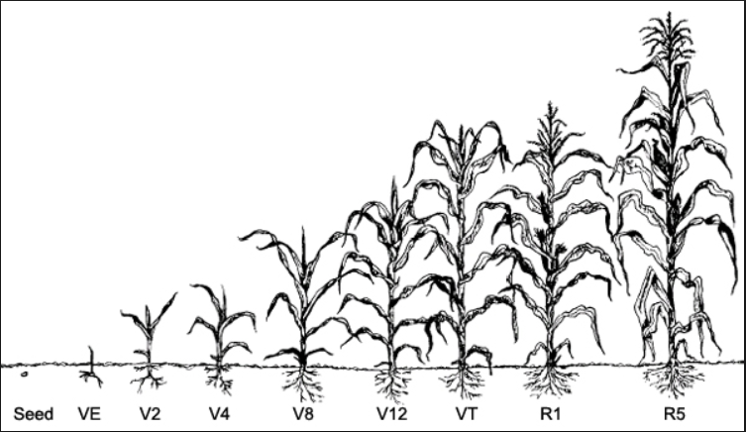
Stages of corn growth

Slide 17
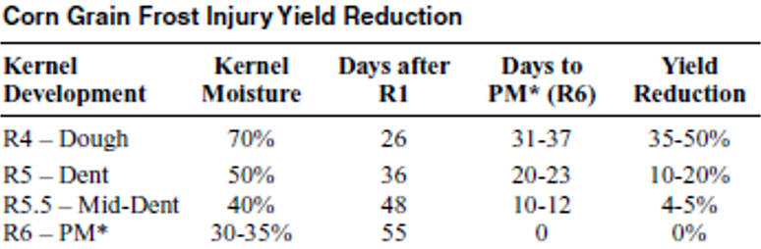
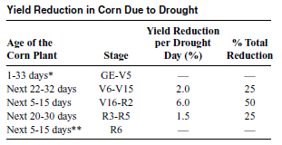
Stages of corn growth

Slide 18
Some of the Features created
Soil temperature
Soil = (SAND*CLAY*SILT)/(3*CLAY+2*SILT+SAND)
Water availability= PREC+SWE+IRRIGATION
Water capacity= AWC/KSAT
Hotdays
WarmNights
4 Hot Days

Slide 19
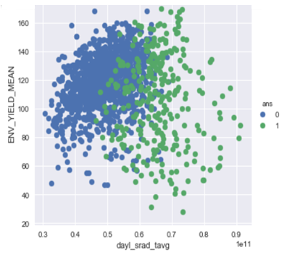
HEAT STRESS

Slide 20
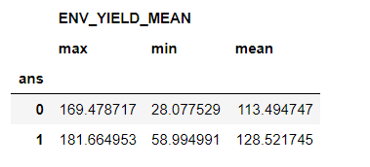
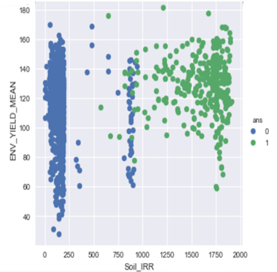
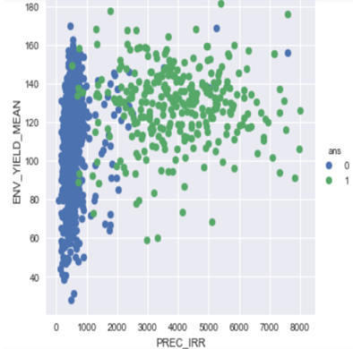
DROUGHT STRESS

Slide 21
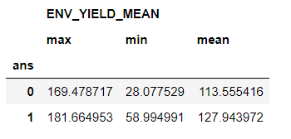
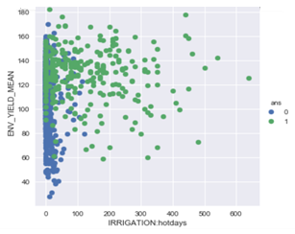
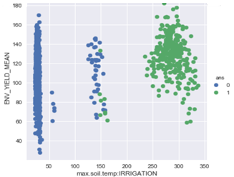
HEAT & DROUGHT STRESS
Pg 29 Appendix

Slide 22
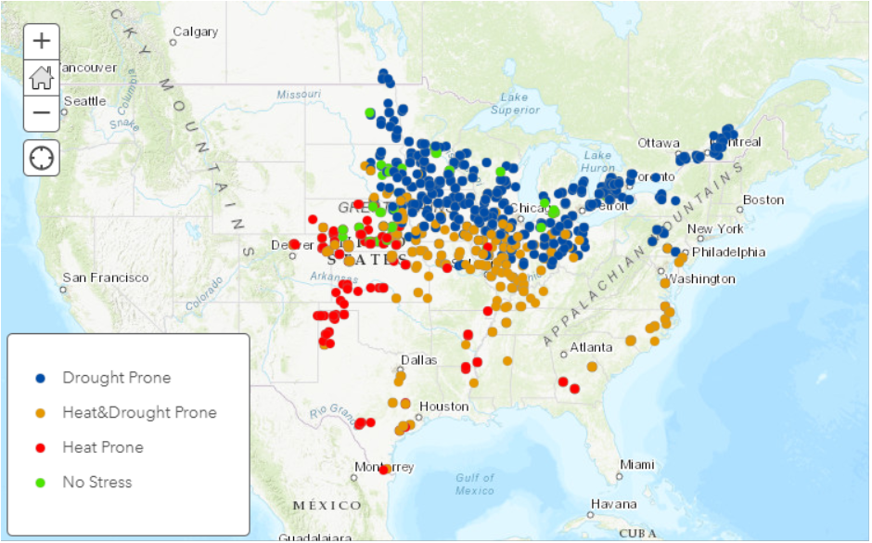

Slide 23
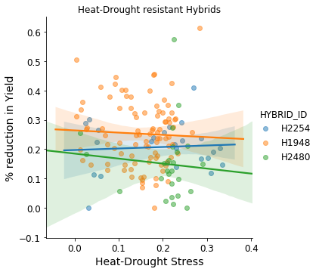
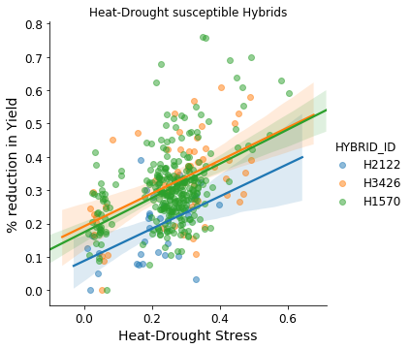
Objective 2
A tolerant hybrid’s yield should be independent of the stress
A susceptible hybrid’s yield should show a monotonic and inverse behavior with stress
We use Linear regression to classify the Hybrids as the relation is monotonic
Pg 30 Appendix

Slide 24
Validation
Linear regression coefficients for each feature with yield
Made intuitive sense
Plots of Stresses with Yield
Decreasing Trend
Pg 31-32 Appendix

Slide 25
Conclusion
Southern part of US more Heat Prone
Northern – drought prone (Frost)
Influential new features created
MAP : Stress Distribution
80% of hybrids are Heat Resistant
60% Drought Resistant
48% Resistant to Heat & Drought
Tolerant | % Hybrids
Heat Tolerant | 80%
Drought Tolerant | 60%
Heat-Drought Tolerant | 48%

Slide 26

Appendix

Slide 27
Performance
Variable | Type | Explanation
HYBRID_ID | Identifier | Identifier for the tested hybrid
ENV_ID | Identifier | Identifier for the tested location and year, used to join to weather_data
HYBRID_MG | Continuous | Maturity group of the tested hybrid
ENV_MG | Continuous | Typical maturity group of the tested location
YIELD | Continuous | Yield of the tested hybrid in tested location (quintiles/hectare)
YEAR | Categorical | Year grown
LAT | Continuous | Latitude of location rounded to nearest .1 degree
LONG | Continuous | Longitude of location rounded to nearest .1 degree
PLANT_DATE | Date | Date the hybrid was planted
HARVEST_DATE | Date | Date the hybrid was harvested
IRRIGATION | Categorical | Level of irrigation in this location
ENV_YIELD_MEAN | Continuous | Average yield in this environment
ENV_YIELD_STD | Continuous | Standard deviation of yield in this environment
ELEVATION | Continuous | Elevation of field
CLAY | Continuous | % of clay in soil
SILT | Continuous | % of silt in soil
SAND | Continuous | % of sand in soil
AWC | Continuous | Available water capacity in soil
PH | Continuous | pH of soil
OM | Continuous | Organic matter in soil
CEC | Continuous | Cation exchange capacity of soil
KSAT | Continuous | Saturated hydraulic conductivity of soil
Weather
ENV_ID | Identifier | Identifier for the tested location and year, used to join to weather_data
DAY_NUM | Integer | Day number within year of weather variables
DAYL | Continuous | Day length (seconds)
PREC | Continuous | Precipitation (mm)
SRAD | Continuous | Solar radiation (W/m^2)
SWE | Continuous | Snow water equivalent (kg/m^2)
TMAX | Continuous | Maximum temperature (degrees Celsius)
TMIN | Continuous | Minimum temperature (degrees Celsius)
VP | Continuous | Vapor pressure (Pa)

Slide 28
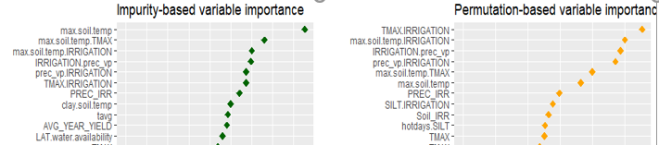
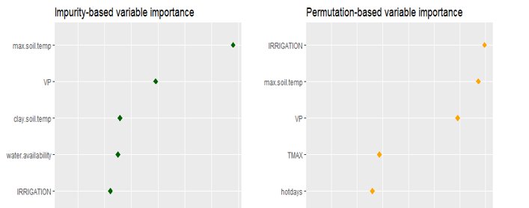

Slide 29
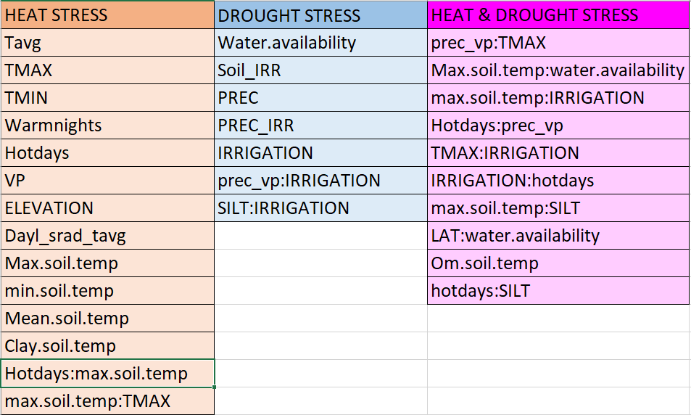
Features Selected

Slide 30
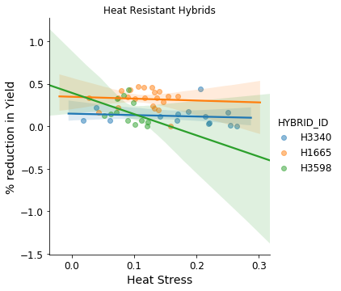
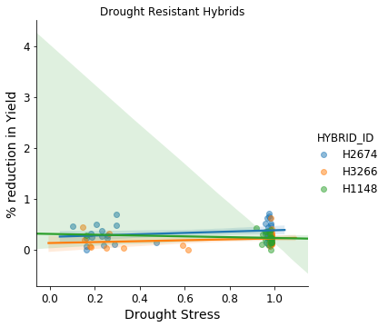
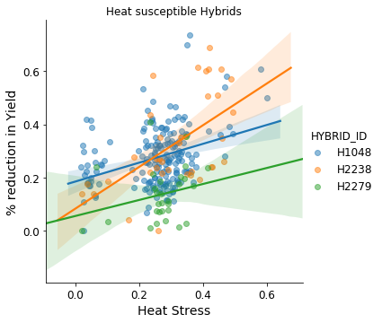
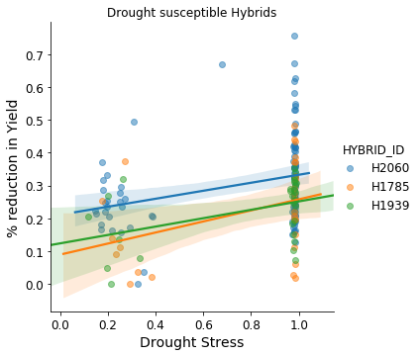

Slide 31
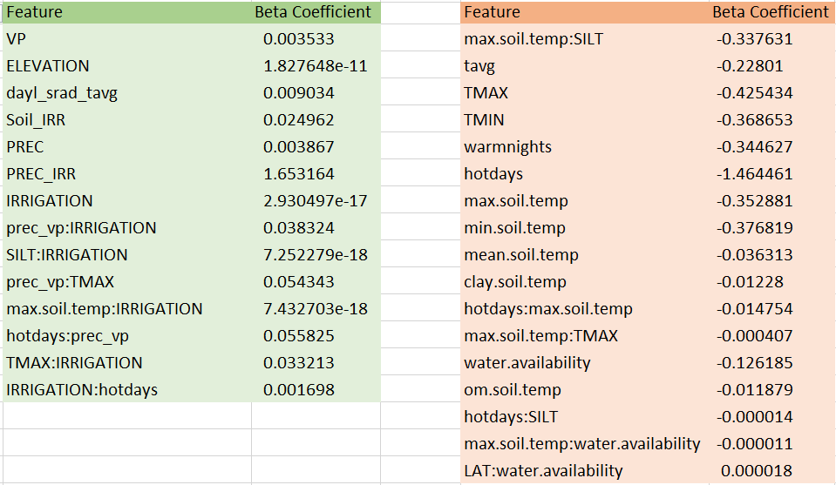
Linear regression Coefficients

Slide 32
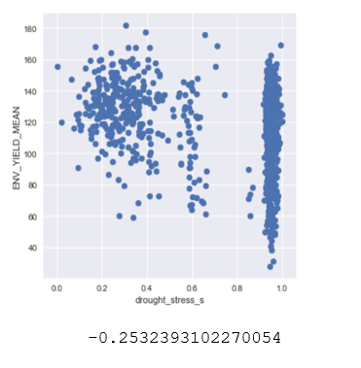
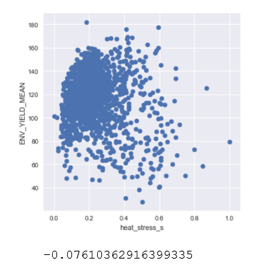
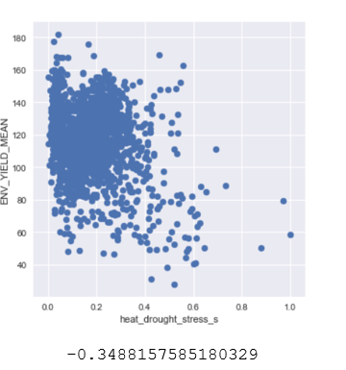
Plots – Yield vs Stress Below are the plots for Mean_Yield vs each of the stresses all of which show a decrease in yield with increase in stress.

Slide 33
REFERENCES
Corn- Growth and Management North Dakota State University - Reviwed by Joel Ransom
Elements of Statistical Learning- Hastie, Tibshirani, Friedman

