Slide 1
Operational Data for Logistics Efficiency
Name of Team Members:
• Omkar Vaity
• Rahul S K
Batch Code: DA634S63
• Project Guide: Komilla Bhatia

Slide 2
Problem Statement
The logistics company is facing operational inefficiencies across its supply chain, including delays in deliveries, inconsistent warehouse utilization, frequent inventory stockouts, and rising operational costs.
Business Objective
Delivery Performance: Identify delays and improve on-time delivery
Cost Efficiency: Analyze cost drivers and reduce transportation cost
Warehouse Efficiency: Optimize utilization and improve productivity
Inventory Management: Reduce stockouts and improve inventory control

Slide 3
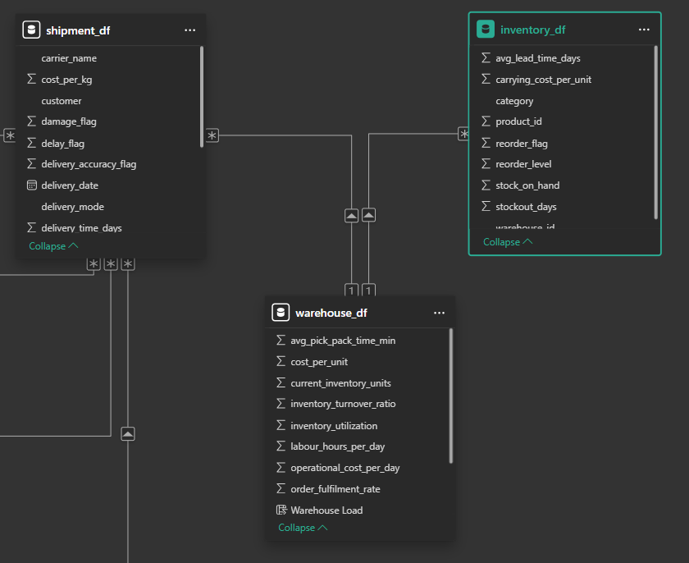
Data Description
Domain:
The dataset belongs to the logistics and supply chain industry.
Data Size & Scale:
Shipment data: ~209K records
(high-volume transactional data)
Inventory data: ~2K records
(product-level stock insights)
Warehouse data: 19 records
(facility-level performance)

Slide 4
Tools & Techniques Used
Python
→ EDA : Pandas, NumPy, Matplotlib, Seaborn
→ Data Cleaning & Preprocessing: Missing value handling, IQR Outlier Treatment
→ Statistical Analysis: T-Test (CLT), Chi-Square Test
→ Predictive Modeling (Regression): Linear Regression, Random Forest
→ Classification Modeling: Logistic Regression, KNN
→ Clustering & Segmentation: K-Means Clustering
→ Model Optimization: Train-Test Split
Excel
Power BI

Slide 5
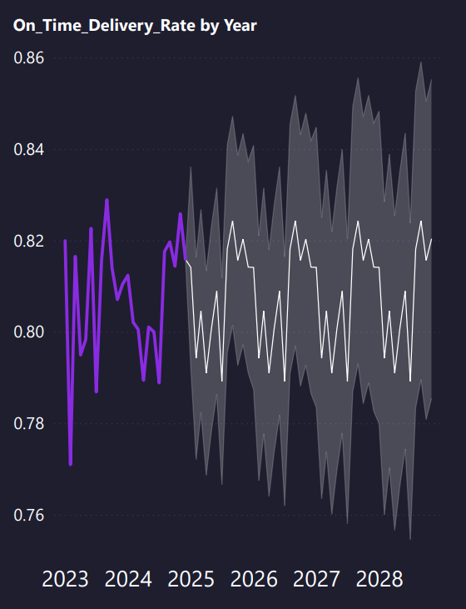
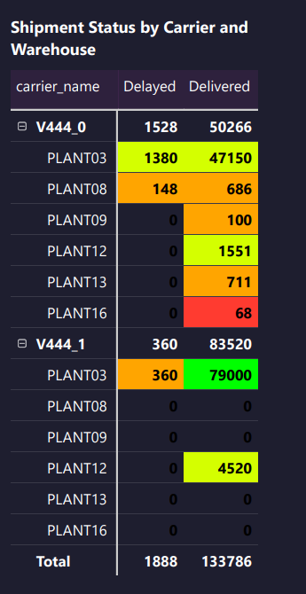
Delivery Performance
110K of 136K shipments were on time overall.
Delay rate is 19.10%, showing nearly one in five shipments missed target.
V444_0 recorded 1,528 delays, far above V444_1 at 360.
PLANT03 drove most delays, with 1,380 under V444_0 alone.
On-time delivery rate stays near 0.80 to 0.82, with limited improvement.
Key insight:
Delivery issues are concentrated in V444_0 and PLANT03 operations

Slide 6
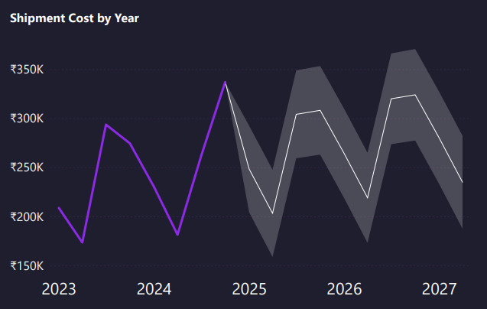
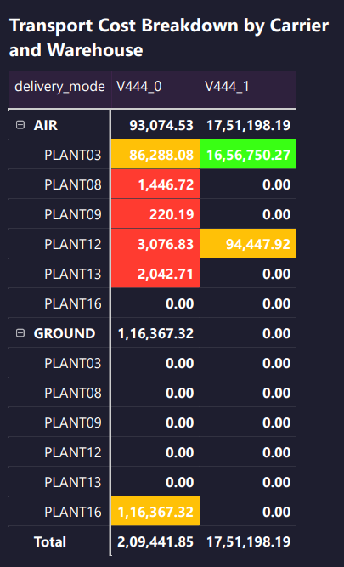
Cost Efficiency
Total logistics cost is 1.96M, with average cost per kg at 13.27.
V444_1 contributes 17,51,198.19 transport cost versus 2,09,441.85 for V444_0.
PLANT03 is the highest-cost node, especially V444_1 AIR at 16,56,750.27.
V444_0 GROUND cost is concentrated at PLANT16 with 1,16,367.32.
Damage is higher for V444_0 at 2,417 cases versus 1,674 for V444_1.
Key insight:
Cost is heavily concentrated in V444_1 AIR shipments from PLANT03

Slide 7
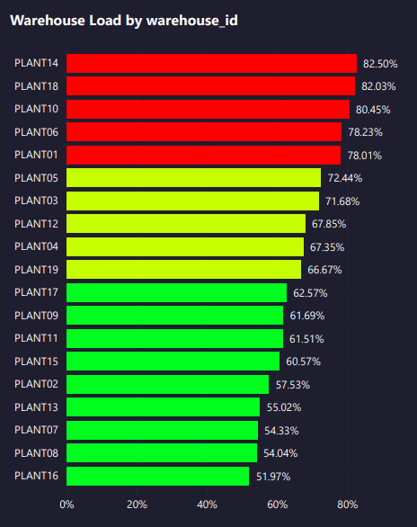
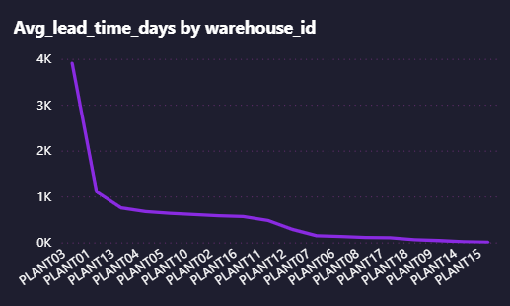
Warehouse
Average warehouse utilization is 66.65 across the visible network.
PLANT14 has the highest load at 82.50%, followed by PLANT18 at 82.03%.
PLANT03 carries the largest delivery volume, 48,530 for V444_0 and 79,360 for V444_1.
High utilization versus fulfillment speed by warehouse is not clearly visible.
Key insight:
Warehouse demand is uneven, with heavy delivery concentration at PLANT03.

Slide 8
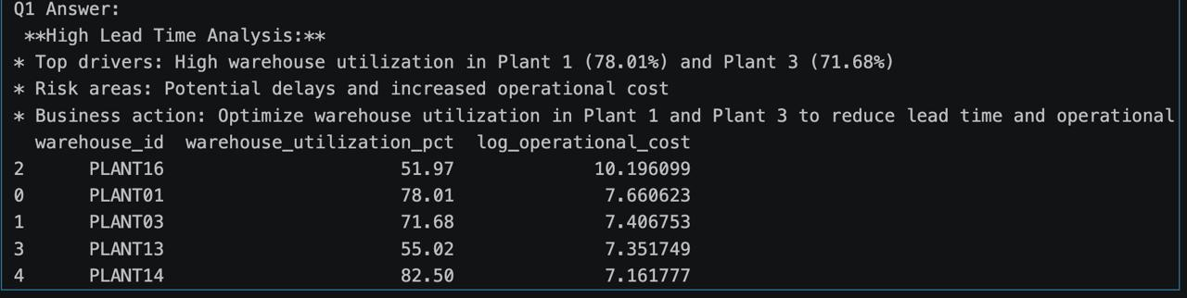
Taking support of LLM model (Groq Api) to identify the root cause and recommend the root cause
Problem statement given to the LLM Model :
Identify delays and improve on-time delivery the overall objective is to reduce operational cost
Objective given to the LLM Model
Why the Lead time is high in plant 3 , plant 1 and how does it affect the operational cost ? Return the output in table or bullet points
Solution provided by the LLM Model
Notes:
Workflow
Compute KPI summary from shipment data in pandas.
Convert metrics into a business prompt template.
Send the prompt to Groq using llama-3.3-70b-versatile with low temperature for stable responses.
Return an answer plus the underlying summary for traceability.
I developed an LLM-based business Q&A layer for supply chain analytics. First, the code calculates logistics KPIs such as delay rates and missed delivery percentage using pandas, then formats those outputs into a structured business prompt, and finally sends that prompt to Groq to generate concise and actionable insights. This makes raw operational metrics easier for business stakeholders to understand and act on.

Slide 9
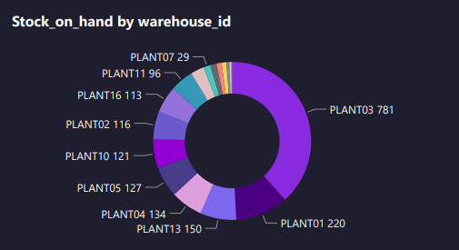
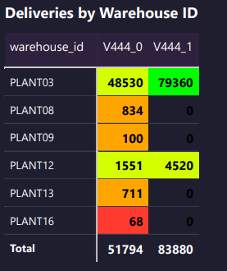
Inventory Management
PLANT03 holds the highest stock on hand at 781 units.
PLANT01 is a distant second with 220 units, far below PLANT03.
Lowest visible stock is PLANT07 with only 29 units.
Inventory carrying cost by warehouse is not visible in dashboard.
Reorder flag rates and stockout prevention effectiveness are not visible.
Key insight:
Inventory is strongly concentrated in PLANT03, while some warehouses hold low stock.

Slide 10
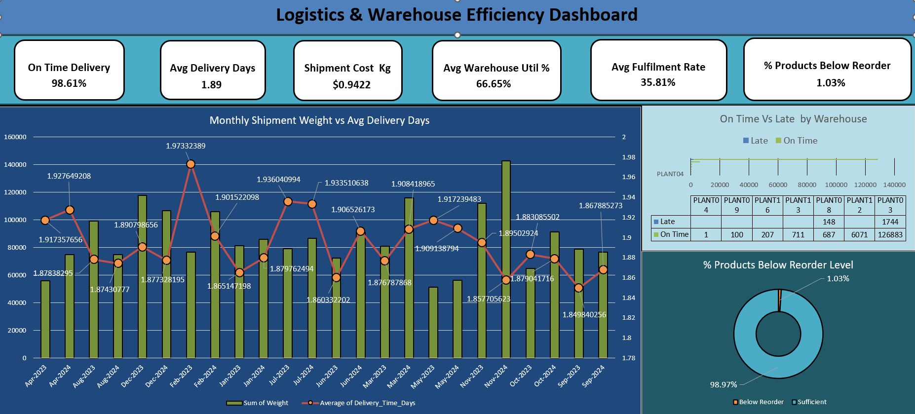
Excel Dashboard
Notes:
Excel with interpretation

Slide 11
Statistical Analysis – (T-Test, Chi-Square Test)
T Test
Objective: Compare transportation cost between delivery modes.
H₀: No cost difference between AIR and GROUND.
H₁: Significant cost difference exists.
Output: Reject H₀.
Sample Size: 5 records from each value (Air and Ground Travel)
Insight
There is a statistically significant cost difference between AIR and GROUND shipments.
Business Benefit
Shift non-urgent shipments to GROUND.
Reduce transportation cost through better mode selection.
Support mode optimization strategy.
Chi-Square Test
Objective: Determine whether carrier selection affects delivery performance.
H₀: Carrier does not affect delivery performance.
H₁: Carrier affects delivery performance.
Output: Reject H₀.
Insight:
Carrier selection significantly impacts delivery performance.
Business Benefit:
Identify high-delay carriers.
Improve SLA performance.
Optimize carrier allocation strategy.
Notes:
1. T-Test
H₀: No cost difference between AIR and GROUND.
H₁: Significant cost difference exists.
Sample Size:
AIR: 5
GROUND: 5
Output:
T = -7.466, p = 0.00168 , Alpha = 0.05→ Reject H₀.
2. Chi-Square Test (Independence Test)
H₀: Carrier does not affect delivery performance.
H₁: Carrier affects delivery performance.
Output:
Chi² = 51870.225, p = 0.000, df = 1 ,Alpha 0.05→ Reject H₀.

Slide 12
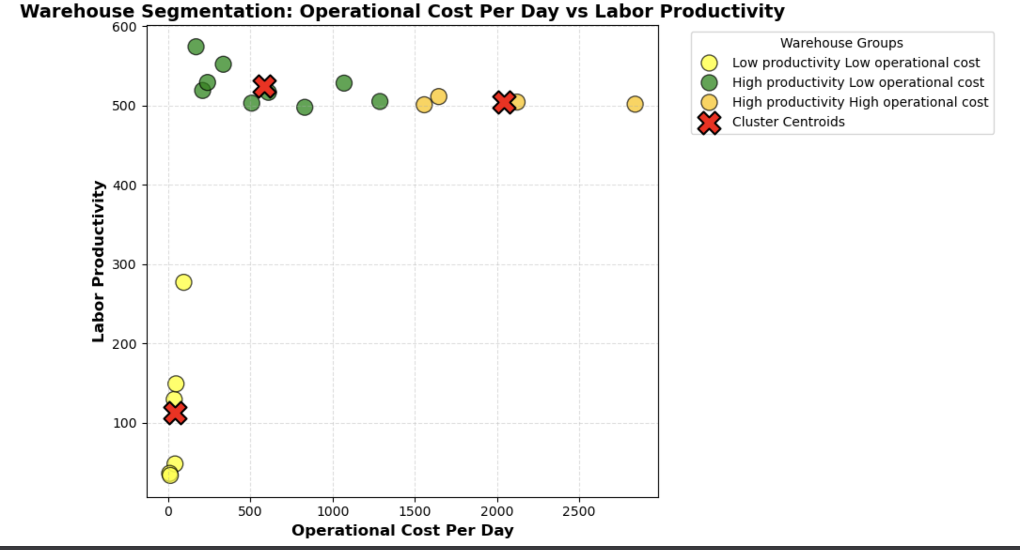
K-Means Clustering
Purpose of ML Model:
To segment warehouses based on operational cost, labor hours, and capacity.
Green Cluster → High productivity Low operational cost
Amber cluster → High productivity High operational cost
Yellow cluster → Low productivity Low operational cost
Business Benefit:
We identified the labors who are highly productive and lead to low operational cost
We also identified labor who are low in productivity
Notes:
Model Performance:
Silhouette Score: 0.589, Davies-Bouldin Index: 0.527, Calinski-Harabasz Score: 88.357.

Slide 13
KNN Classifier / Logistic Regression
→ KNN Classifier
Purpose of ML Model:
To classify shipment delivery outcomes using shipment and carrier patterns.
Input Data:
Weight, Delivery Mode, Carrier Name.
Output Of ML Models:
On-Time Delivery Flag.
Model Performance:
Accuracy Score: 0.794, F1 Score: 0.863 →Reliable model with good scores.
Business Benefit:
Identify delay-prone shipment patterns.
Compare current shipments with similar past cases.
Strengthen delivery risk review decisions.
→ Logistic Regression
Purpose of ML Model:
To predict whether a shipment will be on time or delayed.
Input Data:
Weight, Delivery Mode.
Output Of ML Models:
On-Time Delivery Flag.
Model Performance:
Accuracy Score: 0.808, F1 Score: 0.894 →Reliable model with good scores.
Business Benefit:
Improve proactive delivery planning.
Alert teams on high-risk shipments early.
Support SLA improvement actions.

Slide 14
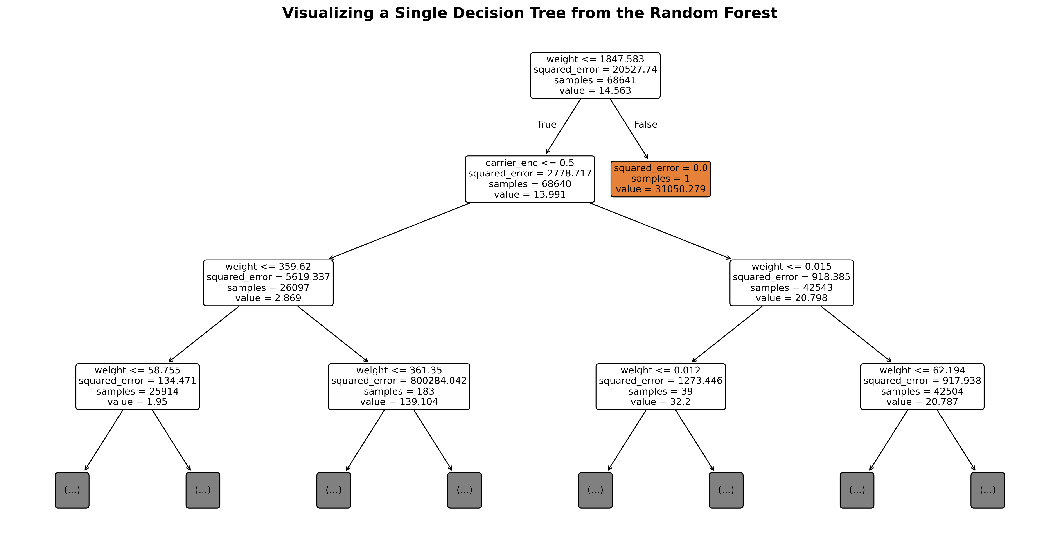
Random Forest Regression
Purpose of ML Model:
To predict shipment cost using shipment weight and carrier information.
Input Data:
Weight, Carrier Name (encoded).
Output Of ML Models:
Predicted Shipment Cost.
Model Performance:
R2 Score: 0.762, MAE: 15.68 – Reliable model with low error.
Business Benefit:
Improves shipment cost forecasting for better transport budget planning by predicting:
Predict shipment cost before dispatch.
Detect high-cost shipment patterns early.
Support pricing and carrier planning decisions.

Slide 15
Summary
136K total shipments were studied, with 110K on-time deliveries and a 19.10% delay rate
On-time delivery is stable, but delays remain concentrated in V444_0 and PLANT03.
Warehouse utilization averaged 66.65, with highest loads at PLANT14 at 82.50 and PLANT18 at 82.03
V4441 AIR accounted for 17,51,198.19 transport cost, and PLANT03 under V4441 AIR alone contributed 16,56,750.27
.

Slide 16
Summary Continued
V4440 was the main delay-risk carrier with 1,528 delays, while V4441 had only 360 delays.
PLANT03 was the most critical node, contributing 1,380 delays under V4440 and 79,000 delivered shipments under V4441.
V4440 also showed higher damage at 2,417 cases compared with 1,674 for V4441.
PLANT03 handled the highest shipment volume and also held the highest stock on hand at 781 units, while PLANT07 had only 29 units.

Slide 17
Conclusion - Business Strategies to improve the Business
1. Improve Delivery Reliability
Prioritize route planning and delay-control actions for V4440, because it recorded 1,528 delays compared with only 360 for V4441.
Focus immediate operational improvement at PLANT03, since it alone contributed 1,380 delays under V4440 and is the biggest delay hotspot.
2. Reduce Transportation Costs
Shift non-urgent shipments from AIR to GROUND where possible, because total logistics cost is 1.96M and AIR-related cost concentration is very high.
Review pricing and transport strategy for V4441 AIR first, since it contributes 17,51,198.19 compared with only 2,09,441.85 for V4440.
3. Optimize Warehouse Operations
Redistribute shipment load across facilities, because average warehouse utilization is 66.65 while PLANT14 and PLANT18 are heavily loaded at 82.50% and 82.03%.

Slide 18
Limitation and Future Scope
Current Limitations
Analysis is based on historical data, which may not fully capture real-time operational changes
Limited variables for external factors (e.g., weather, traffic, fuel cost) affecting delivery performance.
Future Scope
Integrate real-time data systems (IoT, GPS tracking) for live monitoring and decision-making
Include external factors like weather and traffic to improve prediction accuracy

Slide 19
Thank You
Any Questions

