Slide 1
Floating-point arithmetic on Neuromorphic chip
Arun M George
Rahul Sharma

Slide 2

Integrate and Fire Neurons
Based on the fact that shape of the spikes is same.
Information is transmitted in the form of presence and absence of events.
Equivalent to an RC circuit
Membrane Potential of the neuron at any time can be represented in the form of

Slide 3


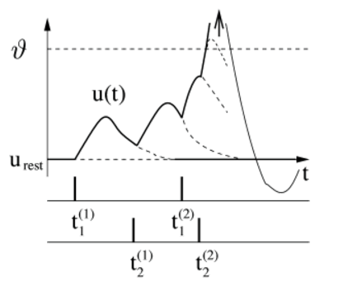
Integrate and Fire Neurons(Cont..)
Threshold for spike firing can be specified as
Linearity of IF models

Slide 4
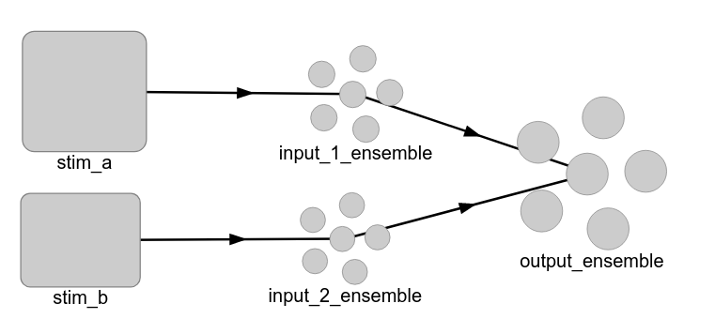
Addition Architecture

Slide 5
Work so far...
Addition of two floating-point numbers
Observed the effect of different values of radius and no of neurons

Slide 6
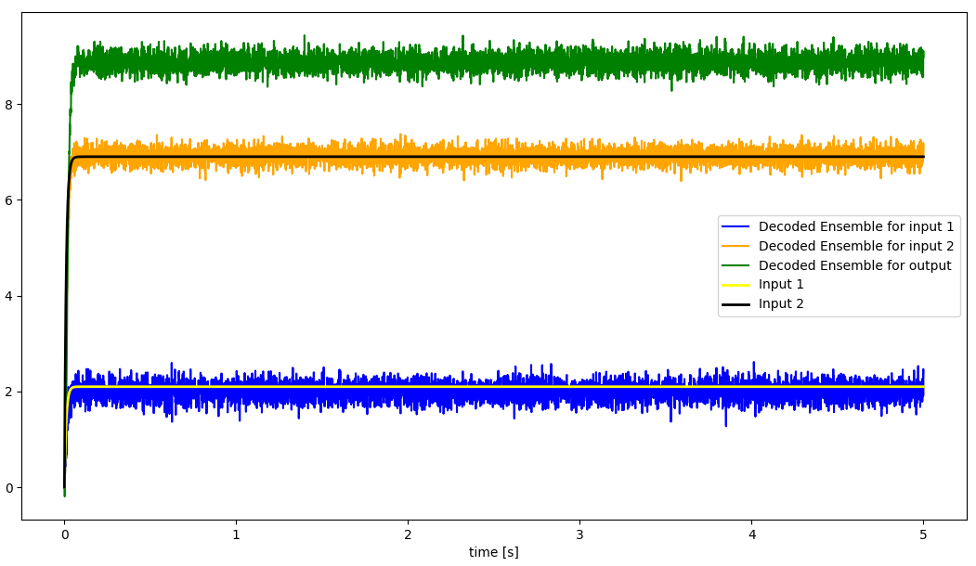
Effect of different values of radius
input_a = 2.1, input_b = 6.9, radius = 10

Slide 7
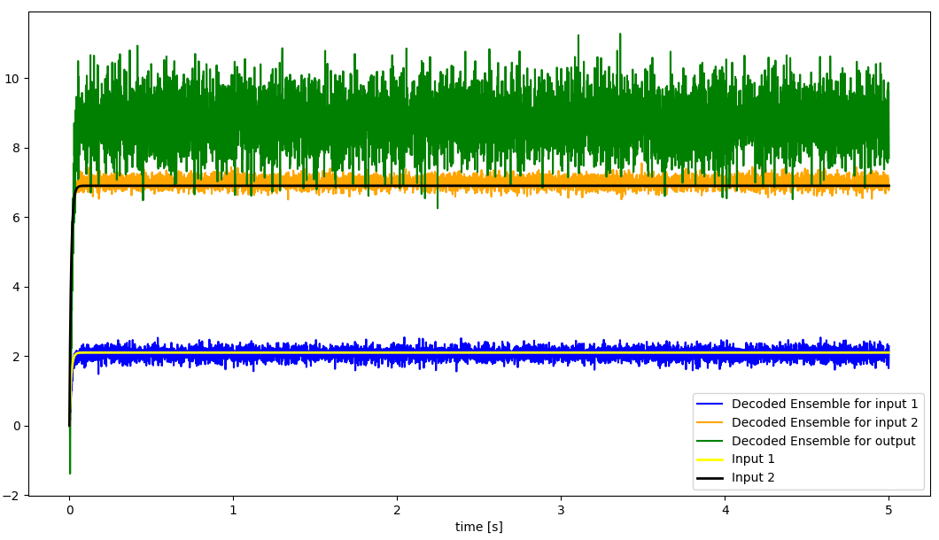
Effect of different values of radius
input_a = 2.1, input_b = 6.9, radius = 50

Slide 8
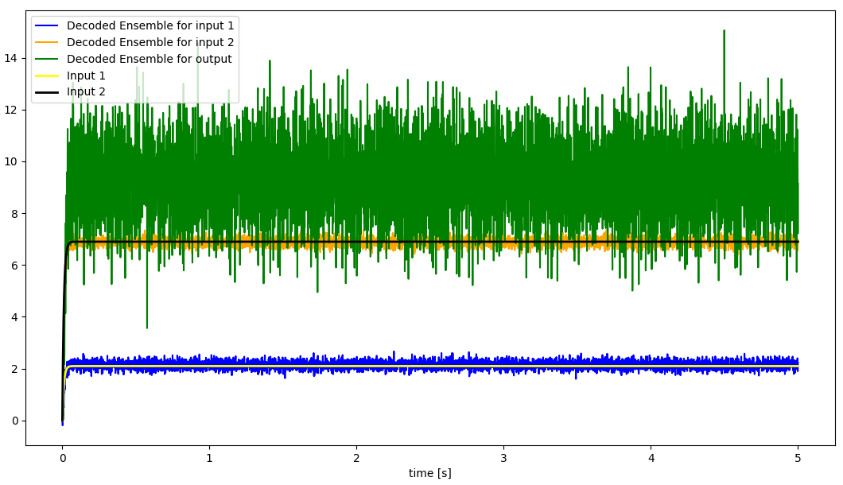
Effect of different values of radius
input_a = 2.1, input_b = 6.9, radius = 100

Slide 9
Effect of different values of no of neurons
input_a = 2.1, input_b = 6.9, radius = 10, n = 100

Slide 10
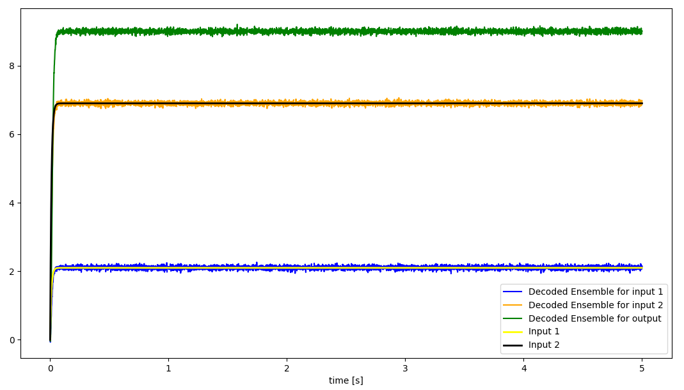
Effect of different values of no of neurons
input_a = 2.1, input_b = 6.9, radius = 10, n = 1000

Slide 11
Conclusions
Higher the no of neurons better the value representation
Radius should not be too large than the value to be represented by a neural population
Problem – How to estimate radius?
  Using addition to estimate radius - “The chicken and egg problem”
  Digit-wise decimal addition, radius = 18, limitation?
  Digit-wise binary addition, radius = 2, much better

Slide 12
Future work
Modify the architecture to incorporate digit-wise addition in binary with carry-propagation
Tune the model by changing the no of neurons
Floating-point addition through normalization

