Slide 1
Floating-point arithmetic on Neuromorphic chip
Arun M George
Rahul Sharma

Slide 2
Floating point addition
Convert each decimal number to binary floating-point
Convert to IEEE 754 format i.e. ±1.M x 2E
Match exponents
Add Mantissa bit-by-bit
Adjust exponent (if needed)

Slide 3
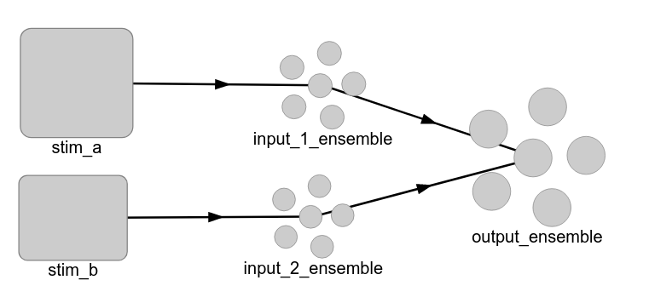
Addition Architecture

