Slide 1
Floating point arithmetic on Neuromorphic chip
Arun M George
Rahul Sharma

Slide 2
Addition/Subtraction flow
(Input 1)₂
Normalize
(Input 2)₂
Match exponents
Add Mantissas
Addition
Check sign bits
Subtract Mantissas
Subtraction
Normalize and rounding
(Output)₂

Slide 3
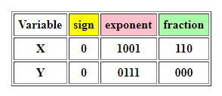

Example
X is 1.110 x 2², and Y is 1.000 x 2⁰
Match exponents -> Y‘ = 0.0100 x 2²
add 1.110_{two} to 0.01_{two}. The sum is: 10.0_{two}
sum does not have a single bit of value 1, so normalize to get 1.000 x 2³

Slide 4
Architecture
(Input 1)₂
(Input 2)₂
Addition of two binary numbers
Normalize binary numbers
Compute 2’s complement
Match exponents
(Output)₂

Slide 5
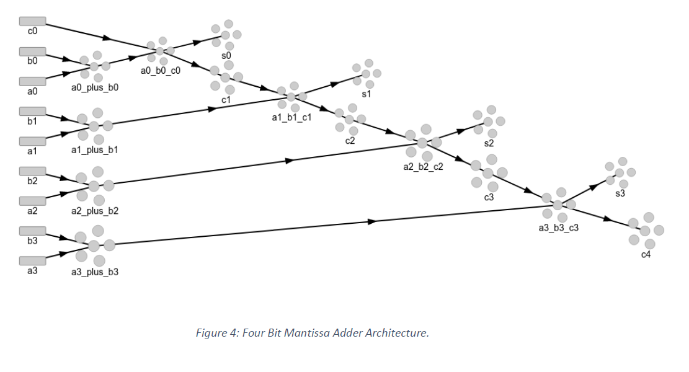
Design for addition of two binary numbers

Slide 6
Future work
Design and implementation of –
Matching exponents
Subtraction
Normalization
2’s complement
Rounding
Performance analysis

