Slide 1
Floating point arithmetic on Neuromorphic chip
Arun M George
Rahul Sharma

Slide 2
Architecture
(Input 1)₂
(Input 2)₂
Addition of two binary numbers
Normalize binary numbers
Compute 2’s complement
Match exponents
(Output)₂

Slide 3
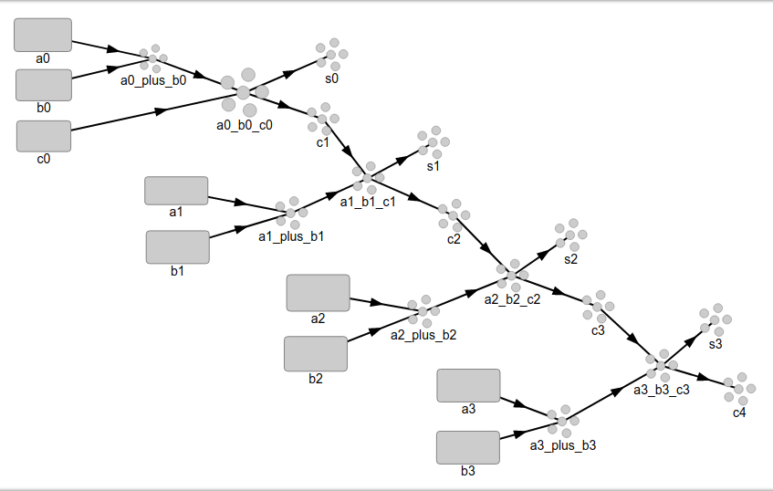
Bitwise adder

Slide 4
2’s complement

Slide 5
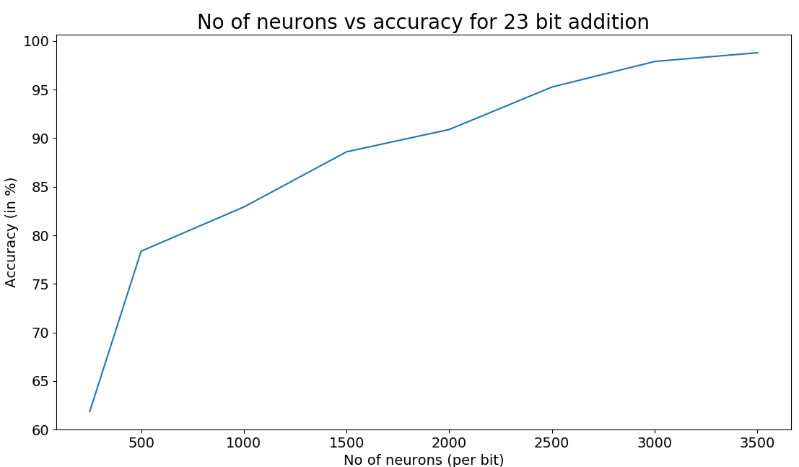

Slide 6
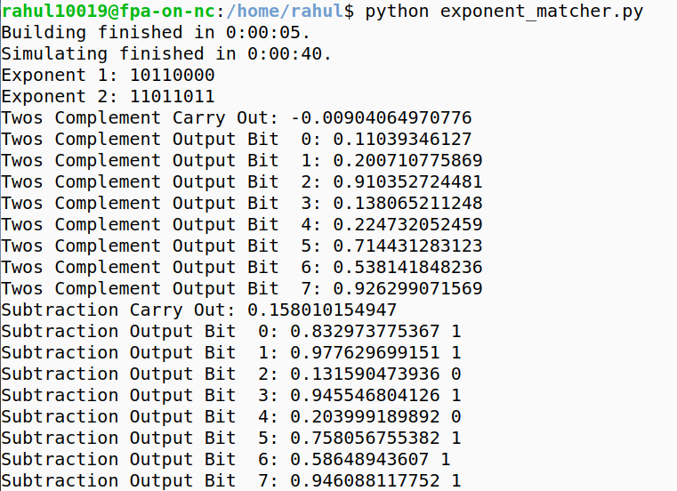
2’s complement result

Slide 7
Future work
Design and implementation of –
  Matching exponents
  Subtraction
  Normalization
  Rounding
Performance analysis on complete system

