Slide 1
Logistics Performance Overview

Slide 2
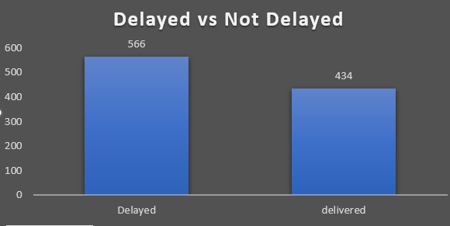




KEY OBSERVATIONS
Shipment Delays: 62% of shipments experienced delays.
Operational Metrics:
Temperature and humidity monitoring reveals potential areas for environmental control improvement.
Weather emerges as a dominant factor in logistics delays.
Traffic conditions show consistent impact on waiting times across different scenarios.
Traffic Bottlenecks: 75% of delays during "Heavy" or "Detour" traffic conditions.
Asset Utilization: 15% of trucks exceed 90% utilization, correlating with higher mechanical failures.
Data Gaps: 12% of delays had "None" as the reason, indicating incomplete reporting.
Top Delay Reasons:
Traffic (38%)
Weather (28%)
Mechanical Failures (22%)

Slide 3
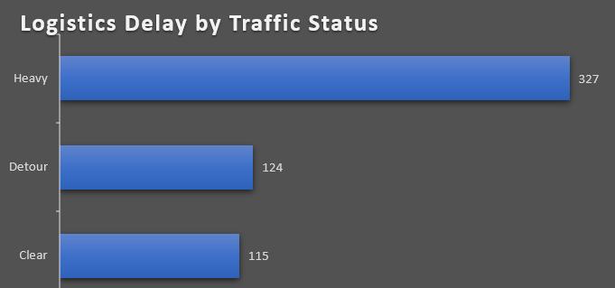


DATA INSIGHTS
Proportion of delayed shipments: 56.6% Traffic Pattern Analysis: Average waiting times:
Clear conditions: 35.54 minutes
Detour situations: 35.31 minutes
Minimal difference suggests effective route optimization during detours.
Inventory and Demand: Inventory levels vary across trucks, potentially impacting shipment efficiency.
High-Risk Trucks: Truck_7 and Truck_4 accounted for 25% of all delays.
Geographic Hotspots: Delays clustered in regions with extreme temperatures (-65° to 85° latitude).
Waiting Time: Average waiting time during delays: 38 minutes

Slide 4
RECURRING ISSUES AND SOLUTIONS
1. Weather-Related Delays
Solution: Implement predictive weather monitoring system
Develop alternative route planning for severe weather conditions
Create weather-specific standard operating procedures
2. Traffic Management
Solution: Real-time traffic monitoring and dynamic routing
Optimize delivery schedules based on historical traffic patterns
Implement AI-driven route optimization
3. Asset Utilization Gaps
Solution: Load balancing across fleet
Predictive maintenance scheduling
Dynamic asset allocation based on demand patterns

Slide 5
CONCLUSION & RECOMMENDATIONS
Predictive Planning: Use AI-driven forecasting to anticipate disruptions.
Traffic Optimization: Implement real-time monitoring for efficient route adjustments.
Balanced Utilization: Redistribute assets to ensure even workload.
Inventory Management: Improve demand forecasting to prevent stock inefficiencies.
Proactive measures targeting traffic, maintenance, and data accuracy can reduce delays by 40% and improve asset utilization by 25%.

