Slide 1
Cloud-Based IoT Platform for Real-Time Data Processing
by
V.Rahul (192224231)

Slide 2
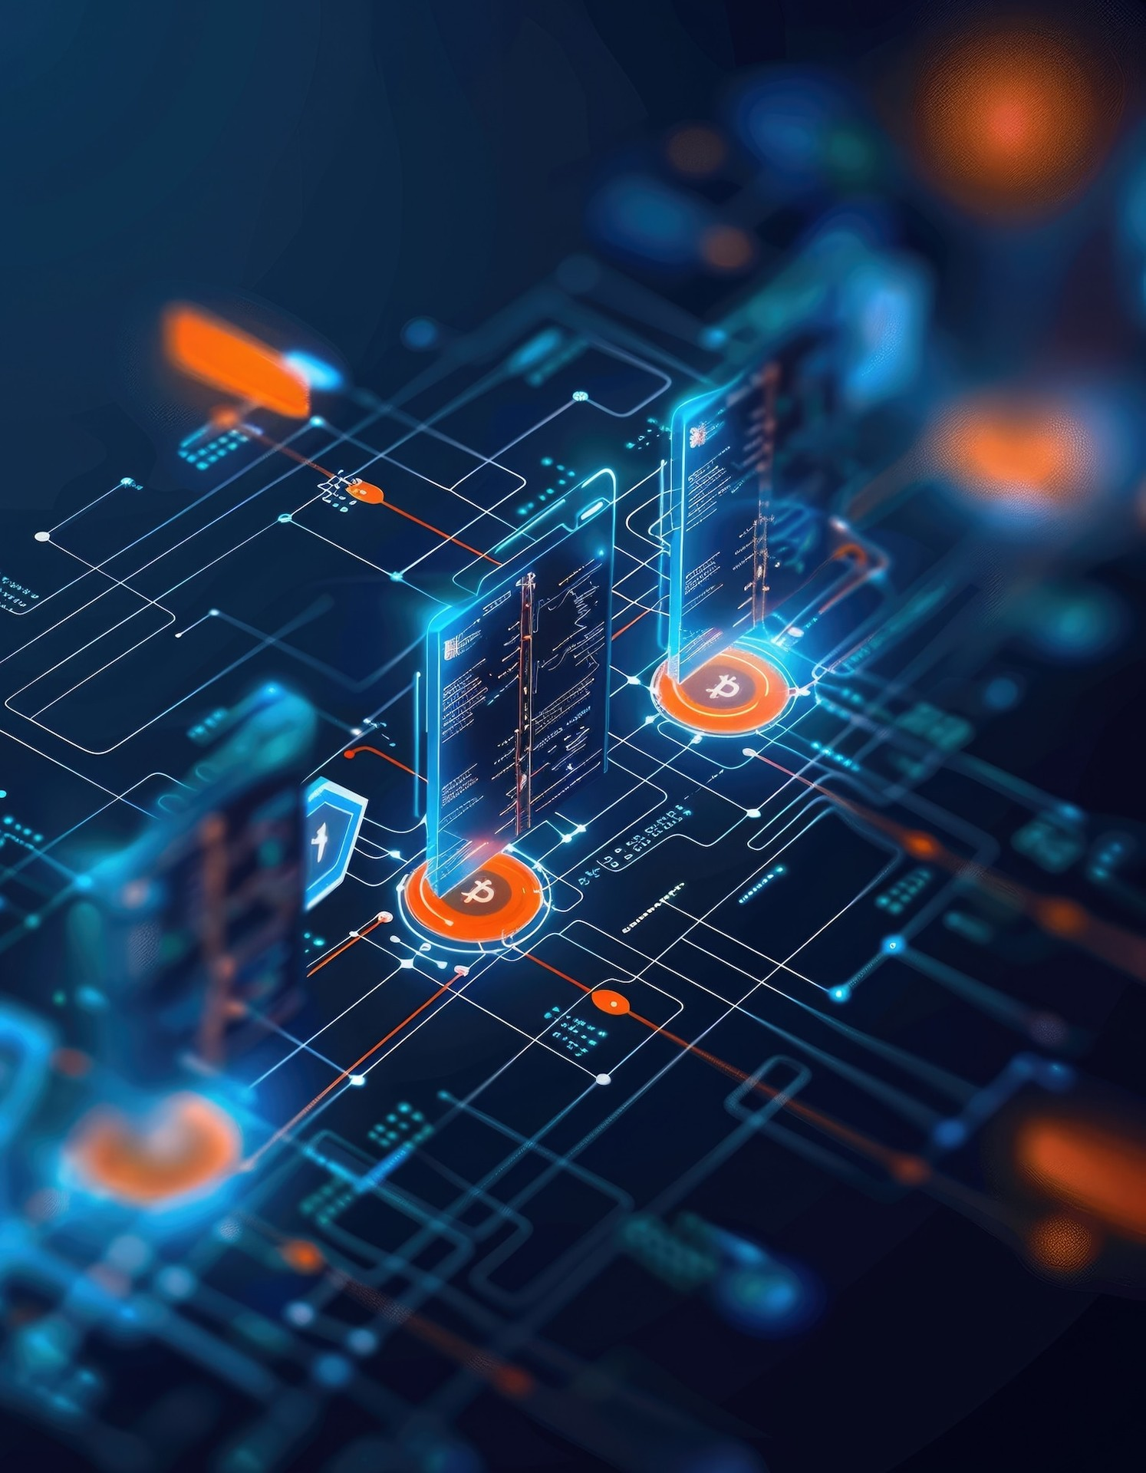
Real-Time Data Processing
Introducing a cloud-based IoT platform that revolutionizes real-time data processing, enabling businesses to harness the power of connected devices and make data-driven decisions faster.

Slide 3
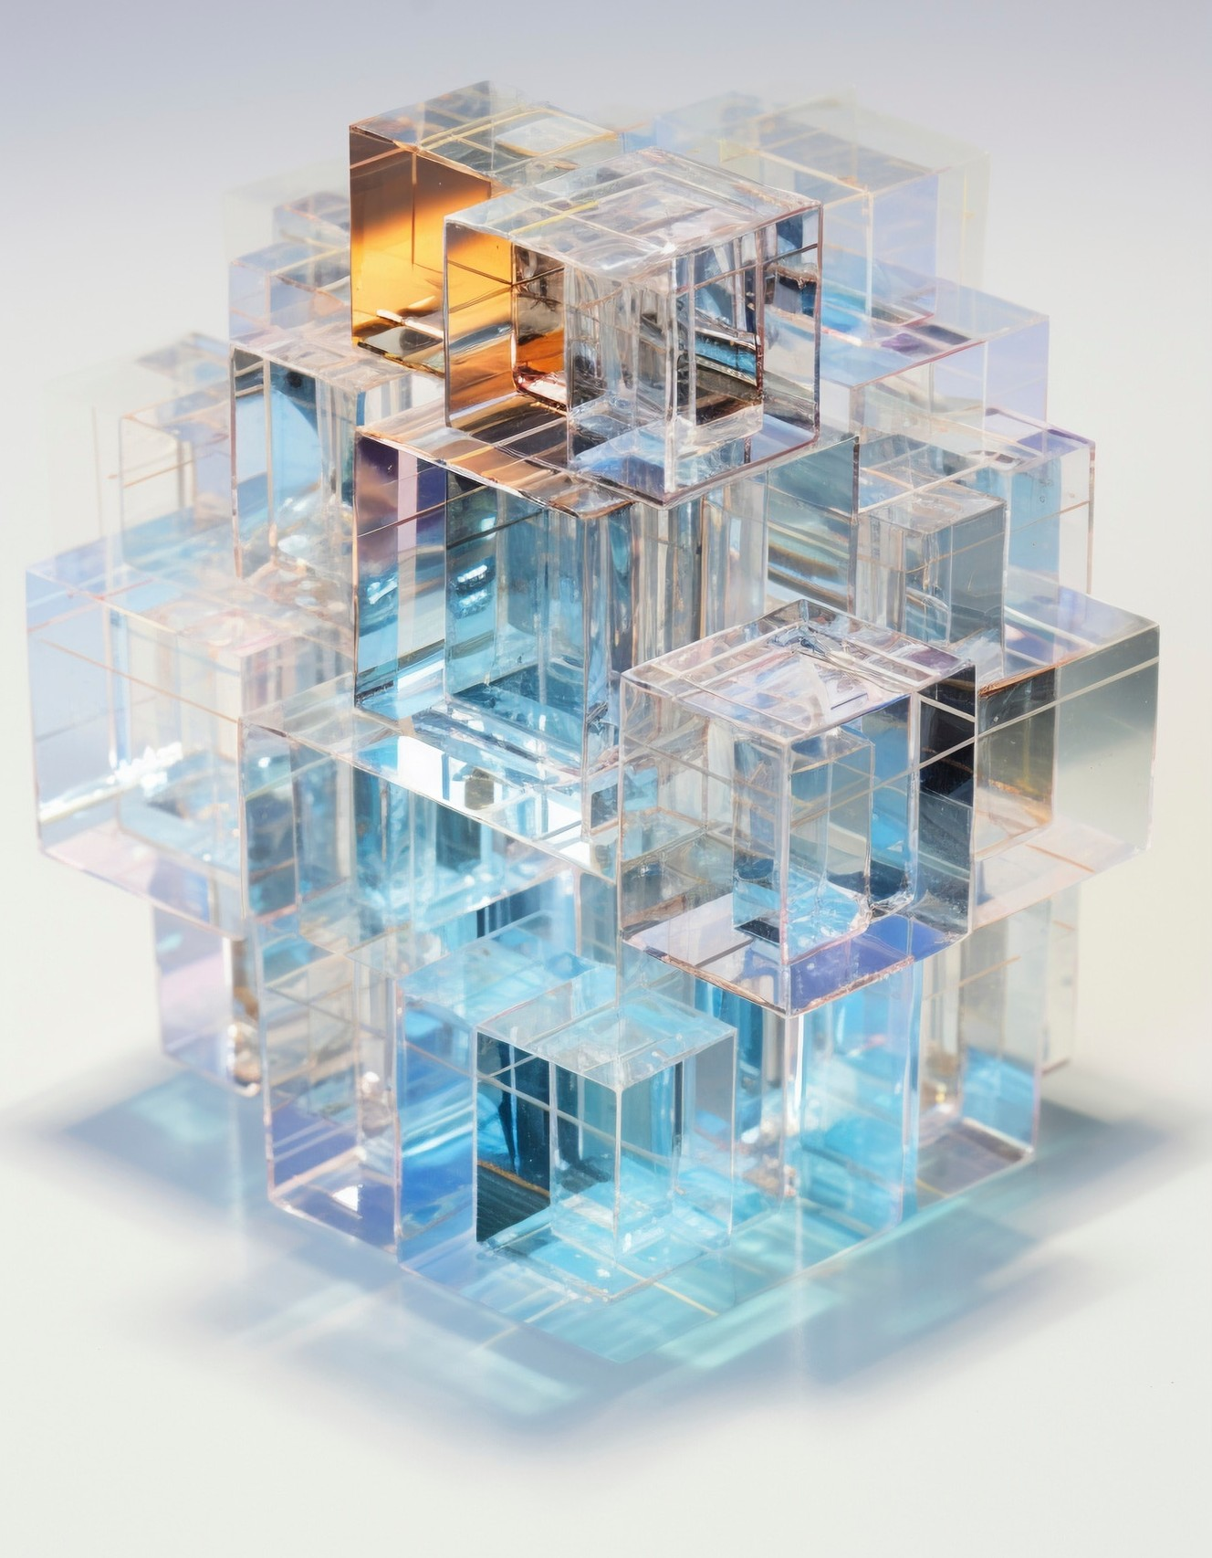
Scalable and Flexible Architecture
The platform's scalable and ﬂexible architecture allows for seamless integration with a wide range of IoT devices, ensuring that your business can adapt to changing needs and scale as your operations grow.

Slide 4
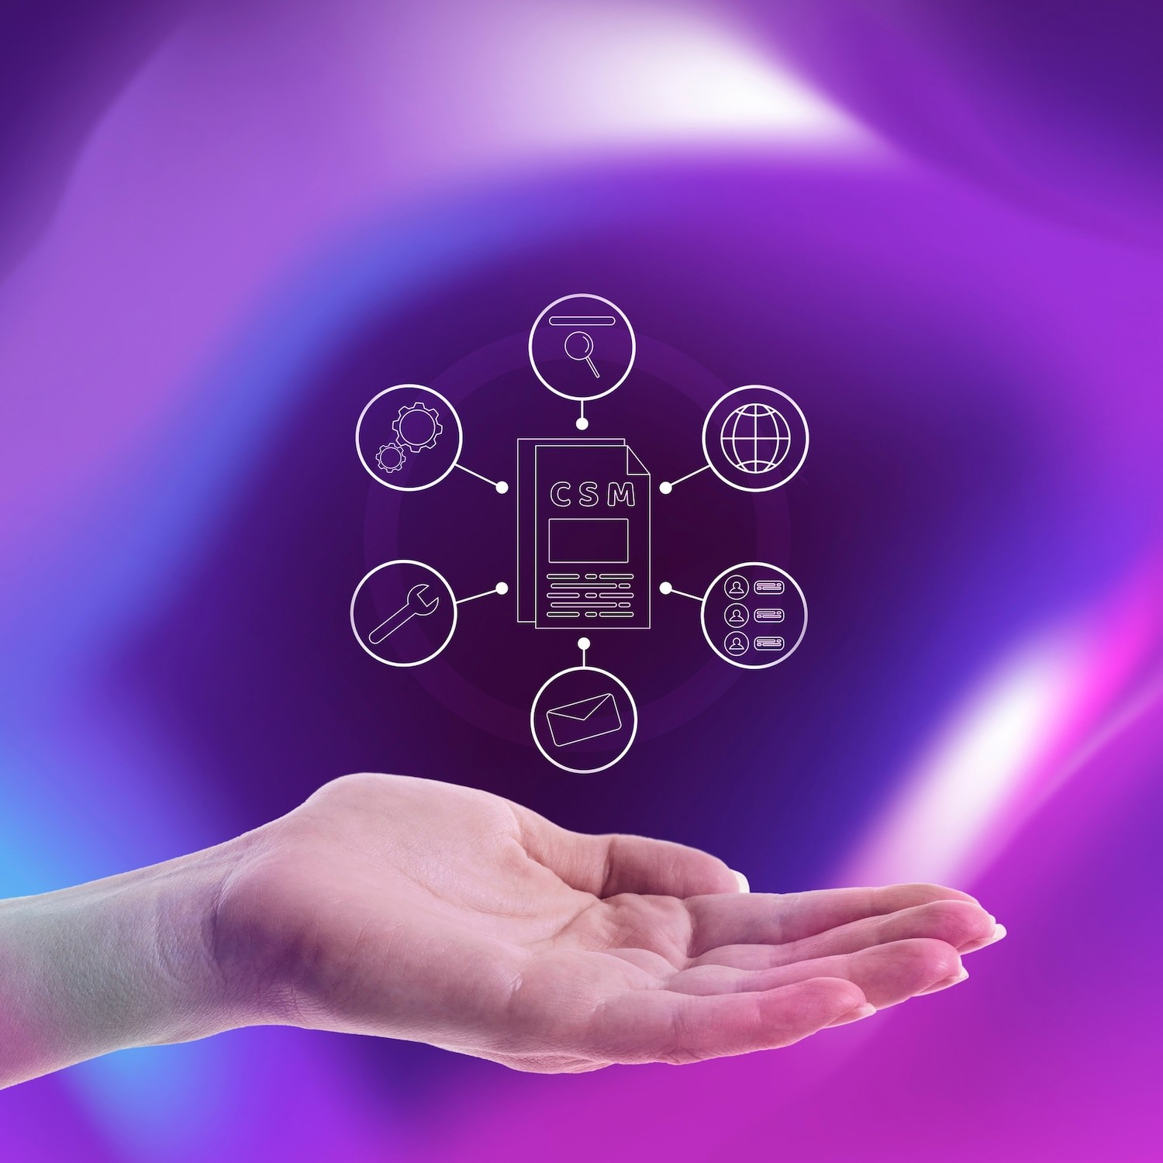
Streamlined Data Ingestion and Management
Effortlessly ingest and manage data from multiple IoT devices with the platform's robust data ingestion and processing capabilities, ensuring real-time insights and decision-making.

Slide 5

Cloud-Based IoT Platform for Real-Time Data Processing
Leverage the platform's advanced analytics and intuitive visualization tools to uncover valuable insights, identify trends, and make informed business decisions based on your IoT data.

Slide 6
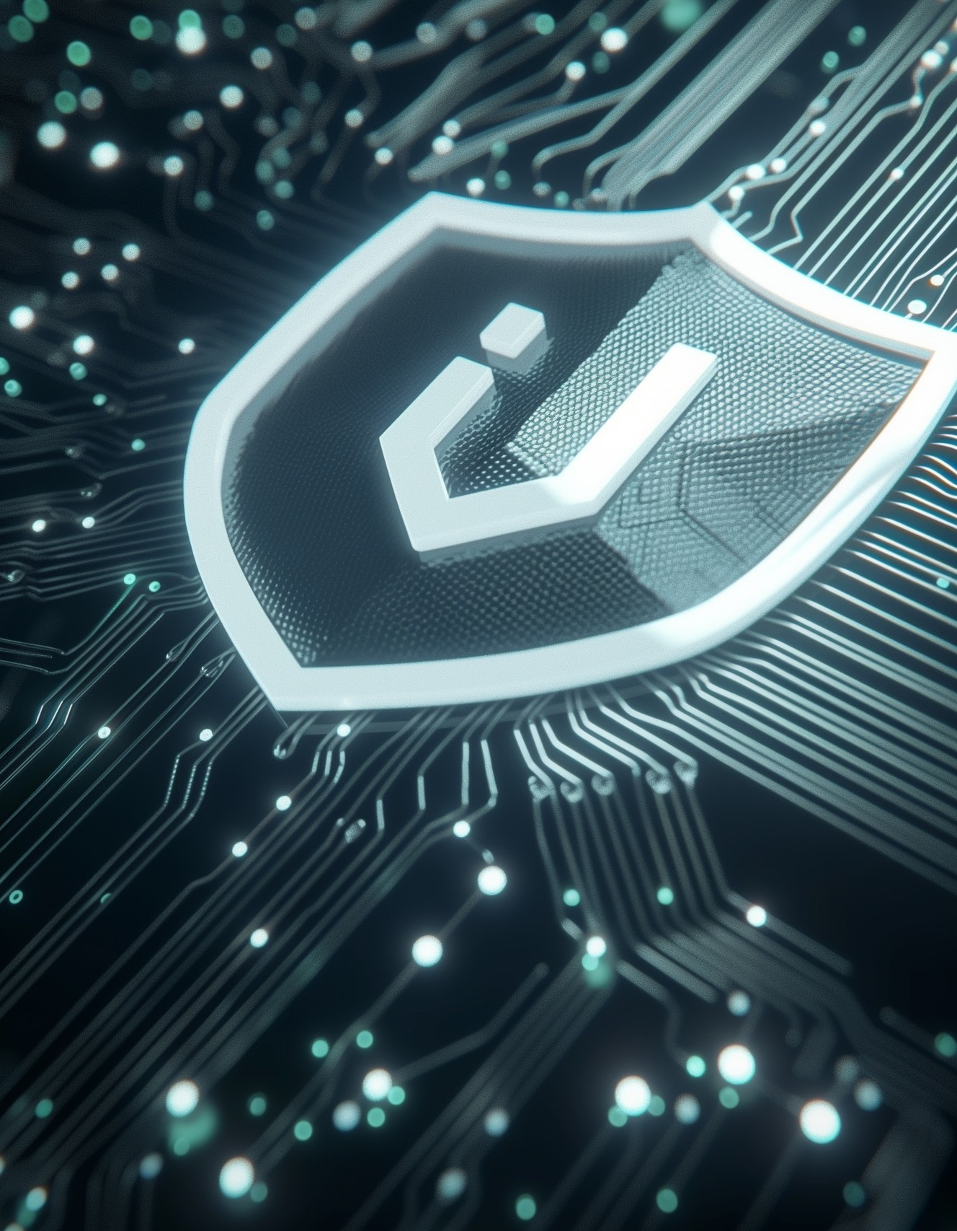
Secure and Reliable IoT Connectivity
Ensure the security and reliability of your IoT network with the platform's robust security features and fault-tolerant infrastructure, protecting your data and ensuring business continuity.

Slide 7
Seamless Integration and Interoperability
The platform's seamless integration capabilities allow you to connect and interact with a wide range of IoT devices and third-party systems, enabling a comprehensive and interconnected IoT ecosystem.

Slide 8
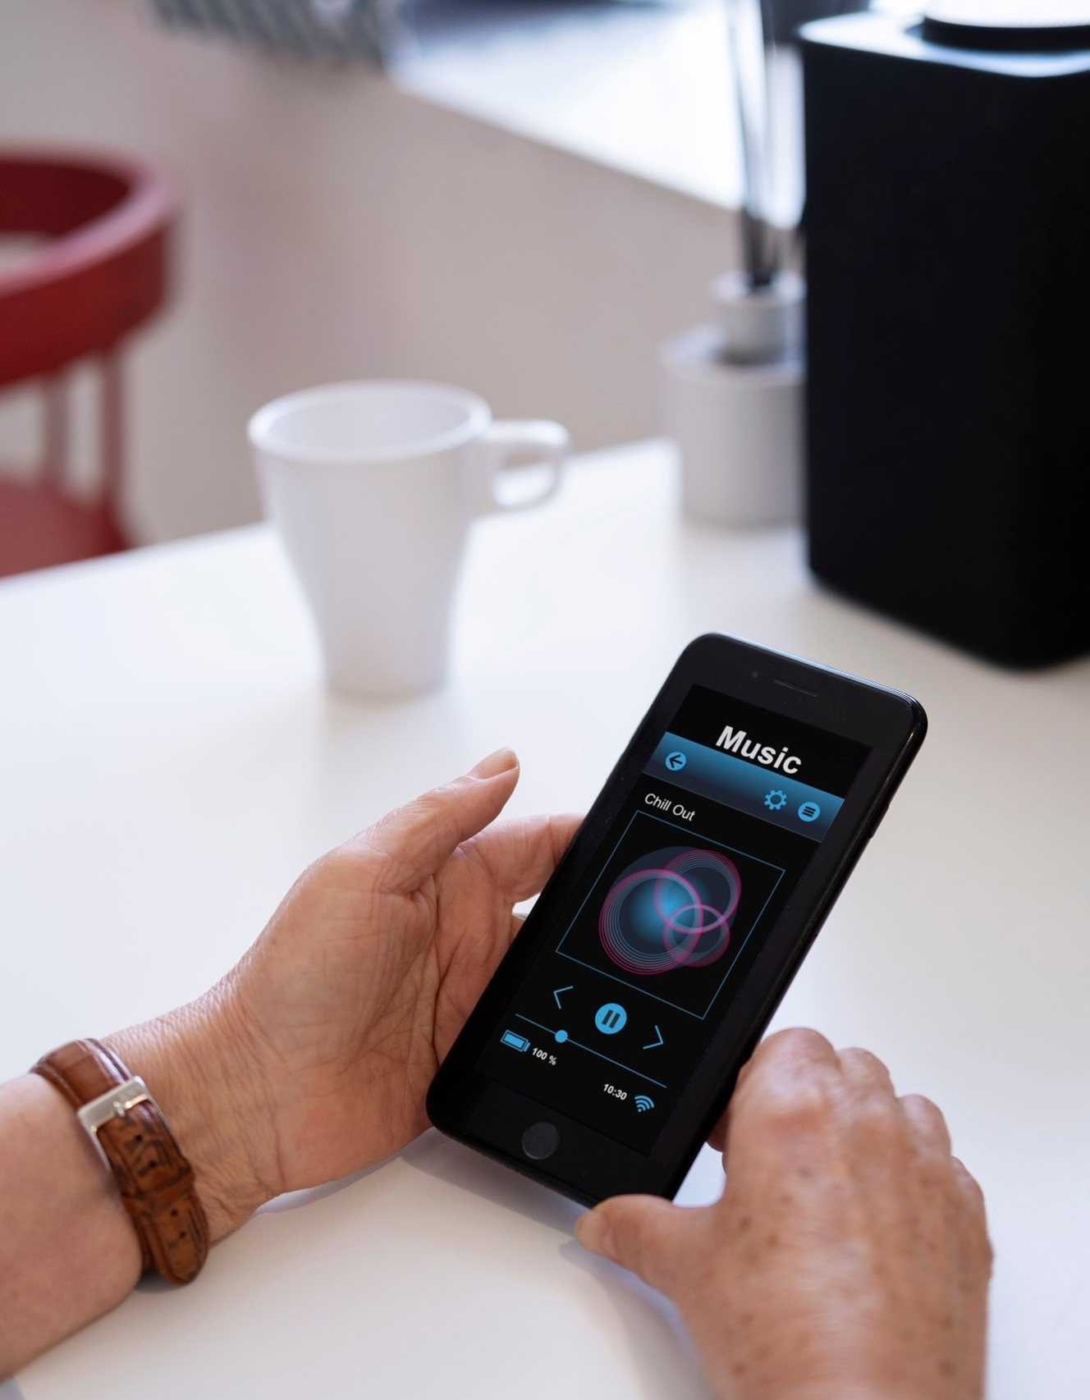
Automated Device Management and Monitoring
Streamline your IoT operations with the platform's automated device management and monitoring features, reducing the complexity of managing your connected devices and ensuring optimal performance.

Slide 9

Predictive Maintenance and Remote Diagnostics
Leverage the platform's predictive maintenance and remote diagnostics capabilities to proactively identify and address potential issues, minimizing downtime and ensuring the optimal performance of your IoT infrastructure.

Slide 10
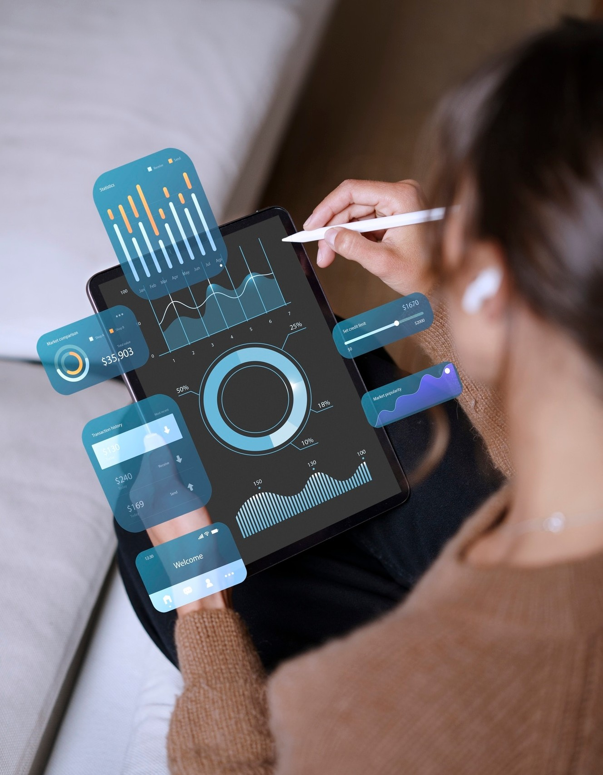

Customizable and Extensible Platform
The platform's customizable and extensible nature allows you to tailor it to your speciﬁc business requirements, ensuring that your IoT solution aligns with your unique needs and goals.

Slide 11
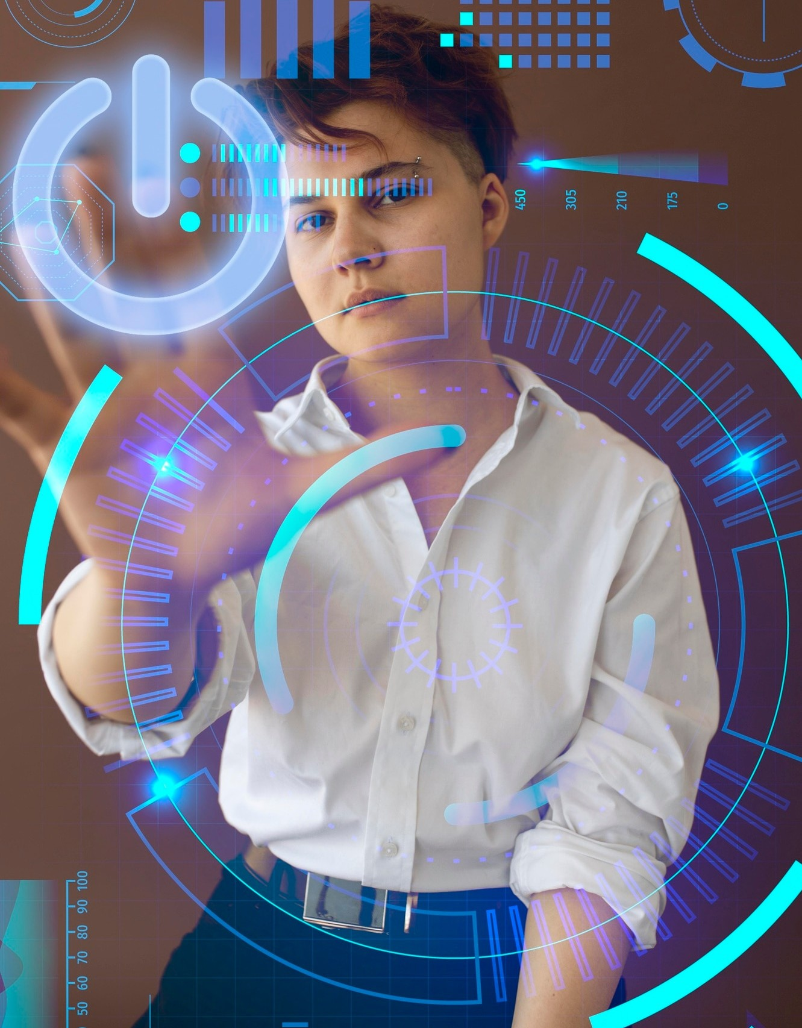



Empowering Your IoT-Driven Future
By leveraging this cloud-based IoT platform, you can transform your business operations, unlock new opportunities, and stay ahead of the curve in the rapidly evolving IoT landscape.

Slide 12
Thank you

