Slide 1


PROGRAMMING ASSIGNMENT 4
CSE 350 NETWORK SECURITY WINTER 2024
Rahul Kumar (2020110)
Mohd Shakir (2020524)
PROJECT 1: DIGITALLY SIGNED DEGREE CERTIFICATES

Slide 2

INTRODUCTION
We made a web server using Flask that necessitates individuals to input their full name, enrollment ID, birthdate, and password. Upon enrollment in our database, users will obtain a grade card and a degree certificate, which bear the signatures of the Director and Registrar and be authenticated using public keys on the backend. Subsequent to a successful verification process, users can retrieve both documents.

Slide 3

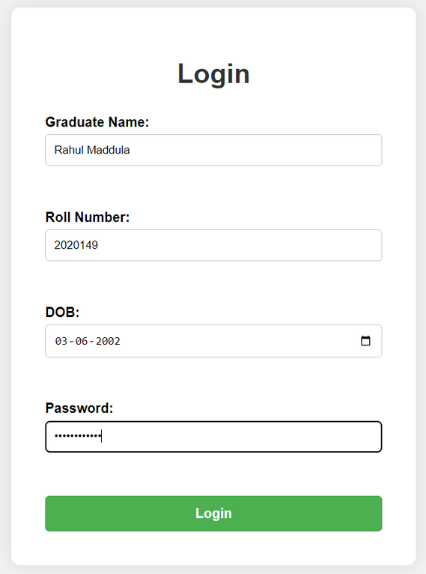
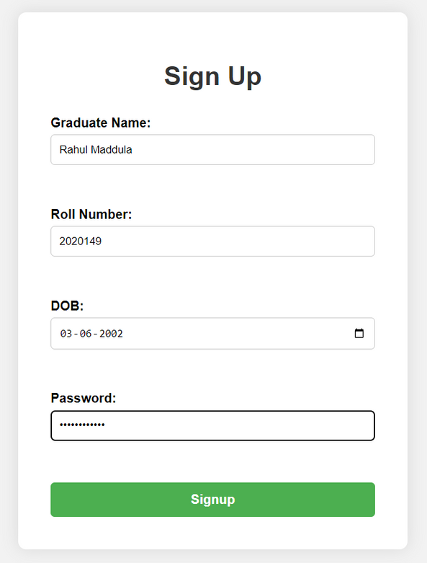
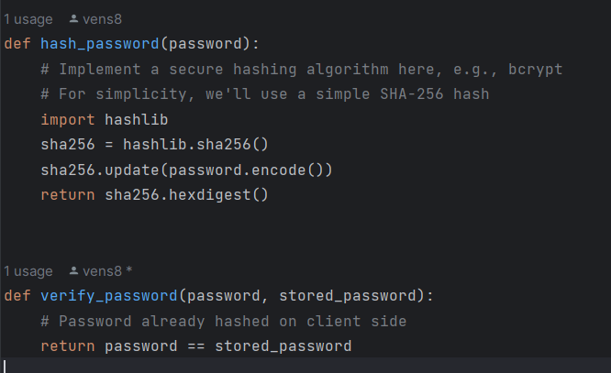

Slide 4

WORKING FLOW
The generation of the documents is being performed in the following manner :-
Creation of the PDF with the premade template
Defining the location of the text fields on the PDF
Adding of info and time on it
Hashing the pdf using SHA256() hash library
Signing the hashed pdf with the private keys of the respective authorities.
Adding a watermark to it to track the origin of the document.

Slide 5
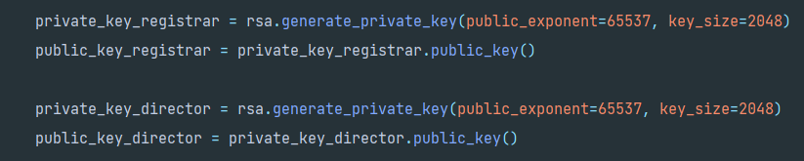
GENERATION OF PRIVATE-PUBLIC KEYS
We have used the RSA library to generate the public and private key pair for registrar and the director.

Slide 6
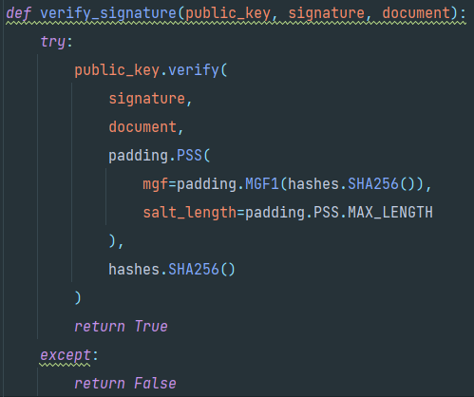
VERIFICATION OF THE DOCUMENTS
This method is used to verify the provided signature against the document using specified padding and hashing algorithm. It returns true if the signature verification succeeds else returns False.

Slide 7
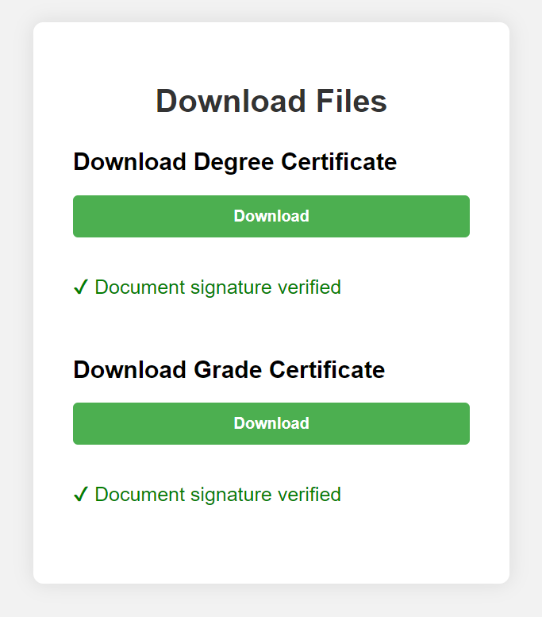
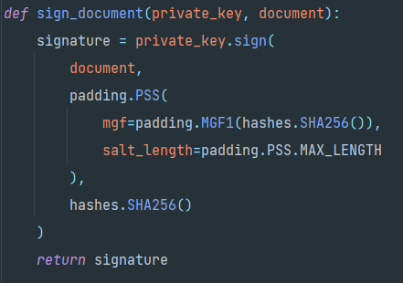
BONUS PART - DIGITAL SIGNING OF DOCUMENT
For signing the documents, we have used padding with the MGF1 masking and SHA256() hash function. This code block is digitally signing the certificate using the provided private_key.

Slide 8
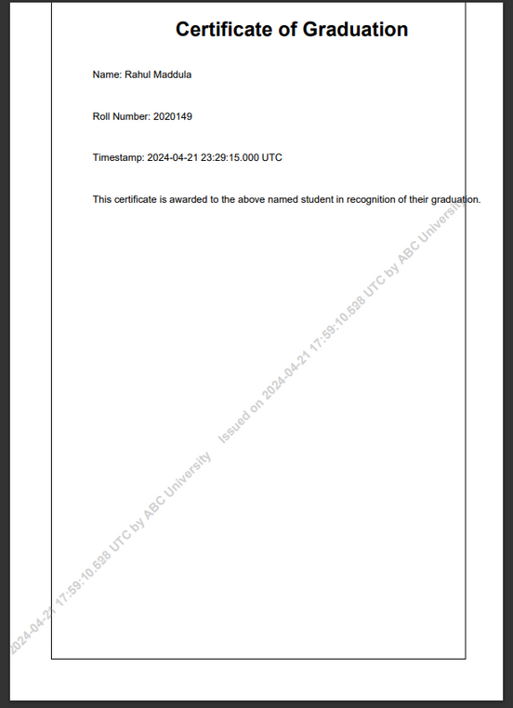
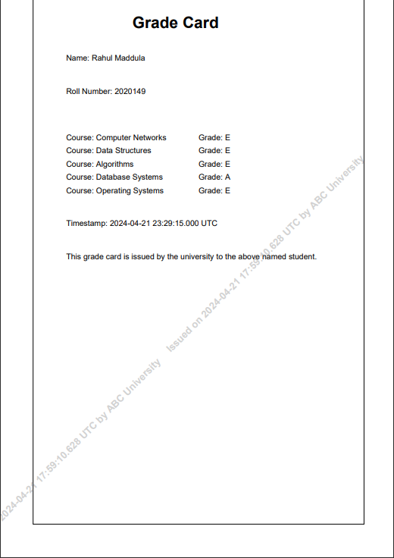
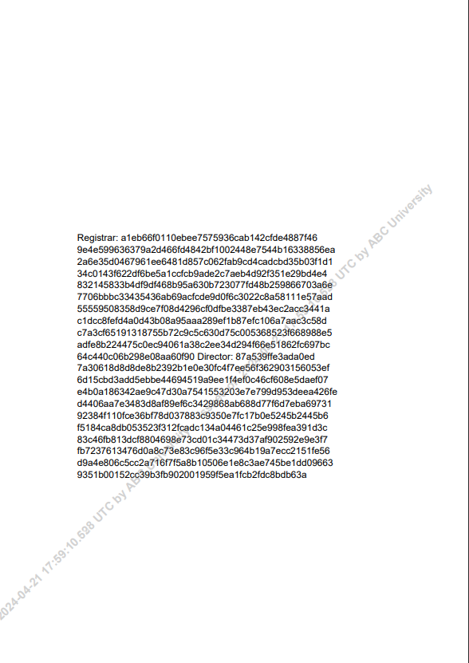
OUTPUT
Graduation
Certificate
Grade Card
Signature

