Slide 1
Compiler Error Explainer using Pattern-Based Analysis and Adaptive Confidence Scoring
Team_No: 20
Project Advisor:
Ms. Neera Chaudhary
Ms. Kavitha C.R.
S.No | Reg.No | Name of the Student | Section
1 | BL.EN.U4CSE23102 | Rahul Reddy | CSE B
2 | BL.EN.U4CSE23107 | Akshay Thammana | CSE B
3 | BL.EN.U4CSE23161 | Santosh Kumar | CSE B

Slide 2
Problem Definition
Compiler outputs from tools like GCC or javac are often cryptic and hard for beginners to understand. Messages such as “expected ‘;’ before ‘return’ token” lack context and assume prior knowledge, making students spend more time decoding errors than fixing them. This creates a learning barrier in C, Java, and Compiler Design, as errors typically only show file, line, and column without explaining the cause, violated concept, or solution.
Motivation: Build a post-processor that intercepts GCC/javac output, applies compiler-theory-based pattern matching, and returns human-readable explanations.

Slide 3
Literature Survey
S.No | Author’s Name | Full title of the paper with year | Inference from the paper (based on methodology, technology) | Open problem (for your proposed work)
1 | Michael Pradel, Koushik Sen | DeepBugs: A Learning Approach to Name-Based Bug Detection (2018) | Uses machine learning to detect bugs in code by learning patterns from large datasets. Demonstrates that automated systems can understand and detect programming errors. | Focuses on bug detection, not on explaining compiler errors or generating user-friendly explanations for beginners.
2 | GCC Team (FSF) | GCC Internals Diagnostic Format (2024) | Defines structured error format: file:line:col:severity:message. Enables parsing of compiler output like a lexer. | Provides raw errors but lacks explanation of cause and fix for users.

Slide 4
Literature Survey
S.No | Author’s Name | Full title of the paper with year | Inference from the paper (based on methodology, technology) | Open problem (for your proposed work)
3 | Andrew Taylor et al. | Dcc --help: Generating Context-Aware Compiler Error Explanations with LLMs (2023) | Uses LLMs to generate beginner-friendly explanations for compiler errors using context like code, error message, and location. Achieves high accuracy (~90%) in explanations. | Relies heavily on LLMs and may generate incorrect or inconsistent explanations. Does not use structured pattern-based approach or confidence scoring.
4 | LLVM Project | Clang Diagnostics Design (2023) | Emphasizes better diagnostics with context, hints, and suggestions. Introduces idea of improving developer experience. | Advanced diagnostics exist but are not beginner-friendly or adaptive.

Slide 5
Literature Survey
S.No | Author’s Name | Full title of the paper with year | Inference from the paper (based on methodology, technology) | Open problem (for your proposed work)
5 | Brett A. Becker et al. | Compiler Error Messages Considered Unhelpful (2019) | Studies which compiler error messages are most helpful for students and how clarity impacts debugging and learning. Highlights importance of understandable error messages.. | Focuses on analysis of usefulness, not on building a system to automatically translate or improve error messages.

Slide 6
Software/Tools Requirements
Frontend: HTML and CSS for a responsive UI, along with JavaScript to handle AJAX calls to the endpoint. A code editor text area with a monospace font, a language selector (C/Java toggle), and colour-coded output display (green for success, red for errors).
Backend: Flask 2.x for building a REST API with a endpoint. Ability to receive JSON input, write temporary source files, execute compiler scripts, and return JSON output.

Slide 7
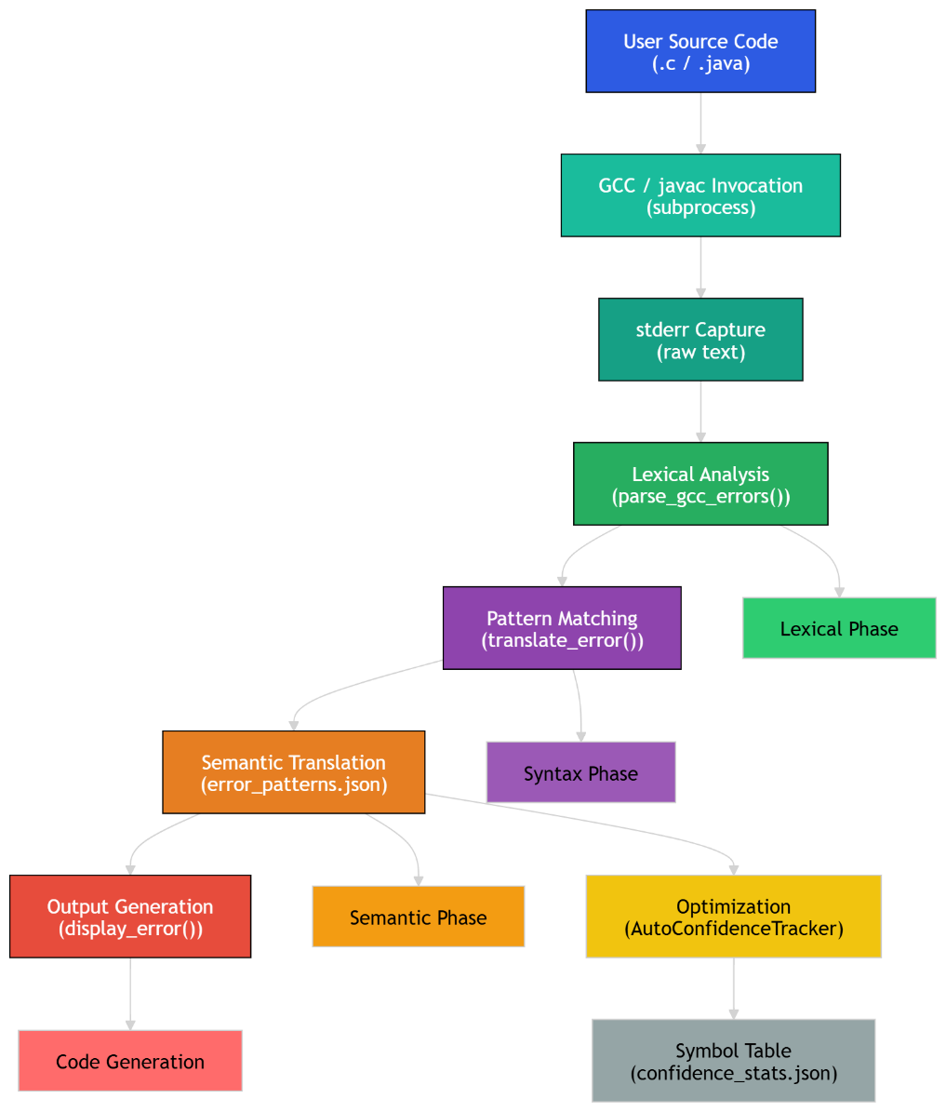
Architecture
Notes:
int a = 5; int b = 3; if (a > b) { result = a + b; // ← this always runs } else { result = a - b; // ← this can NEVER run }

Slide 8
Implementation
Compiler-Inspired Pipeline
Built a post-processing compiler pipeline that translates raw GCC/javac errors into human-readable explanations.
Core Stages
1. Frontend Processing
Lexer Captures raw compiler stderr output using subprocess
Uses regex-based parsing (parse_gcc_errors(), parse_javac_errors())
Converts error text into structured tokens: {file, line, column, severity, message}
3. Pattern Matching & Parsing
Regex-Based Syntax Analysis
Matches error messages using 60+ predefined regex patterns
Each pattern acts like a grammar rule
Extracts meaningful components using capture groups
2. Intermediate Representation
Structured Error Representation
Converts raw error text → structured JSON-like records
Acts as an intermediate representation similar to compiler IR
Standardizes error format for further processing

Slide 9
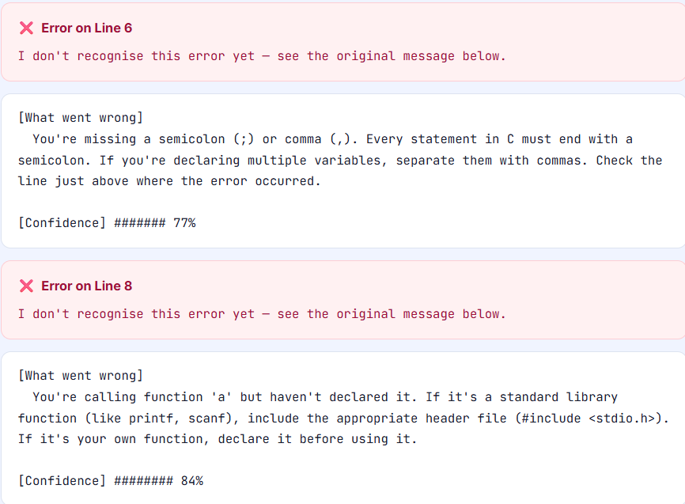
Implementation
Core Stages
4. Semantic Analysis
Error Classification & Explanation
Classifies errors into categories:
syntax_error
type_error
undeclared_identifier
function_call_error
Maps matched patterns to human-readable explanations
Uses template substitution (str.format) to generate final message
5. Output Generation
User-Friendly Error Display
Formats final output with:
Line & column info
Clear explanation
Suggested fix guidance
Confidence score
Output available via:
CLI tool
Flask web interface

Slide 10
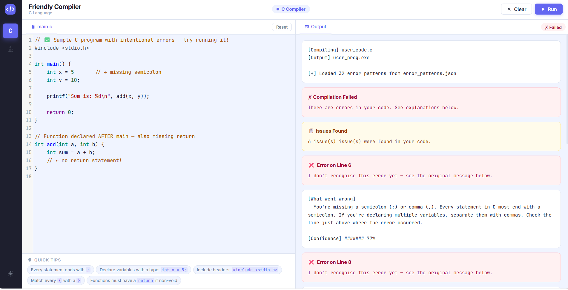
Testing

Slide 11
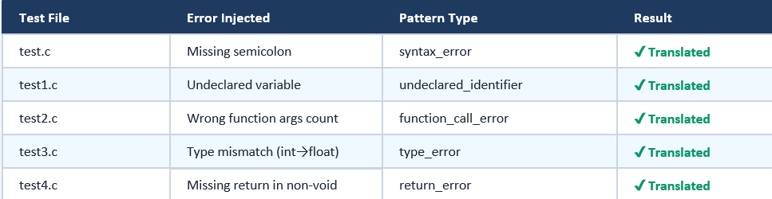
Testing

Slide 12
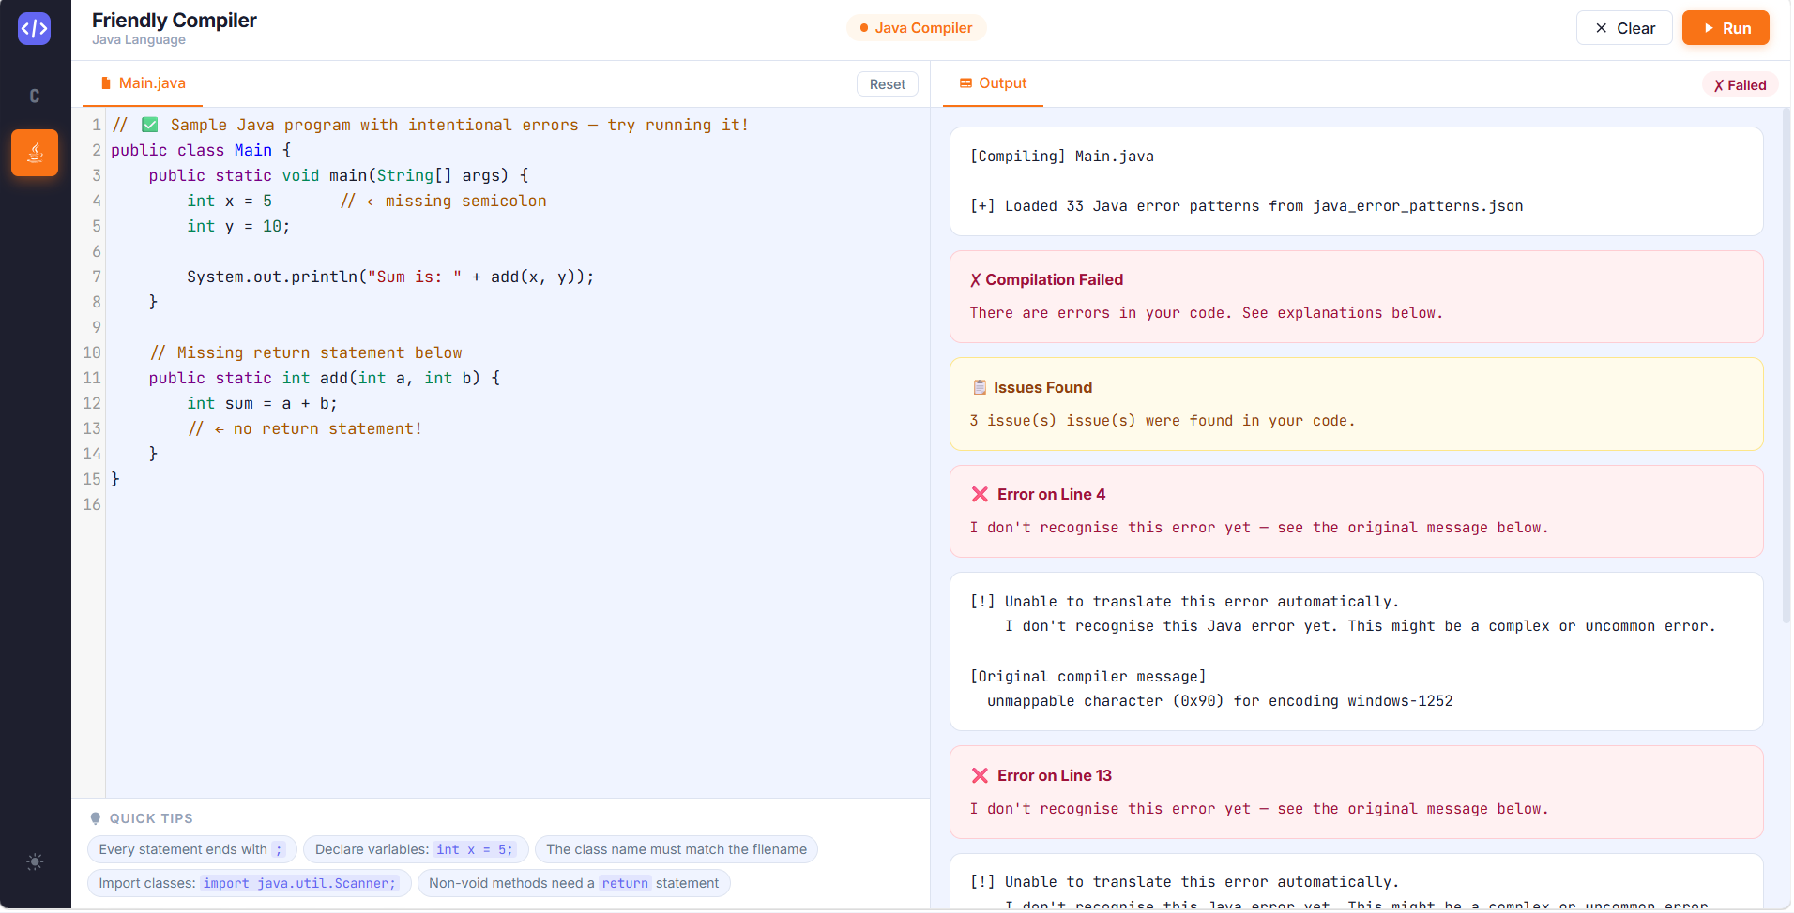
Testing

Slide 13
Timeline
Literature Survey
Design [Front End, Back End]
Implementation
Testing
Document Submission
<25th March 2026>
<5th April,2026>
<16th April,2026>
<25th April>
< by 9th may >
Abstract Submission
15th March 2026>

Slide 14
Conclusion
Developed a compiler-inspired post-processing system that converts
cryptic GCC/javac errors into user-friendly explanations
Successfully transforms source code into:
Structured error tokens (lexer stage)
Pattern-matched representations (parser stage)
Human-readable explanations (semantic stage)
Applies data flow analysis techniques:
Lexical Analysis → parsing stderr into tokens
Syntax Analysis → regex-based pattern matching
Semantic Analysis → error classification & explanation
Optimization → adaptive confidence scoring
Accurately identifies:
100% translation rate for C errors
~97% accuracy for Java errors
Provides:
CLI-based tool for direct usage

Slide 15
Future Enhancements
LLM Integration Use AI (OpenAI/Anthropic) to explain unknown errors and expand coverage automatically
Self-Learning System Automatically generate and update regex patterns from new errors → adaptive system
IDE Integration VS Code extension for real-time friendly error explanations and highlights
Multi-Language Support Extend beyond C & Java → Python, Rust, Clang diagnostics
Fix Suggestions Provide automatic corrected code snippets along with explanations
Analytics Dashboard Track common errors across users to help students and instructors

Slide 16
Contribution of the Team Members
S.No | Reg.No | Name of the Student | Contribution
1 | BL.EN.U4CSE23102 | Rahul Reddy | Lexer, pattern engine, Flask API, Java support, Frontend ui
2 | BL.EN.U4CSE23107 | Akshay Thammana | Literature survey, architecture design, pattern research, Confidence system
3 | BL.EN.U4CSE23161 | Santosh Kumar | Test suite, results analysis, documentation,

Slide 17
References
1}Altalhi, Saeed Musaad, et al. "Error Classification and Static Detection Methods in Tri-Programming Models: MPI, OpenMP, and CUDA." Computers 14.5 (2025): 164.
2}Taylor, Andrew, et al. "dcc--help: Transforming the Role of the Compiler by Generating Context-Aware Error Explanations with Large Language Models." Proceedings of the 55th ACM Technical Symposium on Computer Science Education V. 1. 2024.
3}Kimmel, Bailey, et al. "Enhancing programming error messages in real time with generative AI." Extended Abstracts of the CHI Conference on Human Factors in Computing Systems. 2024.
4}Charles, T., Gwilliam, C. The Effect of Automated Error Message Feedback on Undergraduate Physics Students Learning Python: Reducing Anxiety and Building Confidence. Journal for STEM Educ Res 6, 326–357 (2023).
5}Malik, Shafaque Saira, et al. "Programmer Assisted Tool Impact on Static Error Handling Capability of Novices in Imperative First Programming Languages." LC International Journal of STEM (ISSN: 2708-7123) 1.4 (2020): 90-102.

Slide 18
References
6}Becker, Brett A., et al. "Compiler error messages considered unhelpful: The landscape of text-based programming error message research." Proceedings of the working group reports on innovation and technology in computer science education (2019): 177-210.
7}Pettit, Raymond S., John Homer, and Roger Gee. "Do Enhanced Compiler Error Messages Help Students? Results Inconclusive." Proceedings of the 2017 ACM SIGCSE Technical Symposium on Computer Science Education. 2017.
8}Prather, James, et al. "On novices' interaction with compiler error messages: A human factors approach." Proceedings of the 2017 ACM Conference on International Computing Education Research. 2017.
9}Becker, Brett A. "An effective approach to enhancing compiler error messages." Proceedings of the 47th ACM Technical Symposium on Computing Science Education. 2016.
10}Traver, V. Javier. "On compiler error messages: what they say and what they mean." Advances in Human‐Computer Interaction 2010.1 (2010): 602570.

Slide 19
THANK YOU

