Slide 1

Relationship of Different Biochemical and Clinical Markers with Liver Cirrhosis Stages
Rahul Somabhai Chaudhary(11750265)
INFO 5709: Data Visualization and Communication
Prof: Gahangir Hossain

Slide 2
Introduction
Liver Cirrhosis is a chronic, progressive disease spread across the liver, making it failure to work properly over prolonged period of time.
In this project, I will focus on the relationship between different components such as age, stages, ascites, hepatomegaly etc.
By focusing on these attributes, we can focus on checking the validation of different hypothesis.

Slide 3
Dataset
Dataset contains the information of 25,000 individuals.
The size of the dataset is 25,000 rows and 19 columns.
Dataset has been obtained from Kaggle: Liver Cirrhosis Stage Classification
Dataset contains 19 Different attributes, each is explained below:

Slide 4
Sex: Gender of the patients (Male/Female)
Age: Age of the patient in years
Ascites: It is condition of too much fluid in the abdomen. Here it represents the presence of Ascites or not (Y/N)
Hepatomegaly: Condition of enlarged liver, here it is represented by yes or no(Y/N)
Spiders: Presence of spider angiomas(Y/N)
Edema: It occurs when the fluid accumulates in the leg[1]. presence of edema N (no edema and no diuretic therapy for edema), S (edema present without diuretics, or edema resolved by diuretics), or Y (edema despite diuretic therapy)[2]
Stages: histologic stage of disease ( 1, 2, or 3 )[2]
Status: status of the patient C (censored), CL (censored due to liver tx), or D (death)[2]
Drug: Type of drug used for treatment(D-penicillamine or placebo)
N_Days: Number of days between registration and the earlier of death, transplantation, or study analysis time in 1986[2]
Bilirubin: Serum bilirubin in[mg/dl]
Cholesterol: Blood cholesterol level of patient in [mg/dl]
Albumin: Albumin level in [gm/dl]
Copper: Urine copper level in [ug/day]
Alk_Phos: Alkaline phosphate level in [U/liter]
SGOT: Aspartate aminotransferase [U/ml]
Triglicerides: Triglycerides in [mg/dl]
Platelets: Platelets count per cubic [ml/1000]
Prothrombin: Prothrombin time in seconds

Slide 5
Data Cleaning and Exploratory Data Analyses

Slide 6
Data Cleaning
In the first part, the focus will be on data cleaning using python.
Steps followed for Data cleaning
Importing the modules.
Read the dataset
Checking for null values and if there are any null values, removing it.
Dropping the unnecessary values.

Slide 7
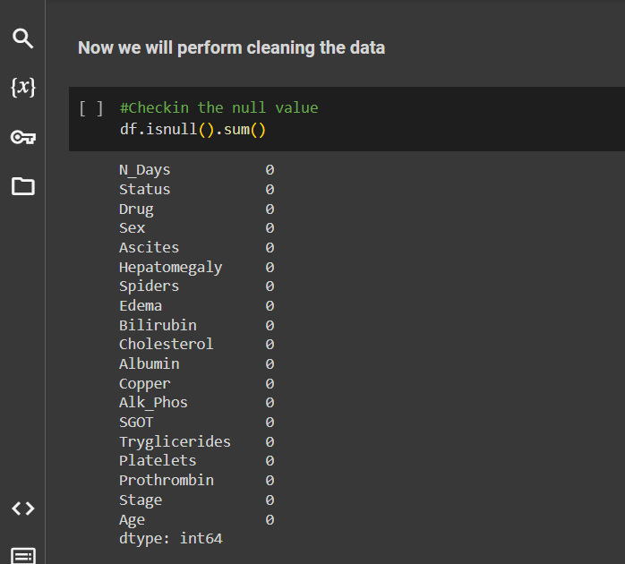
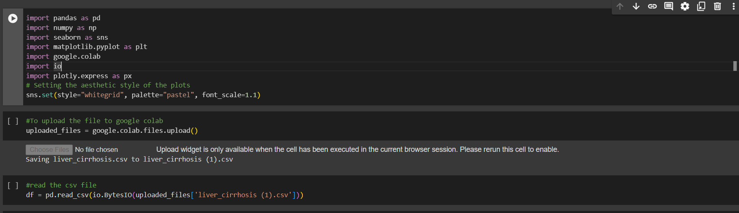
Importing the necessary modules
Checking for any null values.

Slide 8
Exploratory Data Analysis
After the cleaning stage, the next stage is Exploratory Data Analysis (EDA).
EDA will help in understanding the dataset better, it will help with getting knowledge of each column, for example, the unique values in each column.
In EDA, we can make changes in according to our requirement. For example, Age has been change from number of days to number of years.

Slide 9
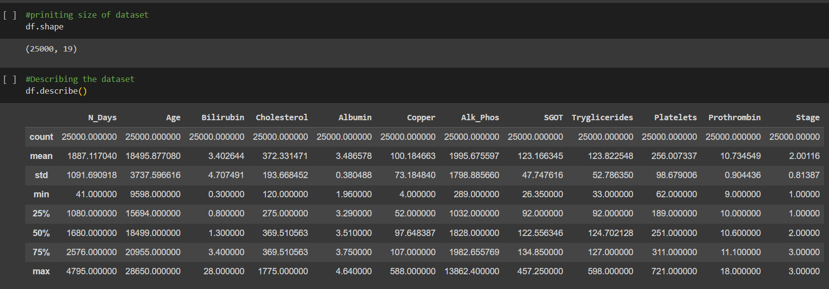
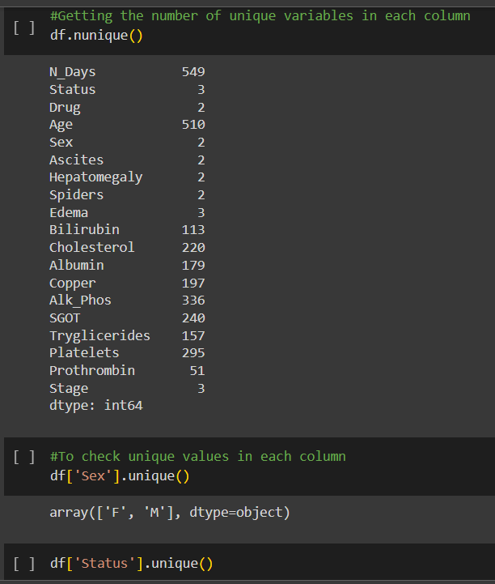
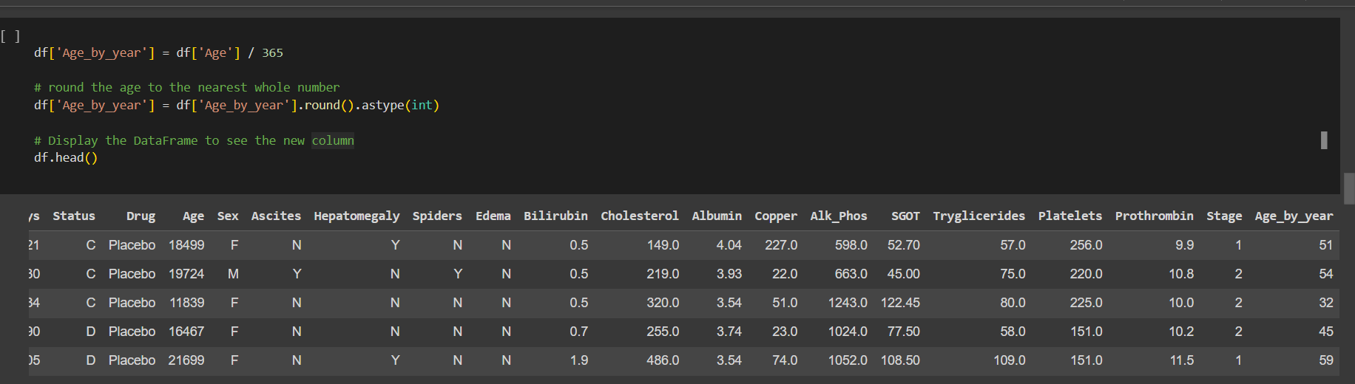
EDA to analyze the dataset
Unique values in each column
Converting age from days to year

Slide 10

Hypothesis Testing using Tableau

Slide 11
Hypothesis
A hypothesis is statement that you suggest from the given information, and it is checked whether it is valid or not.
A good hypothesis should be:
Clear and easy to understand
It should be testable.
It should be in relevance to the research topic.

Slide 12
Null hypothesis and Alternative hypothesis
Null hypothesis suggest that there are no relationship between two variables.
Null hypothesis behaves as a statement researcher needs to disprove.
Alternative hypothesis is another option for null hypothesis.
Alternate hypothesis suggest that there is relationship between two variables.

Slide 13
Hypothesis 1- Patients receiving different drugs have different survival rates.
In this hypothesis we need to prove that there exist relationship between different drugs used and survival rate.
Null Hypothesis(H0): There is no significant difference in the survival rate of different patients receiving different drugs.
To prove the null hypothesis wrong we will use three visualizations:
Box-plot
Bar chart
Scatter plot

Slide 14
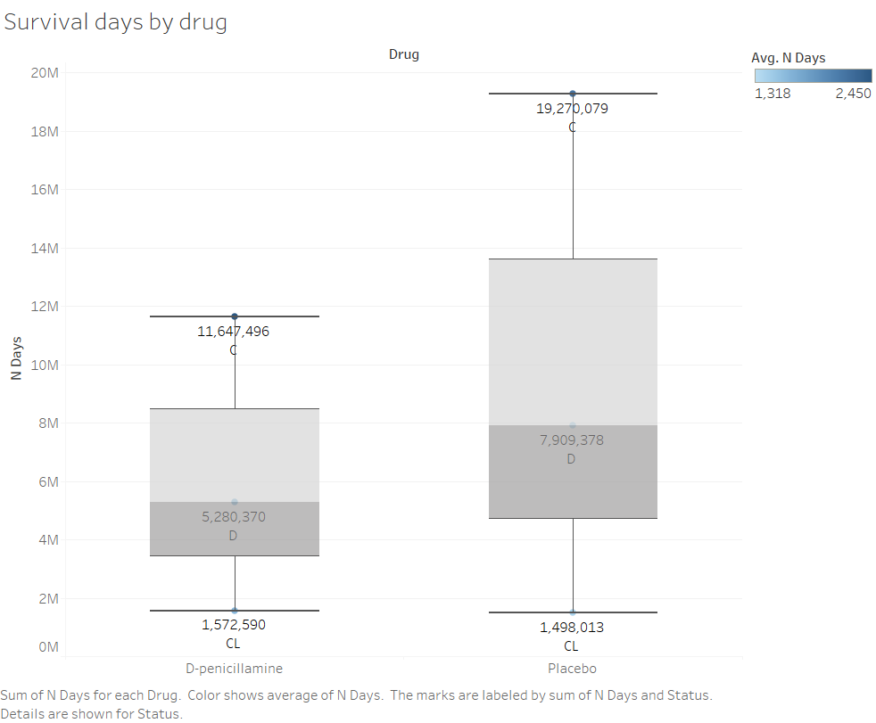
Visualization1:
Box-and-whisker plot has been used to establish the relationship between drugs and survival days.
X-axis: Type of Drug
Y-axis: Number of days
Result:
From the visualization, it can be concluded that there is significant difference in survival days of patients receiving placebo and patient receiving D-penicillamine.
Hence our null hypothesis is rejected and alternative hypothesis which is our hypothesis is valid.

Slide 15
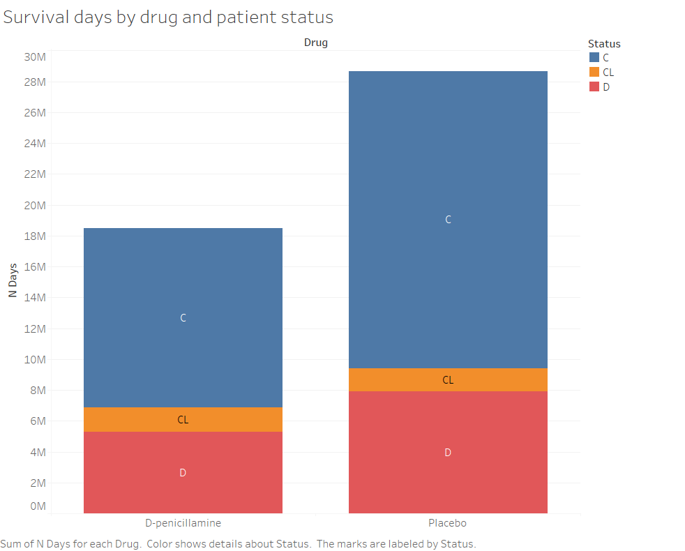
Visualization2:
Bar graph has been used to establish the relationship between drugs and survival days and the stages of liver cirrhosis is added to get the survival days for each stage.
X-axis: Type of Drug
Y-axis: Number of days
Result:
From the visualization, we can clearly conclude that there is significance difference in drug usage and survival days. It implies that our null hypothesis is invalid and actual hypothesis is valid.

Slide 16
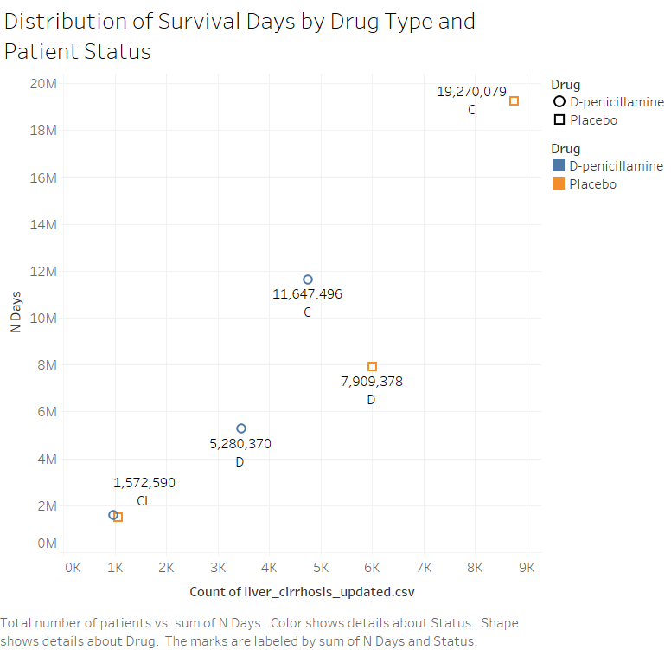
Visualization3:
Scatter plot has been used to establish the relationship between drugs and survival days and each drug is represented in different shape and color, and total number of people is used to express the relation.
X-axis: Total number of patients
Y-axis: Number of days
Result:
From the visualization, it can be observed that the difference exist between the patients receiving the placebo and patients receiving D-penicillamine, making null hypothesis invalid and actual hypothesis valid.

Slide 17
Hypothesis 2- The presence of ascites, hepatomegaly, or edema is more frequent at higher stages of liver cirrhosis.
In this hypothesis we need to prove that the ascites, hepatomegaly and edema level increases as the increase in age.
Null Hypothesis(H0): There is no significant increase in the levels of ascites, hepatomegaly and with increase in age.
To prove the null hypothesis wrong we will use three visualizations:
Heat map
Tree map
Packed bubble

Slide 18
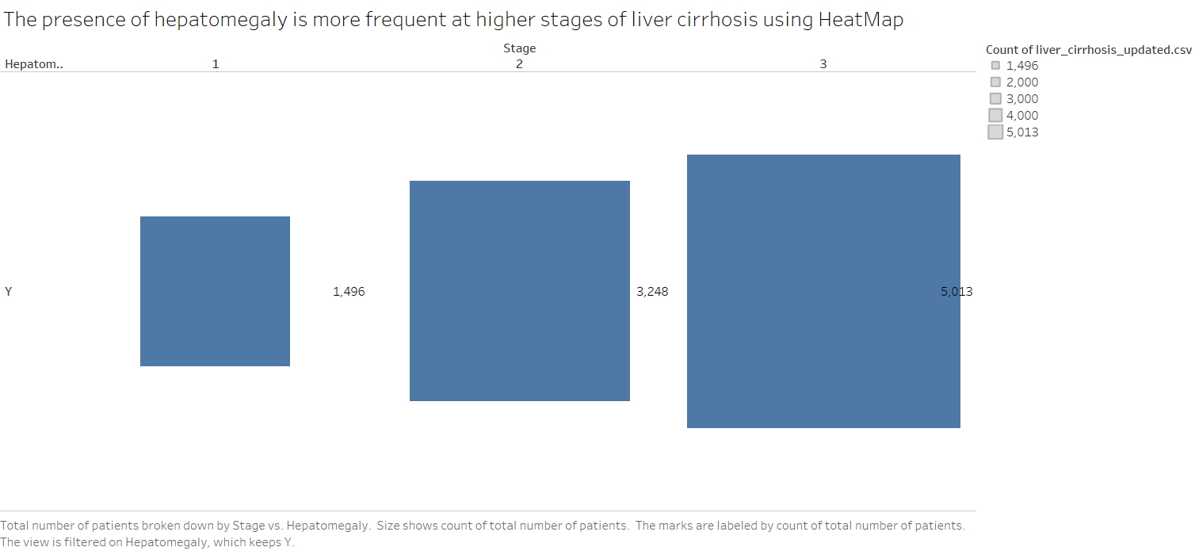
Visualization1:
Heat map has been used to establish the relationship between hepatomegaly and liver cirrhosis stages.
X-axis: Liver cirrhosis stages
Y-axis: Hepatomegaly levels
Result:
From the visualization, it can be concluded that there is significant difference in the average hepatomegaly level of different stages and the hepatomegaly levels increases as the liver cirrhosis stages increases.
Hence our null hypothesis is rejected and alternative hypothesis which is our hypothesis is valid.

Slide 19
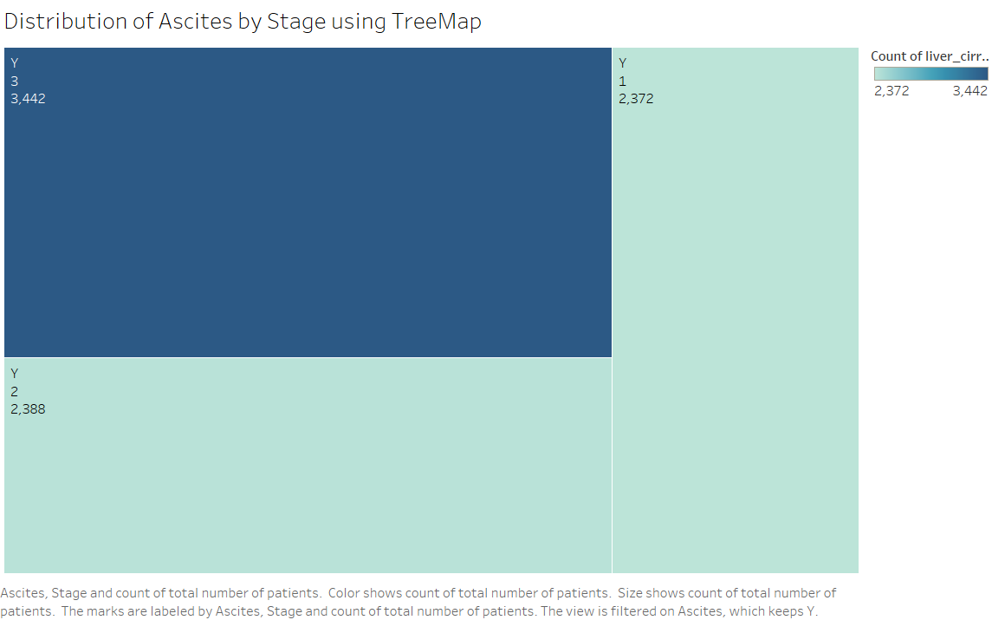
Visualization2:
Tree map has been used to establish the relationship between ascites levels and stages of liver cirrhosis.
Result:
From the visualization, we can clearly conclude that there is significance rise in ascites levels as the liver cirrhosis stages increases. It implies that our null hypothesis is invalid and actual hypothesis is valid.

Slide 20
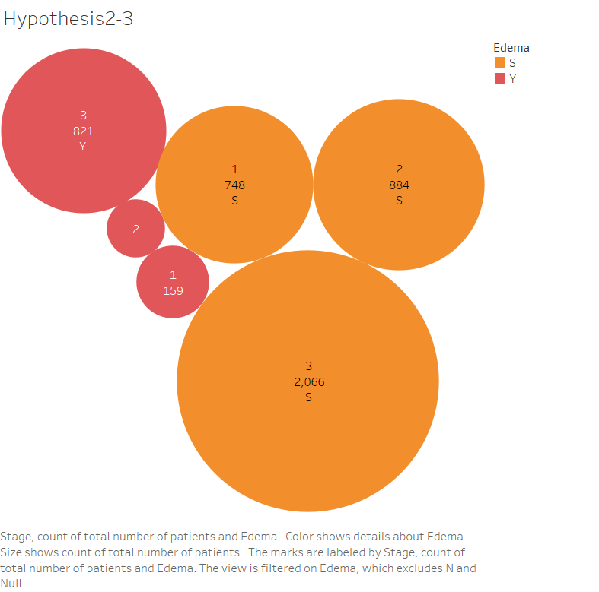
Visualization3:
Packed bubble has been used to establish the relationship between presence of edema and liver cirrhosis stages.
Result:
From the visualization, it can be observed that the edema level for all those whose S (edema present without diuretics, or edema resolved by diuretics), or Y (edema despite diuretic therapy) is observed to raise the level of stages, making null hypothesis invalid and actual hypothesis valid.

Slide 21
Hypothesis 3- Cholesterol levels are not significantly different between patients with and without edema.
In this hypothesis we need to prove that the cholesterol levels are not different of the patient having edema and patient does not have edema.
Null Hypothesis(H0): Cholesterol levels are different of the patient having edema and patient does not have edema.
To prove the null hypothesis wrong we will use three visualizations:
Scatter plot
Box-and-whisker plot
Scatter plot with jitter

Slide 22
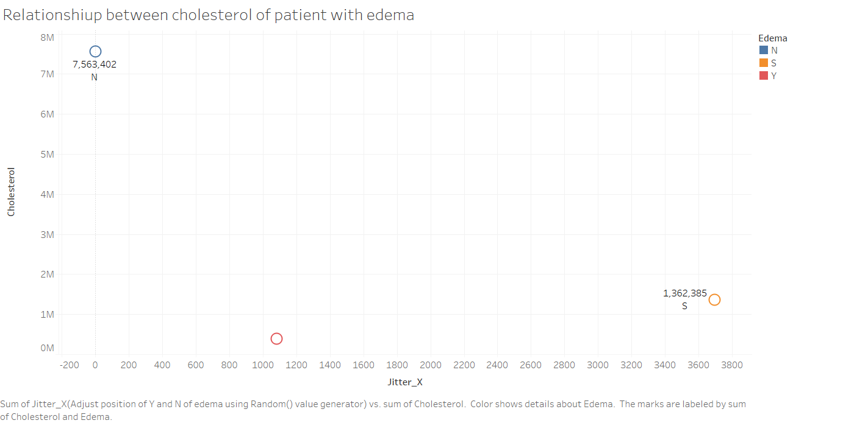
Visualization1:
Scatter has been used to identify the relationship between cholesterol and patients with edema.
X-axis: Jitter_X
Y-axis: Cholesterol
Result:
From the visualization, it can be concluded that there is significant difference in the level of cholesterol of patient with edema and without edema.
Hence our null hypothesis is valid and alternative hypothesis which is our hypothesis can be rejected.

Slide 23
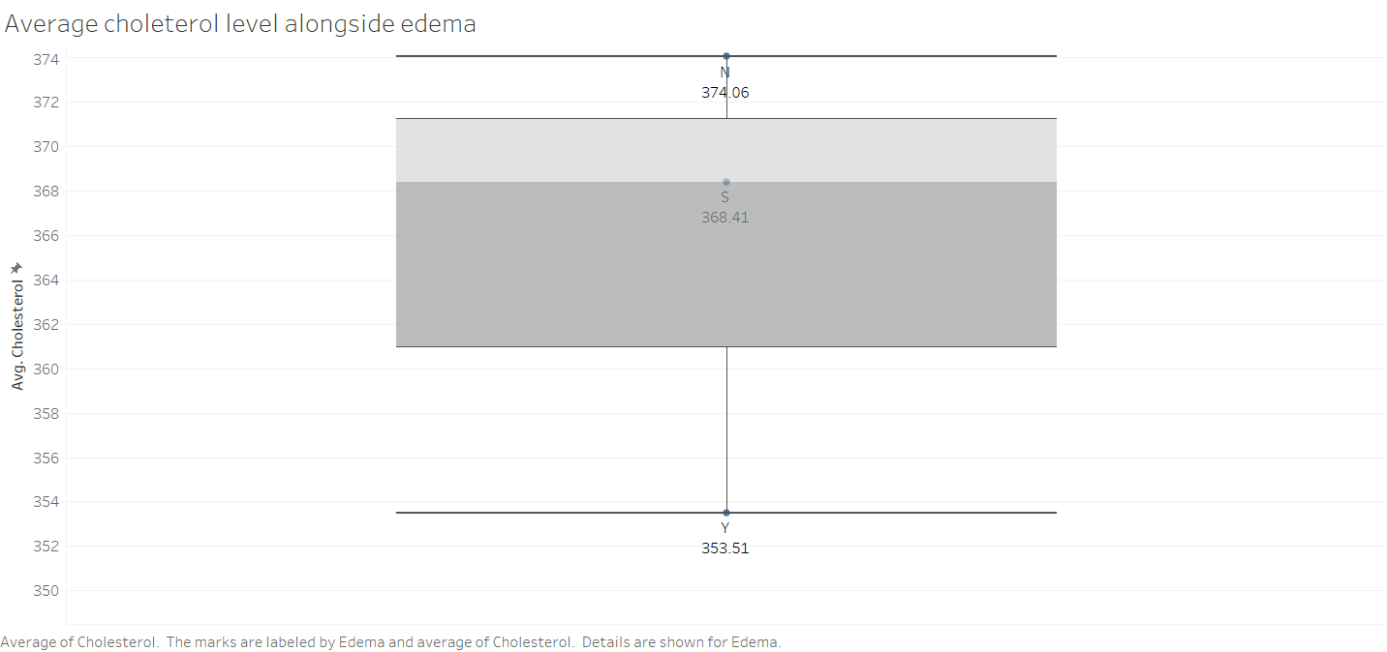
Visualization2:
Box-and-whisker plot has been used to find the relationship between average cholesterol levels and presence of edema.
Result:
From the visualization, we can clearly conclude that there is significance difference in the cholesterol levels of patients with edema and patients without edema. It implies that our null hypothesis is valid and actual hypothesis is invalid.

Slide 24
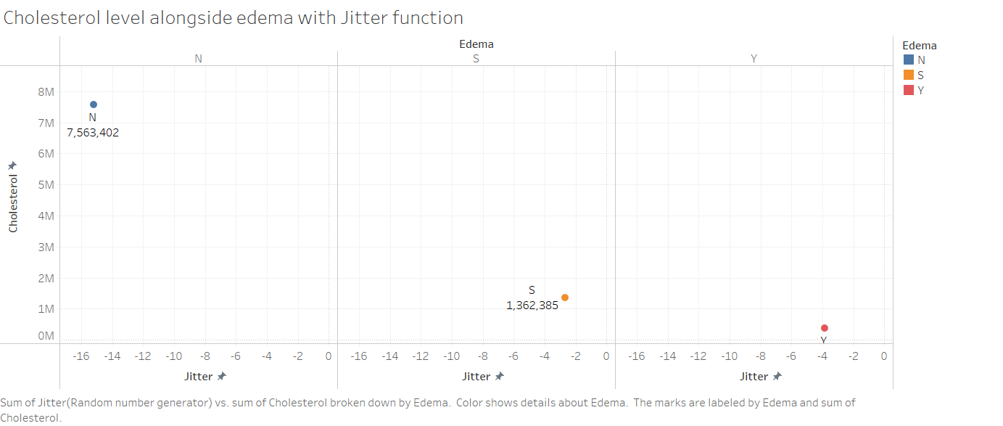
Visualization3:
Scatter plot with Jitter function has been used to check the relationship between presence of edema and cholesterol levels.
Jitter is a function that will adjust a position of ‘Y’ and ‘N’ of edema using Random () function. Here we will use an amplifier with a value of 0.1.
Result:
From the visualization, it can be observed that the change edema status gives significant difference in cholesterol levels.
Due to this reason null hypothesis is valid and our actual hypothesis is invalid.

Slide 25
Hypothesis 4- There is no significant relationship between age and prothrombin time.
In this hypothesis we need to prove that the there is no relationship between age and prothrombin time.
Null Hypothesis(H0): There exist relation between prothrombin levels and age.
To prove the null hypothesis wrong we will use three visualizations:
Heat map
Line chart
Histogram

Slide 26
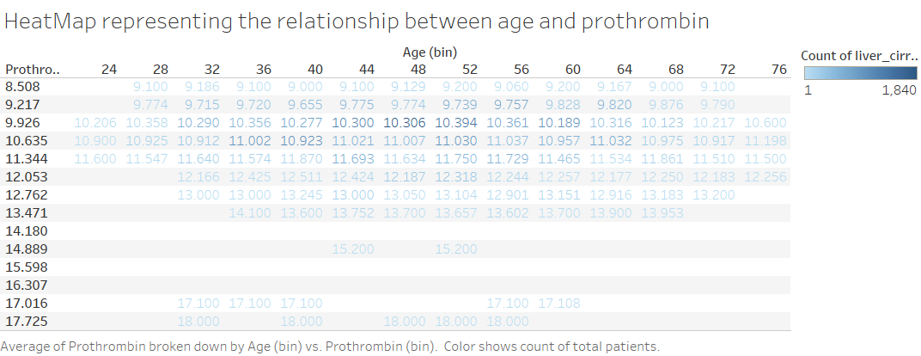
Visualization1:
Heat has been used to check the relationship between age and prothrombin time.
Result:
From the visualization, it can be concluded that with increase in age the prothrombin time is also increasing.
Hence our null hypothesis is valid and alternative hypothesis which is our hypothesis can be rejected.

Slide 27
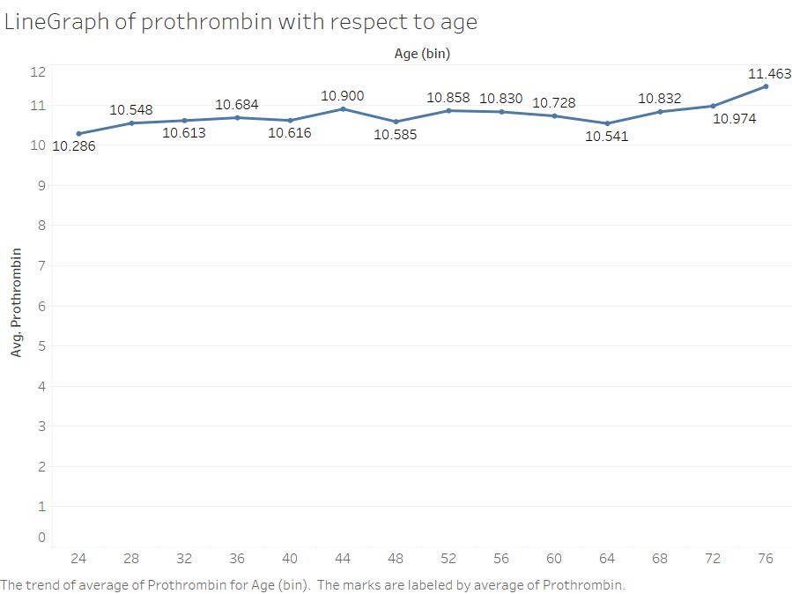
Visualization2:
Line chart has been used to identify the relationship between age and prothrombin time.
Result:
From the visualization, we can clearly conclude that there is significance trend of rise in average prothrombin time with increase in age. It implies that our null hypothesis is valid and actual hypothesis is invalid.

Slide 28
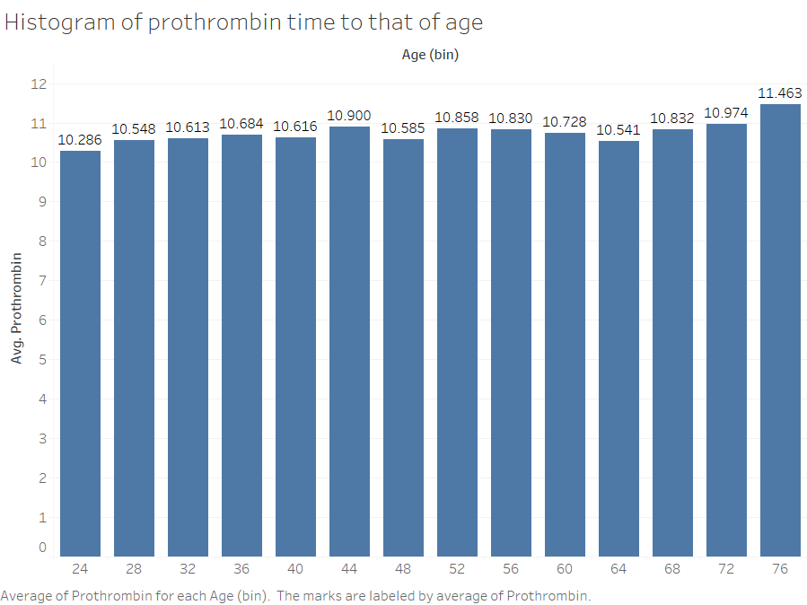
Visualization3:
Histogram plot is used to check whether there is any trend in prothrombin time with respect to age.
Result:
From the visualization, it can be observed that the change age rises the value of prothrombin levels in majority.
Due to this reason null hypothesis is valid and our actual hypothesis is invalid.

Slide 29
Conclusion
From the above results we can conclude that,
Patient receiving different drugs have different survival rate.
The ascites, hepatomegaly, or edema levels are directly proportional to liver cirrhosis stages.
Cholesterol levels are significantly different between the patient with edema and without edema.
Age and prothrombin time are related, with increase in age the prothrombin time increases.

Slide 30
References
Mayo clinic
Liver Cirrhosis Stage Classification Dataset by Aadarsh Velu
Bar Chart wikipedia-https://en.wikipedia.org/wiki/Bar_chart
A complete guide to scatter plot- Atlassian
Heat map- Optimizely.
Build a packed bubble chart by tableau.
A complete guide to line chart- Atlassian
Histogram Unveiled- Atlassian
Research Hypothesis: What It Is, Types + How to Develop?- Question Pro

Slide 31
Thank you

