Slide 1
SAP BTP INTEGRATION DEVELOPMENT
Employee Data Synchronization
using SAP Integration Suite
Prepared by: Nalumachu Rahul Sai P-User ID: P2012786030 Client: GlobalTech Ltd (Training Scenario) Duration: 11-08-2026 to 17-08-2026

Slide 2
Problem Statement
Organizations maintain employee information across multiple SAP systems, making manual data transfer and synchronization time-consuming and error-prone. Employee data from SAP SuccessFactors must be regularly retrieved, transformed, and transferred to SAP S/4HANA in the required format.
!
Manual Effort
Time-consuming manual data transfer
!
Data Inconsistency
There is also a need to generate employee data files (CSV), securely transfer them via SFTP or email, and identify and communicate integration failures to responsible users.
Error-prone processing across systems
!
No Visibility
Failures not automatically communicated
SAP BTP Integration — Employee Data Synchronization
2

Slide 3
Objective
Automate employee data integration end-to-end using SAP BTP Cloud Integration — from a scheduled trigger through to delivery, with built-in exception handling.
1
2
3
Retrieve
Transform
Create
Timer Start event pulls employee data from SAP SuccessFactors automatically.
Map retrieved data into the S/4HANA-required structure.
Post transformed data to create employee records in S/4HANA.
4
5
6
Convert
Distribute
Handle Errors
Convert processed employee data from XML to CSV format.
Send output via SFTP and Email using Sequential Multicast.
Exception Subprocess identifies failures and sends notifications.
SAP BTP Integration — Employee Data Synchronization
3

Slide 4
Software Development Life Cycle
Agile Scrum methodology — each phase mapped to capstone build activities
1
2
3
4
5
6
Requirement
Analysis
Design
Development
Testing
Deployment
Maintenance
Reviewed problem statement; identified source, target, and downstream systems; documented field mapping.
Designed iFlow structure — main sync process + exception sub-process; defined field mapping and landscape.
Built the iFlow: OData connections, message mappings, XML-to-CSV converter, SFTP & Mail adapters.
Executed end-to-end runs; validated CSV output against field mapping; resolved runtime errors.
Deployed and activated on SAP CI tenant; verified triggers and completion in CPI Monitor.
Monitored processing logs; configured automated failure alerts to administrators.
SAP BTP Integration — Employee Data Synchronization
4

Slide 5
User Stories — Key Highlights
12 user stories captured across integration roles (full backlog in appendix)
US01
High
US03
High
US04
High
Integration Administrator
Integration Developer
S/4HANA User
Start the iFlow automatically via Timer so processing needs no manual execution.
Map SuccessFactors employee fields to the required S/4HANA structure.
Create employee records automatically to keep systems synchronized.
US06
High
US07
High
US10
High
Business User
External System User
System Administrator
Convert employee data from XML to CSV for file-based use and reporting.
Transfer the generated CSV via SFTP to share data securely.
Capture integration errors using an Exception Subprocess.
SAP BTP Integration — Employee Data Synchronization
5

Slide 6
Product Backlog
All requirements and activities required to deliver the integration solution
ID | Backlog Item | Priority | Status
PB01 | SAP BTP and i-Flow Setup | High | Completed
PB02 | Fetch Employee Data from SuccessFactors | High | Completed
PB03 | Map Data to S/4HANA | High | Completed
PB04 | Create Employee Record in S/4HANA | High | Completed
PB05 | Map Required Fields | High | Completed
PB06 | XML to CSV Conversion | High | Completed
PB07 | SFTP and Email Output | Medium | Completed
PB08 | Exception Handling | High | Completed
PB09 | Testing and Deployment | High | Completed
SAP BTP Integration — Employee Data Synchronization
6

Slide 7
Sprint Planning
Project delivered across 5 sprints — each with a clear goal and expected outcome
1
2
3
4
5
Sprint 1
Sprint 2
Sprint 3
Sprint 4
Sprint 5
Environment Setup & iFlow Creation
SuccessFactors Retrieval & Mapping
S/4HANA Integration & Field Mapping
XML to CSV & File Distribution
Exception Handling, Testing & Deployment
Configure SAP BTP CI environment and create the base integration flow.
Retrieve employee data from SuccessFactors and transform it into the S/4HANA structure.
Send mapped data to S/4HANA, create records, and map required fields.
Convert processed data to CSV and distribute via SFTP and email.
Implement error handling, complete end-to-end testing, and deploy the final flow.
SAP BTP Integration — Employee Data Synchronization
7

Slide 8
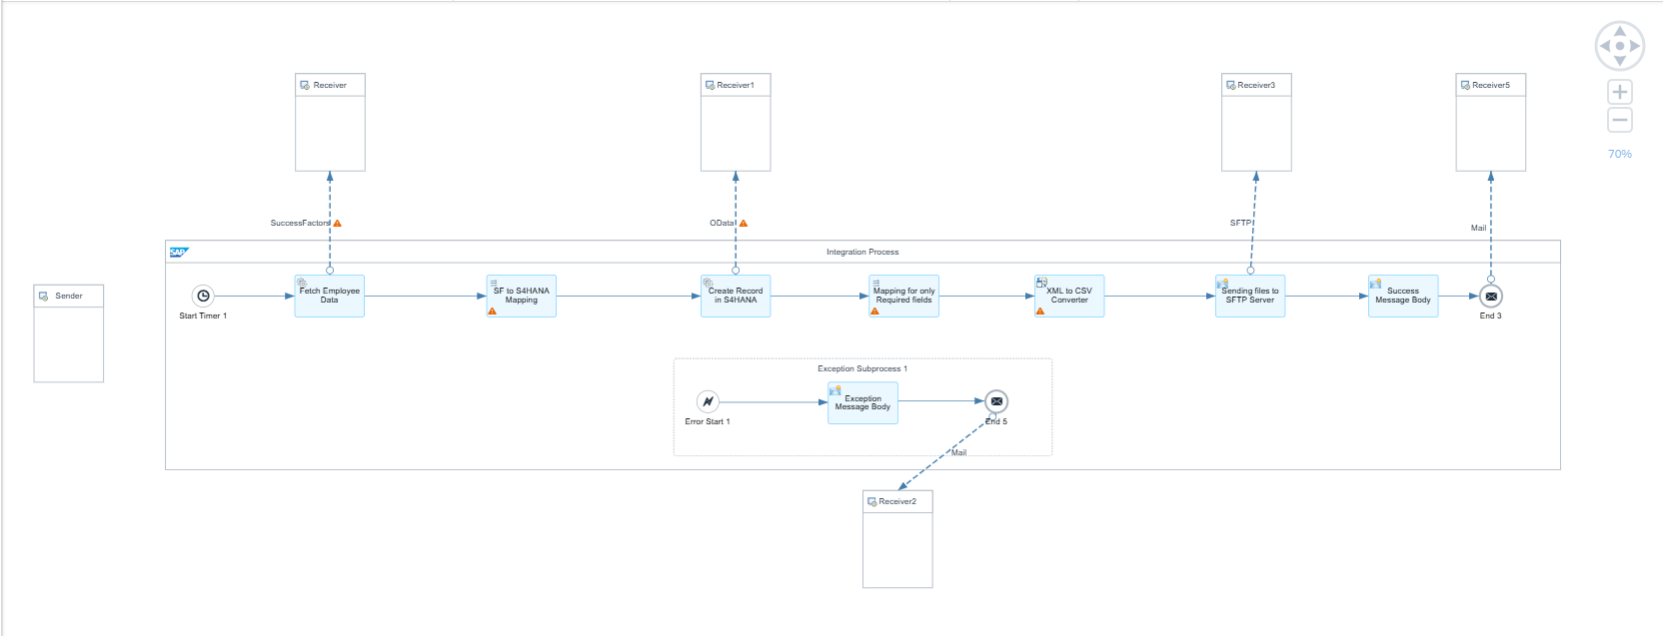
Integration Architecture
I-Flow 1 (Main): Timer Start → Fetch SF Records → Map SF to S/4HANA → Create Record → Map Required Fields → XML to CSV → Send to SFTP → Success Mail I-Flow 2 (Exception): Error Start → Exception Message Body → Send Message to Mail
SAP BTP Integration — Employee Data Synchronization
8

Slide 9
Mapping SuccessFactors to S/4HANA
Source-to-target field mapping ensures employee data lands in S/4HANA in the correct structure.
Source Field | Target Field | Mapping Expression
Mandt | Mandt | Constant → 500
Participant ID | Participantid | Nalumachu + ' ' + RahulSai
Employee Name | Sfempname | firstname + ' ' + lastname
City | City | city
Country | Country | country
Example Mapped Record
Mandt: 500
Participantid: Nalumachu RahulSai
Country: India
Sfempname: Harrison Skou
City: Chennai
SAP BTP Integration — Employee Data Synchronization
9

Slide 10
Conversion & Distribution
XML → CSV Conversion
SFTP Delivery
Converts processed employee data into CSV for convenient file-based exchange and reporting.
The SFTP Adapter securely transfers the generated CSV employee file to the configured SFTP server, providing reliable file-based integration.
<Employee>
<Mandt>500</Mandt>
<Participantid>Nalumachu RahulSai</Participantid>
...
</Employee>
Mandt,Participantid,Country,Sfempname,City
500,Nalumachu RahulSai,India,Harrison Skou,Chennai
Email Notification
The Mail branch sends employee information and success notifications, distributed alongside SFTP via Sequential Multicast in the same flow.
Required because CSV files are convenient for file-based data exchange and reporting.
SAP BTP Integration — Employee Data Synchronization
10

Slide 11
Exception Handling
Every processing error in the main flow is caught by the exception sub-process and emailed to the administrator.
Error Start Event
→
Capture Exception Info
→
Prepare Exception Content
→
Send Email Notification
Exception content includes:
Main Flow End Events
Error message
Error reason
Integration flow information
Processing details
Failure information
SFTP End Event — successful completion of the SFTP branch Mail End Event — successful completion of the email branch Exception End Event — completion after error notification is generated
SAP BTP Integration — Employee Data Synchronization
11

Slide 12
Testing — Executed Test Cases
End-to-end testing validated mapping logic, adapter connectivity, and exception handling
TC01
Successful
TC02
Handled
Standard Execution (Happy Path)
Duplicate Key Rejection
S/4HANA returns 201 Created; SFTP receives the CSV; success email delivered.
Existing Participantid triggers HTTP 400; Exception Subprocess alerts the administrator.
TC03
Handled
TC04
Handled
Network Timeout / Bad Gateway
XML to CSV — Invalid File Path
S/4HANA unavailable triggers HTTP 502; exact error routed to administrator email.
Incorrect Path to Source fails conversion before SFTP send; path corrected & revalidated.
SAP BTP Integration — Employee Data Synchronization
12

Slide 13
Defects & Issue Resolution
ID | Defect | Impact | Resolution | Status
BUG01 | Incorrect field mapping | Incorrect target data | Corrected field mapping | Fixed
BUG02 | Data format mismatch | Target processing failure | Corrected data transformation | Fixed
BUG03 | Invalid employee payload | Processing failure | Added validation and error handling | Fixed
BUG04 | CSV output format issue | Incorrect file generation | Corrected XML to CSV configuration | Fixed
BUG05 | Exception not notified | Error not identified quickly | Configured Exception Subprocess + email | Fixed
BUG06 | Output channel issue | File/email not delivered | Corrected receiver configuration | Fixed
SAP BTP Integration — Employee Data Synchronization
13

Slide 14
Version Control & Git Integration
1
Durable External Backup
2
Iterative History & Traceability
Exporting the finalized flow as a ZIP with XSD schemas and documentation to Git ensures a permanent, auditable backup outside the CPI tenant.
Maintains an immutable commit history tracking step-by-step refinements — mapping changes, converter fixes, receiver configs.
3
Reversion & Rollback Safety
4
Collaborative CI/CD Readiness
Enables instant rollback to previously verified integration bundles without relying on ad-hoc manual copies.
Supports multi-developer sync, branching workflows, and automated release pipelines for enterprise-grade governance.
SAP BTP Integration — Employee Data Synchronization
14

Slide 15
Conclusion
This integration successfully automates employee data synchronization from SAP SuccessFactors to SAP S/4HANA and securely delivers a payroll-ready CSV file to the SFTP server. Every adapter authenticates through centrally managed Security Material — no credential is exposed in the design artifact.
5
Sprints Completed
12
User Stories
Built-in exception handling protects the process end-to-end — HTTP 400 and 502 failures and converter errors were each reproduced, diagnosed, and resolved, with every failure automatically emailed to the administrator.
4
Test Cases Validated
Executed through Agile sprints and validated with structured, evidence-backed test cases, the solution meets all capstone requirements and is ready for production hardening.
6
Defects Resolved

