Slide 1
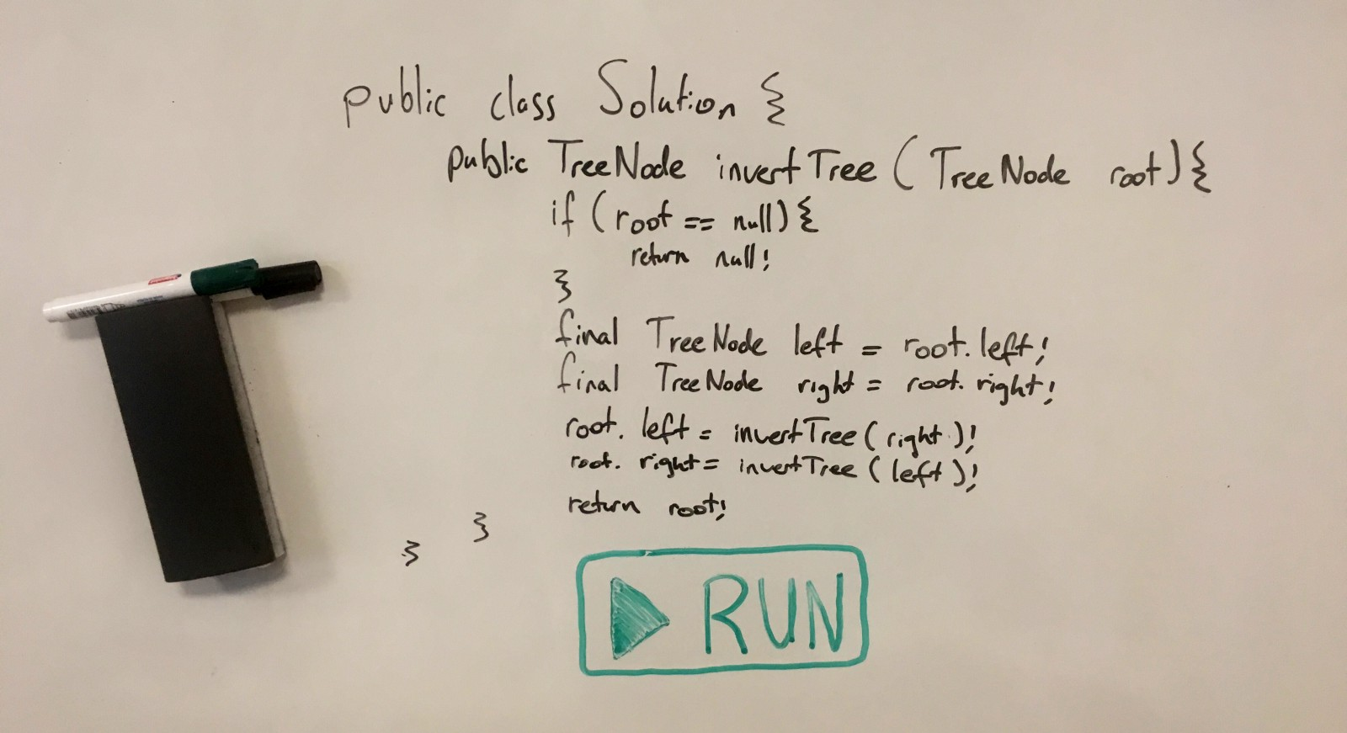
System Design Interviews

Slide 2
System Design Interview
What is a system design interview and why it is important?

Slide 3
What is System Design Interview
In this type of interview you are asked to design a system or application from scratch
Usually the interview lasts for 45 mins or an hour
Requires a broad set of knowledge.
Involves concepts of scalability, availability and sometime security.
Sample Question :
Q1. Design a mobile application like Uber ?
Q2. Create a chat messenger like WhatsApp, take scalability into account ?

Slide 4
Why they are difficult ?
Broad range of knowledge required
Even if you are asked the same question that you have read before different interviewers might expect different answer for the same question
Usually required to write code on white board which requires some practice before hand.

Slide 5
Sample System Design Interview Questions
Design an ecommerce website like Amazon, FlipKart ?
Design a chat messenger service like WhatsApp ?
Design an autocomplete feature like on google search engine ?
Design a search engine ?
Create an Uber like service to find a nearby taxi or Create a yelp like service ?
Design a ticketing system to book cinema tickets online ?

Slide 6
Why these interviews are Important ?
Almost all top software companies have this round of interview.
Clearing this interview helps in negotiating a better offer.
Preparing for this interview helps us broaden our own knowledge level in different technologies.

Slide 7
References
Crack the system design interview.
How to ace a system design interview.
Best way to prepare for system design interview.
Popular system design interview questions.
System design interview questions.

Slide 8
References
Crack the system design interview.
How to ace a system design interview.
Best way to prepare for system design interview.
Popular system design interview questions.
System design interview questions.

