Slide 1
Lending Club Case Study
Rahul Gupta
Kanhaiya Choudhary
ML C39 Batch

Slide 2
Problem Statement
To understand the driving factors (or driver variables) behind loan default, i.e. the variables which are strong indicators of default.
The company can utilise this knowledge for its portfolio and risk assessment.

Slide 3
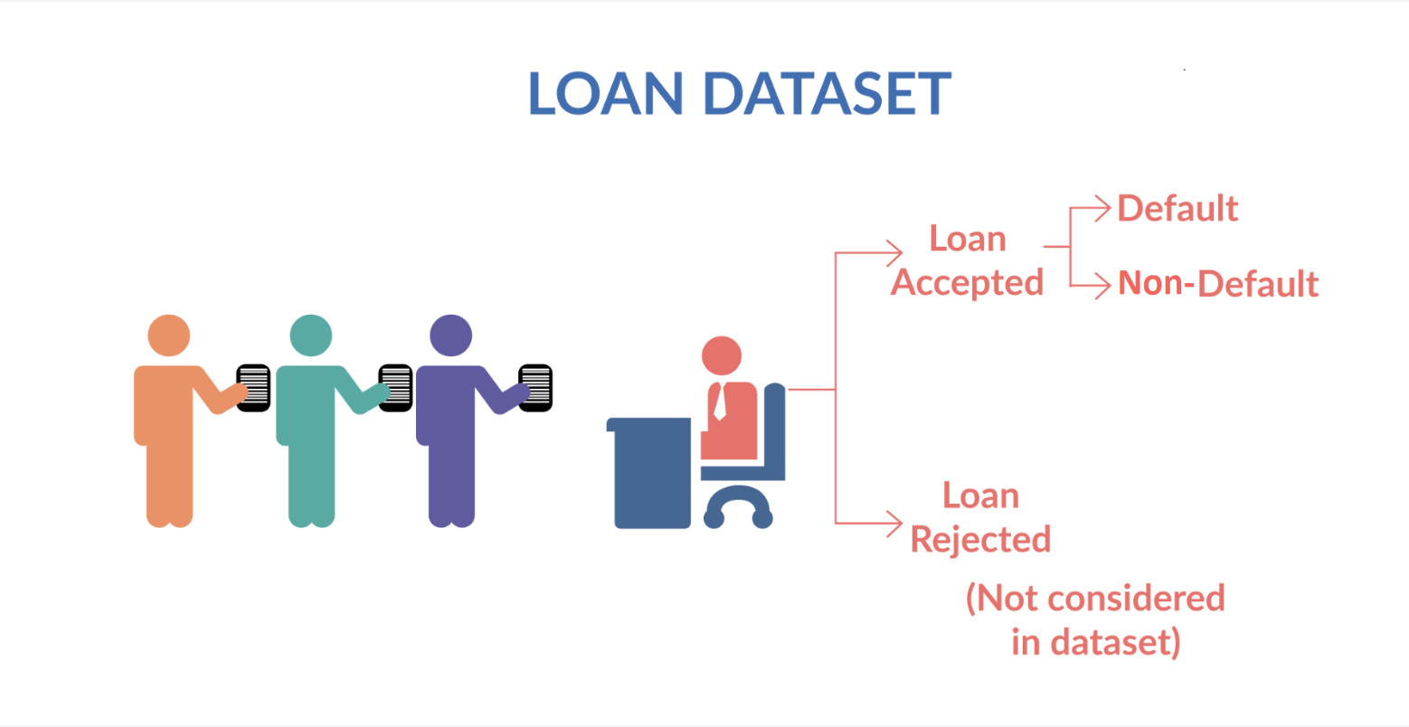
Fully paid: Applicant has fully paid the loan (the principal and the interest rate)
Current: Applicant is in the process of paying the instalments, i.e. the tenure of the loan is not yet completed. These candidates are not labelled as 'defaulted'.
Charged-off: Applicant has not paid the instalments in due time for a long period of time, i.e. he/she has defaulted on the loan

Slide 4
Problem Solving Methodology
To understand how consumer attributes and loan attributes influence the tendency of default.
Using EDA for this analysis
Steps –
Data Cleaning
Data Understanding
Univariate Analysis
Segmented Univariate Analysis
Bivariate Analysis
Recommendation

Slide 5
Data Cleaning
Check the percentage of missing values
Remove all those with very high missing percentage
For columns with less missing percentage: perform Imputations
Drop rows where the missing percentage is quite high

Slide 6
Data Analysis
The objective is to identify predictors of default so that at the time of loan application, we can use those variables for approval/rejection of the loan.
There are broadly three types of variables –
those which are related to the applicant
Loan characteristics
Customer behavior variables
Now, the customer behavior variables are not available at the time of loan application, and thus they cannot be used as predictors for credit approval.

Slide 7
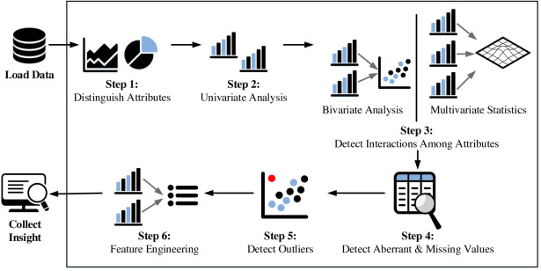
EDA Process

Slide 8
Analysis

Slide 9
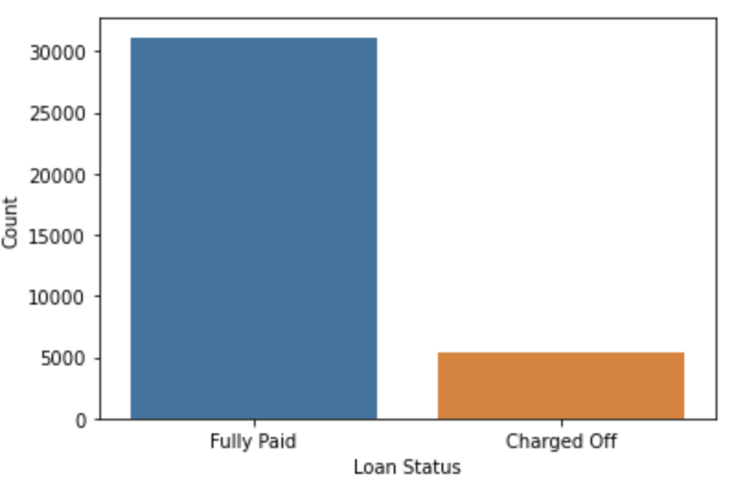
Split of Fully Paid vs Charged Off (Defaulters)

Slide 10
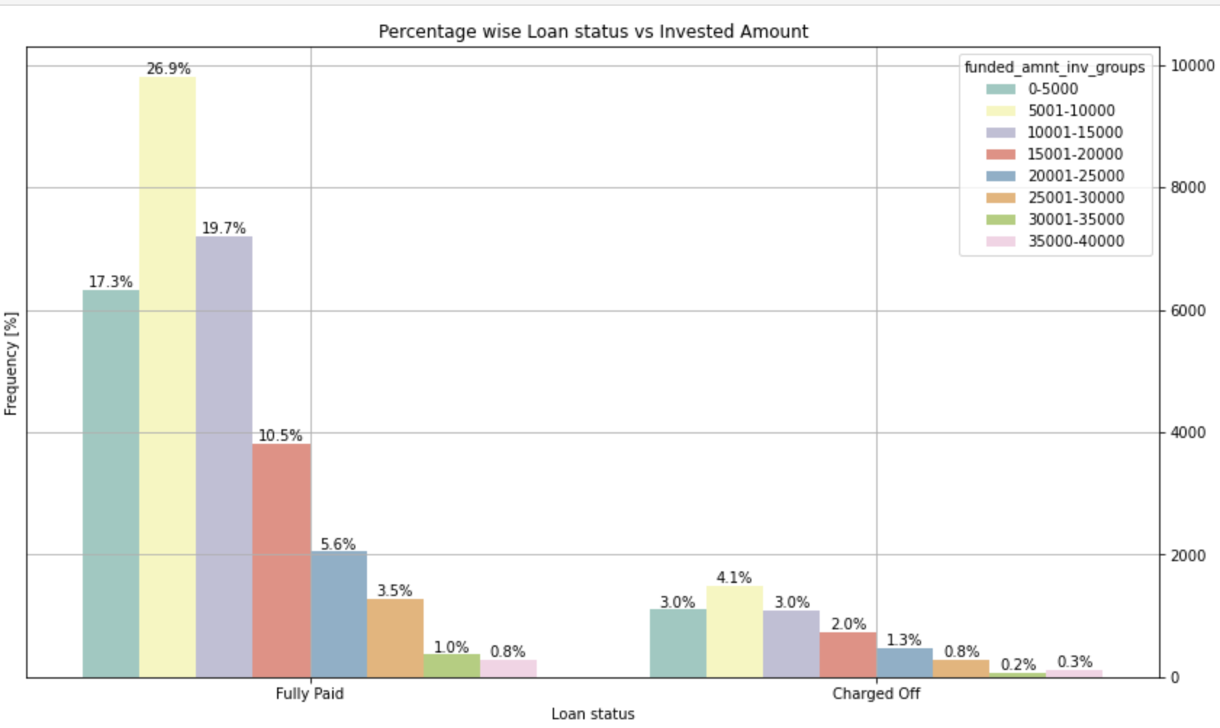
We see funded amount invested is positively correlated with both Charged off and Fully Paid.
We see that Employees who have exp 10+, 0, 2 & 3 years are likely to become Defaulters.

Slide 11
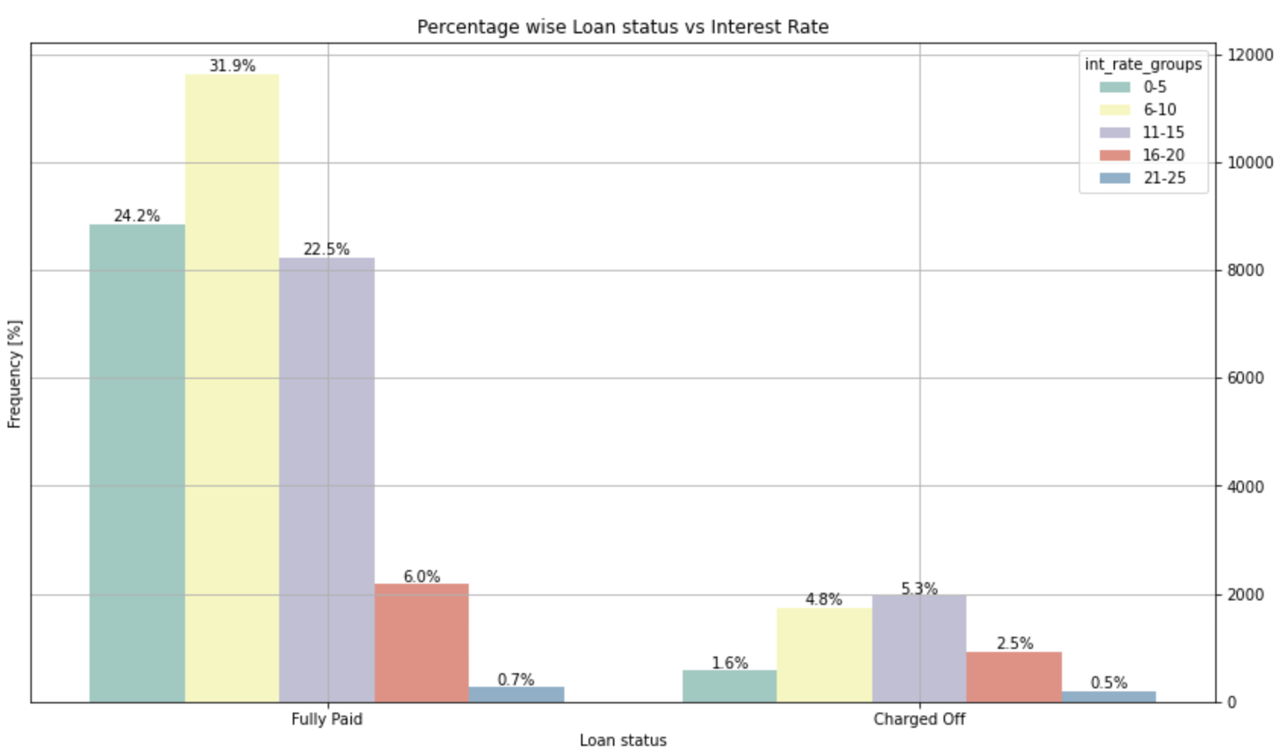
We see annual income is positively correlated with both Charged off and Fully Paid.
We also see if annual income is in range of 40001 to 60000 then chances of becoming defaulter is higher.
Looking at the ratio of say charged off by Fully Paid say for 0-20000, has higher chances of becoming defaulter.

Slide 12
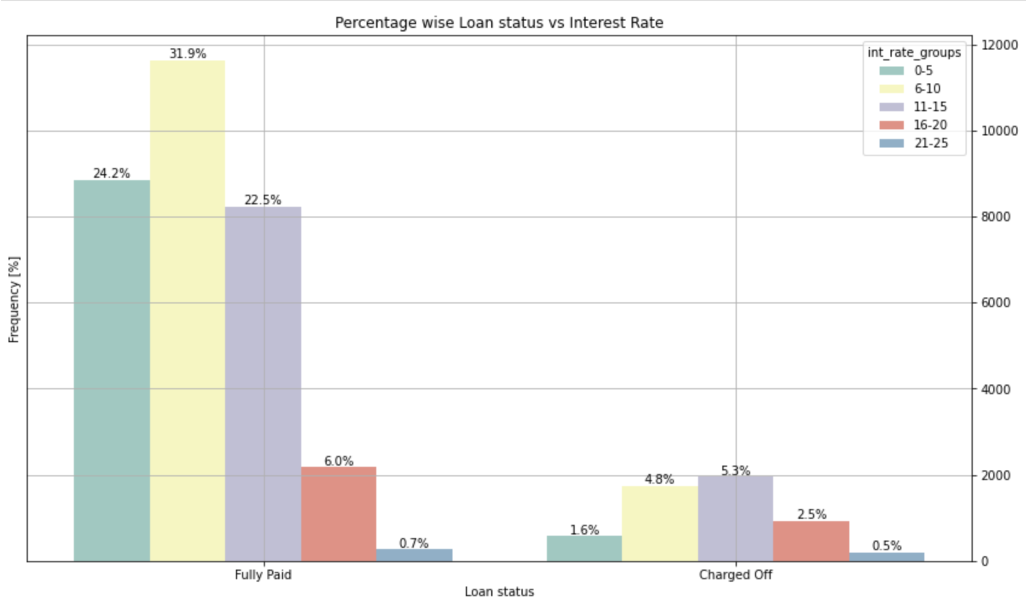
We see interest rate is positively correlated with both Charged off and Fully Paid.
We also see if interest rate rate is in range of 11% to 15% then chances of becoming defaulter is higher.
But ratio wise 21-25 % inteset rate group has higher chances of becoming defaulter.

Slide 13
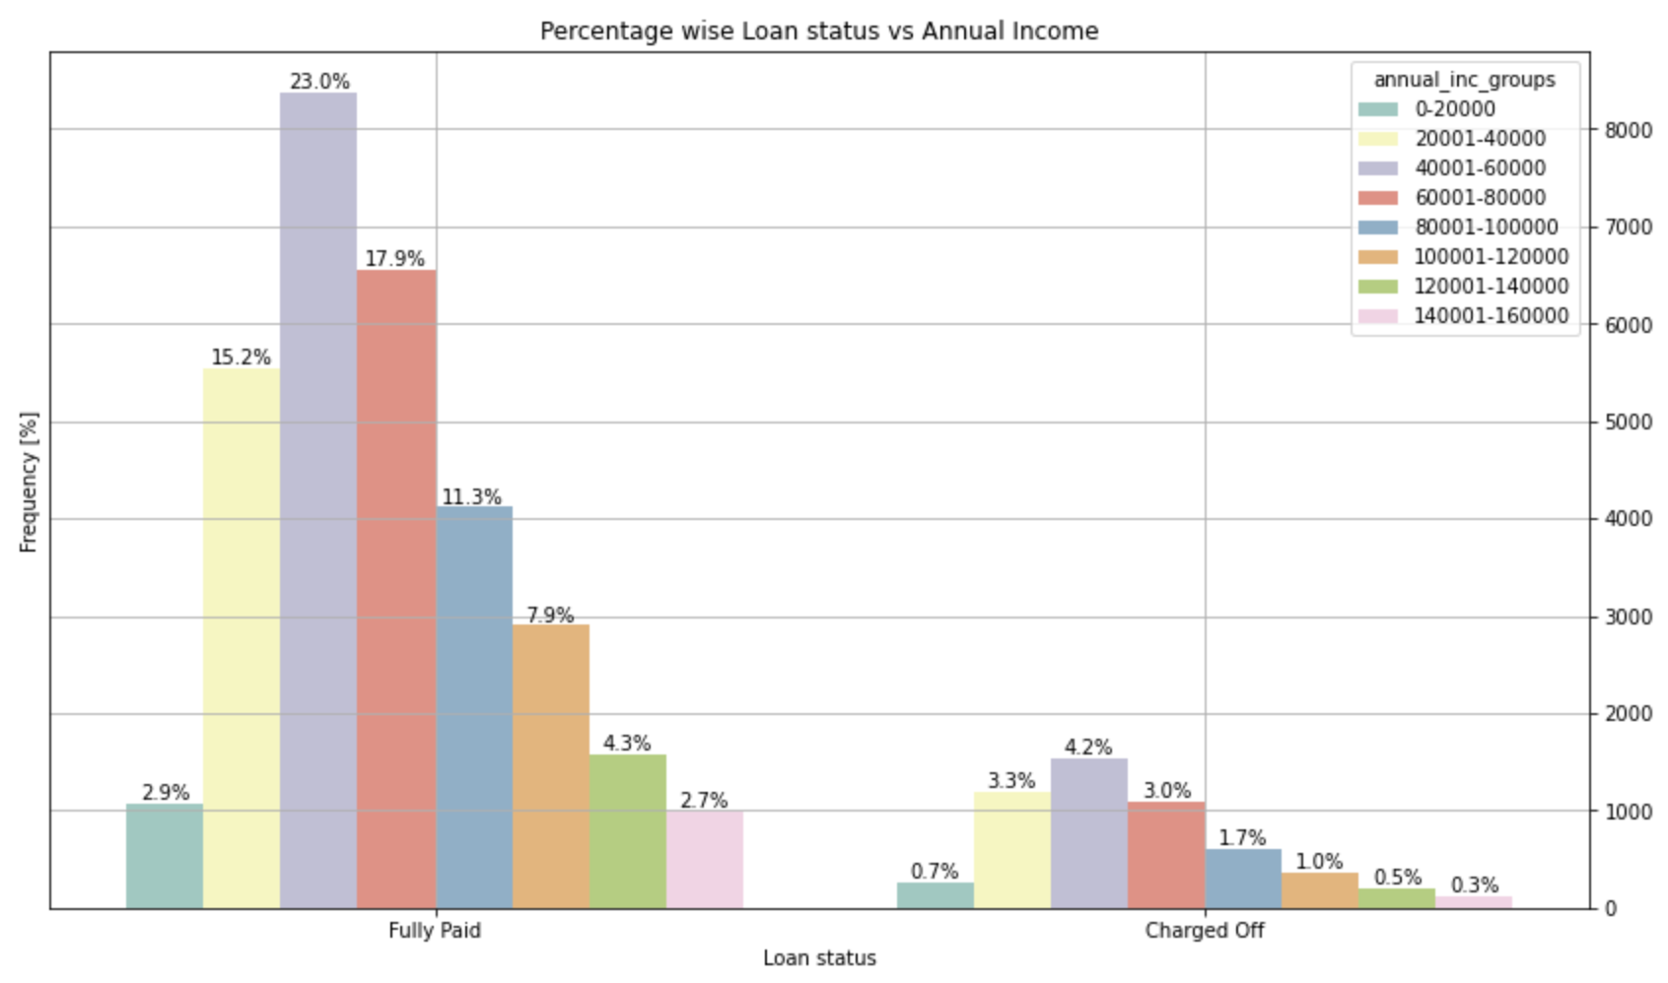
We see annual income is positively correlated with both Charged off and Fully Paid.
We also see if annual income is in range of 40001 to 60000 then chances of becoming defaulter is higher.
Looking at the ratio of say charged off/ Fully Paid , say for the range 0-20000 has higher chances of becoming defaulter.

Slide 14
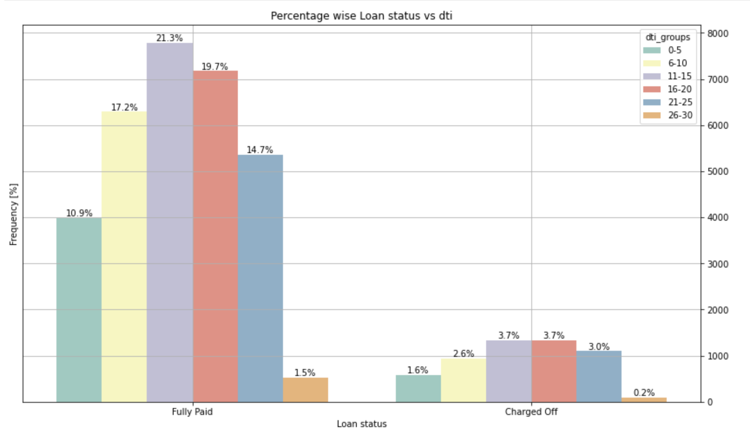
We see dti is positively correlated with both Charged off and Fully Paid.
We also see if dti is in range of either 11 to 15 or 16-20 then chances of becoming defaulter is higher.

Slide 15
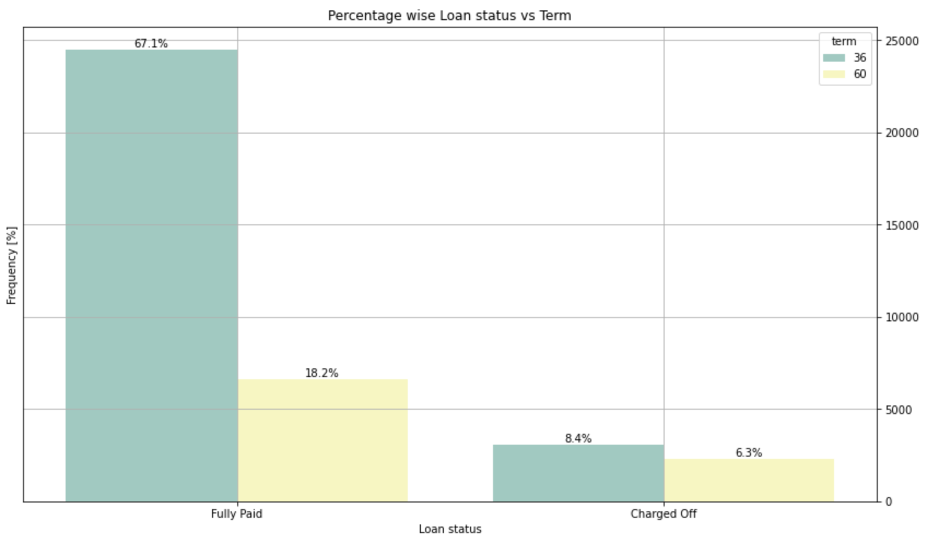
We see loan term is positively correlated with both Charged off and Fully Paid.
We also see if term is 36 months then chances of becoming defaulter is higher.
But ratio wise 60 months has much higher number and hence higher chances of defaulters.

Slide 16
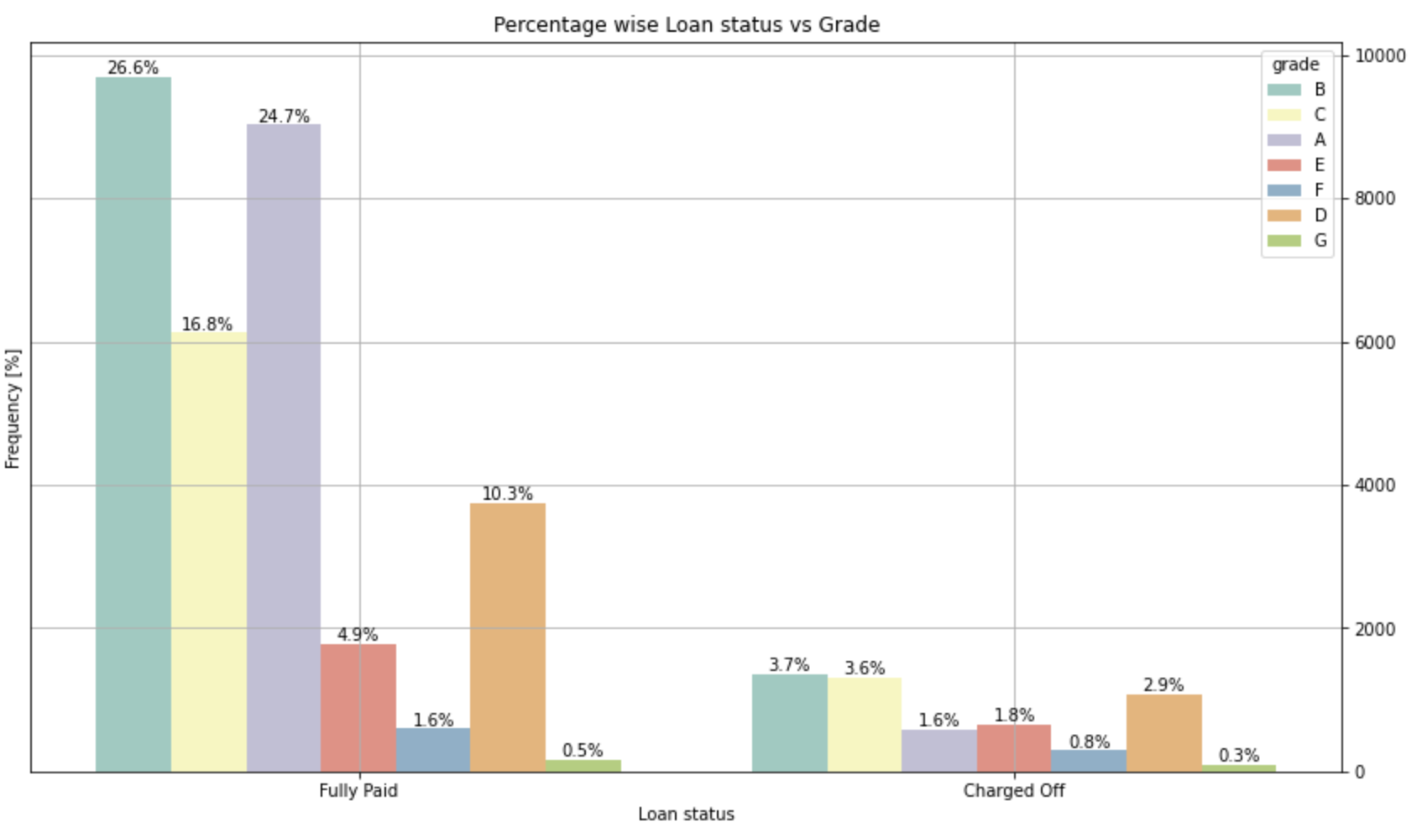
We see grade is positively correlated with both Charged off and Fully Paid.
We also see if grade is B, then chances of becoming defaulter is higher.
But ratio wise G has higher chances of being defaulter.

Slide 17
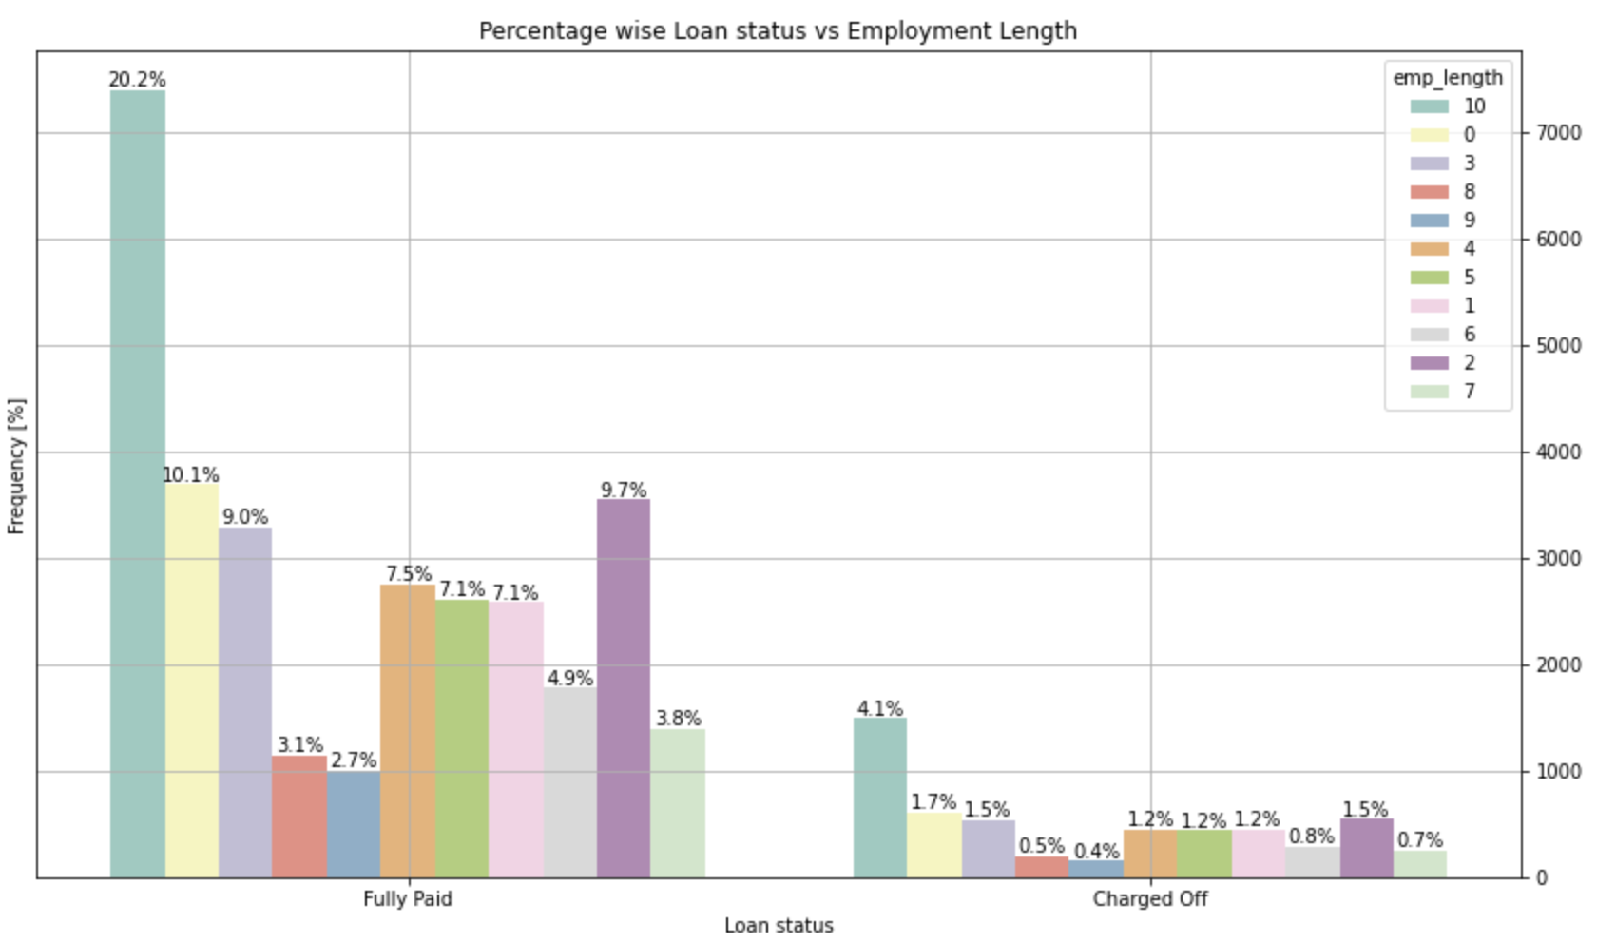
We see employment length is positively correlated with both Charged off and Fully Paid.
Basically, employment length may not be a good criteria to detect Defaulters.
Also, we see that Employees who have exp 10+, 0, 2 & 3 years are likely to become Defaulters.

Slide 18
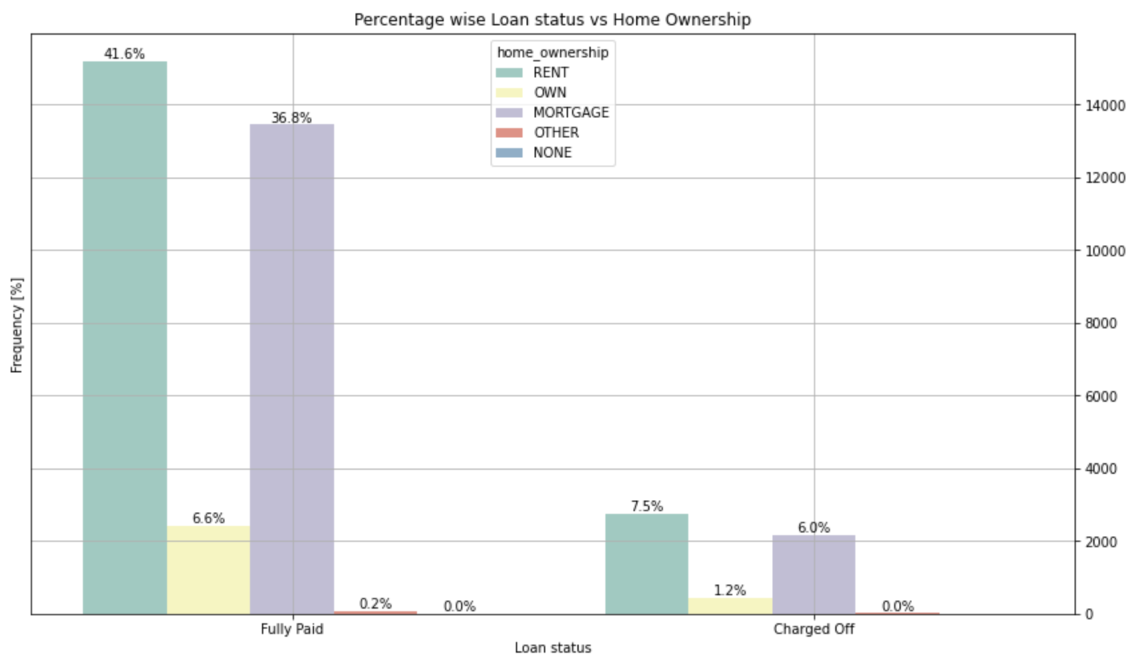
We see home ownership is positively correlated with both Charged off and Fully Paid.
We also see if home ownership is either RENT or MORTGAGE, then chances of becoming defaulter is higher.

Slide 19
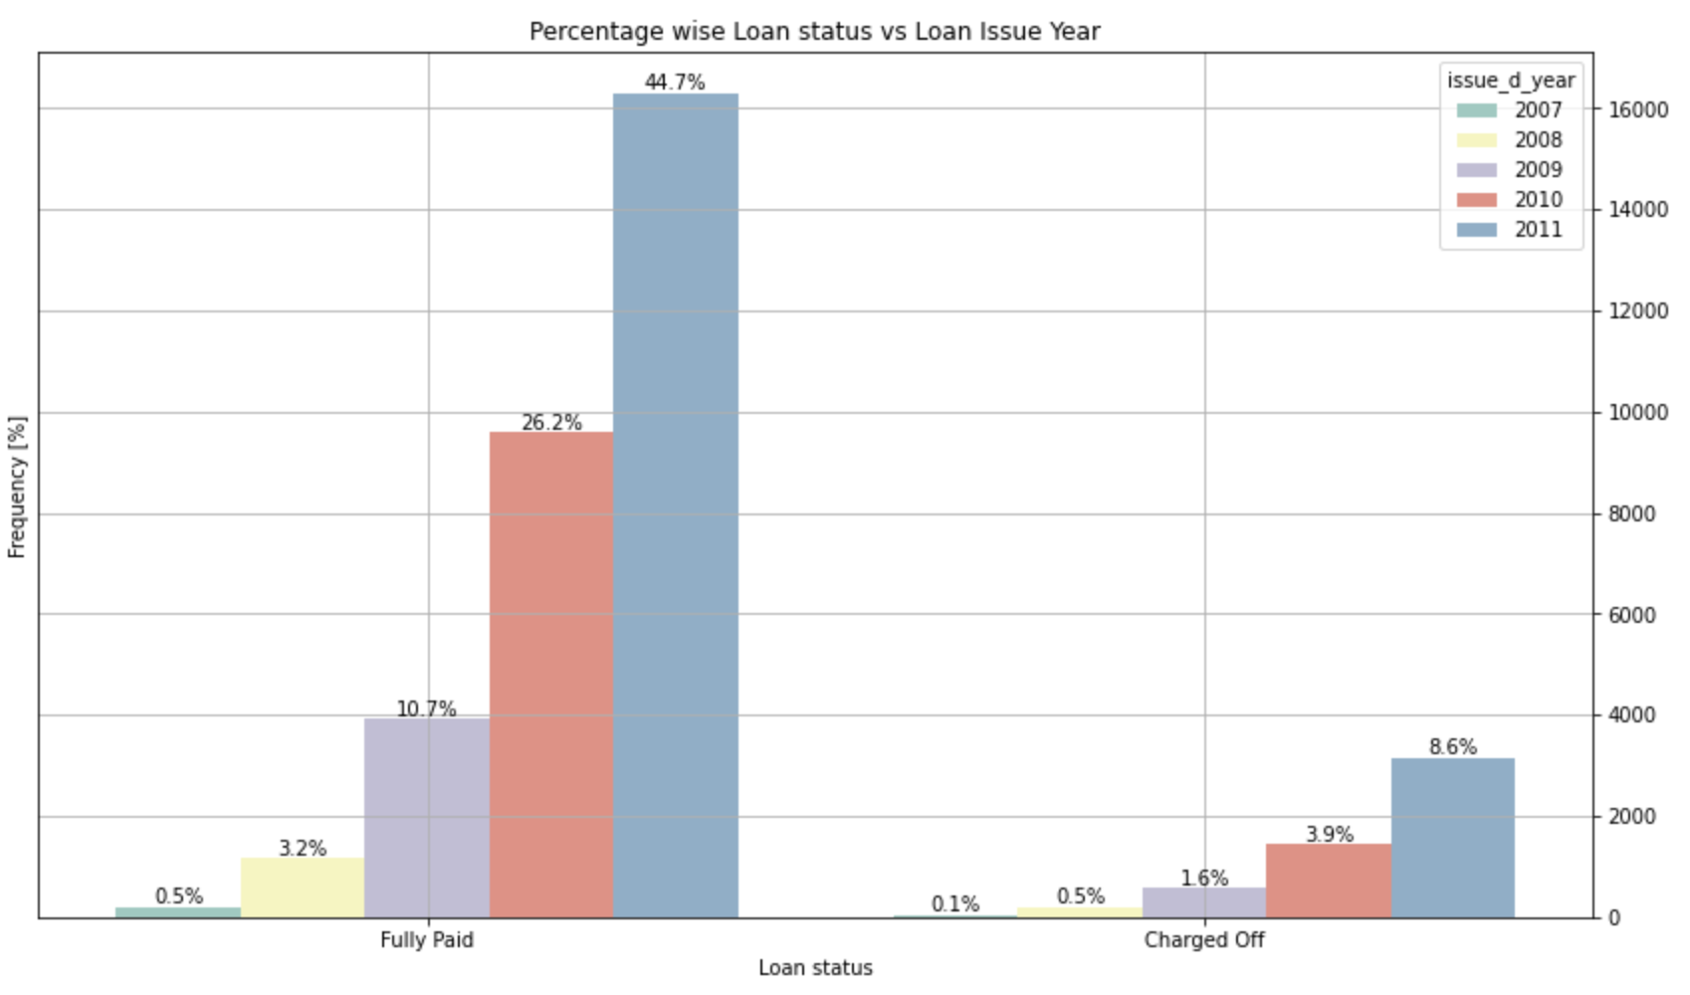
We see loan issue year is positively correlated with both Charged off and Fully Paid.
We also see if loan issue year is 2011 then chances of becoming defaulter is higher.

Slide 20
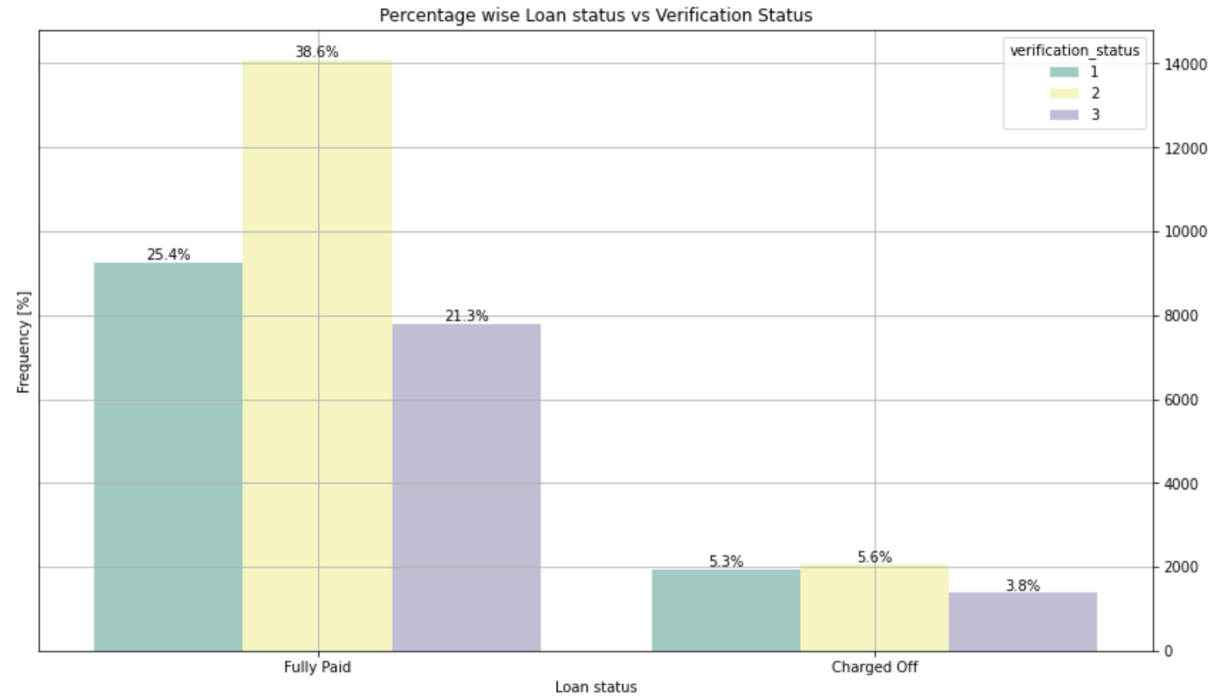
We see verification status is positively correlated with both Charged off and Fully Paid.
We also see if verification status is not verified then chances of becoming defaulter is higher.
But percentage wise Verified also has higher chances of being defaulter.

Slide 21
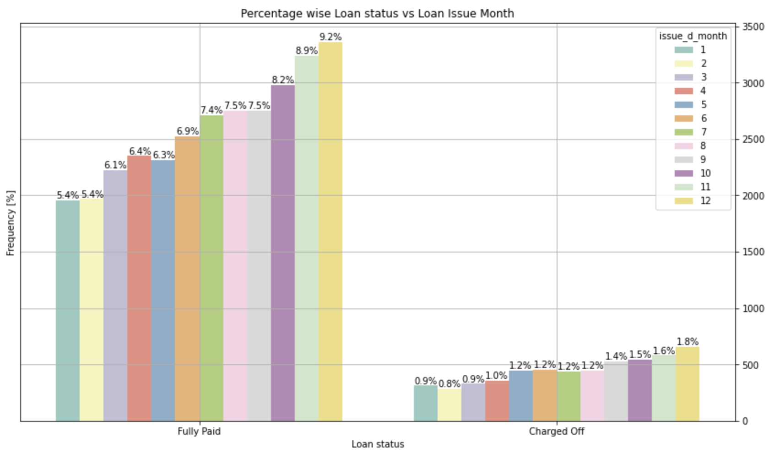
We see Loan Issue month is positively correlated with both Charged off and Fully Paid.
We also see if loan issue month is either Dec or Nov, then chances of becoming defaulter is higher.

Slide 22
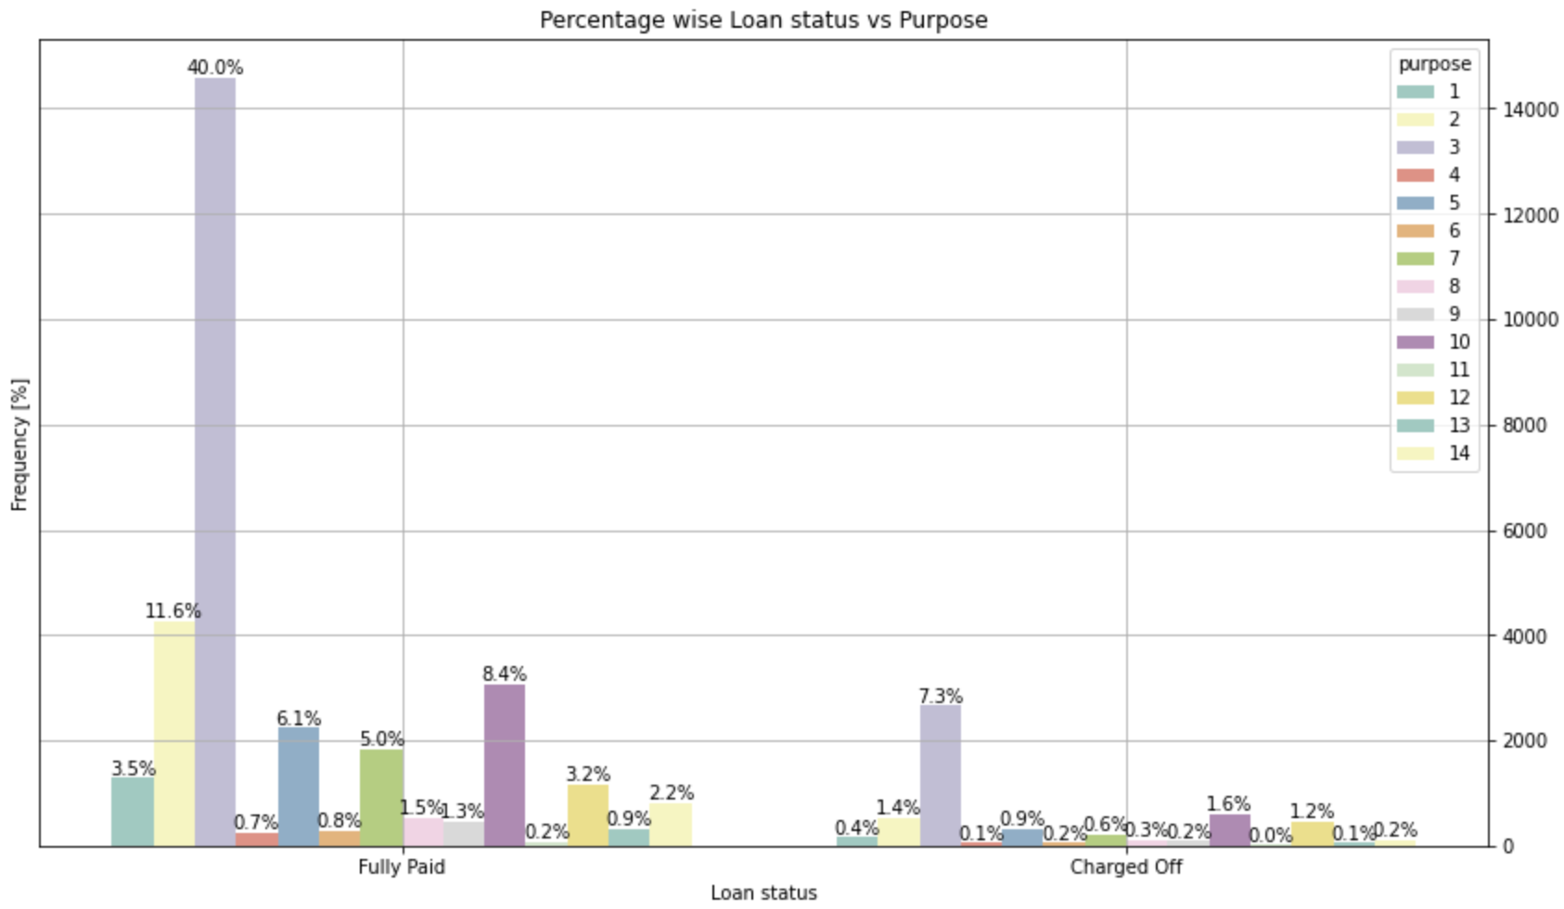
We see purpose is positively correlated with both Charged off and Fully Paid.
We also see if purpose is debt_consolidation, then chances of becoming defaulter is higher.

Slide 23
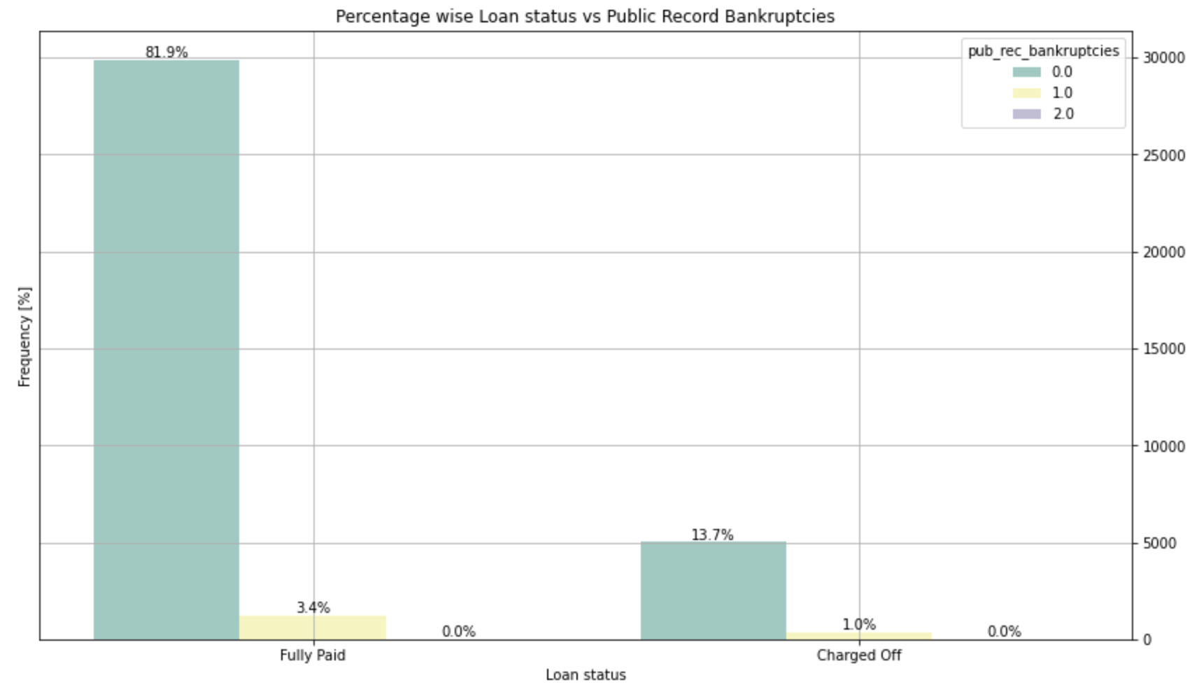
We see number of public record bankruptcies is positively correlated with both Charged off and Fully Paid.
We also see if number of public record bankruptcies is 0 then chances of becoming defaulter is higher.

Slide 24
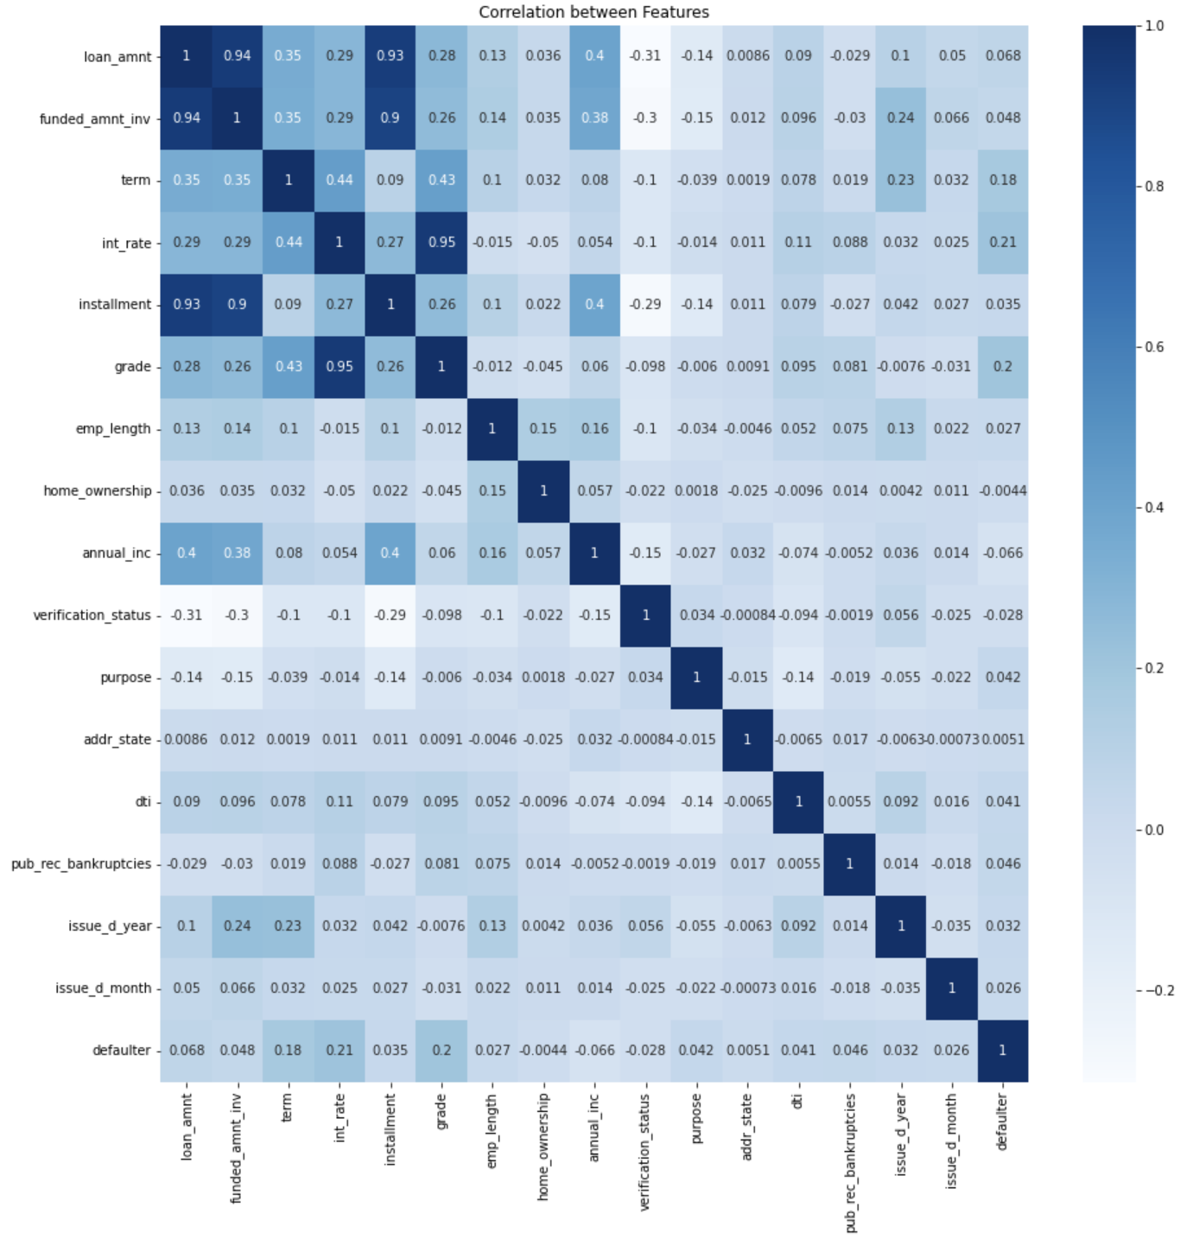
We plotted this plot/heatmap to show correlation of different features.

Slide 25
Summary based on this correlation heatmap:
Negatively correlated features
Home ownership, borrower’s annual income and verification status are negatively correlated with defaulter.
If home ownership is “RENT” or “Mortgage”, then chances of becoming defaulter is higher.
If verification status is “Verified”, then chances of becoming defaulter is higher.
For Annual income , looking at the ratio of say charged off/ Fully Paid, say for 0-20000 range, has higher chances of becoming defaulter. Heatmap is also confirming this.
Positively corelated features
Key features which are positively corelated are term, interest rate and grade .
Other remaining features are also positively corelated, but the extent of correlation is less as compared to term, interest rate and grade.
So higher the term, greater will be chances of becoming defaulter. Hence 60 months is the likely term with more percentage of defaulters.
Higher the interest rate means higher the chances of becoming defaulter. Hence likely range with higher percent of defaulters would be 21-25%
Higher the grade means higher the chances of becoming defaulter. Hence grade G is likely range with higher percent of defaulters.

