Slide 1
FIFA Player Performance Analysis
Rahul Naik
Sports Anlystics Portfolio Project
B.Tech CSE | Data Analyst Aspirant | SQL Developer
PostgreSQL . SQL . Git . GitHub
Notes:
Welcome to this presentation on FIFA Player Performance Analysis. We'll explore how data science can unlock key insights into player performance, strategy, and talent identification. My name is [Your Name], and I'm excited to share our findings and recommendations with you today.

Slide 2
FIFA Player Performance Analysis using SQL
A data-driven exploration of player performance, market value, and club strategies using PostgreSQL & SQL — simulating real-world sports analytics scenarios.
The project includes:
· Loading and exploring the dataset
· Performing Exploratory Data Analysis (EDA)
· Cleaning and validating data
· Running analytical SQL queries in PostgreSQL
· Creating a detailed project report
· Designing a presentation using Gamma AI

Slide 3
Dataset
The dataset covers 2,800 rows and 16 columns across 7 clubs, 8 nationalities, and 9 positions — used to analyze performance, transfer decisions, and club strategies.
2800
7
Total Players
Total Clubs
28
76.87
Average Age
Avg Overall Rating
€90.57M
24.1%
Avg Market Value
Injury-Prone Players

Slide 4
Tools & Project Workflow
Tools & Technologies
Project Workflow
Data Loading
PostgreSQL
SQL
Import CSV into PostgreSQL
Database management & analysis
Data querying & business analysis
EDA
Explore structure & distributions
Gamma AI
Git & GitHub
Presentation & storytelling
Version control & hosting
Data Cleaning
Validate & verify quality
SQL Analysis
Answer business questions
Reporting & Presentation
Summarize findings & insights

Slide 5
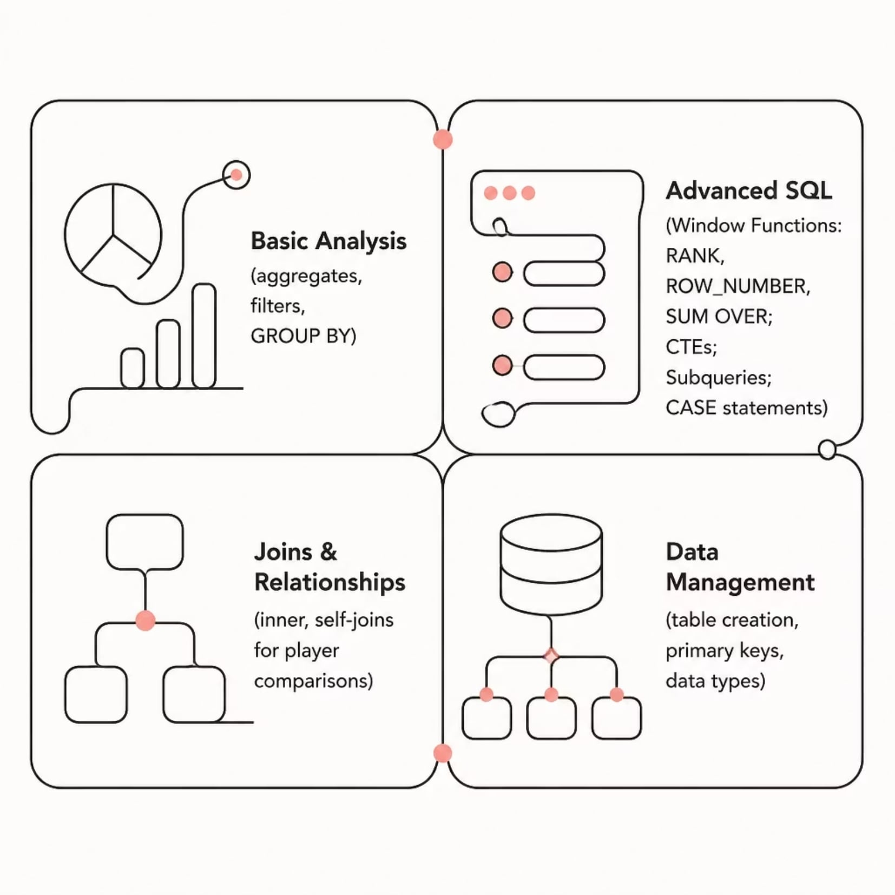
SQL Concepts Implemented
The project applied the full spectrum of SQL — from basic aggregations to advanced window functions — to answer real-world football analytics questions across performance, transfers, and club strategy.
Example SQL Concepts by Category
Basic Analysis
SELECT, WHERE, GROUP BY, COUNT, SUM, AVG
Filter match or player records
Summarize goals, assists, and appearances
Compare averages across clubs or seasons
Advanced SQL
RANK(), ROW_NUMBER(), DENSE_RANK(), WITH CTEs, Subqueries, CASE WHEN
Rank players by performance metrics
Build reusable query steps with CTEs
Create conditional logic for categories and insights
Data Management
CREATE TABLE, PRIMARY KEY, FOREIGN KEY, Data Types
Design structured tables for analysis
Maintain relationships between datasets
Use the right field types for

Slide 6
Sample SQL Queries
1.Player Categorize (CASE)
2.Most Expensive per Position (Subquery)
Classifies players as Elite/Good/Avg/Poor by rating, Superstar/World Class/Valuable/Budget Player by market value, and Young/Prime/Veteran by age — three CASE statements in one query.
Uses a correlated subquery to find the highest-valued player in each playing position.
3.Potential Gap Analysis (CTE)
4.Top Scorers per Club (Window Function)
CTE calculates (potential − overall) gap; outer query identifies players with the largest improvement room.
ROW_NUMBER() OVER(PARTITION BY club ORDER BY goals DESC) ranks players to find top 2 scorers per club.

Slide 7
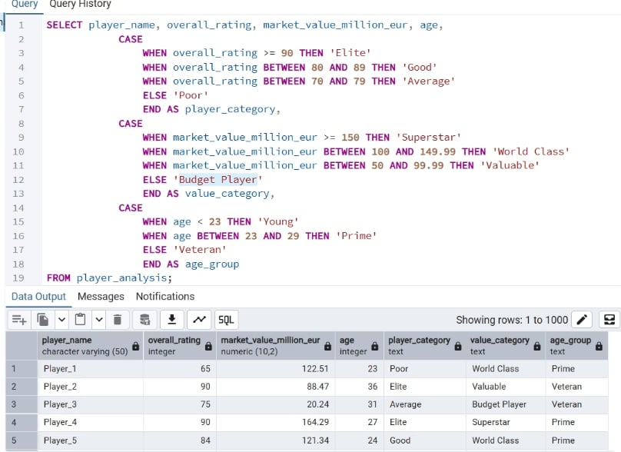
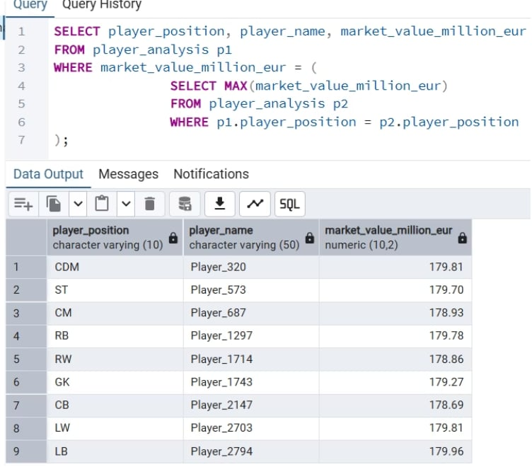
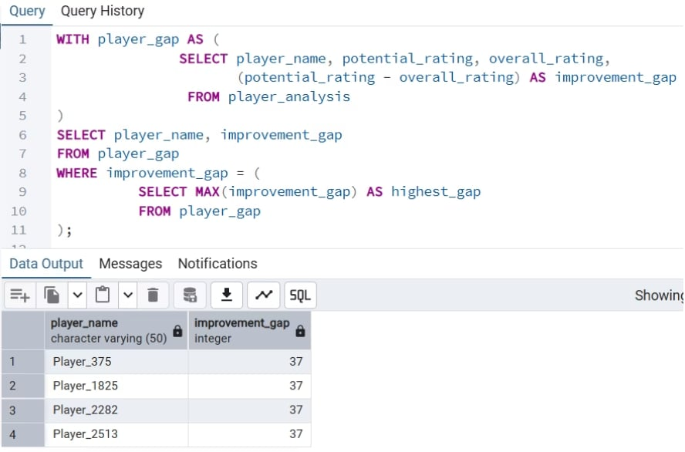
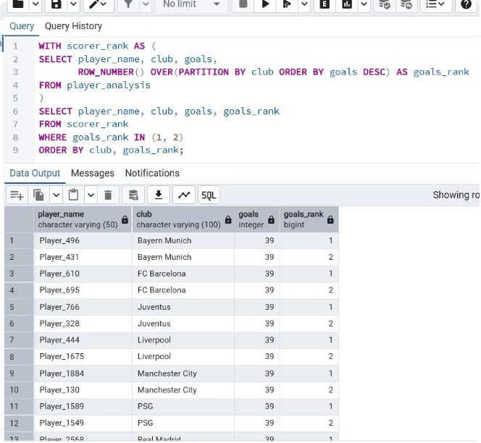
Sample SQL Query Exceution and Output
1. Player Categorization (CASE)
2. Most Expensive per Position (Subquery)
3. Potential Gap Analysis (CTE)
4. Top Scorers per Club (Window Function)

Slide 8
Business Questions
Clubs with total market value above €30000 million
Players more valuable than the average player in the club
Most expensive player in each playing position
Players with the largest gap between potential and overall rating
Clubs with average market value greater than €90 million
Clubs spending more than €200 million on injury-prone players
Second highest-rated player in each club
Players whose market value is higher than the previous player in their club

Slide 9
Key Insights
📈 Young Talent
💰 Undervalued Gems
⚠️ Injury Risk
Young players show the highest improvement potential — early signing maximizes ROI.
Several high-performing players are undervalued in the transfer market.
Injury-prone players represent significant financial risk; some clubs invest heavily in them.
📄 Contract Risk
🎯 Efficiency Metrics
Players nearing contract expiration increase transfer risk and reduce asset value.
Goals per 90 minutes reveal hidden high-impact performers beyond total goals.

Slide 10
Business Recommendations
🎯 Scout High-Potential Youth
🔎 Target Undervalued Players
🛡️ Reduce Injury-Risk Investment
Sign players with large improvement gaps before their value rises.
Data-driven scouting improves squad quality while controlling spend.
Factor injury history into transfer decisions; limit budget allocation to high-risk players.
🤝 Renew Key Contracts Early
📊 Use Efficiency Metrics
👥 Build Balanced Squads
Evaluate using goals/assists per 90 min for fair starter vs. substitute comparison.
Prioritize players with <1 year left to protect club assets.
Depth over star dependency improves long-term competitiveness.
🧠 Analytics for Transfers
Combine ratings, value, age, potential & injury history to reduce transfer risk.

Slide 11
Project Structure & How to Run
Repository Structure
Steps to Run
Clone the repo from GitHub
fifa-player-performance-analysis-sql/
├── README.md
├── dataset/
│ └── fifa_player_performance_analysis.csv
├── sql_queries/
│ ├── player_analysis.sql
│ ├── data_cleaning.sql
│ ├── eda.sql
│ ├── business_questions.sql
│ └── advanced_queries.sql
├── docs/
│ └── FIFA_Player_Performance_Analysis_Report.pdf
└── FIFA_Player_Performance_Analysis_Presentation.pdf
Open PostgreSQL and create a new database
Import the CSV dataset
Execute the SQL scripts
Review insights, report & presentation

Slide 12
Conclusion & What's Next
This project demonstrated how SQL & PostgreSQL can drive real-world football analytics — from scouting and transfers to contract management and squad planning.
Skills Demonstrated
Future Roadmap
SQL.
PostgreSQL
EDA.
Data Cleaning.
Window Functions.
CTEs.
Business Analysis.
Data Storytelling.
Python automation.
Power BI dashboards.
ML predictive models.
Expanded datasets.
Automated ETL pipelines.
Scouting recommendation system.

