Slide 1

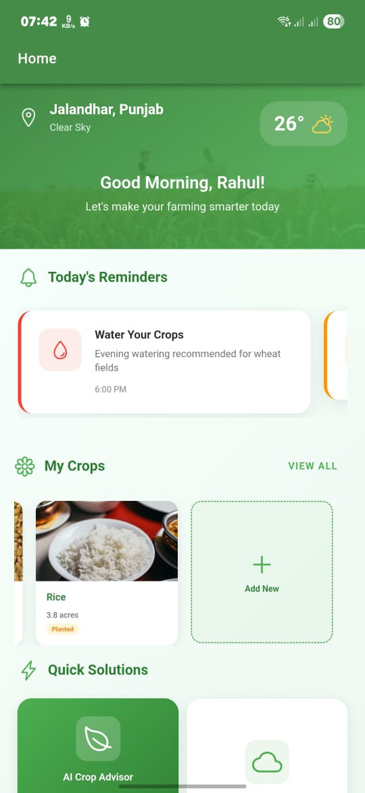
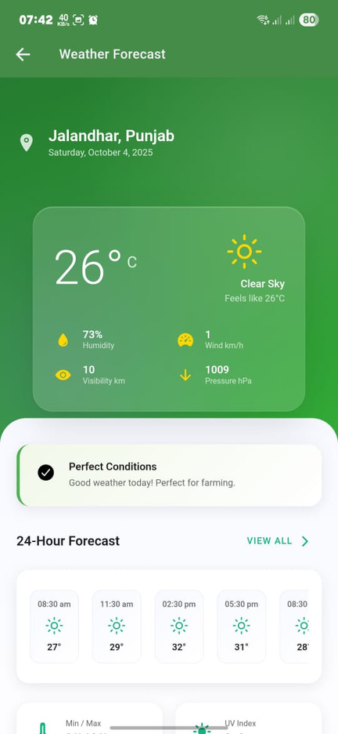
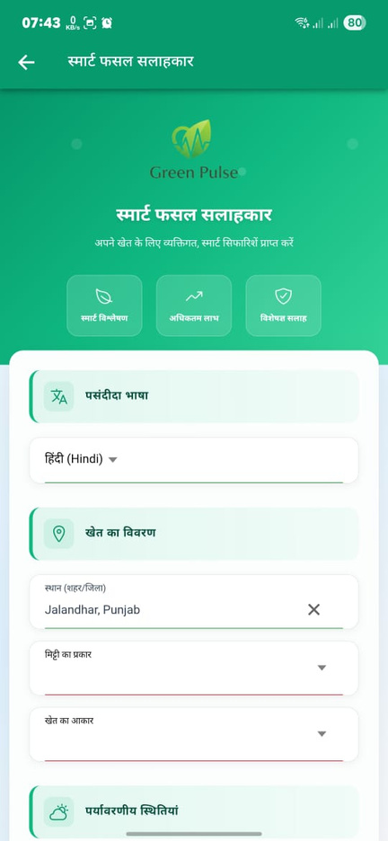
All New
Green Pulse

Slide 2

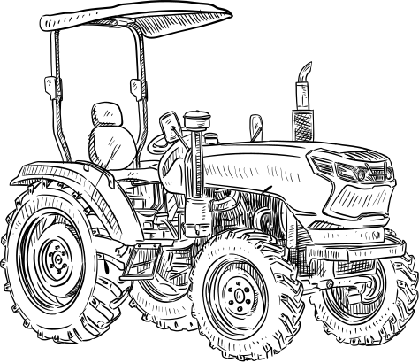
Green Pulse App
AI-powered farming for small & marginal farmers

Slide 3


Problem Statement
Farmers rely on guesswork for crop decisions
Lack of soil & weather-specific advice
Difficulty in detecting pests & diseases early
Unaware of real-time market prices
Language barriers restrict access to digital tools

Slide 4


Solution Overview
A Multilingual, AI-based Mobile App & Chatbot that provides:
Mobile-First Design Built with Ionic + Laravel
Real-time soil & fertilizer guidance
Farmers get easy guidance according to their region Language
Market price updates

Slide 5

Key Features
Multilingual Support – Farmers get advice in local language
Soil Health & Fertilizer Guidance – AI-driven recommendations
Weather-based Alerts, heatwave &Whatsapp alerts
Pest/Disease Detection – Upload photo → AI diagnosis
Market Price Tracking – Real-time mandi & online prices

Slide 6
How It Works
Farmer registers & selects preferred language
App syncs with weather, AI, and market data
Farmer inputs crop details / uploads images
AI provides instant advisory & alerts
Chatbot answers queries in real-time

Slide 7




Technology Stack
Frontend: Ionic (cross-platform mobile app, modern UI/UX)
Backend: Laravel (REST APIs, authentication, data storage)
Database: MySQL
Integrations APIs: Google Gemini / ElevenLabs

Slide 8


Impact
Increased crop yield
Reduced fertilizer misuse
Early pest control → less crop loss
Better market awareness → higher income
Empowerment through local-language advisory

Slide 9
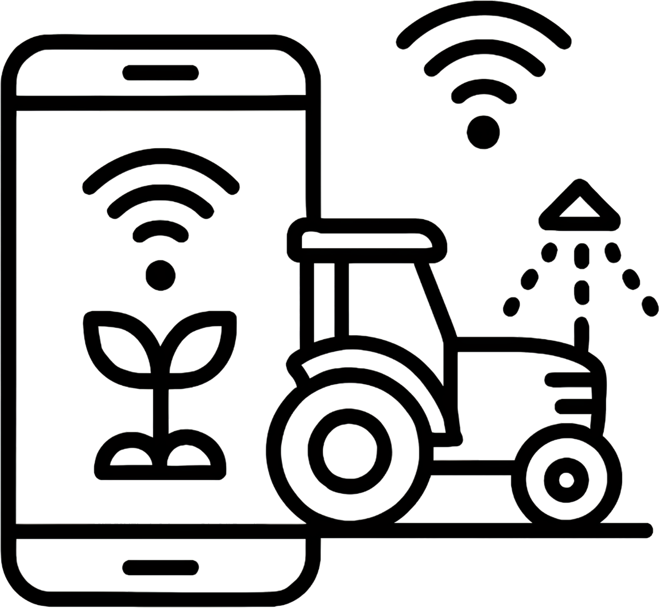
Future Scope
Ai Call Agent with Native Languages
Integration with drones & IoT soil sensors
AI-powered yield prediction
Farmer-to-farmer knowledge sharing
Government & NGO partnerships
Attach hardware devices

Slide 10


Conclusion
Our mobile app empowers farmers with real-time, location-specific crop guidance in their preferred language. By providing soil & weather advice, pest/disease alerts, and market price updates, farmers can:
Increase crop yield
Reduce fertilizer misuse
Control pests early → minimize crop loss
Make better decisions → higher income
In short: Easy-to-use mobile advisory = Smarter and more profitable farming.

