Slide 1

POCKETS OF PLAYLIST
TEAM MEMBERS :
AMRUTHA JAYANTHIMALA SUKUMARAN - C0860921
NAGARAJU TALLPALLEY -C0859913
ARVIND SINGH JUGTWAN -C0860886
RAHUL RAVINDRA MADESHIYA -C0860488

Slide 2
INTRODUCTION OF OUR PROJECT
Pockets of Playlists is a company that specializes in computer software and database development.
Recently, Nayak joined the team and is excited to work with Pitch Garland, a veteran of the music industry and a driving force behind the company's success.
As an intern, Nayak will help develop software that connects songs and compositions with peers.
Pitch's fun and quirky personality fuels the team's passion, further inspiring them to develop innovative solutions for music-related.

Slide 3
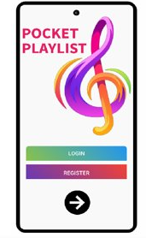
DEVELOPERS TOOLS FOR ANDROID :
TOOLS: Android studio and android debug bridge , Eclipse, VYSOR, Stetho.
LANGUAGES : python, c#, c++, html and css , java.
FRAMEWORKS: Flutter framework , react native, iconic framework, xamarin framework, jquery.

Slide 4

DEVELOPERS TOOLS FOR MacOS:
TOOLS: FelxiHub, Xcode.
LANGUAGES: swift, python, java, ruby
FRAMEWORK: getcss, react native , kendo UI, javascript UI, NET MAUI

Slide 5
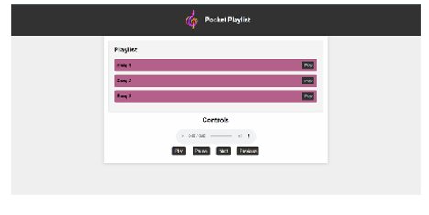
DEVELOPERS TOOLS FOR WEB APP DEVELOPMENT:
TOOLS: Tauri, ElectronJS,
LANGUAGES: C++, C#, python , javascript, html and css.
FRAMEWORK : .NET, XOJO, pyqt,Kivy.

Slide 6
DATABASE OPTIMIZATION TECHNIQUES & STRATEGIES:
Database optimization is fundamental for organizations seeking to make the most of their data assets. This procedure involves a set of methods and actions to ensure that data is collected, analyzed, and stored efficiently. It encompasses a range of techniques aimed at improving data quality.
The goal is to ensure that the data is relevant, meaningful, and up to date. As a result, when data sets are extracted and examined for metrics and key performance indicators, the data is accurate and faithfully reflects consumer behaviours, preferences, and challenges.

Slide 7
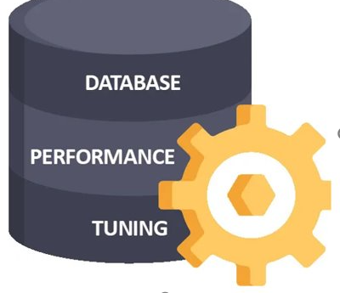
DATABASE OPTIMIZATION TECHNIQUES & STRATEGIES:
1.Data Collection
2.Data Analysis
3.Data Storage
4.Automation Solutions
5.Customized Approaches
6.Data Governance
7.Scalability

Slide 8
IMPACT OF COLLABRATION WITH STAKEHOLDERS:
Contextual Awareness: Enhanced understanding of project context and objectives.
User-Centered Approach: Tailoring solutions to meet user expectations.
Realistic Planning: Addressing practical constraints for achievable project plans.
Expert Insights: Deepened knowledge in complex areas for informed decisions.
Continuous Improvement: Iterative problem-solving, leading to ongoing enhancements.
Risk Mitigation: Proactive identification and resolution of potential issues.
Alignment with Goals: Ensured team efforts align with project objectives.
Adaptability: Increased team adaptability to evolving requirements.

Slide 9
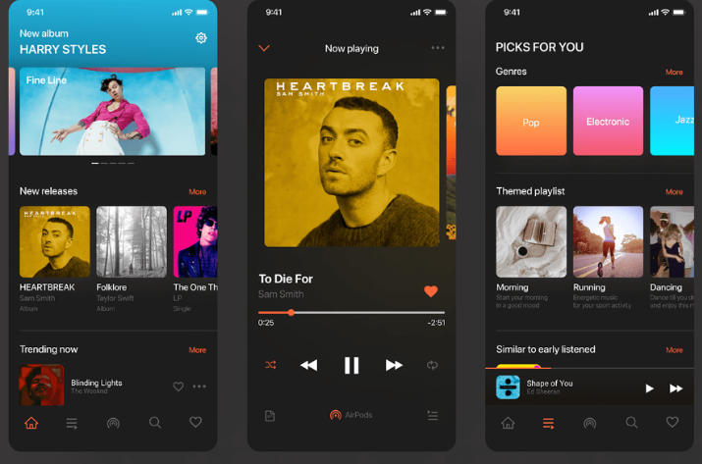
KEY FEATURES INCLUDED IN OUR APP :
FOR EXAMPLE:
User Verification: Registration, Login, Password Recovery.
Song Exploration: Search Functionality, Category-Based Navigation, Personalized Suggestions.
Playlist Control: Creation, Adding/Removing Songs, Management.
Content Sharing: Social Media Sharing, Collaborative Playlist Building, Shareable Links.

Slide 10
PROGRESSIVE WEB APP CONCEPTS:
Online Access: The Progressive Web Apps (PWAs) can function even without an internet connection, making offline access a unique feature.
Responsive Design :PWAs adjust seamlessly to various devices and screen sizes through flexible layouts, images, and CSS media queries.
Push notifications: can be sent to users by PWAs, even when the app is inactive, thanks to the Push API. The API enables servers to dispatch messages to the Service Worker, which displays notifications.

Slide 11
PROGRESSIVE WEB APP CONCEPTS:
Our aim with "Pocket of Playlist" is to create a dynamic and user-focused music app that caters to the preferences and requirements of our users. To achieve this, we have incorporated key concepts of progressive web apps. By focusing on testing processes, we are confident that our PWA will provide an outstanding online user experience that will enhance user satisfaction, retention, and engagement. Our development approach, "Pockets of Playlist," is centered around this commitment to quality and user happiness. We are excited to unveil our exceptional PWA, which we believe will delight our users.

Slide 12

DATA SECUIRTY FOR POCKETS OF PLAYLIST :
Top visible vulnerabilites
Data leaks
Code injections
Insecure authentication
User privacy
Third party libraries

Slide 13
DATA SECURITY FOR OUR APP:
in today's digital age, it is of utmost importance to secure our data. Adhering to recommended security protocols becomes the cornerstone of safeguarding our personal information and confidential data. This includes creating strong and unique passwords, enabling two-factor authentication for our various accounts, and consistently updating software and applications. The use of firewalls and anti-virus solutions acts as a shield against vulnerabilities and malicious software. Encryption serves as an additional layer of protection, and regular data backups are vital for swift recovery in unforeseen situations. Exercising vigilance when dealing with emails and hyperlinks, strengthening wifi networks, and routinely reviewing app permissions are all integral components of data security. By adopting these measures and staying informed about emerging threats, we can significantly enhance the security of our data.

Slide 14
CLIENT REQUIREMENT FOR PLATFORM ENCHANCMENT:
Seamless social sharing :Seamless social sharing involves integrating social sharing features to provide users with a convenient experience across various social media platforms.
Real –time Collabrative Editing :Real-time collaborative editing allows multiple users to work on a document or project at the same time, with any changes made being immediately visible to all participants. This functionality is crucial for enhancing productivity and promoting teamwork, and is commonly used in a variety of applications such as document and code editors, project management tools, and more.

Slide 15
CLIENTS REQUIREMENTS:
User –friendly interface
Audio editing tools
Multi-track Editing
Real –time collaboration
Effects and filters
Instrumental and virtual instruments
File compatiblity
Version control
Cloud integration
Security measures
Platform compatiblity
User permissions
Export and sharing options
Feedback and support

Slide 16
LIST OF USER’S STORIES THAT CAPTURE UNIQUE PLAYLIST FEATURES:
STORY 01: Users want to collaborate with friends on playlists, enabling multiple participants to add, delete, and modify music in real-time.
STORY 02: Music fans desire an AI-powered recommendation system that can create dynamic playlists based on their listening history, mood, and time of day.
STORY 03: Fitness enthusiasts require a tool that can automatically produce playlists tailored to their training regimens, adjusting pace and genre based on activity intensity.
STORY 04: Commuters want to create playlists that change based on their GPS locations so that the music matches their environment or travel path.
STORY 05: Users with varying musical tastes wish to blend multiple playlists into one cohesive list without duplicate tracks.

Slide 17
LIST OF USER’S STORIES THAT CAPTURE UNIQUE PLAYLIST FEATURES:
STORY 06: Party hosts want a feature that allows guests to make live song requests, which are seamlessly integrated into the playlist queue.
STORY 07: Language learners need access to curated playlists with songs in the language they're learning, which gradually increase in complexity as they progress.
STORY 08: Individuals seeking nostalgia may choose to create playlists based on specific life eras or milestones, gathering songs from particular years or key life events.
STORY 09: Curators require a tool that can assess the mood or energy of existing playlists and suggest complementary music to enhance the overall vibe.
STORY 10: Users who want to conserve data choose an offline option that allows them to pre-download or cache playlists for offline listening.

Slide 18
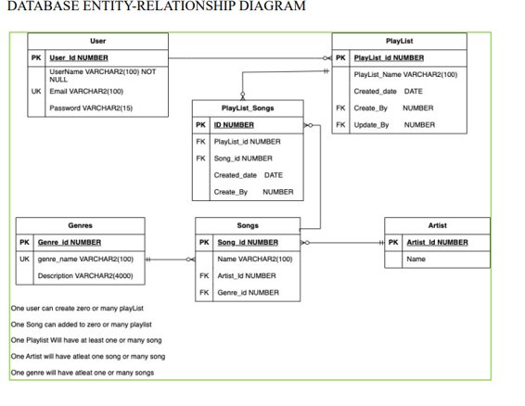
DATABASE SCHEMA AND TABLES FOR PLAYLISTS, SONGS, ARTISTS, GENRES, AND OTHER RELEVANT ENTITIES:

Slide 19
CONCLUSION:
After reviewing our efforts to enhance playlist-building tools, we realized that understanding user stories is crucial to creating an engaging musical experience. Our thorough examination of each user narrative uncovered specific attributes, such as genres, moods, and artist preferences, that are vital for an immersive musical journey. It was imperative to choose appropriate data types to facilitate the efficient storage and management of various playlist elements. Through our research, we identified suitable data types that corresponded to the different characteristics of playlist attributes. Our commitment to building an exceptional music platform remains unshaken, driven by our desire to innovate and evolve in response to user needs, enabling seamless integration between music enthusiasts and technology.

Slide 20
THANKYOU

