Slide 1
Oral Cancer Detection
Project Id - 148-CSE-M
Under the guidance of
Ms. Deepti Gupta
Mr. Rahul Tanwar (01414802719)
Mr. Saurabh Bisht (01314807220)
Mr.Akshansh kumar (10014802719)

Slide 2
Contents
Problem Statement
Project Title
Abstract
Introduction
Technology Stack
References

Slide 3
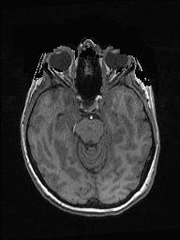
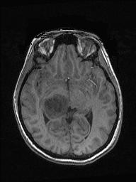
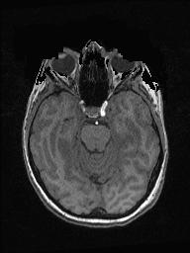
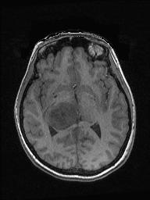
Problem Statement
we need to convert the DICOM images to JPG format before feeding them into the CNN models. The goal of this project is to develop accurate CNN models that can effectively classify medical images and assist healthcare professionals in making accurate diagnoses. In our work we will use Convolutional Neural Network, VGG-16,ResNet-50 and Inception v3

Slide 4
Abstract
Oral cancer is one of the most common head and neck malignancies and has an overall 5-year survival rate that remains below 50%. Oral cancer is generally preceded by oral potentially malignant disorders (OPMDs) but determining the risk of OPMD progressing to cancer remains a difficult task. Several diagnostic technologies have been developed to facilitate the detection of OPMD and oral cancer, and some of these have been translated into regulatory-approved in vitro diagnostic systems or medical devices. Furthermore, the rapid development of novel biomarkers, electronic systems, and artificial intelligence may help to develop a new era where OPMD and oral cancer are detected at an early stage. To detect oral cancer we are going to use deep learning on jpg images (converted from dicom images). In our work we will use Convolutional Neural Network, VGG-16,ResNet-50 and Inception v3

Slide 5
Introduction
Now most detection and diagnosis methods depend on decision of neuro specialists, and radiologist for image evaluation which possible to human errors and time consuming
The main purpose of this project is to build a robust CNN model

Slide 6
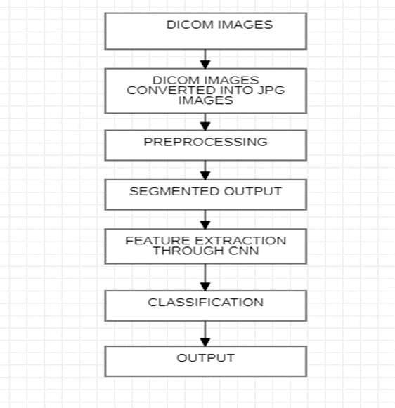

Slide 7
Technology Stack
Python , Deep Learning, CNN Models such as InceptionNet, VGG16, ResNet50

Slide 8
References
[1] Hao Zhang, Wei Li, Hanzhong Zhang “ An Image Recognition Framework for Oral Cancer Cells” 2021
[2] Huiping Lin, Hanshen Chen, Luxi Weng, Jiaqi Shao, and Jun Lina, “Automatic detection of oral cancer in smartphone-based images using deep learning for early diagnosis” 2021
[3] Rogério Ribeiro de Paiva, Paulo Tadeu de Souza Figueiredo, André Ferreira Leite, Maria Alves Garcia Silva “Oral cancer staging established by magnetic resonance imaging” 2011
[4] Zhalong Hu; Abeer Alsadoon; Paul Manoranjan; P. W. C. Prasad; Salih Ali; A. Elchouemic “Early stage oral cavity cancer detection: Anisotropic pre-processing and fuzzy C-means segmentation” 2018
[5] T. Morikawa , A. Kozakai , A. Kosugi , H. Bessho , T. Shibahara “Image processing analysis of oral cancer, oral potentially malignant disorders, and other oral diseases using optical instruments” 2020

