Slide 1

DSP-PROJECT
CNN Based Audio Classification Using Mel-Spectrogram
Students : Chaitanya Ponnana
Rahul Adithya P
Surya Gurajapu
01/13

Slide 2
Overview of Our Approach
Raw audio signals are high-dimensional, vary in length, and are hard for models to learn directly, so the goal is to convert each audio clip into a compact and informative time-frequency representation and then classify it into one of the selected sound classes using a CNN.
MFCC-style processing is a common method used to convert speech or audio into useful features.
This process includes pre-emphasis, framing, windowing, FFT, Mel filter banks, log compression, DCT, and normalization.
IIT Bhubaneshwar
02/13

Slide 3
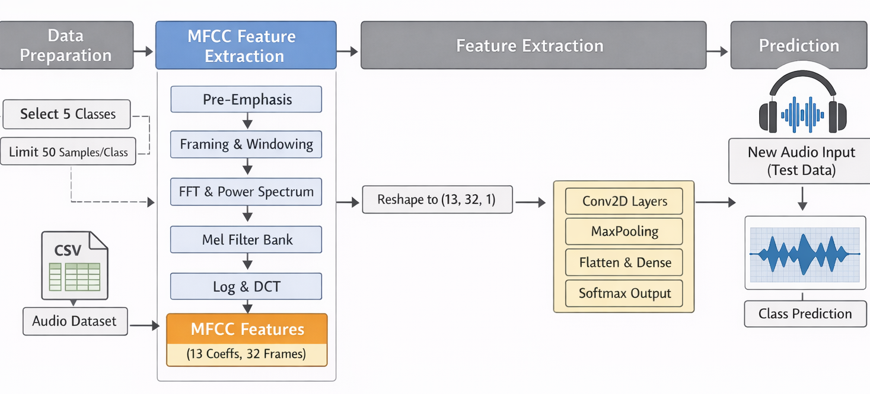
PIPELINE
IIT Bhubaneshwar
03/13

Slide 4
Data Input and Audio Preprocessing
Load dataset from CSV (train.csv)
Select top 5 classes
Limit to ≤ 100 samples per class (balancing)
Load audio using librosa.
Resample to 16 kHz.
Fix duration to one second and Pad if short.
Trim if long.
IIT Bhubaneshwar
04/13

Slide 5
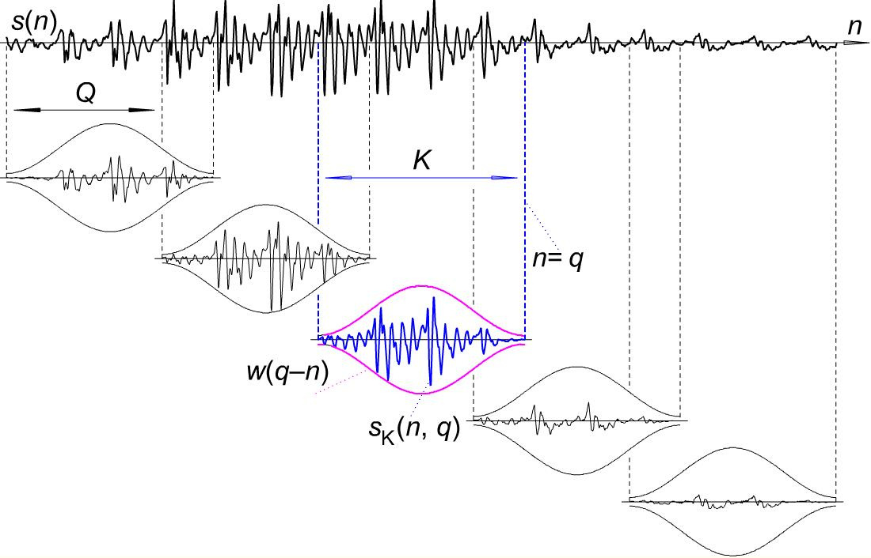
,
MFCC Extraction Details
Pre-emphasis: Boosts high-frequency components to balance spectral energy distribution.
Framing: Segments signal into short-time frames assuming local stationarity.
Windowing (Hamming): Reduces spectral leakage by smoothing frame edges.
FFT: Transforms time-domain frames into frequency-domain representation.
IIT Bhubaneshwar
05/13

Slide 6
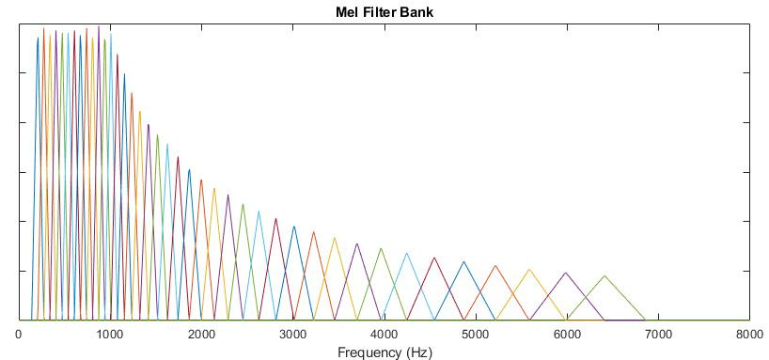


,
MFCC Extraction Details
Power Spectrum: Computes energy distribution across frequency bins.
Mel Filter Bank: Maps frequencies onto the perceptual Mel scale, emphasizing human hearing.
A single number representing the total energy in that Mel frequency band
IIT Bhubaneshwar
06/13

Slide 7
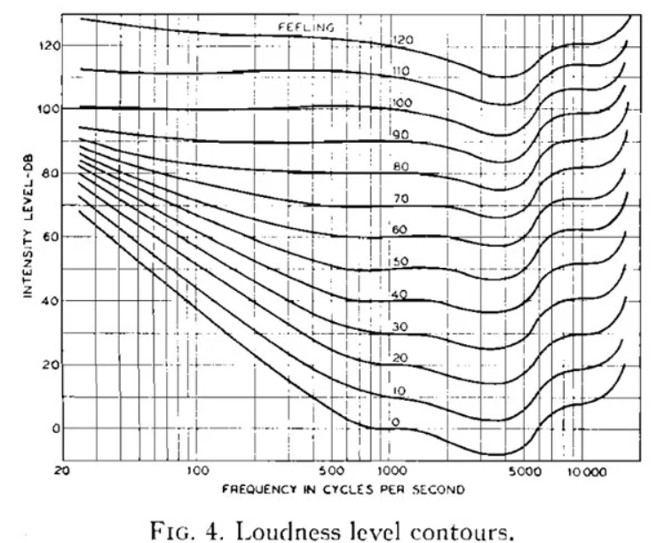

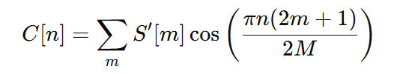
,
MFCC Extraction Details
Log Compression: Reduces dynamic range and approximates human loudness perception.
DCT: Decorrelates filter bank outputs to produce compact MFCC features.
IIT Bhubaneshwar
07/13

Slide 8
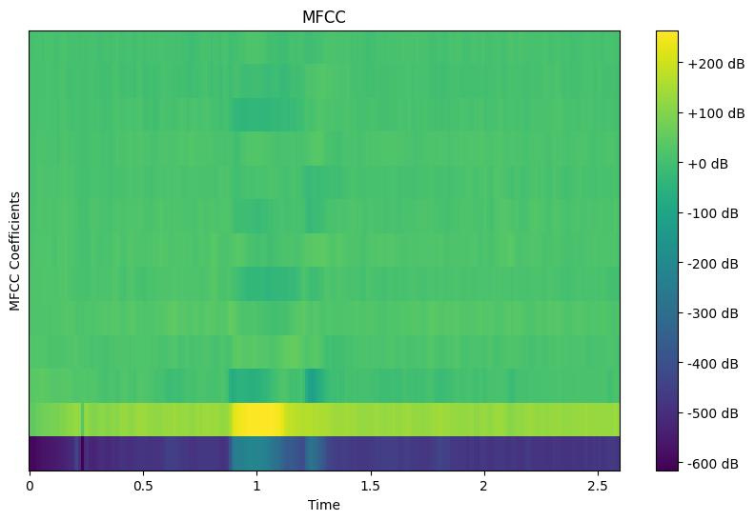
,
MFCC Extraction Details
MFCC Representation: Encodes spectral envelope in low-dimensional form, often visualized as a 3D time–frequency–intensity representation.
Intensity: Represents the log-scaled energy (magnitude) of the signal in each Mel-frequency band at a given time frame.
Frame Limiting: Standardizes temporal dimension (fixed number of frames).
Normalization: Centers features to stabilize learning and reduce bias.
Final Output: Structured time-frequency feature map ready for CNN input.
IIT Bhubaneshwar
08/13

Slide 9
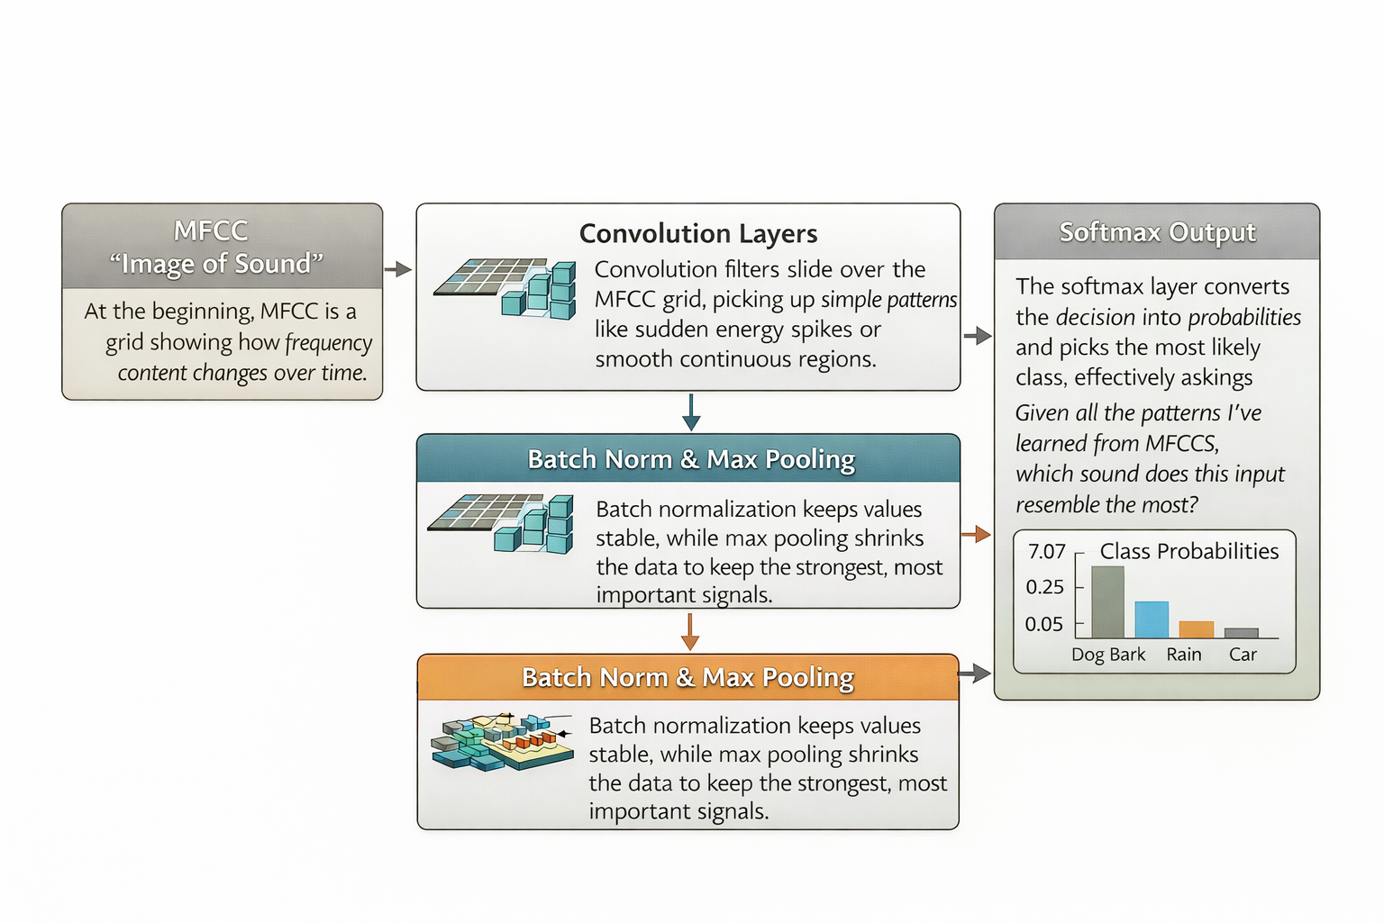
,
MFCC → CNN Pipeline
IIT Bhubaneshwar
09/13

Slide 10
CNN Model Architecture
Convolution Blocks (×3):
Stacked Conv2D → BatchNorm → MaxPooling layers progressively extract hierarchical patterns from MFCC maps — from low-level spectral edges to high-level acoustic features.
Feature Compression:
Flatten + Dropout converts 2D feature maps into a compact vector while reducing overfitting and improving generalization.
Classification Head:
Dense(128) → Softmax learns nonlinear decision boundaries and outputs class probabilities.
Abhaya Libre
IIT Bhubaneshwar
10/13

Slide 11
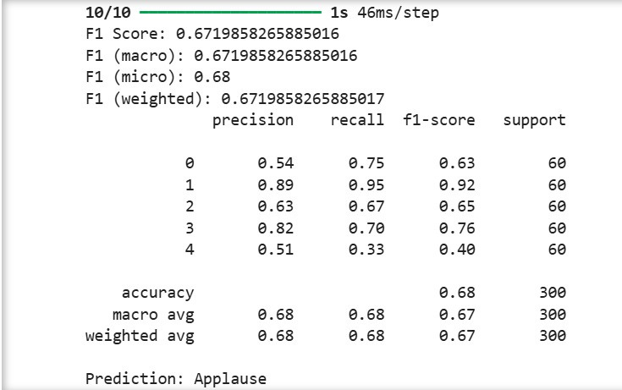
Training Setup and metrics
Loss function: sparse_categorical_crossentropy
Optimizer: Adam
Metric: accuracy
Train-test split: 80% / 20%
Stratified split to preserve class balance
IIT Bhubaneshwar
11/13

Slide 12
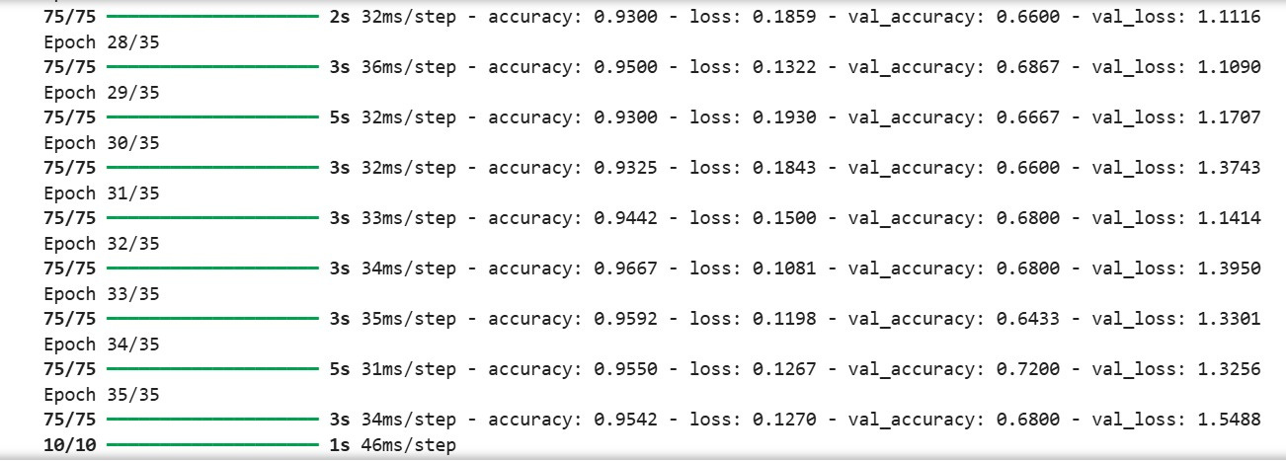
Results
CNN
IIT Bhubaneshwar
12/13

Slide 13
Conclusion and reference
This project combines classical DSP and deep learning in one pipeline. The DSP stage converts raw audio into structured MFCC features, and the CNN stage learns class-specific patterns from those features. That is why the presentation should be described as “DSP-based audio feature extraction followed by CNN-based deep learning classification.” MFCCs remain a widely used and practical front end for audio tasks, even though CNNs are the final classifier here.
ref 1 : https://practicalcryptography.com/miscellaneous/machine-learning/guide-mel-frequency-cepstral-coefficients-mfccs/https://haythamfayek.com/2016/04/21/speech-processing-for-machine-
learning.htmlhttps://datagenetics.com/blog/november32012/index.html
ref2 : http://practicalcryptography.com/miscellaneous/machine-learning/guide-mel-frequency-cepstral-coefficients-mfccs/
ref3 : https://haythamfayek.com/2016/04/21/speech-processing-for-machine-learning.html
ref 4 : http://datagenetics.com/blog/november32012/index.html
IIT Bhubaneshwar
13/13

