Slide 1
Localization of Sensors
Gaurav Sharma
Rahul Ajmera
Group 5
Department of Computer Science and Engineering
Indian Institute of Technology , Kanpur
8th April 2013

Slide 2
Problem Statement
Given a sensor network of N sensors at locations S = {S1, S2,.......,SN}. So, mathematically the localization problem can be formulated as follows: given a multihop network, represented by a graph G = (V, E),and a set of beacon nodes B, their positions {xb, yb} for all b ε B, we want to find the position {xu, yu} for all unknown nodes u ε U.

Slide 3
Radio Propagation Model
ITU Terrain Model.
Applicable for all terrains.
Valid for all distances and frequency.
Handles diffraction due to obstacles.
Developed on the basis of diffraction theory and first fresnel zone.

Slide 4
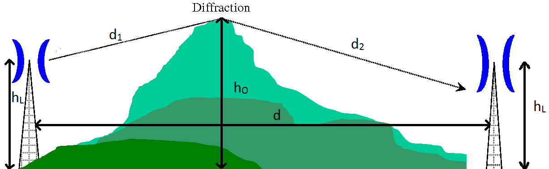
Radio Propagation Model
Formula: A=10-20C_{N} C_{N}=h/F₁ h=h_{L}-h_{O}
F₁=17.3 √d₁d₂/fd where, f is frequency and A is additional loss due to diffraction.
These losses are summed with Friis transmission equation loss to get overall signal strength.

Slide 5
Implemented Algorithms
APIT
Diffusion
Moving Sensor
Moving Target
Gradient
Simulated Annealing
Centroid

Slide 6
APIT
Node are assumed to be listening to beacons, and storing distances from each one.
Based on the signal strength, it determines the triangles in which the node lies.
Centroid of the intersection area of all such triangles is estimated to be the localized coordinates.

Slide 7
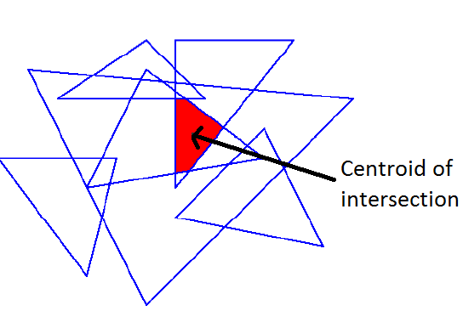
APIT

Slide 8
Diffusion
Location of a node is centroid of its one hop neighbors.
Iteratively allocate location of a node to be average of it's neighbors.
Terminate when steady state is reached, or after a fixed number of loops.

Slide 9
Moving Sensor
A beacon is randomly moved in the grid and it broadcasts its coordinates to the neighbors at all time.
Every time a node senses the beacon, it generates a new quadratic constraint that it uses to further reduce the uncertainty in its position.

Slide 10
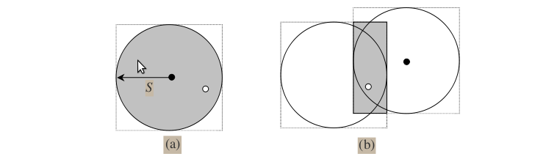
Moving Sensor
(a) Node sensing beacon for the first time and constraining itself in the shaded region.
(b) Beacon moves to another location, node senses again and reduces its region.

Slide 11
Moving Target
All the nodes are moved in the grid to detect beacons.
When it detects a beacon it introduce a bounding box constraint on its position.
If the node does not encounter any beacon than it bounding box remains the whole grid.
If a beacon at (x`,y`) after travelling (x,y) than a square bound of side twice the node range is imposed at (x`-x,y`-y).

Slide 12
Moving Target

Slide 13
Gradient
All beacons initiates a gradient by sending its neighbors a message with its location and a count set to one.
Each recipient remembers the value of the count and forwards the message to its one hop neighbors with the count incremented by one.
Hence a wave of messages propagates outwards from the beacon, while each sensor maintains the minimum counter value received from all beacons.

Slide 14
Gradient
Hop size of each beacon is calculated by using the number of hops and actual distances from other beacons.
A error function of two variables x,y for each node is minimized, which is defined by:
Error = |Σ(x-x_{i})²+Σ(y-y_{i})²-Σd_{i}²| summed over all beacon nodes(i).

Slide 15
Centroid
Triangulation of beacons is used, to determine triangle containing the nodes, based on the signal strength.
Contribution to localization α 1/Area of Triangle
Fast Algorithm.

Slide 16
Simulated Annealing
System starts from random state and comes to equlibrium.
A small pertubation (random displacement ) is given to nodes and Cost Function is calculated for that state.
If cost decreases than new state is accepted but if cost increases than the state is accepted with probability, so that it does not get stuck at local minima.

Slide 17
Simulated Annealing
Cost Function
Probability Function

Slide 18
Results

Slide 19
Results

Slide 20
Results

Slide 21
Results

Slide 22
Conclusion
Based on the qualities required by the system, a cost function of the system can be obtained in terms of accuracy, tolerance due to obstacles, time required for computation and variation in error.
Based on the obtained cost function an appropriate algorithm could be used which minimizes the cost.

