Slide 1
Translation of Code-Mixed Data to English and its Sentiment Analysis
By: Rahul Augustine C J
PES2PGE20DS193

Slide 2
What is Code-Mixed Data ?
Words belonging to different languages are mixed with each other in the same sentence.
Contains mixed vocabulary and syntax of multiple languages.
For example : मेने बास numbering नही की है
Also, using roman characters instead of the native script.
For example : My brother always told me ki in retrospect, badi dikkatein chhoti lagti hain.
It is informal in nature and used mostly on social media.

Slide 3
Problems related to Code-Mixed Data
Social media platforms such as YouTube, Facebook and Twitter do not have the ability to perform sentiment analysis on comments, posts, tweets, etc. that are in code-mixed form.
They also do not have the ability to translate languages written in code-mixed form to English for the users to understand its meaning.
The pre-trained models are trained on languages in their native script, not in code-mixed form that users prefer to write online.

Slide 4
Solution – Translate Code-Mixed Data to English (But why English??)
Most of the NLP work is done in the English Language.
State-of-the-art pre-trained models that are finetuned for sentiment analysis are trained on huge datasets in the English language when compared to other languages.

Slide 5
Benefits
Increase the accuracy for the sentiment analysis of code-mixed data.
Enable any user (even the non-native speakers) on social media platforms to understand its meaning.

Slide 6
Why is this required ?
To filter out any negative comments, posts or tweets on social media.
To enable social media users to report any negative conversations without relying on native speakers.
Therefore, to build automatic moderation systems to eliminate a huge portion of the harmful content from social media sites.

Slide 7
What is the Goal of this Project ?
Improve the translation quality of code-mixed data to English and the F1 score / accuracy for the sentiment analysis of code-mixed data.

Slide 8
How to achieve this ? – The Steps involved in the Project
Transliteration & Normalization
Translation
CSNLI library
(transliterates the Hindi words in Roman script to Devanagari and also performs text normalization for Hindi and English)
mBART
(translates Hindi code-mixed data to English)
BLEU Scores
(to see how good the translation is)
Sentiment-Analysis
F1-weighted Scores
(to measure how well the pre-trained models are able to classify the data based on its sentiment)
BERTweet
(pre-trained model fine-tuned for sentiment-analysis in the English language )

Slide 9
Datasets
Hindi – English code-mixed data.
Machine Translation:
PHINC: A Parallel Hinglish Social Media Code-Mixed Corpus for Machine Translation. (~13,700 sentences)
Enabling Code-Mixed Translation: Parallel Corpus Creation and MT Augmentation Approach. (~6,000 sentences)
Sentiment Analysis:
Sentiment Analysis of Code-Mixed Indian Languages: An Overview of SAIL Code-Mixed Shared Task @ICON-2017. (~12,600 sentences)

Slide 10
Transliteration & Normalization (Why CSNLI Library ?)
Made for Hindi – English code-mixed data.
(In this thesis, we will be using the transliterated versions of the datasets that has already been made available.)

Slide 11
Transliteration & Normalization – Process
Input
Output
My brother always told me ki in retrospect, badi dikkatein chhoti lagti hain.
My brother always told me की in retrospect, बड़ी दिक्कतें छोटी लगती हैं.
CSNLI Library

Slide 12
Translation (Why mBART ?)
Leading recent research in multilingual translation.
Demonstrates competitive performance on a variety of low-resource machine translation pairs, as well as performance advances in languages not included in its pre-training corpus.
Pre-trained on large-scale monolingual corpora of 25 languages collected from Common Crawl1 using the BART objective.
With 55,608 million tokens (300.8 GB) and 1,715 million tokens (20.2 GB), the pre-training corpus includes both English and Hindi.
Unique pre-training objective : The input texts are noised by masking, deleting phrases and permuting sentences, and the texts are recovered using a single Transformer model.
Without any task-specific or language-specific changes or initialization procedures, mBART is trained once for all languages, yielding a set of parameters that may be fine-tuned for any of the language pairs in both supervised and unsupervised contexts.
While prior efforts focused primarily on the encoder, decoder, or reconstructing sections of the text, mBART is the first method for pre-training a whole sequence-to-sequence model by denoising full texts in several languages.

Slide 13
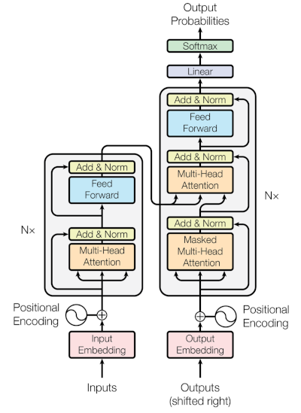
Encoder & Decoder

Slide 14
mBART - Architecture & Working
Who am I ? <s> Where did I come from ? </s> <En>
Transformer Encoder
Transformer Decoder
Well then . <s> See you tomorrow .</s> <En>
Where did __ from ? </s> Who __ I __ <s> <En>
<En> Who am I ? <s> Where did I come from ? </s>
Transformer Encoder
Transformer Decoder
तो ठीक है । <s> कल मिलते हैं । </s> <Hi>
तो ठीक है । <s> कल मिलते हैं । </s> <Hi>
<En> Well then . <s> See you tomorrow .</s>
Transformer Encoder
Transformer Decoder
__ मिलते हैं । </s> तो __ । <s> <Hi>
<Hi> तो ठीक है । <s> कल मिलते हैं । </s>
Multilingual Denoising Pre-Training (mBART)
Fine-tuning on Machine Translation

Slide 15
Translation – Process
Input
Output
My brother always told me की in retrospect, बड़ी दिक्कतें छोटी लगती हैं.
My brother always told me that, in retrospect, big problems seem to be small.
mBART

Slide 16
BLEU Scores
Evaluates the quality of machine translation.
BLEU always returns a number between 0 and 1.
Advantages:
fast and simple to calculate
widely used in research work
Disadvantages:
doesn’t consider the meaning
doesn’t incorporate sentence structure
struggles with non-English languages
hard to compare models that uses different tokenizers

Slide 17
SacreBleu Scores
Computing the SacreBLEU score is almost identical to the BLEU score.
For machine translation, the current recommendation is to use the SacreBLEU metric.
Adjusts the tokenization limitations of BLEU.
SacreBLEU takes care of the tokenization under the hood, that is it uses internal tokenizer to compute n-gram precisions.
Score ranges from 0 to 100.

Slide 18
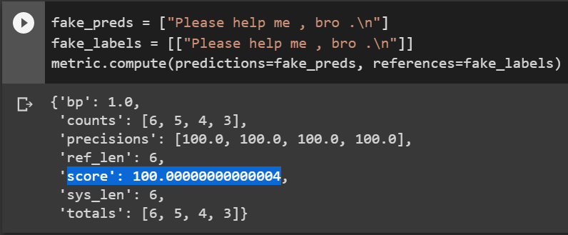
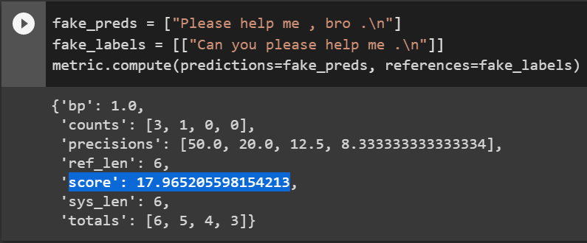
SacreBLEU Example

Slide 19
Sentiment Analysis (Why BERTweet ?)
First large-scale pre-trained language model for English Tweets that's been made available.
Developed on a corpus of 850 million English tweets.
Experiments demonstrate that BERTweet outperforms previous state-of-the-art models RoBERTabase and XLM-Rbase on three Tweet NLP tasks: part-of-speech tagging, named-entity recognition, and text classification.

Slide 20
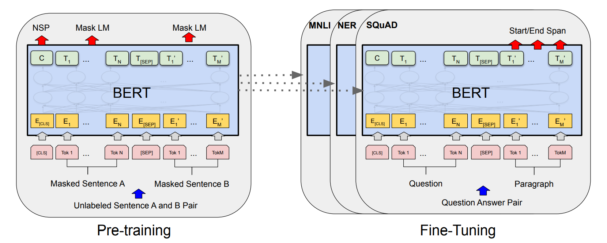
BERTweet – Architecture (same as BERT)

Slide 21
BERTweet – Process
Output
Positive = 1
Input
My brother always told me that, in retrospect, big problems seem to be small.
BERTweet
Neutral = 0
Negative = 0

Slide 22
F1-Weighted Score
Determined by averaging all per-class F1 scores while taking into account each class's support.
The number of actual instances of the class in the dataset is referred to as support.
The 'weight' refers to the proportion of each class's support compared to the total amount of support.

Slide 23
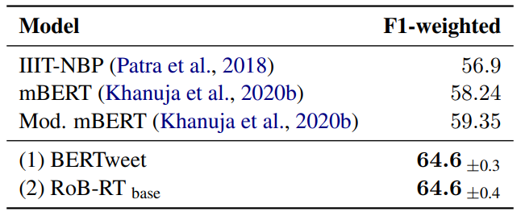
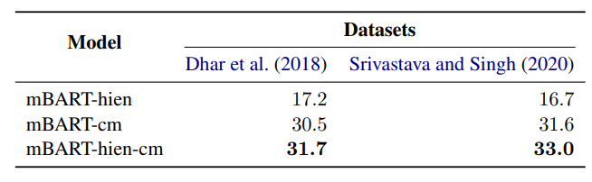
Previous Work
Machine Translation
Sentiment Analysis

Slide 24
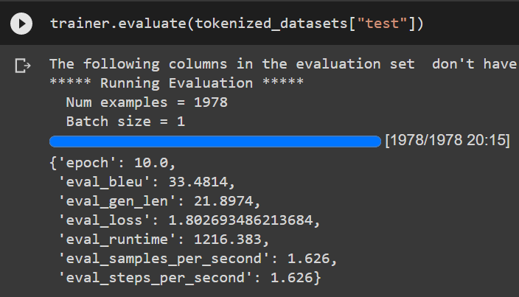
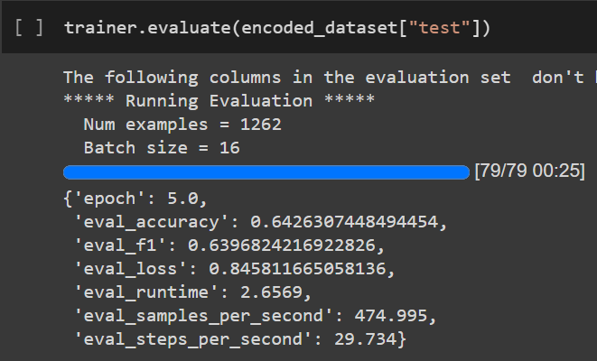
Results
Machine Translation
Sentiment Analysis

Slide 25
Graphical Comparison (Sentiment-Analysis)

Slide 26
Confusion Matrix
Previous Work
This Work
404
71%
404
71%
404
71%
404
71%
58
10%
58
10%
58
10%
58
10%
111
19%
111
19%
111
19%
404
71%
58
10%
111
19%
425
74%
69
12%
79
14%
NEU
NEU
NEU
NEU
106
37%
106
37%
106
37%
106
37%
152
52%
152
52%
152
52%
152
52%
32
11%
32
11%
32
11%
106
37%
152
52%
32
11%
113
39%
147
51%
30
10%
-VE
-VE
Target Class
-VE
-VE
Target Class
Target Class
Target Class
Target Class
94
24%
94
24%
94
24%
38
10%
38
10%
267
67%
94
24%
38
10%
267
67%
116
29%
44
11%
239
60%
+VE
+VE
+VE
+VE
NEU
NEU
-VE
-VE
+VE
+VE
NEU
-VE
+VE
Predicted Class
Predicted Class

Slide 27
Research Work Comparison
Research Work | Data for translation (# of sentences) | Translation (BLEU) | Data for Sentiment-Analysis(# of sentences) | Sentiment-Analysis (F1-Weighted)
Current SOTA | 1,629,516 | 31.05 | 12,601 | 64.6
This Project | 19,834 | 33.5 | 12,601 | 64

Slide 28
Future Work
Improve the quality of translation to English (improve the BLEU scores)
Overcome the Class Imbalance problem

Slide 29
Thank You

