Slide 1
openXMPP
A modular, multi-platform, standards-compliant XMPP library written in C#
Rahul and John

Slide 2
Outline
Introduction to XMPP
Motivation for openXMPP
Library Design and Systems Concepts
openXMPP Demonstration
Future Work
Questions

Slide 3
XMPP
Extensible Messaging and Presence Protocol
A protocol for streaming XML elements in close to real time between any two network endpoints
Provides a generalized, extensible framework for exchanging XML data
Mainly used in instant messaging and presence applications (Jabber)
RFC 3920: XMPP Core. http://www.xmpp.org/specs/rfc3920.html.

Slide 4
openXMPP
A modular, multi-platform standards-compliant XMPP library
Provides required functionality listed in RFC 3920 and RFC 3921:
  XML streams
  XML stanzas
  TLS stream encryption
  SASL authentication
  Resource binding
  Roster and subscription management
  Internationalization (*)
  Conversation threads (*)
  Directed presence information (*)
  New account registration (*)
Library: 3601 lines, 1379 statements
Project: 5825 lines, 2304 statements
* Optional RFC functionality

Slide 5
XMPP session establishment
Offline
Connected
StartingTLS
Connected
StartingSASL
StartingSession
LoggedIn
Client
Server
<stream:features>
<starttls xmlns='urn:ietf:params:xml:ns:xmpp-tls'>
<required/>
</starttls>
<mechanisms xmlns='urn:ietf:params:xml:ns:xmpp-sasl'>
<mechanism>DIGEST-MD5</mechanism>
<mechanism>PLAIN</mechanism>
</mechanisms>
</stream:features>
<stream:features>
<starttls xmlns='urn:ietf:params:xml:ns:xmpp-tls'>
<required/>
</starttls>
<mechanisms xmlns='urn:ietf:params:xml:ns:xmpp-sasl'>
<mechanism>DIGEST-MD5</mechanism>
<mechanism>PLAIN</mechanism>
</mechanisms>
</stream:features>
<auth xmlns="urn:ietf:params:xml:ns:xmpp-sasl"
mechanism="PLAIN">
amNsLm9wZW5YTVBQQGdtYWlsLmNvbQBqY2wu
b3BlblhNUFAAT3BFblhtUHA=
</auth>
<iq type="set" id="openXMPP_luxqnoei1">
<bind xmlns="urn:ietf:params:xml:ns:xmpp-bind">
<resource>openXMPP</resource>
</bind>
</iq>
<iq id="openXMPP_luxqnoei1" type="result" xmlns="jabber:client">
<bind xmlns="urn:ietf:params:xml:ns:xmpp-bind">
<jid>somenode@example.com/openXMPP128A956D</jid>
</bind>
</iq>
<iq type="set" id="openXMPP_luxqnoei2">
<session xmlns="urn:ietf:params:xml:ns:xmpp-session" />
</iq>
<?xml version='1.0'?>
<stream:stream to='example.com' xmlns='jabber:client'
xmlns:stream='http://etherx.jabber.org/streams' version='1.0'>
<?xml version='1.0'?>
<stream:stream to='example.com' xmlns='jabber:client'
xmlns:stream='http://etherx.jabber.org/streams' version='1.0'>
<?xml version='1.0'?>
<stream:stream to='example.com' xmlns='jabber:client'
xmlns:stream='http://etherx.jabber.org/streams' version='1.0'>
<?xml version='1.0'?>
<stream:stream to='example.com' xmlns='jabber:client'
xmlns:stream='http://etherx.jabber.org/streams' version='1.0'>
<?xml version='1.0'?>
<stream:stream to='example.com' xmlns='jabber:client'
xmlns:stream='http://etherx.jabber.org/streams' version='1.0'>
<?xml version='1.0'?>
<stream:stream to='example.com' xmlns='jabber:client'
xmlns:stream='http://etherx.jabber.org/streams' version='1.0'>
<iq type="result" id="openXMPP_luxqnoei2" xmlns="jabber:client" />
<proceed xmlns='urn:ietf:params:xml:ns:xmpp-tls'/>
<starttls xmlns='urn:ietf:params:xml:ns:xmpp-tls'/>
<success xmlns="urn:ietf:params:xml:ns:xmpp-sasl" />

Slide 6
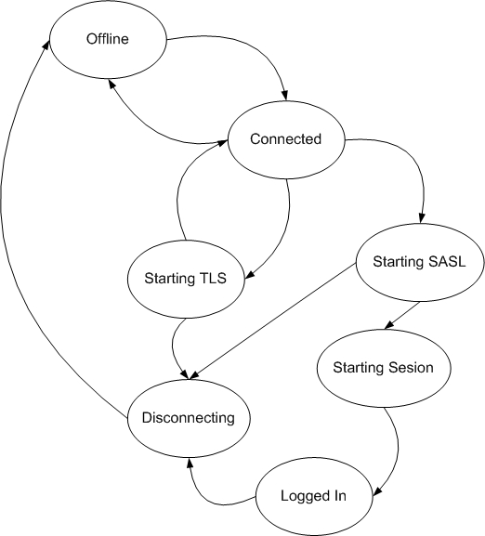
State Diagram

Slide 7
Outline
Introduction to XMPP
Motivation for openXMPP
Library Design and Systems Concepts
openXMPP Demonstration
Future Work
Questions

Slide 8
Motivation
Most clients re-implement XMPP
Many existing XMPP libraries do not comply with RFC specification
There is no cross-platform XMPP library for the .NET framework (agsXMPP, Piorun, Jabber-Net)

Slide 9
Outline
Introduction to XMPP
Motivation for openXMPP
Library Design and Systems Concepts
openXMPP Demonstration
Future Work
Questions

Slide 10
Modularity
Abstract implementation of system-specific components (network, SASL)
Application-specified implementation
System.Runtime.Reflection loading of appropriate classes
End-to-end argument

Slide 11
Multi-platform Support
Windows
  TLS from Mentalis SecLib
  SASL from .NET cryptography
Linux (OS X?)
  TLS from Mono Security Library
  SASL from system cryptography classes

Slide 12
Synchronous / Asynchronous
Network communication asynchronous
Some operations require synchronization
Solution: Multithreaded stages with message queues
Event-driven design
SEDA

Slide 13
Outline
Introduction to XMPP
Motivation for openXMPP
Library Design and Systems Concepts
openXMPP Demonstration
Future Work
Questions

Slide 14
Outline
Introduction to XMPP
Motivation for openXMPP
Library Design and Systems Concepts
openXMPP Demonstration
Future Work
Questions

Slide 15
PocketPC
.NET CF 1.1
  System.Runtime.Serialization
  System.Security.Cryptography
  System.Threading
  Synchronized Collections

Slide 16
PocketPC (cont.)
.NET CF 2.0
  System.Runtime.Serialization
  System.Security.Cryptography
  System.Threading
  Synchronized Collections

Slide 17
Solution
PocketXMPP client is (mostly) written
Implement modules for openXMPP
Enjoy!

Slide 18
Outline
Introduction to XMPP
Motivation for openXMPP
Library Design and Systems Concepts
openXMPP Demonstration
Future Work
Questions

Slide 19
References
RFC 3920. http://ww.xmpp.org/specs/rfc3920.html
RFC 3921. http://www.xmpp.org/specs/rfc3920.html
AgsXMPP. http://www.ag-software.de
Jabber.NET. http://www.jabberstudio.org/projects/jabber-net/project/view.php
Google Talk. http://www.google.com/talk/developer.html

