Slide 1
DIP Project: Image Steganography
Group 1

Slide 2
Objective
The main objective of our project is to hide the data in the image using LSB based data embedding at the sender side and to decode the data at the receiver side.

Slide 3
Techniques Used
Spatial Operations
Geometric Spatial Transformations
Scaling
Image Enhancement
Color Image Sharpening using Unsharp Masking
Color Transformations
Image Segmentation
Thresholding
Morphological processing
Set and Logical Operations
Erosion
Dilation
Closing
Hole Filling
Extraction of Connected Components

Slide 4
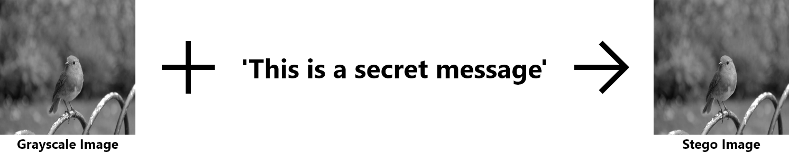
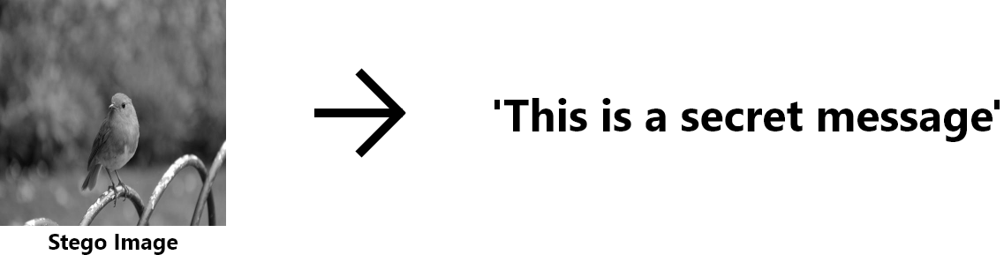
Text Hiding
Text Extraction

Slide 5

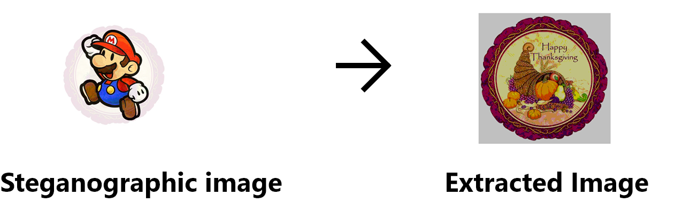
Image Hiding
Image Extraction

Slide 6
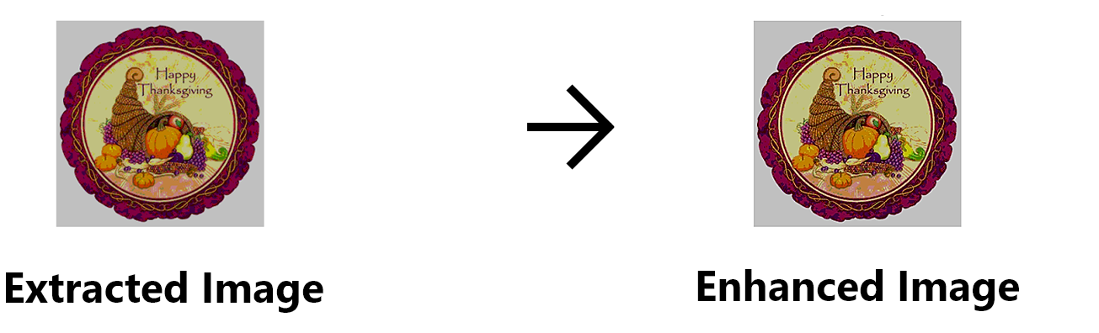
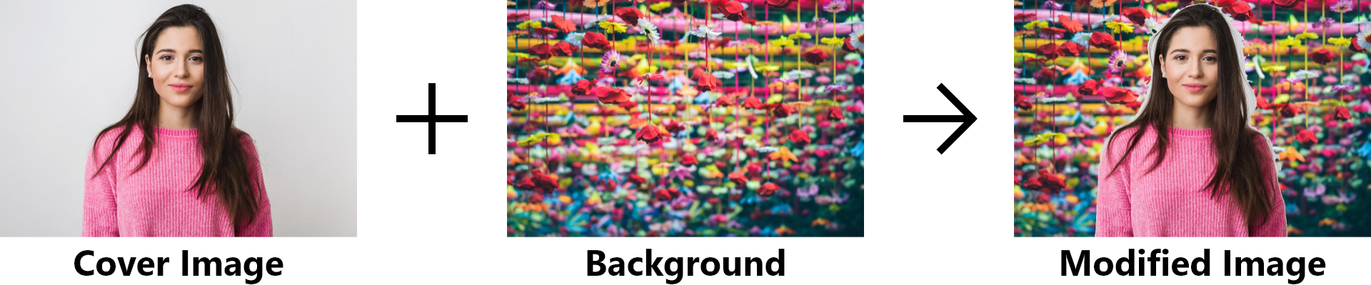
Enhancing the extracted image
Preprocessing of Cover Image

Slide 7

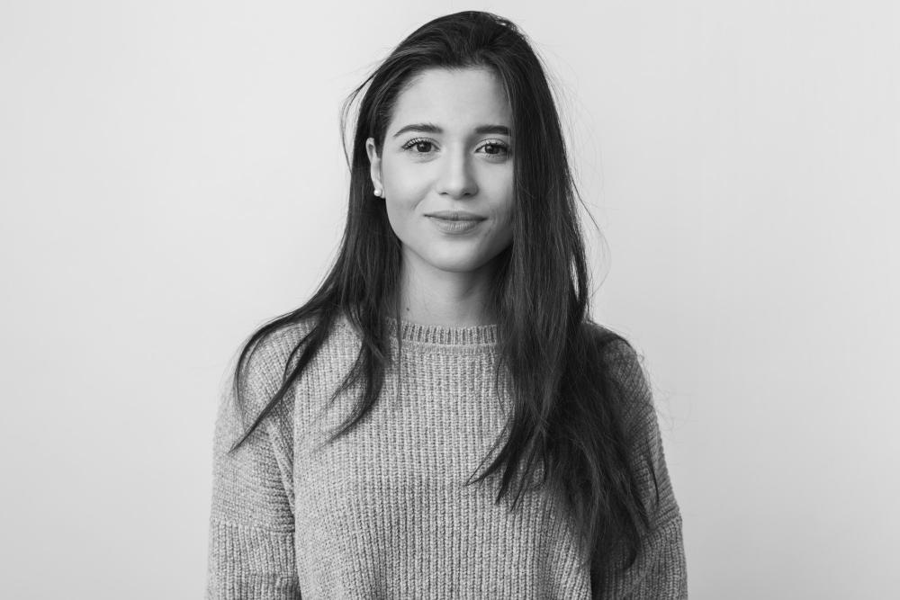
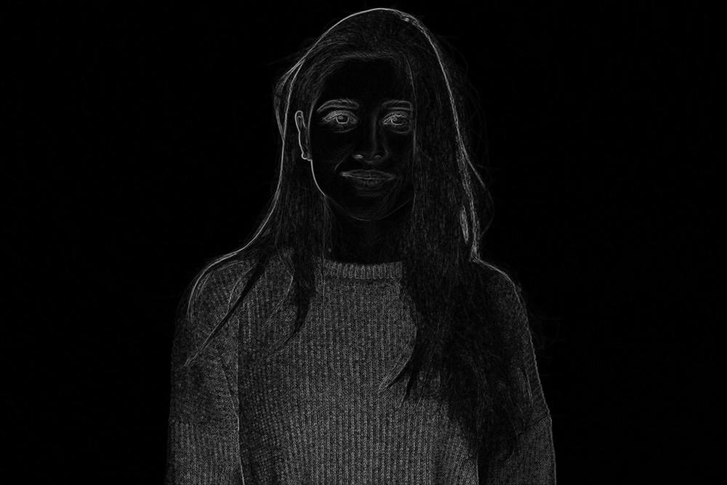
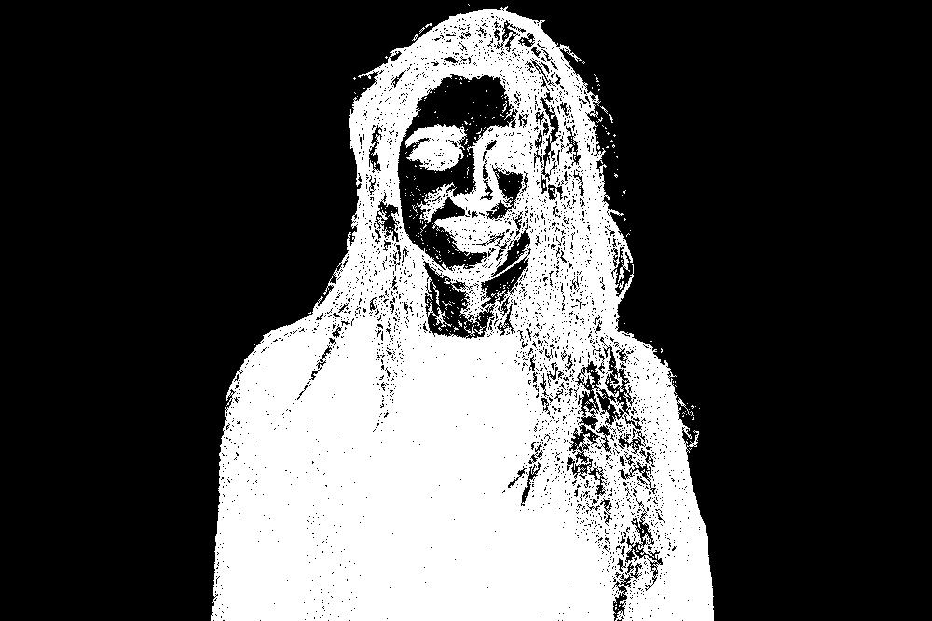
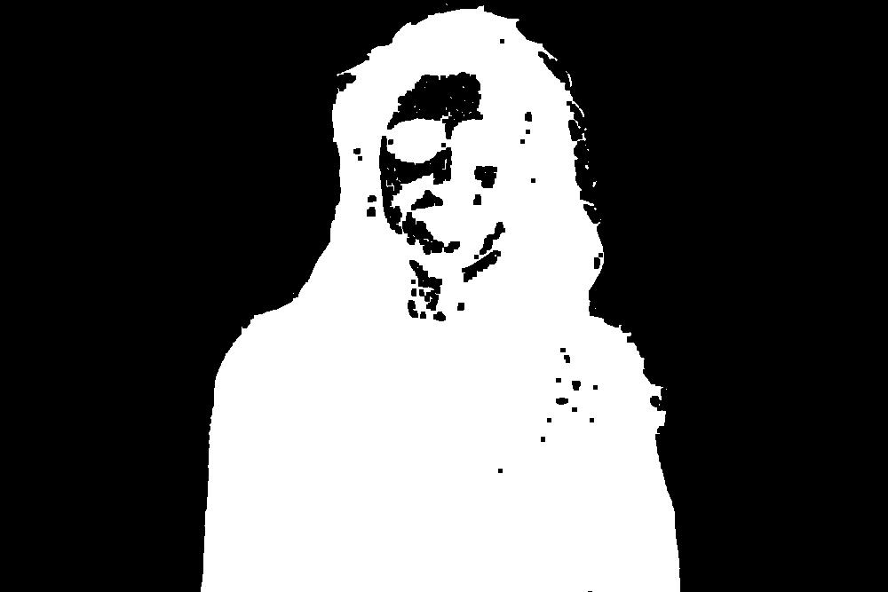
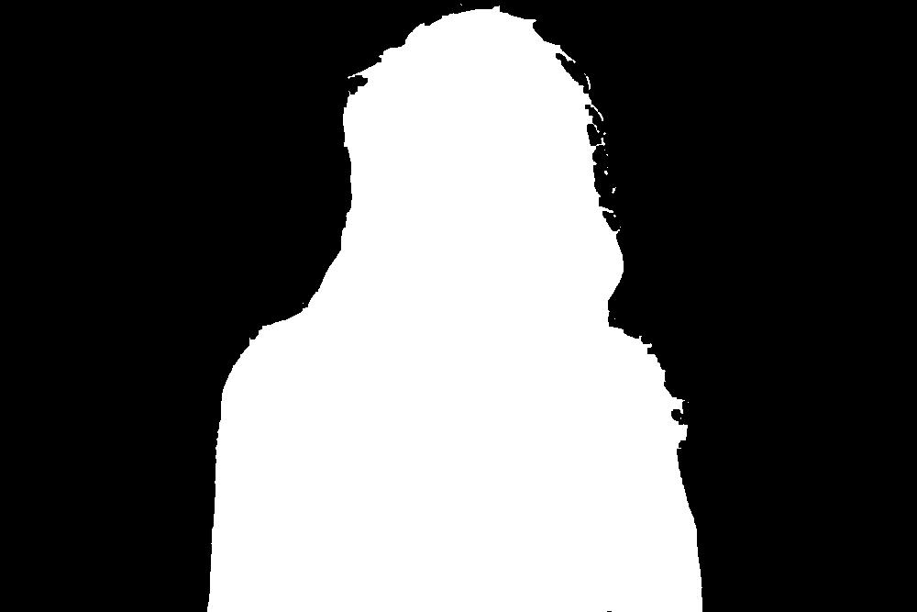



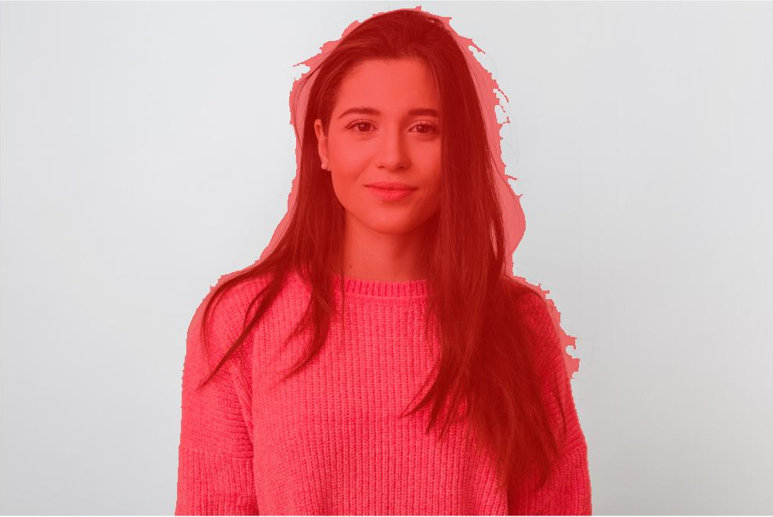
Isolating the background
img = imread('sample.jpg');
gray = rgb2gray(img);
SE = strel('Disk',1,4);
morphologicalGradient = imsubtract(imdilate(gray, SE),imerode(gray, SE));
mask=im2bw(morphologicalGradient,0.03);
mask = imclose(mask, SE);
mask = imfill(mask,'holes');
mask = bwareafilt(mask,1);
notMask = ~mask;
mask = mask | bwpropfilt(notMask,'Area',[-Inf, 5000 - eps(5000)]);
showMaskAsOverlay(0.5,mask,'r');

Slide 8
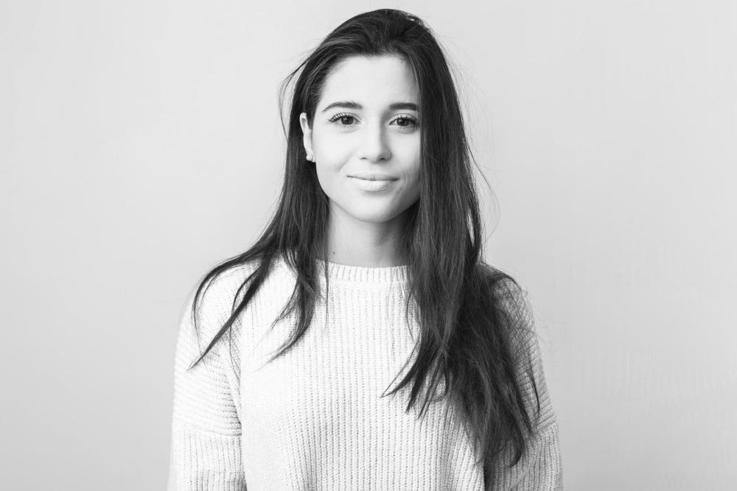
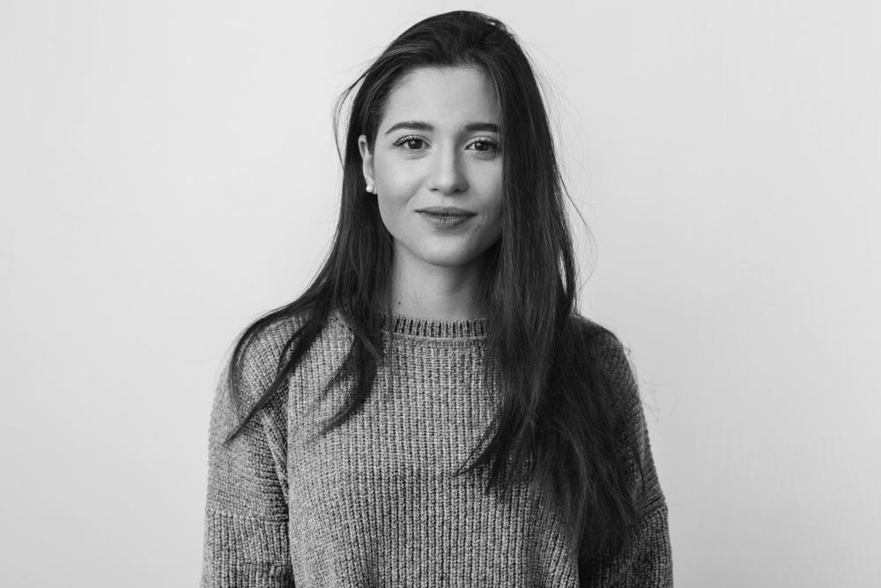

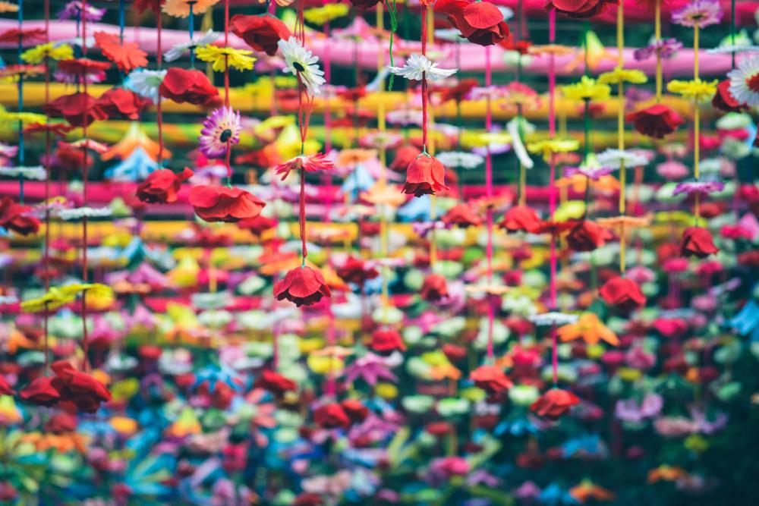
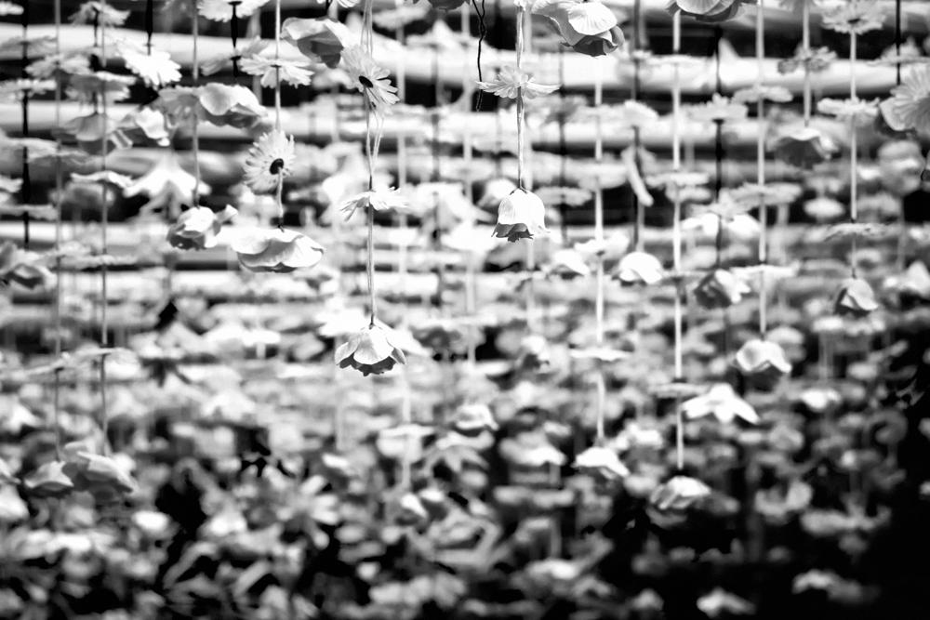
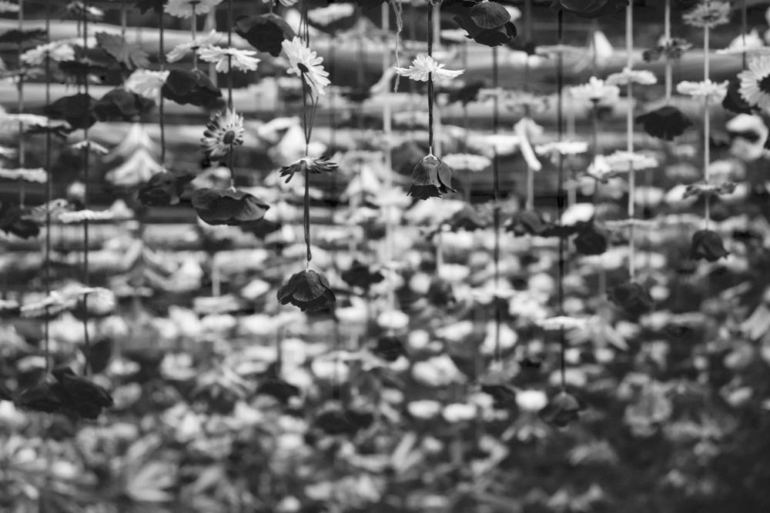
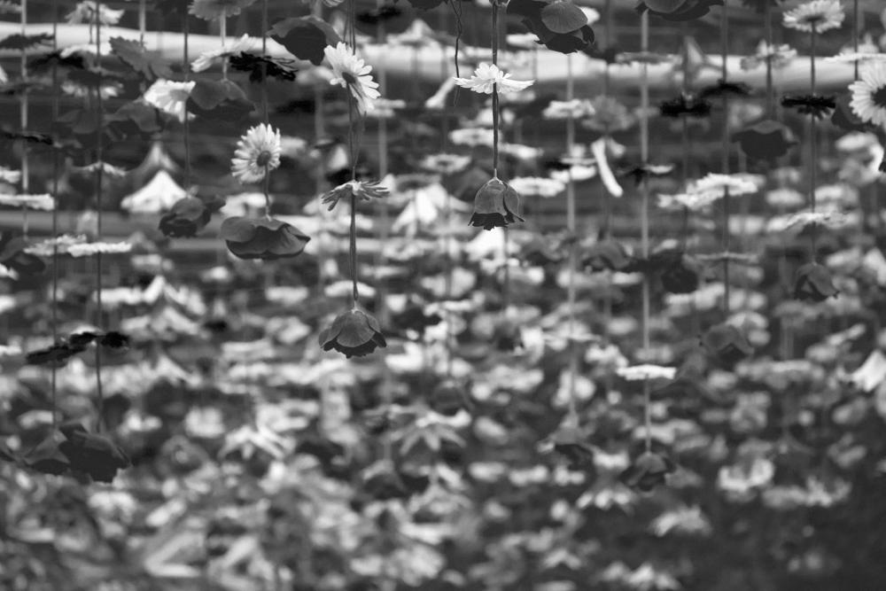

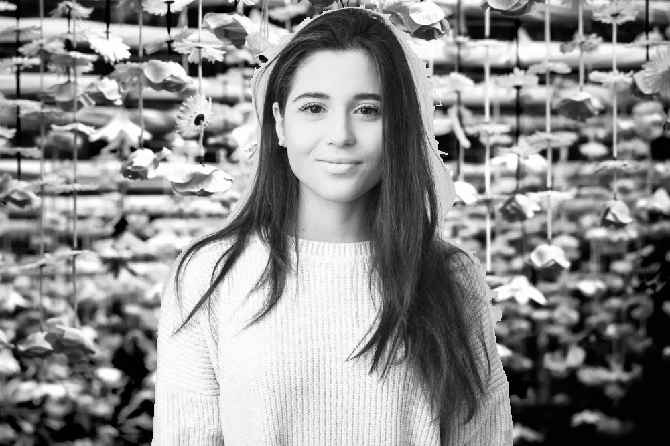
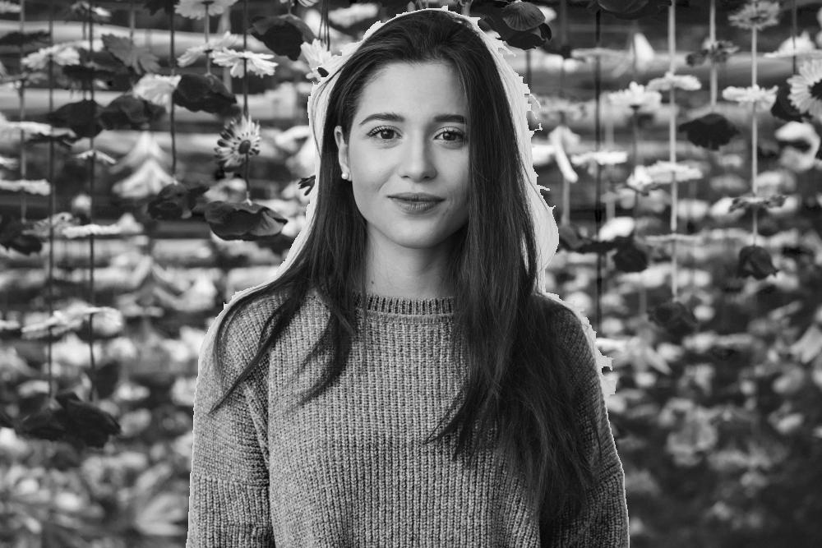
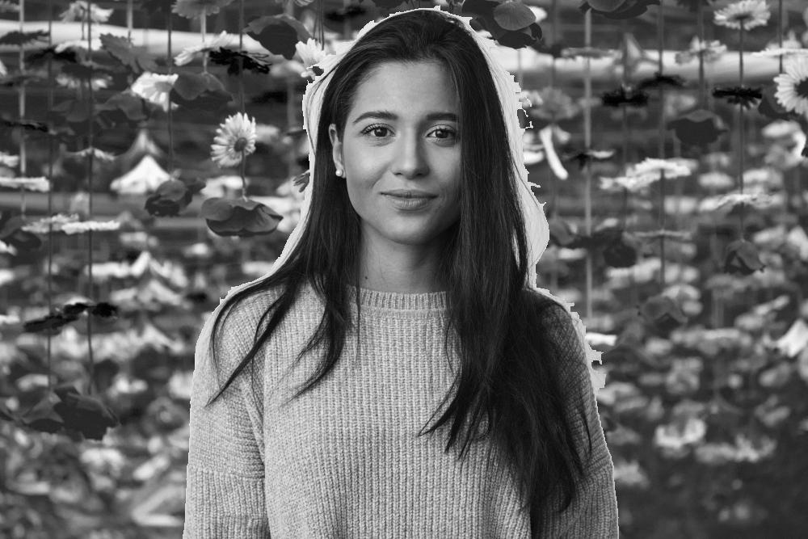
Modifying the background
img = imread('sample.jpg');
r = img(:,:,1);
g = img(:,:,2);
b = img(:,:,3);
background = imread('background.jpg');
rb = background(:,:,1);
gb = background(:,:,2);
bb = background(:,:,3);
img = cat(3,r,g,b);
r(~mask) = rb(~mask);
g(~mask) = gb(~mask);
b(~mask) = bb(~mask);

