Slide 1
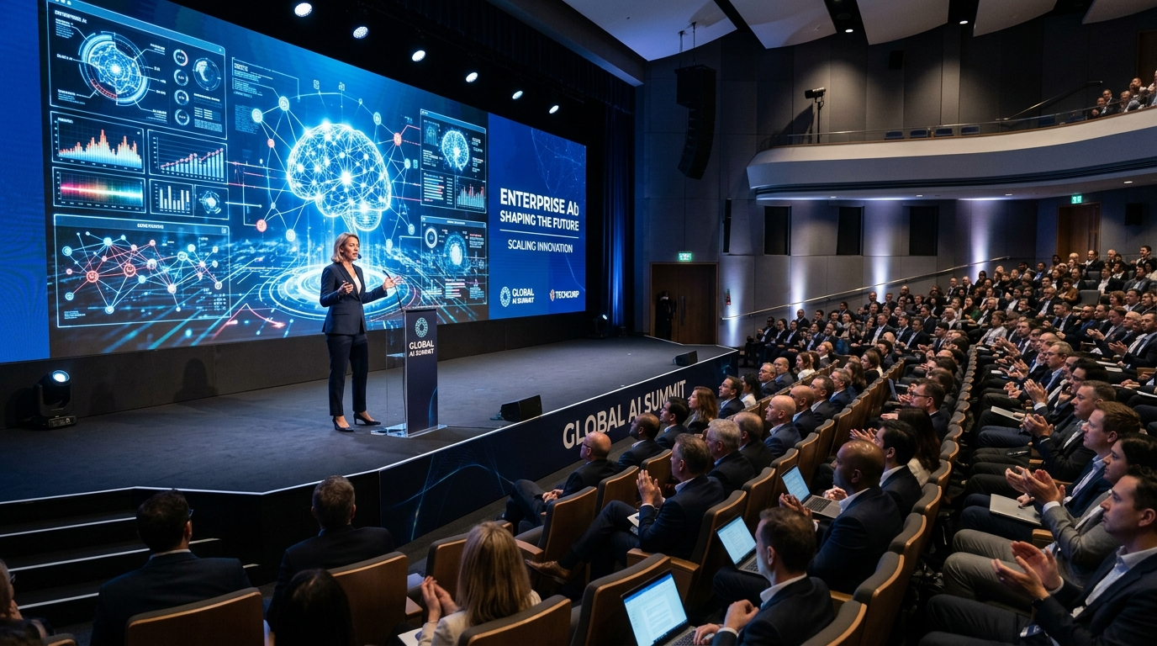
TLCE LMS Portal
Modernized Training, Learning, Conference & Engagement Platform
A comprehensive suite built with strict corporate color alignment, anti-cheat assessment tracking, automated notifications, and real-time manager notification routing.
Project Release • Version 2.0
xyz
LEARNING & DEVELOPMENT

Slide 2

Executive Summary & Brand Identity
Corporate Color & Identity
• Platform Mission
Designed to deliver and coordinate training modules for xyz engineering, design, strategy and product teams.
• Corporate Navy (#003087)
Central theme accent used for headers, primary buttons, and tabs.
• Accent Blue (#009CDE)
Interactive highlights applied to checked-in lists, calendar badging, and progress sliders.
• White Dashboard Layout
Minimalist white pages replace standard styling configurations, providing readability and corporate formatting.
xyz Learning & Development Department • TLCE LMS Portfolio

Slide 3
Program Catalog & Yearly Calendar
1. Immersive Carousel
• Auto-Play Slider
Featured banner program showing key upcoming courses.
• Details Overlay
Integrates dates, times, key objectives, and registration triggers on the slider.
• Enrolled Tags
Displays enrolled status directly on slides.
2. Roster Grid Cards
• Metadata Badging
Displays duration hours, target audiences, and meal tags.
• Dynamic Capacity Status
Color progress bars transition from green (available) to red (fully booked).
• Direct CTA Triggers
Launches registration modals immediately.
3. Yearly Calendar Grid
• 12-Month Flow
Includes one highlighted program scheduled for each month of the year.
• Key Focus Highlights
Displays summaries of monthly objectives (e.g. Design Systems, Strategic Business Acumen).
• Status Indicators
Updates calendar items dynamically on registration.
xyz Learning & Development Department • TLCE LMS Portfolio

Slide 4
Registration, Meals & Logistics
Registration & Seat Allocation
• Over-Capacity Waitlisting
Automatically disables registration button and displays 'Join Waitlist' if seats hit 100% capacity.
• Veg/Non-Veg Meal Options
Complimentary options restricted strictly to 'Veg' and 'Non-Veg'. Only displays on events providing lunch/dinner.
• User Dashboard Badging
Highlights confirmations and waitlist order indices.
Corporate Shuttle booking System
• Standalone Toggle Switch
Replaced standard label+input toggle with a custom div component to prevent double-fire toggle errors.
• Drop Location Stations
Selectable pickup zones (e.g. City Tech Park, Tower A Plaza, East Business Bay).
• Timetable Batches
Accommodates specific shift pick-ups (08:30 AM, 09:15 AM, 10:00 AM, 01:15 PM).
• Visual Confirmation Tag
Generates summary details dynamically on the modal.
xyz Learning & Development Department • TLCE LMS Portfolio

Slide 5
Automated Email Timeline triggers
Timeline-Triggered Reminders & Logs
Automated email reminders are dispatched to the simulated Inbox Logs view based on program date parameters:
Step 1: 2 Days Prior
Dispatched to confirmation registries
Contains logistical coordinates, map pins, venue location, and shuttle cab options.
Step 2: 1 Day Prior
High priority cert reminder
Urges participants to complete mandatory pre-program assessments in fullscreen mode.
Step 3: Day-Of (6 AM)
Immediate session trigger
Delivers final stream login credentials and pick-up details to the attendee dashboard.
xyz Learning & Development Department • TLCE LMS Portfolio

Slide 6
Assessment Suite & Exam Integrity
Assessment Delivery Engine
• Integrated Pre/Post Tests
Supports Multiple Choice Questions (MCQ) and One-Word short answer text fields.
• Dynamic Question Injection
Loads category-specific question sets (Engineering, Strategy, UX) based on the active event category.
• Copy-Paste Blockers
Blocks keyboard copy/paste commands (Ctrl+C, Ctrl+V), right-click context menu, and text drag-selections.
• Immediate Roster Recording
Scores >= 60% are marked 'Passed' immediately on the admin dashboard console.
Fullscreen Anti-Cheat Mechanism
• Mandatory Fullscreen Mode
Tests launch in mandatory fullscreen. The browser event listener actively monitors window focus parameters.
• 3-Strike Exit Rule
Exiting fullscreen prompts a strike warning. On the 3rd strike, the test auto-terminates.
• Auto-Failed Status
disallows further attempts. The exam is marked 'Failed (Cheating)'.
xyz Learning & Development Department • TLCE LMS Portfolio

Slide 7
Feedback Engine & L&D AI Assistant
Feedback & Evaluation System
• 4-Category Rating Metrics
Enables 5-star evaluation of Overall Experience, Speaker Quality, Content Relevance, and Logistics.
• Detailed Comment Feedbacks
Includes text boxes for participants to explain practical application and improvement feedback.
• Admin Log Dispatches
Submitting feedback broadcasts full response logs directly to the Admin Inbox Drawer.
Compact AI Chat Assistant
• Floating Picture-in-Picture
Launches a compact 360x500px overlay in the bottom-right corner rather than a full page block.
• Quick FAQ Selection Chips
Includes 6 preset question chips (e.g. 'Cab pickup options?') for instant queries without typing.
• Groq Llama 3.3 Integration
Provides prompt responses. System instructions block internal model name leakage.
xyz Learning & Development Department • TLCE LMS Portfolio

Slide 8
Total Learning Hours & Analytics Dashboard
Analytics Calculations & Formulas
Total Learning Hours = Σ (Program Duration in Hours × Registered Participants) across all 12 annual courses. The table below represents live analytics metrics generated by the platform:
Program Name (Month) | Duration (Hours) | Registered Attendees | Learning Hours Produced
Strategic Thinking & Business Acumen (Jan) | 4 hours | 20 participants | 80 hours
Generative AI for Enterprise Workflows (Apr) | 4 hours | 32 participants | 128 hours
Leading at xyz (May) | 3 hours | 60 participants (FULL) | 180 hours
Design Systems & Enterprise UX (Nov) | 6 hours | 22 participants | 132 hours
xyz Learning & Development Department • TLCE LMS Portfolio

Slide 9
Technology Stack & Architecture
Frontend Technology Layer
• React 18 & Vite
Ultra-fast hot module reloading and UI response times.
• Lucide Icons Library
Consistent vector icons mapped to action tags.
• Inline Variable CSS
Strict colors mapped to pre-defined corporate themes.
State Engine Layer
• React Context API
Tracks registrations, waitlists, feedbacks, and test metrics.
• Dynamic State Hooks
Provides centralized data access across tabs.
Persistence & Emails
• LocalStorage Hooks
Ensures check-ins, notifications, and results persist across user browser reboots.
• Simulated Email Engine
Logs email dispatches directly to the Admin Inbox Drawer.
xyz Learning & Development Department • TLCE LMS Portfolio

Slide 10

Conclusion & Deployment Summary
Deployment Release Success
• Git Repository Synced
All modifications committed and pushed successfully to the main branch on the origin remote repository.
• Vercel Live Build
Auto-compiled and published to Vercel production edge servers, live and fully active.
• Roster Workflows Verified
Full path testing (login -> check in -> assessment validation -> feedback dispatch) verified successfully.
xyz Learning & Development Department • TLCE LMS Portfolio

