Slide 1
Gearman
http://gearman.org/getting-started/
Reference :
http://nileshzemase.blogspot.in/2013/07/gearman-and-supervisor-to-run-multiple.html

Slide 2
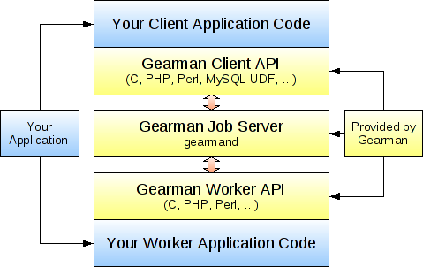
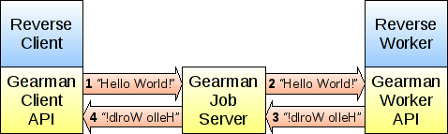
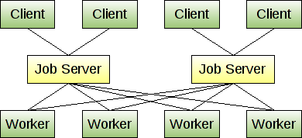

Slide 3
PHP Version 5.5.9-1ubuntu4.17
Install gearman job server 1.0.6-3
apt-get install gearman-job-server
Install PHP wrapper to libgearman
Description : This extension uses libgearman library to provide API for communicating with gearmand, and writing clients and workers.
Installing using Git
wget https://pecl.php.net/get/gearman-1.1.2.tgz
tar xzf gearman-1.1.2.tgz
cd gearman-*
phpize
./configure
Make
Make test
------make test response start----------------------
PHP : /usr/bin/php
PHP_SAPI : cli
PHP_VERSION : 5.5.9-1ubuntu4.17
ZEND_VERSION: 2.5.0
PHP_OS : Linux - Linux ashutosh-H97M-D3H 3.19.0-61-generic #69~14.04.1-Ubuntu SMP Thu Jun 9 09:09:13 UTC 2016 x86_64
INI actual : /home/rahul/gearman-1.1.2/tmp-php.ini
More .INIs :
CWD : /home/rahul/gearman-1.1.2
Extra dirs :
VALGRIND : Not used
------make test response ends---------------------------
make install
------make install response start----------------------
Installing shared extensions: /usr/lib/php5/20121212/
------make install response ends----------------------
You then need to make PHP aware of the new extension by adding the
following line to your php.ini for apache and php cli:
sudo nano /etc/php5/apache2/php.ini
sudo nano /etc/php5/cli/php.ini
extension="gearman.so"
Sudo service apache2 restart
Gearman ------ config
gearman support enabled
extension version 1.1.2
libgearman version 1.0.6
Default TCP Host localhost
Default TCP Port 4730

Slide 4
Run gearman Job server as background process : gearmand -d
Service started as : gearman-job-server
Shutdown gearman : sudo service gearman-job-server stop/strart/restart/status
------additional not required--
Client and worker API only for running code from command line:
Install gearman worker tool :
apt-get install gearman-tools
Run a worker from command line:
gearman -w -f wc -- wc -l
------additional not required--
Worker can be run in parallel only from command line or from different browsers.
Reinstalling german:
sudo apt-get install --reinstall php5-gearman

Slide 5
//save as worker.php
<?php
$worker= new GearmanWorker();
$worker->addServer();
$worker->addFunction("reverse", "my_reverse_function");
while ($worker->work());
function my_reverse_function($job)
{
return strrev($job->workload());
}
?>
// save as client.php
<?php
$client= new GearmanClient();
$client->addServer();
print $client->do("reverse", "Hello World!");
?>
//run php worker.php before client.php and you can see the result.
Run
php /var/www/html/gearmandemo/worker.php

Slide 6
SuperVisorD
Referene:https://www.digitalocean.com/community/tutorials/how-to-install-and-manage-supervisor-on-ubuntu-and-debian-vps
http://nileshzemase.blogspot.in/2013/07/gearman-and-supervisor-to-run-multiple.html

Slide 7
Install supervisord: //version 3.0b2-1
sudo apt-get install supervisor
service supervisor restart
Configure gearman with supervisor:
Now create a new file in - /etc/supervisor/conf.d/ as reports.conf
And add
---------------------
[program:reports]
command=php /var/www/html/gearmandemo/worker.php
numprocs=10
process_name=%(program_name)s_%(process_num)02d
autostart=true
autorestart=true
stdout_logfile=/var/www/html/gearmandemo/log/reports_log.log
stdout_logfile_maxbytes=1MB
stderr_logfile=/var/www/html/gearmandemo/log/reports_error.log
stderr_logfile_maxbytes=1MB
---------------------
To discuss: the max processes, Log path logsize
TO DO : has to check the log folder for writable mode from code.
Then restart supervisor
$ sudo service supervisor restart
OR
$ sudo service supervisor stop
wait for few (5-10) seconds
$ sudo service supervisor start
Check list of running workers:
sudo supervisorctl

Slide 8
You can stop or start or restart the processes using below command
$ sudo supervisorctl
supervisor> stop reports:
reports_00: stopped
reports_01: stopped
supervisor> start reports:
reports_00: started
reports_01: started
supervisor> restartreports:
reports_00: stopped
reports_01: stopped
reports_00: started
reports_01: started
To exit from this shell :
Hit “exit”

Slide 9
Adding Library for Yii 1.6
/// composer require "demi/php-gearman" "~1.0"

Slide 10
Install GearmanUI Tool (Opt)
Reference : http://gaspaio.github.io/gearmanui/

Slide 11
git clone git://github.com/gaspaio/gearmanui.git gearman-ui
cd gearman-ui
composer install –no-dev
//install npm
sudo apt-get install npm
//install bower
npm install -g bower
//install files from bower.json
ln -s /usr/bin/nodejs /usr/bin/node
bower install
cp config.yml.dist config.yml
Url : http://localhost/gearman/gearman-ui/web/

