Slide 1
Computer Network Project Title: Sync_Music
Rahul Aggarwal(IIITU17332)
Chandan Kumar(IIITU17324)
Vishal Kumar(IIITU17330)

Slide 2
About
This is a Network music player. It is be able to play synchronised music simultaneously on multiple pc's connected on the same network.
Fully Dynamic multi-threaded server side deployable on any computer to serve as server.
It is a distributed application.
Simultaneous routing of data. There will be one server and several clients.

Slide 3
What is it?
It is a distributed system whose components are located on different networked computers, which communicate and coordinate their actions by passing messages to one another.

Slide 4
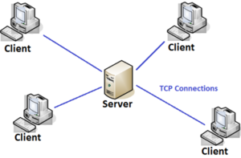
Architecture

Slide 5
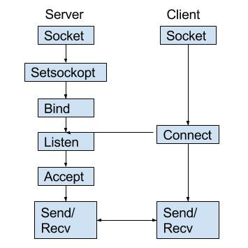
Socket Programming
Socket programming is a way of connecting two nodes on a network to communicate with each other. One socket(node) listens on a particular port at an IP, while other socket reaches out to the other to form a connection. Server forms the listener socket while client reaches out to the server.

Slide 6
Challenges
Time Delay in sending songs
Status: Solved
Multi-Threading
Multithreading is a type of execution model that allows multiple threads to exist within the context of a process such that they execute independently but share their process resources. Like executing/calling a function and meanwhile calling another function.
Songs are not in sync
Status: Pending
Attempt: UTC(Global time)
Songs are now in sync
Technology: Cristian’s Algorithm

Slide 7
Technologies Used
Python
Sockets:
A Unix Socket is used in a client-server application framework. A server is a process that performs some functions on request from a client. Most of the application-level protocols like FTP, SMTP, and POP3 make use of sockets to establish connection between client and server and then for exchanging data
Pygame:
It is a Free and Open Source python programming language library for making multimedia applications like games built on top of the excellent SDL library. Like SDL, pygame is highly portable and runs on nearly every platform and operating system.
Threading:
In computer science, a thread of execution is the smallest sequence of programmed instructions that can be managed independently by a scheduler, which is typically a part of the operating system.

Slide 8
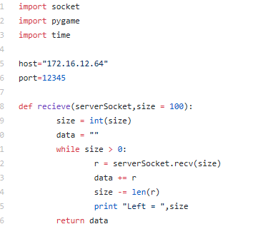
Code
Server

Slide 9
Advantages Party, suppose we go on a trip and forgot our speaker then we can connect several devices together making one device as host who can play and control many functions(volume, speed, playlist, etc..) on all devices.
Disadvantages
Have limited coverage, can only connect near-by devices

Slide 10
References
http://net-informations.com/python/net/thread.htm
https://www.geeksforgeeks.org › python-gui-tkinter
https://www.tutorialspoint.com › python › python_gui_programming
https://www.codeproject.com/Questions/1014567/How-to-connect-single-client-to-multiple-server

Slide 11
Thank You

