Slide 1
ECE 313 Final Project
Group Gamma
Nicholas Foss, Rahul Joshi, Lawrence Fung

Slide 2
Division of Tasks
Division of Tasks:
Lawrence Fung
Task 0, Task 2, first report, first presentation
Rahul Joshi and Nicholas Foss:
Task 1, Task 3.1, Task 3.2
Lawrence, Rahul, and Nicholas:
Task 2, Task 3.3

Slide 3
Concepts Used
Normal likelihood matrices for ML and MAP
Joint likelihood matrices
Creating decision rules using ML and MAP
Using correlation to analyze data
Determining conditional probabilities using generated alarms
Using hash tables, we mapped X values to its corresponding ML and MAP rule, so that we generated the test alarms by iterating over the testing data and hashing each x value to its decision
MAPnHashTable class from online to map X and Y pair values in the joint matrix to its decision
To run all combinations of features, we implemented user interaction where the user must enter the pair of features to be run over all 9 patients
Via “input” command in MatLab

Slide 4
Analysis Approach
Lowest ML/MAP errors
Correlation coefficients
Why?
To minimize error, we would want to minimize the probabilities for false alarm and miss detection
To minimize these two probabilities, you would want to minimize the number of disagreements between your alarms and the physician’s alarms
Another way of thinking about it would be to maximize the number of agreements between our system & the actual alarm data
One patient had a 3 way tie in number of mismatches, so we need to use another technique to break the tie

Slide 5
Analysis Approach
Based on previous criticism from our first presentation, we looked at the percentage of mismatches instead of sum of mismatches due to variable number of alarms for each feature to select our top 3 patients & top 2 features.
But, we got the the same results.
In the case of a tie, we took the pair of features with the lowest correlation coefficient
We chose features mean area under heartbeat and number of beats per minute because they consistently had the lowest percentage of mismatches for many patients.
Feature numbers 1 & 3
Notes:
ML

Slide 6
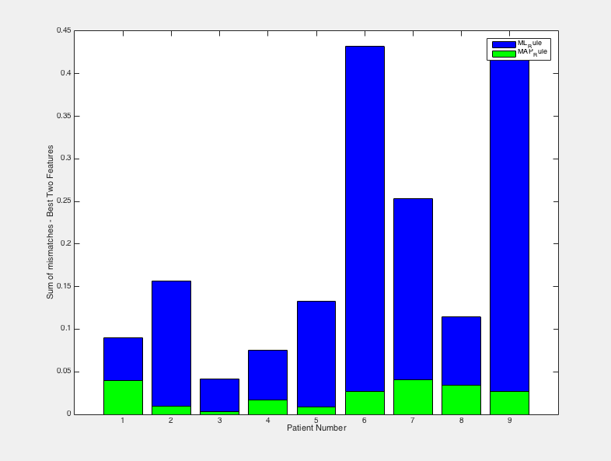
Analysis Results

Slide 7
Analysis Results
Feature change in Task 3.3
We changed our features in task 3 from “Mean area under heart beat” and “Heart Rate” to “Mean R to R Peak” and “Systolic blood pressure”
Features 2 & 5
To come to this conclusion, we ran all feature combinations over all 9 patients and calculated all ML and MAP average errors
Better accuracy with larger sample size (3 patients vs 9 patients)
We added the ML and MAP average errors for each combinations of features and determined the lowest value and chose that combination as the best feature combination

Slide 8
Analysis Results

Slide 9
Project Summary
After completion of task 3, we came to the following conclusions:
Patients selected:
Patients 1,3,and 5
Ended up looping over all 9 to select best pair of features
Best pair of features
Mean R-to-R peak interval (feature 2)
Systolic Blood Pressure (feature 5)

Slide 10
Conclusion
Project Usefulness
Exposure to using Matlab for analyzation of data
Better understand concepts that may not be straightforward in theory
Ex: In mini project 2, we better understood Probability of False Alarm, Miss Detection, and Error by determining these errors given physician and monitoring system alarms
Suggestions for Improvement
Clearer instructions
Better help on piazza

