Slide 1
ECE 313 Final Project
Group Gamma
Nicholas Foss, Rahul Joshi, Lawrence Fung

Slide 2
Technique Used
Lowest ML/MAP errors
Correlation coefficients
Why?
To minimize error, we would want to minimize the probabilities for false alarm and miss detection
To minimize these two probabilities, you would want to minimize the number of disagreements between your alarms and the physician’s alarms
Another way of thinking about it would be to maximize the number of agreements between our system & the actual alarm data
One patient had a 3 way tie in number of mismatches, so we need to use another technique to break the tie

Slide 3
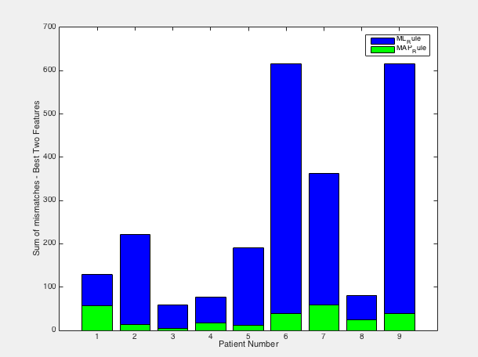
Analysis of Technique 1

Slide 4
Analysis of Technique 1 (cont’d)
To pick the top 3 patients that would yield the lower error probabilities, we looked at the sum of mismatches for the top two features we chose for each patient
From the chart, we picked:
ML Rule: patients 3, 4, & 6
MAP Rule: patients 2, 3, 5
NOTE: patient 2 MAP rule had a three way tie for number of mismatches, need another technique to break the tie
To break the tie, we took the pair of features with the lowest correlation coefficient
The pair of features with lowest coeff were features 1 and 6, so we will go with these

Slide 5
Conclusion
Here are the patients and features for each patient we will use for task 3
ML Rule
Patient 3 – Heart Rate & Systolic BP
Patient 4 – Mean R-to-R Peak & Pulse Pressure
Patient 8 – Mean R-to-R Peak & Heart Rate
MAP Rule
Patient 2 – Mean Area Under Heart Beat & Diastolic BP
Patient 3 – Systolic BP & Pulse Pressure
Patient 5 – Mean Area Under Heart Beat & Mean R-to-R Peak

Slide 6
Timeline & Division of Tasks
Rahul Joshi- Complete Task 3.1 by: 11/26/2014
Nicholas Foss- Complete Task 3.2 by: 12/2/2014
Lawrence Fung- Final report
Rahul , Nicholas, Lawrence – Complete Task 3.3 by due date

