Slide 1
ACME Real Estate Agency
housing model project

Slide 2
Mission statement
To develop a model that will predict the value of house.
This will help our clients , either buy or sell a house at a fair price.
Narrow down 2 factors that drive the pricing the most.

Slide 3
methodology
Develop a model using Linear Regression to predict the value of a house based on aforementioned data available.
What is Linear Regression?
An approach to modelling relationship between variables.

Slide 4
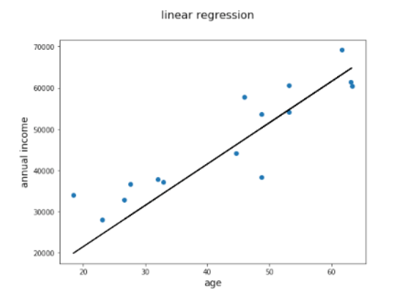
Linear REGRESSION

Slide 5
Linear regression – process flow
Dataset
Obtain data
Perform EDA
Variables
Dependent
Independent
Linearity
Check for existing r’ships between the variables
Model
Build baseline model
Iterate models to increase efficiency - Employ methods like transformation, scaling etc.
Validate
Metric to define model efficiency
Conclusions
What drives pricing the most?

Slide 6

Dataset
King’s County Dataset – Information for each house is shown in the snippet below:

Slide 7
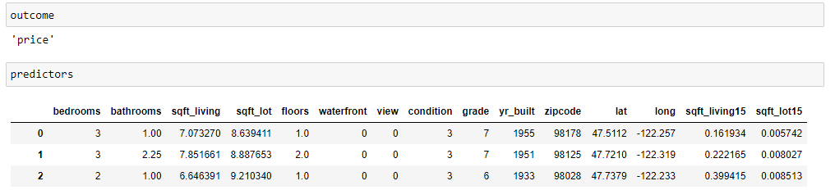
Selecting variables

Slide 8
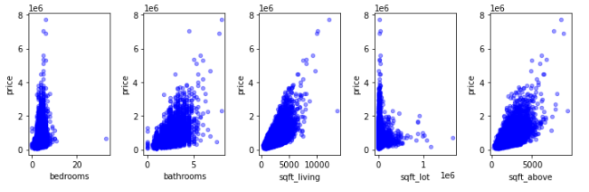
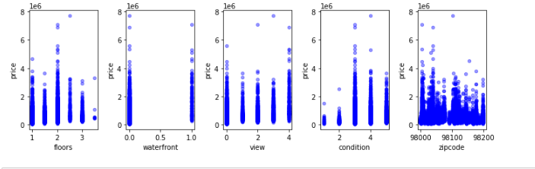
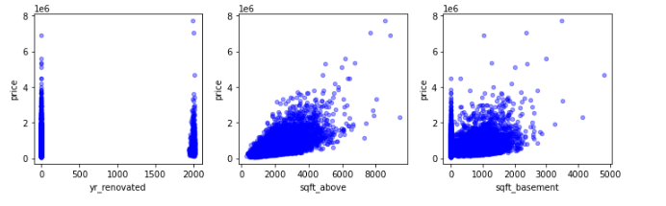
View r’ships between variables

Slide 9
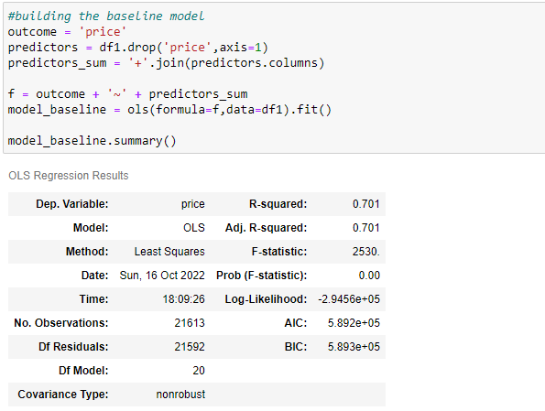
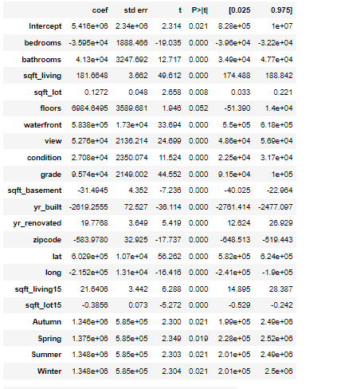
Build baseline model - statsmodels

Slide 10
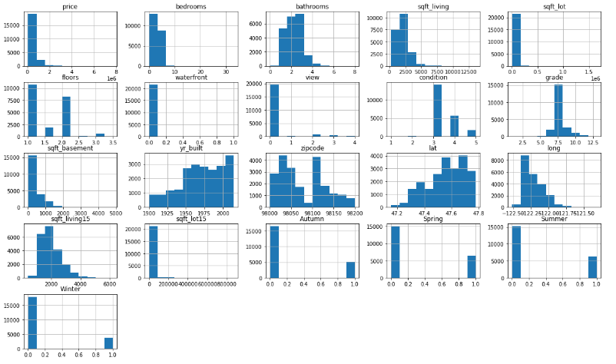
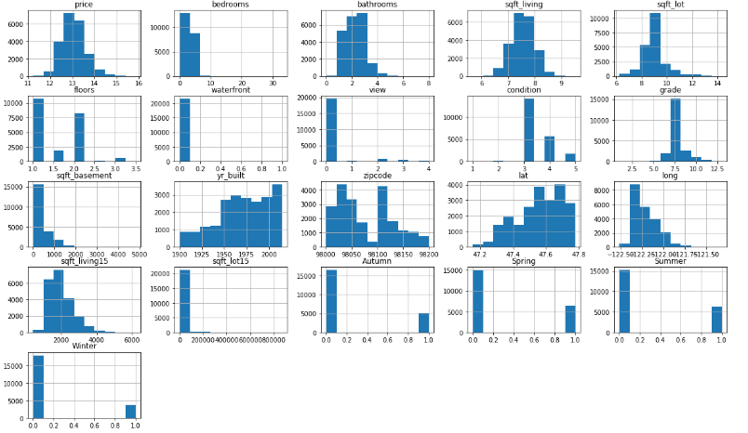
Log transform to improve normality

Slide 11
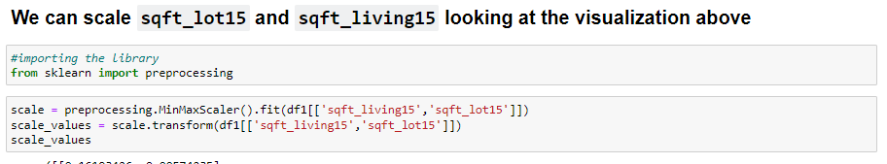
Scaling variables

Slide 12
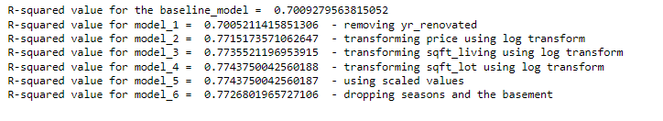
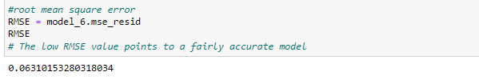
validate

Slide 13
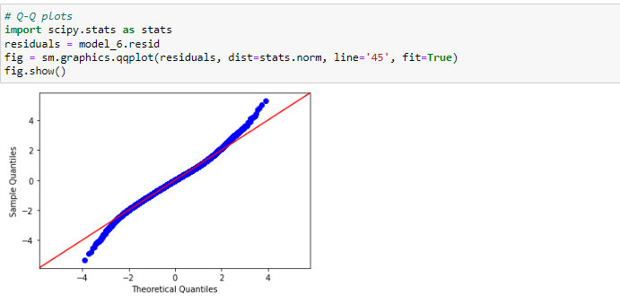
validate

Slide 14
What drives pricing the most?

