Slide 1
Wireless Guide for Silicon Valley – Tourist Guide
CMPE 285
Prof. Weider Yu

Slide 2
Team Members – Team#1
Names | SID | Email | Specialization | Project Team Role
Rahul Akurati | 008118708 | rahul.akurati@sjsu.edu | Computer Networks, Software Systems | Software Engineer-Developer
Dinesh Reddy | 008724131 | Dineshreddy.tathekalva@sjsu.edu | Enterprise software technology | Software Engineer – UI Engineer
Alka Bhatia | 009345323 | Bhatia.alka@gmail.com | Systems Engineering | Project Manager
Srilatha Ayyannagari | 008735285 | Srilatha.vs@gmail.com | Networks | Software Engineer – Test Engineer
Arthi Sivanantham | 008128055 | arthi.sivanantham@gmail.com | Networks | User – Test Engineer

Slide 3
Agenda
Project Overview
Project Design
Software Architecture
Software development process
Tools and Languages used
API’s used
Functional Requirements
Web Design Principles
Challenges encountered
Conclusion
References

Slide 4
Project Overview
The project is a web application and it enables the end user to search and choose a holiday trip.
There are holiday packages and also end user can customize the tour by manually selecting the places.
The client side technologies are emphasized to make the site responsive reducing the load on the server side.

Slide 5
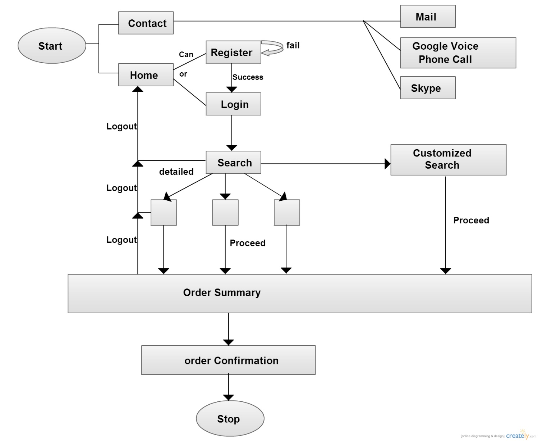
Project Design

Slide 6
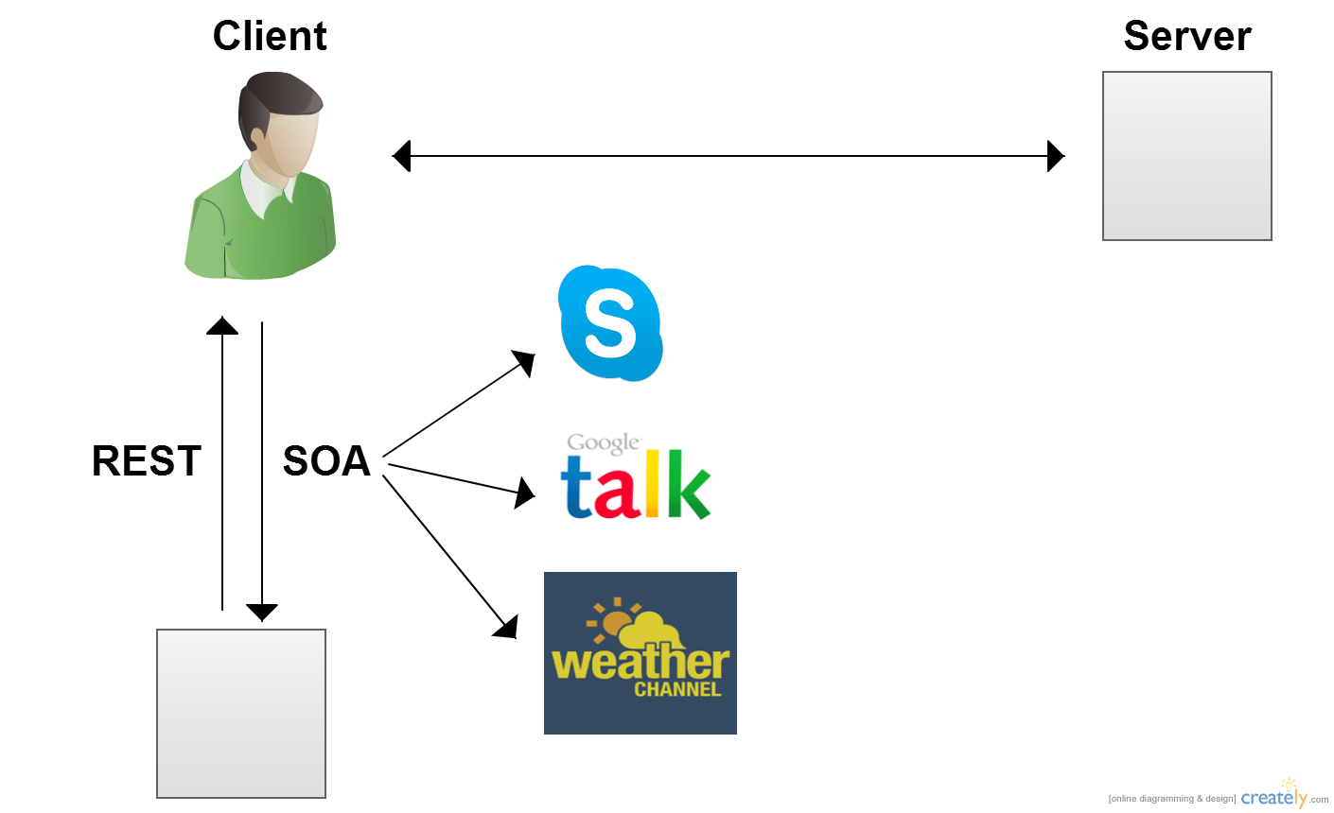
Software Architecture (Web Platform)

Slide 7
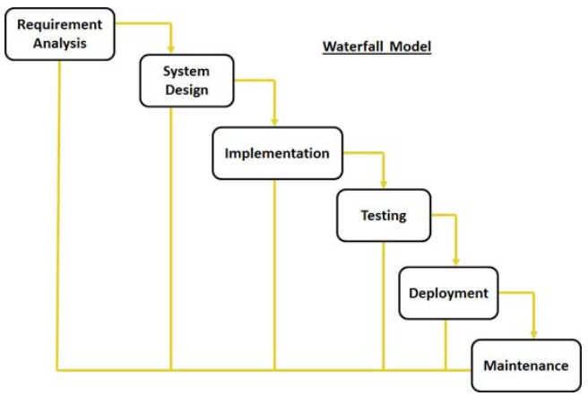
Software development process
We have followed Waterfall model for developing this project.

Slide 8
Software development process cont…
Requirement Analysis:
We met the professor regularly for collecting the requirements for this project.
We referred to various existing websites
System software and design
In this phase we finalized the tools and technologies to be used, design principles to be followed and we prepared a high level design document

Slide 9
Software development process cont…
Coding and module testing
Developed modules based on features and tested them individually before integration.
Integration testing:
After all modules are developed and tested, we integrated them together. Then we did integration testing
Deployment:
We deployed the application using local host on multiple computers within the team

Slide 10
Tools and Languages used
Tools
Visual Studio 2012
Microsoft .NET Framework 4.5
SQL Server 2012
Languages
JavaScript
HTML 5
CSS 3
JQuery

Slide 11
API’s used
Twitter Bootstrap
The weather channel
Skype
Google Voice

Slide 12
WEB APPLICATION

Slide 13
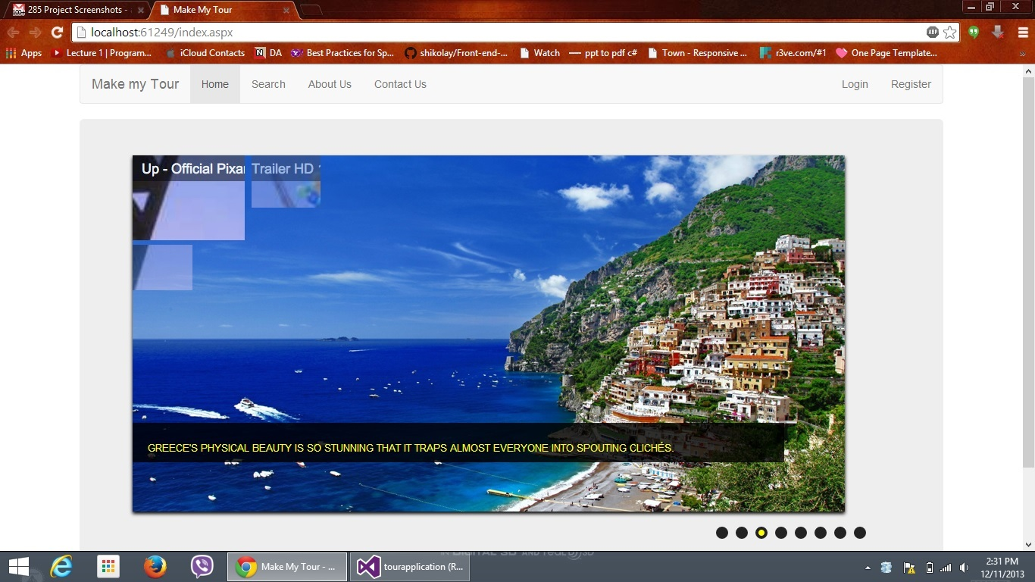
HOME PAGE OF THE WEB APP

Slide 14
FUNCTIONAL REQUIREMENTS
OUR SYSTEM IS DESIGNED FOR THE CLIENT
WE HAVE ONE MODULE- CLIENT

Slide 15
Main Functionalities of the Client
Register
Login
Search
Customized search
View details of the holiday
Get cost estimate
Payment/orderpayment
Checking the weather of client location
Making skype calls
Making phone calls
Sending an email

Slide 16
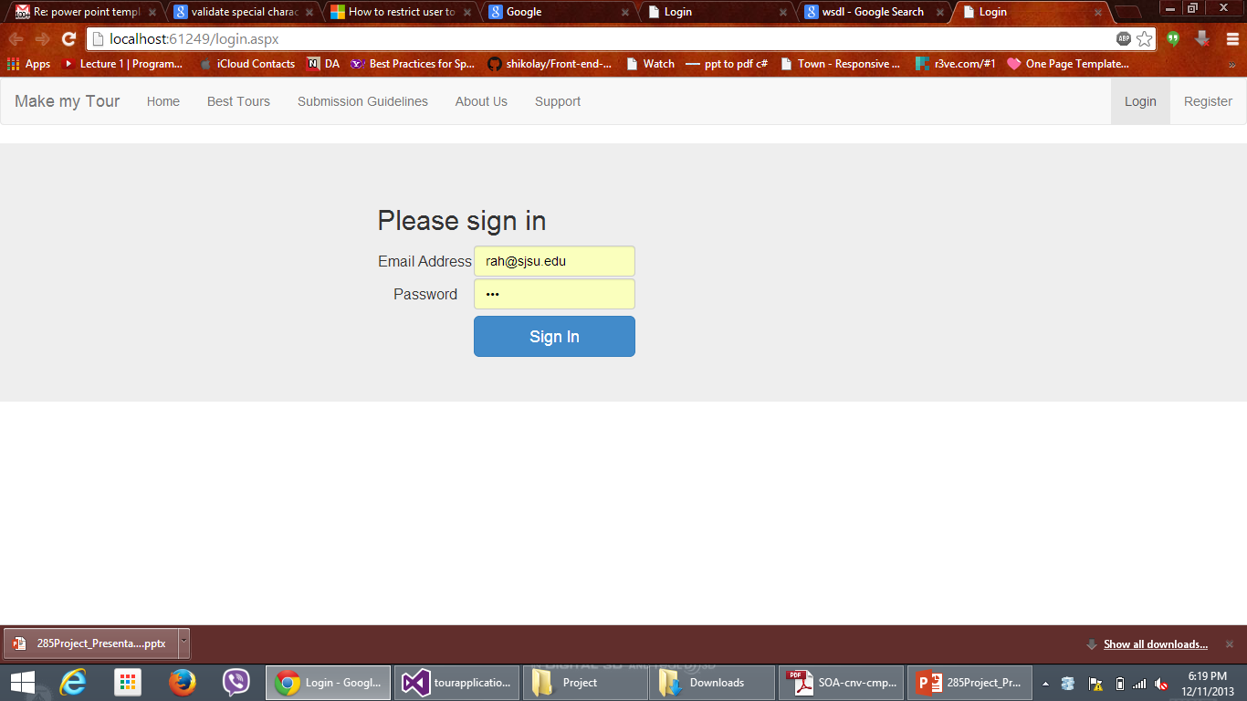
SNAPSHOTS OF EXECUTION- LOGIN

Slide 17
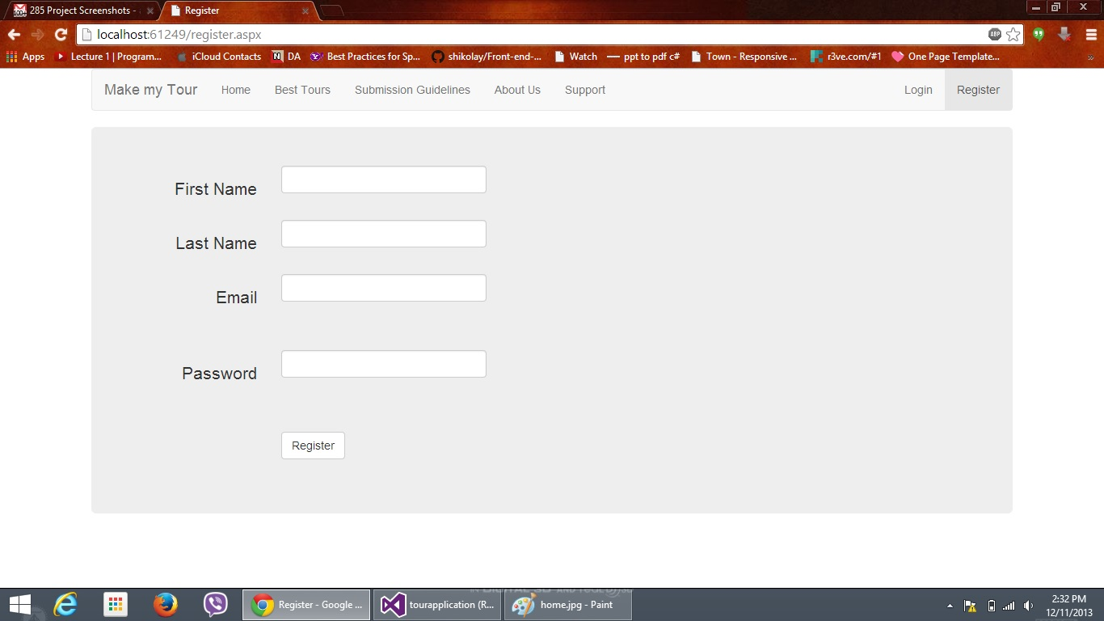
SNAPSHOTS OF EXECUTION- REGISTER

Slide 18
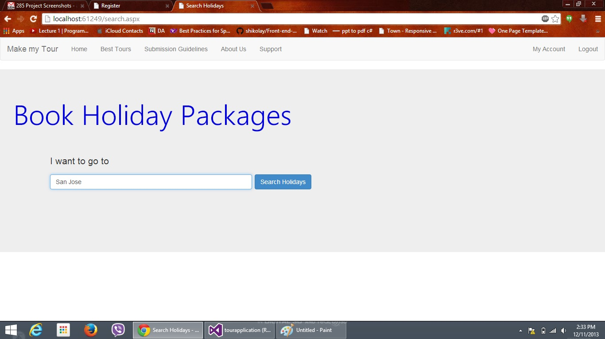
SNAPSHOTS OF EXECUTION- SEARCH

Slide 19
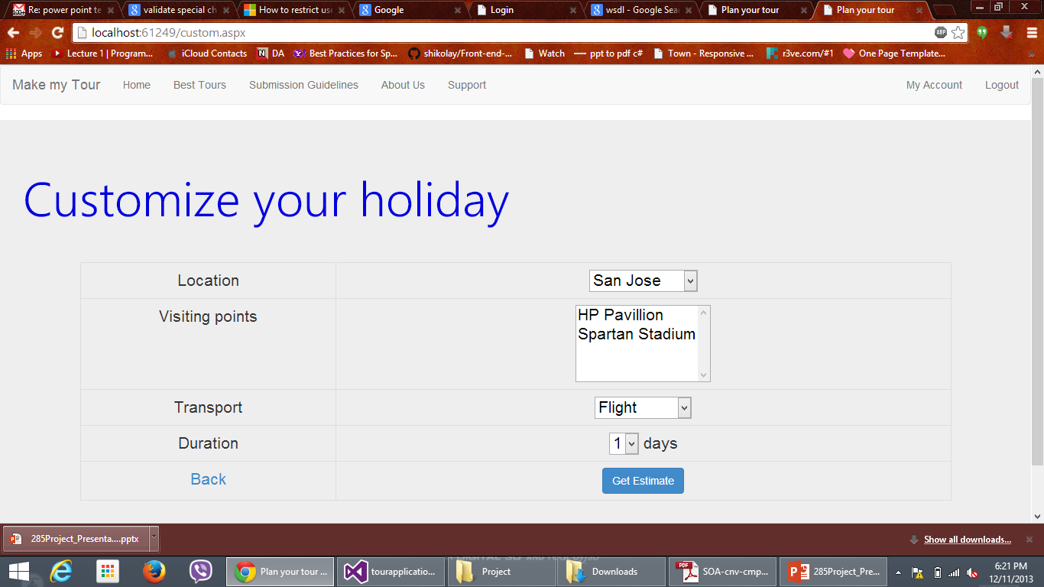
SNAPSHOTS OF EXECUTION- CUSTOMIZED SEARCH

Slide 20
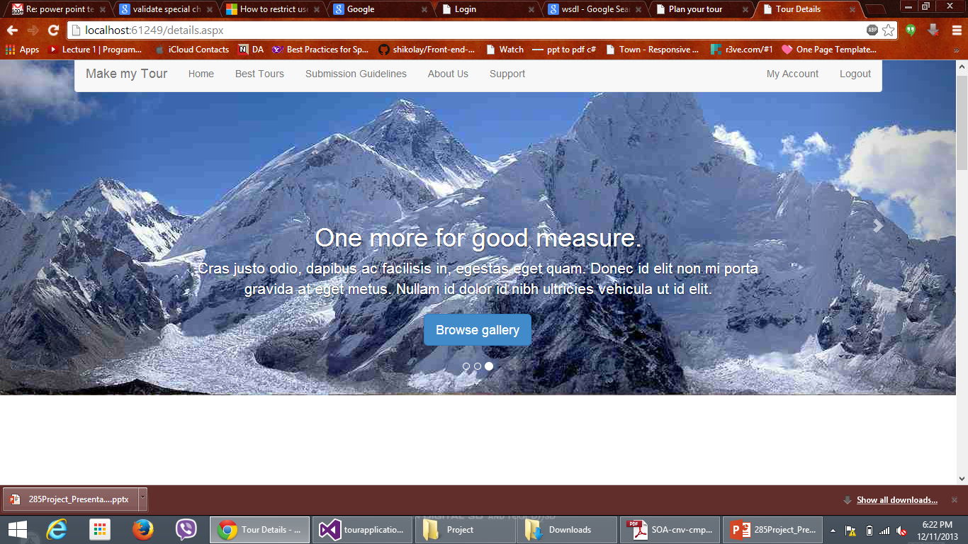
SNAPSHOTS OF EXECUTION- HOLIDAY DETAILS VIEW

Slide 21
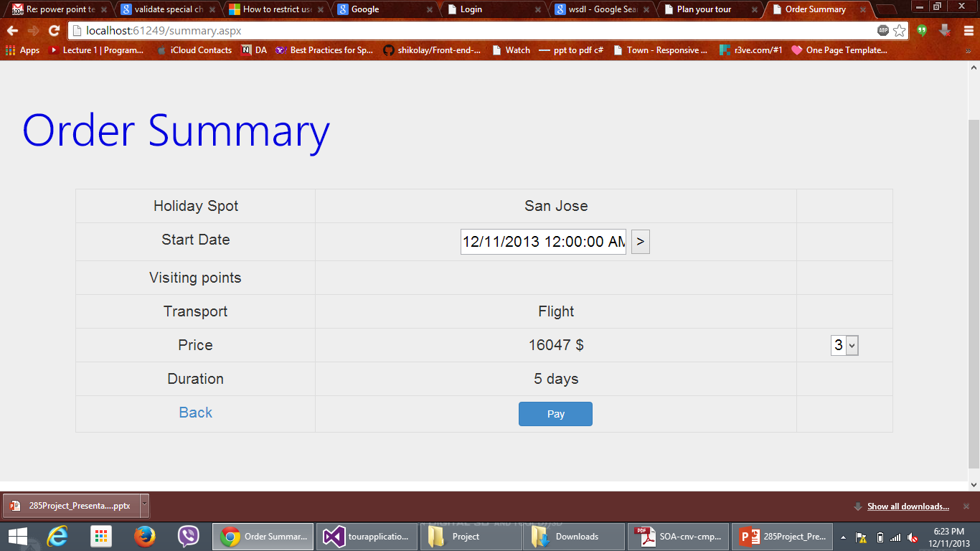
SNAPSHOTS OF EXECUTION- PAYMENT

Slide 22
Web Design Principles
Aesthetics
Simplicity
Easy to navigate
Multimedia
Consistency
Security

Slide 23
Web Design Principles
Aesthetics
Aesthetics can be defined as “appealing to senses”.
The design of graphical user interface with “aesthetics” quality incorporated would have a great effect on productivity of the products.
In other words, “The look and feel” of Web pages is considered as an important design principle.

Slide 24
Web Design Principles (Cont.,)
Aesthetics in our project
This design principle is incorporated in our project by providing an attractive Home page for users.
Apart from providing pleasant pictures of places that people would like to visit, we have included a slider of pictures which will attract every user who visits our Home page.

Slide 25
Web Design Principles (Cont.,)

Slide 26
Web Design Principles (Cont.,)
Consistency
This design principle focuses on maintaining similar or consistent look and feel in all the web pages related to the web site.
Makes it simple for the users to navigate smoothly without any concerns.
Consistency over various types of pages and forms gives the website a unified feel and pulls it all together, improving the user experience.

Slide 27
Web Design Principles (Cont.,)
Consistency in our project
Consistent look and feel is incorporated into our project by using CSS and HTML5 style of design throughout the entire project (like, User’s Home page, Search page, Log-In/Register pages etc.)
In this way, our end user will be comfortable in browsing our web site, knowing that it is familiar to them – even if they’ve never visited it before.

Slide 28
Web Design Principles (Cont.,)

Slide 29
Web Design Principles (Cont.,)
Simplicity:
Simplicity in Web pages can be achieved by removing all unnecessary elements from the Design and Content.
Simple websites will have the following characteristics.
Easy to navigate
Its contents are more scan able.
Load faster.

Slide 30
Web Design Principles (Cont.,)
Simplicity in our project
We have considered this design principle in our project by incorporating all of it’s characteristics.
Our simple and elegant design of web pages will help the user for easy navigation.
Our end user need not wait for longer times for the desired web pages to load.

Slide 31
Web Design Principles (Cont.,)

Slide 32
Web Design Principles (Cont.,)
Security
Security comes in 3 flavors namely,
Authentication
Authorization
Encryption
This is an important web design principle which provides secure transmission of data.

Slide 33
Web Design Principles (Cont.,)
Security in our project
We have implemented security in our project in User Log-In and Registration pages.
We have used “Message Digest (MD5)” cryptographic algorithm for hashing our passwords.
We are providing strong security against “SQL Injection” attacks which is the most prominent form of Web Application attacks till date.

Slide 34
Challenges encountered
Cross browser incompatibility
Handling security
Conflict on design principles when working with third party APIs.

Slide 35
Conclusion
With this project we got exposure and hands on expertise on many technologies which are used in this project. We have understood web design principles which we learned in this course and able to implement in our project. We understood the application of SOA and implemented it in our project.

Slide 36
References
[1] Weider D. Yu Chia H. Ong 2009 A SOA Based Software Engineering Design Approach in Service Engineering (IEEE International Conference on e-Business Engineering)
[2] Applied Microsoft .NET Framework Programming, by Jeffrey Richter, Microsoft Press, 2002
[3] Distributed Service-Oriented Software Development, by Yinong Chen and Wei- Tek Tsai, Kendall/Hunt Publishing Company, 2008
[4] http://www.tutorialspoint.com/sdlc/sdlc_waterfall_model.htm
[5] http://www.slideshare.net/prince229grips/role-of-consistency-in-website-designing

Slide 37
References (Cont.,)
[6] http://webdesign.tutsplus.com/articles/design-theory/building-consistency-and-relationships-into-your-designs/
[7] http://businessresources.over-blog.com/article-consistency-in-web-design-why-it-s-important-to-be-consistent-when-designing-your-website-86102646.html
[8] http://www.noupe.com/design/simplicity-in-good-web-design-advantages-how-to.html
[9] http://alistapart.com/article/the-web-aesthetic
[10] http://www.w3schools.com/
[11] https://education.deterlab.net/file.php/12/SoftwareExploits_UCLA/Exercise.html

