Slide 1
Where are we?
Dates:
Homework #3: Improving Author Identification via Genetic & Evolutionary Feature Selection/Weighting (10/25 – 11/8)
Homework #4: Genetic & Evolutionary Probing (11/1 – 11/15)
Homework #5: Adversarial Authorship & Countermeasures (11/27 – 12/4)
Grad Projects due 12/14
Final Exam: 12/14, 8-10:30am

Slide 2
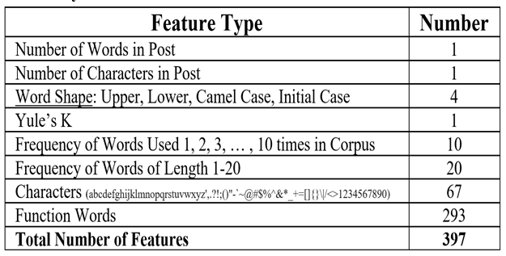
Project Ideas
(Adversarial Authorship)
From: https://people.eecs.berkeley.edu/~dawnsong/papers/2012%20On%20the%20Feasibility%20of%20Internet-Scale%20Author%20Identification.pdf
From:“Tempestt Neal, Kalaivani Sundararajan, Aneez Fatima, Yiming Yan, Yingfei Xiang, and Damon Woodard. 2017. Surveying Stylometry Techniques and Applications. ACM Comput. Surv. 50, 6, Article 86 (November 2017), 36 pages. DOI: https://doi.org/10.1145/3132039”
Kesel03
Teahan03
Stamatatos07
From: https://pan.webis.de/clef18/pan18-web/author-obfuscation.html
Caravel [code] (best-performing approach at PAN 2015)
GLAD [code]
Authorid [code]
AuthorIdentification-PFP [code]

