Slide 1
UML
Use cases and class diagrams

Slide 2
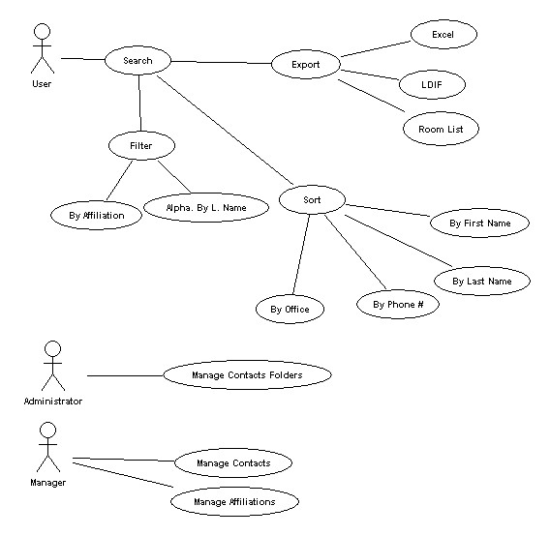
Use case Diagrams
Actors
Use Cases
Relationships

Slide 3
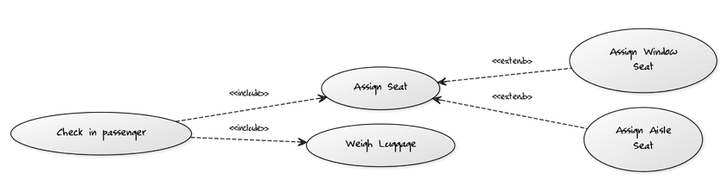
Include vs extend
Include: When one action requires another.
Extend: When one action can be replaced by another (inheritance)

Slide 4

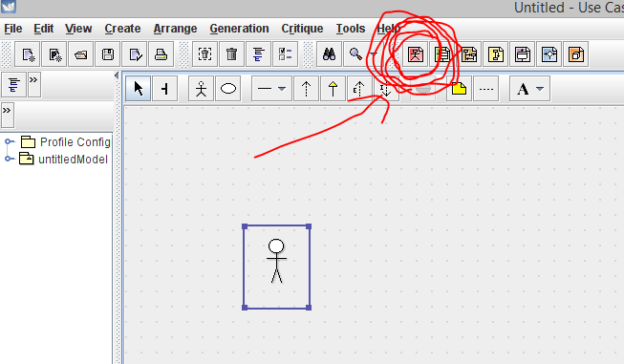
ArgoUML
Make Use case diagrams by pressing the red button on top

Slide 5
Exercise
You have been asked to design the backend system of a library. The library has books, videos, and CDs that it loans to its users. Reference-only material is loaned for 2hrs and can’t be removed from the library.
Users can borrow, renew or return any of these items. However, children are allowed only to borrow books.
Librarians can create new users and charge late fees.
Draw a use case diagram using ArgoUML. You may choose to be as detailed as you like

Slide 6
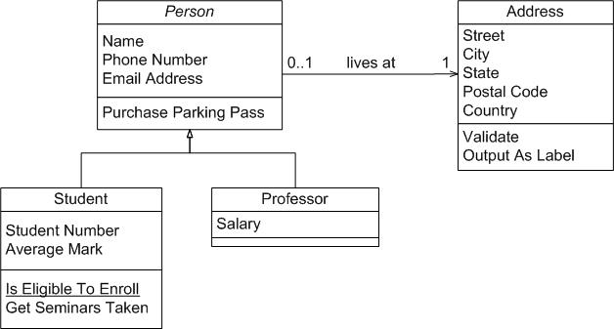
Class diagrams
The other thing you need to know about UML

Slide 7
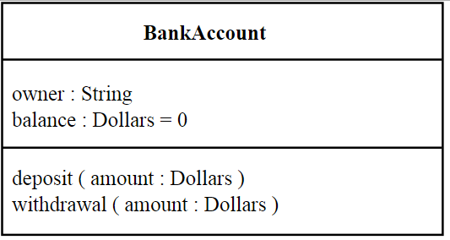
Class Diagrams
Title
Members
Methods

Slide 8
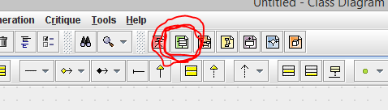
Class Diagrams in ArgoUml

Slide 9
Relationships
Has A (Association, Aggregation, Composition)
Is A (inheritance)

Slide 10

Association
Taken from http://en.wikipedia.org/wiki/Class_diagram

Slide 11

Aggregation
Taken from http://en.wikipedia.org/wiki/Class_diagram
Destroying the container does not destroy the content

Slide 12

Composition
Taken from http://en.wikipedia.org/wiki/Class_diagram

Slide 13
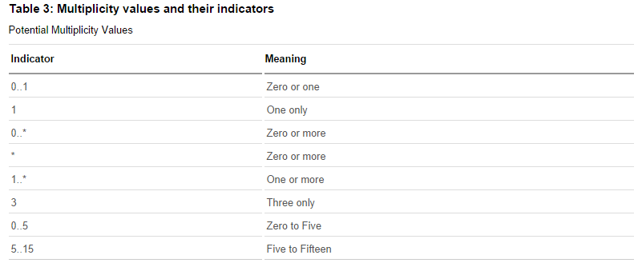
Multiplicity
Taken from http://www.ibm.com/developerworks/rational/library/content/RationalEdge/sep04/bell/

Slide 14
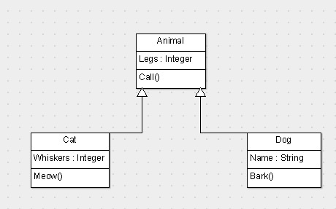
Inheritance

Slide 15
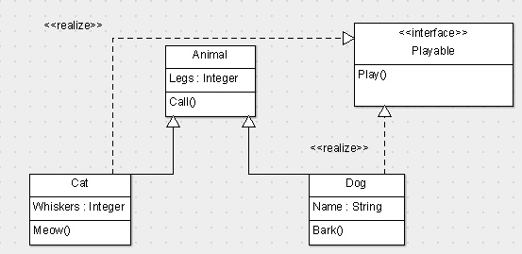
Interfaces
Name
Methods

Slide 16
Exercise
You have been asked to design the backend system of a library. The library has books, videos, and CDs that it loans to its users. All library material has a id# and a title. In addition, books have one or more authors, videos have one producer and one or more actors, while CDs have one or more entertainers. The library maintains one or more copies of each library item (book, video or CD). Copies of all library material can be loaned to users. Reference-only material is loaned for 2hrs and can’t be removed from the library. Other material can be loaned for 2 weeks. For every loan, the library records the user, the loan date and time, and the return date and time. For users, the library maintains their name, address and phone number.

Slide 17
Extra Credit
http://bombermine.com/#/play/

Slide 18
References
http://www.objectmentor.com/resources/articles/umlClassDiagrams.pdf
http://www.ibm.com/developerworks/rational/library/content/RationalEdge/sep04/bell/
http://en.wikipedia.org/wiki/Class_diagram
http://slides.com/dominiccharleyroy/

