Slide 1
Searching for a Path
A* search and Euclidian distance
Notes:
Talk about bomberman wikipage
Talk about what’s due
Talk about groups created
Talk about new way of making controllers

Slide 2
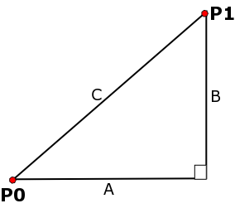
Euclidian distance

Slide 3
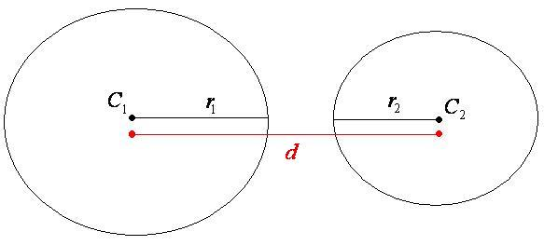
Collision detection revisited

Slide 4


Collision detection revisited

Slide 5
Collision detection Revisited
Algorithm:
If(circlesAreTouching){
Collision Detected
}
Else{
No collision
}

Slide 6
Collision detection Revisited
Algorithm:
Boolean circlesAreTouching = pow(C1.x-C2.x,2) + pow(C1.y-C2.y,2,)< pow(r1+r2,2)
If(circlesAreTouching){
Collision Detected
}
Else{
No collision
}

Slide 7

Graph Searching
Finding a path to Bomberman

Slide 8
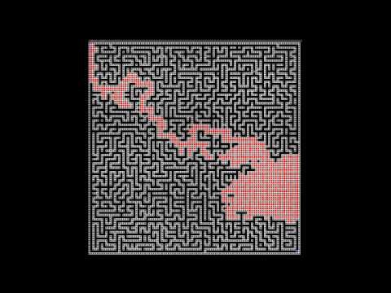
A* video

Slide 9
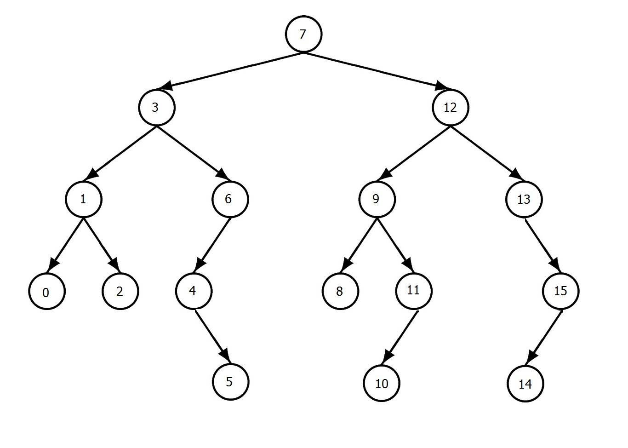
Depth First Search (recursive)
Example: find the node with value 5 using DFS

Slide 10
Depth First Search (recursive)
Example: find the node with value 5 using DFS
Solution: Use Pre-Order Traversal
Pre-Order:
7-3-1-0-2-6-4-5
How efficient would it be to find 14?

Slide 11
Depth First Search (recursive)
tNode PreOrder( tNode Root, int value){
//base case
if(Root == null){
return null;
}
//check root
if(Root.value == value){
return Root;
}
//check left child
tNode nLeft = PreOrder( Root.left, value);
//check right child
tNode nRight = PreOrder(Root.right, value);
return (nLeft != null) ? nLeft : nRight;
}
What’s inefficient here?

Slide 12
Breadth First Search
Example: find the node with value 5 using BFS

Slide 13
Breadth First Search
Example: find the node with value 5 using BFS
Solution: Use BFS tree Traversal
BFS:
7-3-12-1-6-9-13-0-2-4-8-11-15-5
What’s more efficient BFS or DFS?

Slide 14
Breadth First Search
tNode BFSTree( tNode Root, int value){
Queue<tNode> tQ = new LinkedList<tNode>();
//add root to queue
tQ.add(Root);
while(tQ. isEmpty()){
//check head
tNode head = tQ.remove();
if(head == value){
return head;
}
//add children
tQ.add(head.left);
tQ.add(head.right);
}
return null;
}

Slide 15
What’s special about A*
A* is a BFS algorithm that has been tweaked
DFS and BFS made no assumptions about which direction to search in
A* uses a guess to choose the search direction

Slide 16
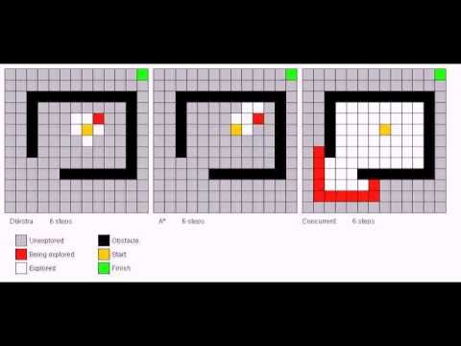
A* compared to other Searches

Slide 17
A* algorithm
Given start node, goal node find path between them if it exists

Slide 18
A* pseudo algorithm
gNode AStar(gNode start,Point goal){
list<gnode> openlist;
list<gnode> closedlist
openlist.add(start)
while(!openlist.empty()){
gnode c = openlist.getNext();
closedlist.add(c)
if(c.Point == goal)
return c;
if(c != obstacle && !closedlist.contains(c)
for(Node n in C's adjacency){
openList.add(n).sortbyCost();
}
}
return null;
}
This is the special twist in A-star
The distance or “cost” is given by the following formula:
F= G+H
Where F is the cost
G is the distance from the start node
H is the Guess of how much distance is remaining
We can use Euclidian distance as our guess (or “Heuristic”)

Slide 19
What is a Cost?
Start
Goal
G = Distance from start
Current point
H = Estimated Distance to goal
Total Cost = F = G + H

Slide 20
Yeah but I’m using a grid as my graph
Ok lets look at the example code

Slide 21
Excercise
Optimize the data structures in the Example in order to obtain a faster run time
Hint:
Openlist should have a small insertion time
Closedlist should have a small insertion time and lookup time

Slide 22
Recap
Easier Collision detection
Easier Controller architecture
Implementing A star search

Slide 23
Resources
Visualize Searches: http://qiao.github.io/PathFinding.js/visual/
In depth A* explanation: http://www.policyalmanac.org/games/aStarTutorial.htm

