Slide 1
Git and Github
A very short introduction
More info in the notes
Notes:
Most picture slides will have additional information here in the notes.

Slide 2
What is Version Control?
Version Control software is a tool used to keep track of different versions of files
Revert to an old version
Branch to create multiple version
Merge two different versions together
Synchronize files on different machines

Slide 3
Pop Quiz
Would it be a good idea to use version control on your photo album?
When would you want to revert to a previous version of a file?
Why would you want to branch your files?

Slide 4
Why You're going to use it
You need it for this class
It’s a great way to sync your code with your team
Because using dropbox to sync your code is so last semester

Slide 5
Let get Git
http://git-scm.com/download/win
http://git-scm.com/download/mac
sudo apt-get install git

Slide 6

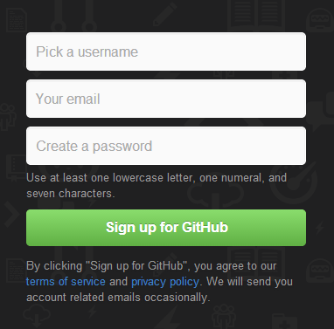
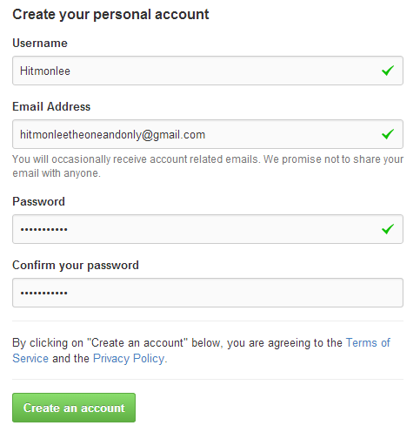
Registering for Github
1
2
3
Notes:
Go to https://github.com
Click to sign up
Create a free account
Profit

Slide 7
Making git work with GitHub (ssh keys)
See link #4 at the end of these slides
Notes:
A demonstration will be shown in class

Slide 8
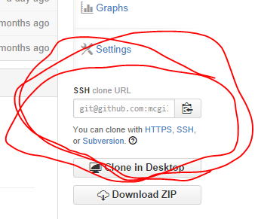

Getting the class notes
1
2
3
Notes:
Go to https://github.com/mcgill-ecse321/class-notes
Find the link to clone on the right hand side
Type the command ‘git clone git@github.com:mcgill-ecse321/class-notes.git’
enjoy

Slide 9
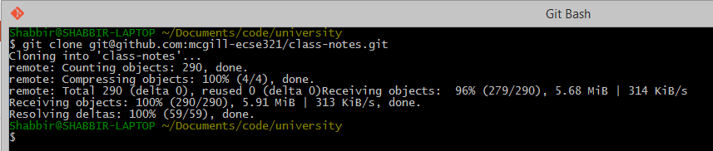
Cloning a repo from the net
Notes:
Congratulations. If you see the above message you’ve correctly cloned the repository

Slide 10


Understanding Git and some basic functions
Going from this
To this

Slide 11
Quick glossary
Git is your version control software
Git Hub is a website that hosts your repositories
Repositories are a collection of files and file histories
Commits are like save states

Slide 12



Repositories
This is what a Repository Looks like
.git
All the data about a repository lives in this folder
Helloworld.java
Helloworld.o
Notes:
A repository is essentially a folder
But this folder also contains extra information about your previous versions known as commits

Slide 13


Creating our own Repository
1
2
3
Notes:
Create a folder
Go into that folder
Type the command ‘Git init’
Lean back

Slide 14
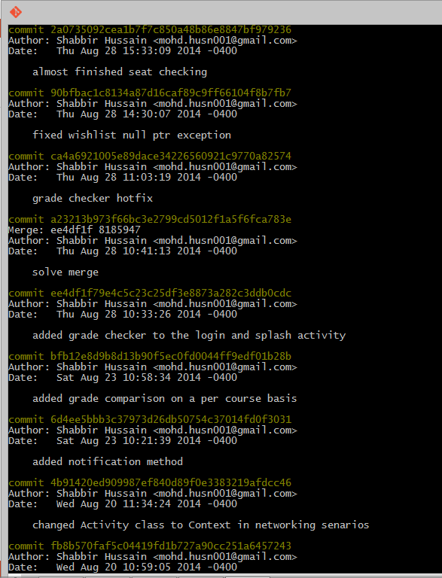
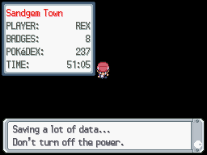
What is a Commit?
Save states
Commits
Notes:
A commit is a save state of all your files
Commits are useful to go back to a an exact point in time
Commits are just like save states in video games
A commit object contains:
Unique Sha1 identifier
Snapshot of all the files in the working directory
Creation date
Author

Slide 15


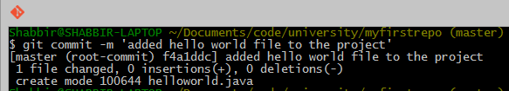
Adding and committing a file
1
2
3
Notes:
Create a file called helloworld.java
Add it to the repository
Commit your new file to the repository

Slide 16
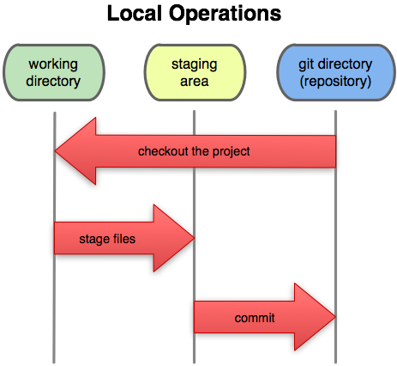
Workflows in Git
Working Directory: Files being worked on right now
Staging area: Files ready to be committed
Repository: A collection of commits
Why should we stage files instead of directly committing them?
Notes:
The above diagram represents 3 states a file can be in.
The working directory is the current state of all files.
The staging area is an abstract concept. It is the state files are put into right before being committed. We stage a file with the command “git add <filename>”. This is useful for situations when you want a commit to represent several files. Why else would you stage a file?
Once files are staged. We can commit staged files to the repository.

Slide 17

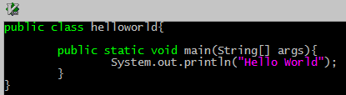
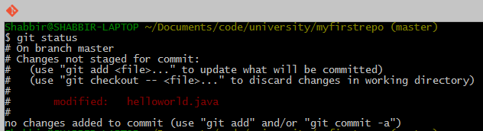
File Status Updates
1
2
3
Notes:
Open the file in an editor (you can use your favorite editor like note pad)
Modify the file to print hello world and save
Check the status of the repository
Checking the status tells us the state our repository is in. In this case it says that we made changes to a file but did not add it to the staging area

Slide 18


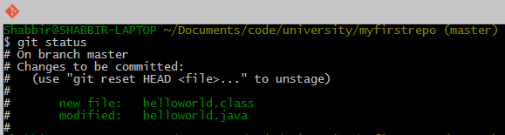
Staging and Unstaging files
1
2
3
Notes:
Compile the file
Then add all the files to the staging area (“git add .” is a shorthand for adding all files to the staging area)
Check the status of the repo
Here in the Status We can see that there are two files in the staging area. This is because we created a class file when we compiled our program.

Slide 19
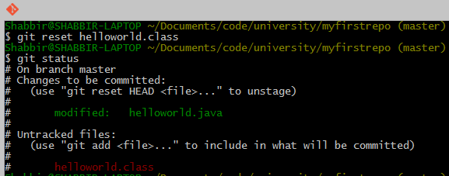
Staging and Unstaging files
Notes:
Let’s pretend we don’t want the class file to be in our next commit. We can remove a file from the staging area with “git reset <filename>”

Slide 20


Committing files (cont.)
Only Staged files are committed.
Notes:
In this case, only our helloworld.java will be in our most recent commit.

Slide 21
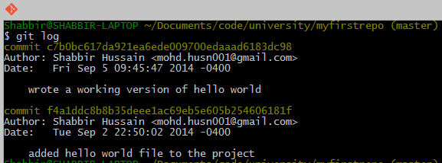
Reviewing commits
Notes:
Check the logs to see who committed, what they committed, and when with “git log”

Slide 22
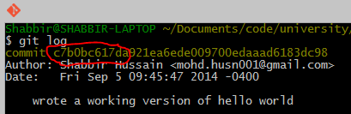


Tagging commits
1
2
3
Notes:
Identify a few digits of the commit you want to tag
Tag the commit using “git tag <tagname> <firstFewDigitsOfCommit>”
Check tag using git log
Tagging is useful if you want to identify a point in your code using human words. For example, if you have multiple versions of your code, you can tag which commit corresponds to version 1. Tagging will be useful for your class assignments
Also, we used a different flavor of git log. We added some options so that it would show us the log in a different format.

Slide 23
Rolling back to a previous version

Slide 24
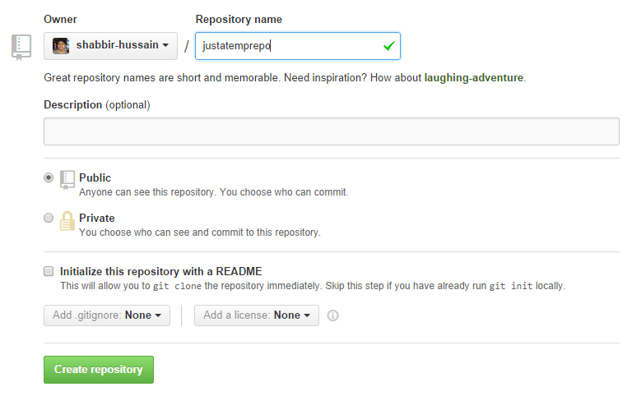
Uploading your local Repository to the cloud
1
2
Notes:
We now need to sync our work to the cloud.
Start by
going to the link
and creating a new repository on github

Slide 25

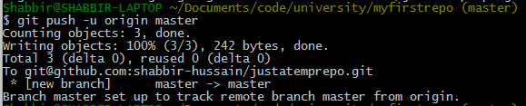
Uploading your local Repository to the cloud
3
4
5
Notes:
3. Copy the link to the clipboard
4. Use the link to set the origin
5. Push your commits to the remote repository

Slide 26
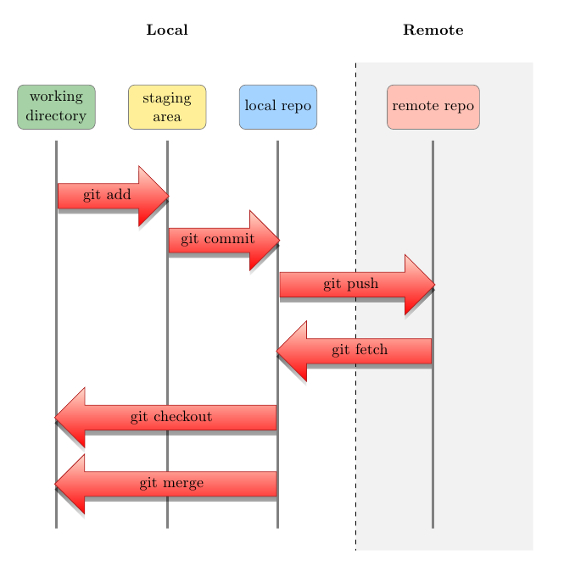
Uploading your local Repository to the cloud
Notes:
Now that you have linked your local repository to one in the cloud, you can push commit to synchronize the remote repo, or pull commits to synchronize the local repo.

Slide 27
Extra Credits
Vogella Reference: http://www.vogella.com/tutorials/Git/article.html
Try github Interactive Tutorial: https://try.github.io/levels/1/challenges/1
Visual Explanation: http://www.wei-wang.com/ExplainGitWithD3/
SSH keys tutorial: https://help.github.com/articles/generating-ssh-keys
Notes:
Do the tutorials in link 2 and 3

