Slide 1
Git and Github
A very short introduction
More info in the notes
Notes:
Most picture slides will have additional information here in the notes.

Slide 2
What is Version Control?
Version Control software is a tool used to keep track of different versions of files
Revert to an old version
Branch to create multiple version
Merge two different versions together
Synchronize files on different machines

Slide 3
Pop Quiz
Would it be a good idea to use version control on your photo album?
When would you want to revert to a previous version of a file?
Why would you want to branch your files?

Slide 4
Why You're going to use it
You need it for this class
It’s a great way to sync your code with your team
Because using dropbox to sync your code is so last semester

Slide 5
Let get Git
http://git-scm.com/download/win
http://git-scm.com/download/mac
sudo apt-get install git

Slide 6

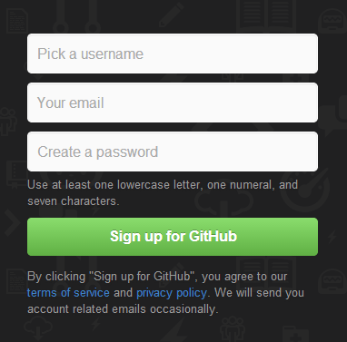
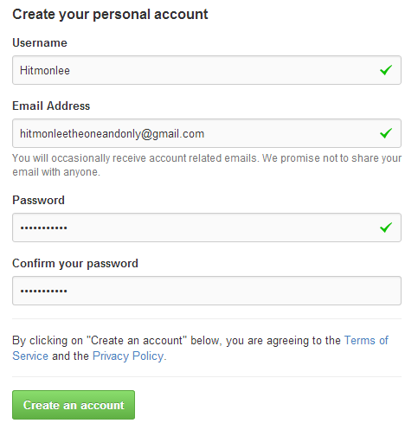
Registering for Github
1
2
3
Notes:
Go to https://github.com
Click to sign up
Create a free account
Profit

Slide 7
Making git work with GitHub (ssh keys)
See link #4
Notes:
A demonstration will be shown in class

Slide 8


Understanding Git and some basic functions
Going from this
To this

Slide 9
Quick glossary
Git is your version control software
Git Hub is a website that hosts your repositories
Repositories are a collection of files and file histories
Commits are like save states

Slide 10



Repositories
This is what a Repository Looks like
.git
All the data about a repository lives in this folder
Helloworld.java
Helloworld.o
Notes:
A repository is essentially a folder
But this folder also contains extra information about your previous versions known as commits

Slide 11
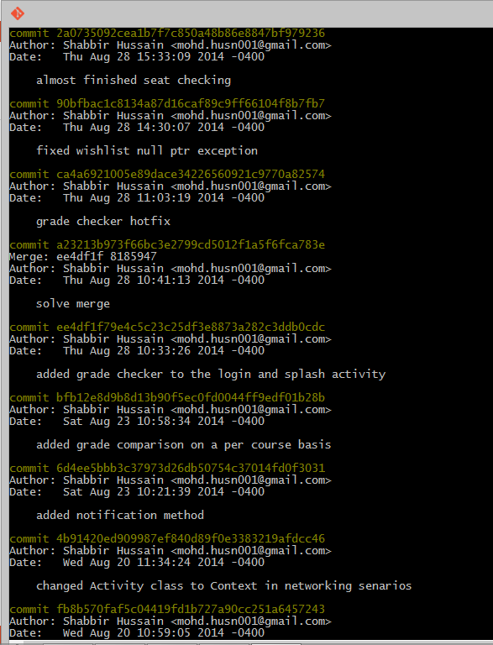
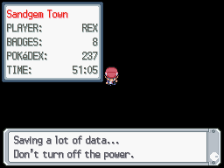
What is a Commit?
Save states
Commits
Notes:
A commit is a save state of all your files
Commits are useful to go back to a an exact point in time
Commits are just like save states in video games
A commit object contains:
Unique Sha1 identifier
Snapshot of all the files in the working directory
Creation date
Author

Slide 12
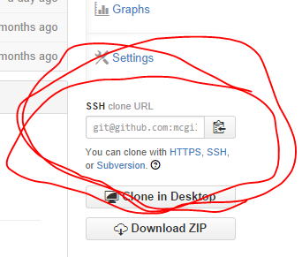

Cloning a repo from the net
1
2
3
Notes:
Go to https://github.com/mcgill-ecse321/class-notes
Find the link to clone on the right hand side
Type the command ‘git clone git@github.com:mcgill-ecse321/class-notes.git’
enjoy

Slide 13
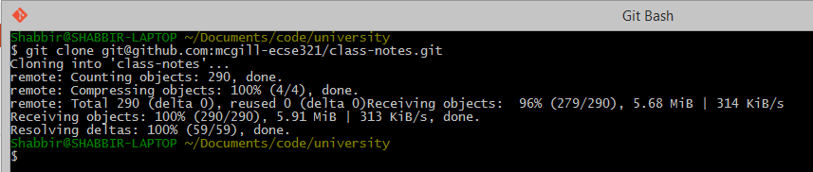
Cloning a repo from the net
Notes:
Congratulations. If you see the above message you’ve correctly cloned the repository

Slide 14





Working with Friends
.git
Helloworld.java
Helloworld.o
Remote Repo
Github.com
Best Friend
His Computer
You
Your Computer
.git
.git
Helloworld.java
Helloworld.java
Helloworld.o
Helloworld.o
His Local Repo
Your Local Repo
Notes:
In the git model a full working copy of the repository lives in your computer locally as well as on a remote repository somewhere in the cloud
We cloned the current version of the class notes to our computer
To synchronize across machines by push and pull commands
When adding new changes to your files you can push commits to update the remote repo
If you know your friend has updated the remote repo you can pull to get these commits

Slide 15
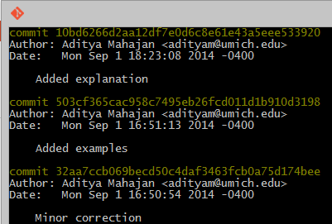
Repository logs
Notes:
Check the logs to see who committed, what they committed, and when

Slide 16


Creating our own Repository
1
2
3
Notes:
Create a folder
Go into that folder
Type the command ‘Git init’
Lean back

Slide 17


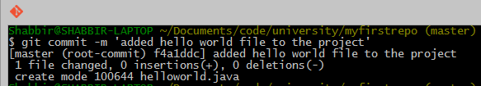
Adding and committing a file
1
2
3
Notes:
Create a file called helloworld.java
Add it to the repository
Commit your new file to the repository

Slide 18
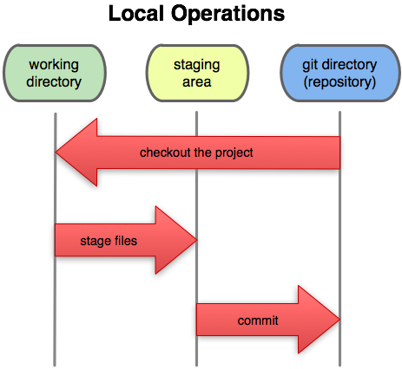
Workflows in Git
Working Directory: Files being worked on right now
Staging area: Files ready to be committed
Repository: A collection of commits
Why should we stage files instead of directly committing them?
Notes:
The above diagram represents 3 states a file can be in.
The working directory is the current state of all files.
The staging area is an abstract concept. It is the state files are put into right before being committed. We stage a file with the command “git add <filename>”. This is useful for situations when you want a commit to represent several files. Why else would you stage a file?
Once files are staged. We can commit staged files to the repository.

Slide 19
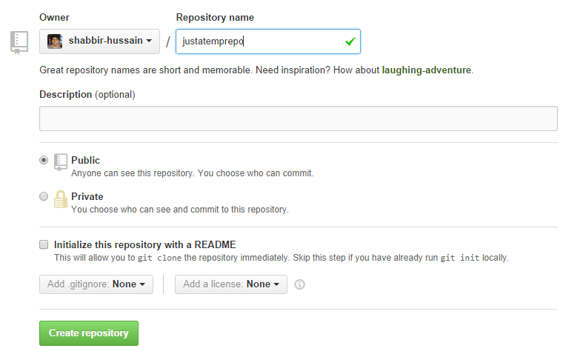
Uploading your local Repository to the cloud
1
2
Notes:
We now need to sync our work to the cloud.
Start by
going to the link
and creating a new repository on github

Slide 20

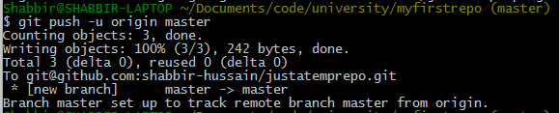
Uploading your local Repository to the cloud
3
4
5
Notes:
3. Copy the link to the clipboard
4. Use the link to set the origin
5. Push your commits to the remote repository

Slide 21
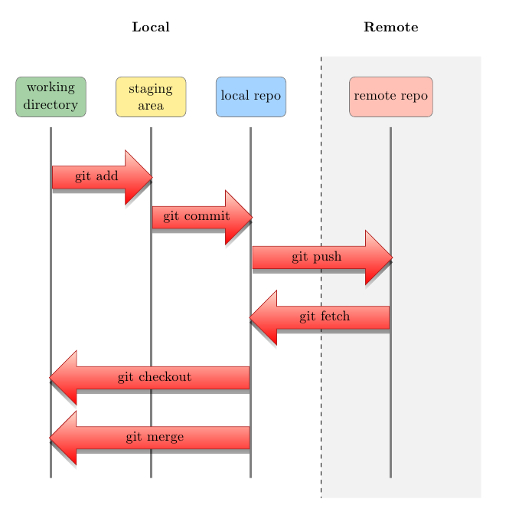
Uploading your local Repository to the cloud
Notes:
Now that you have linked your local repository to one in the cloud, you can push commit to synchronize the remote repo, or pull commits to synchronize the local repo.

Slide 22
Extra Credits
Vogella Reference: http://www.vogella.com/tutorials/Git/article.html
Try github Interactive Tutorial: https://try.github.io/levels/1/challenges/1
Visual Explanation: http://www.wei-wang.com/ExplainGitWithD3/
SSH keys tutorial: https://help.github.com/articles/generating-ssh-keys
Notes:
Do the tutorials in link 2 and 3

