Slide 1
Intro to Java Game programming
Using Java Swing and MVC architecture

Slide 2

Model View Controller Architecture
High Coupling
Low Cohesion
Modular
Model: Representation of Data
View: Graphical Interface
Controller: Binds Model to View
Notes:
Source: http://en.wikipedia.org/wiki/Model%E2%80%93view%E2%80%93controller#mediaviewer/File:MVC-Process.svg

Slide 3
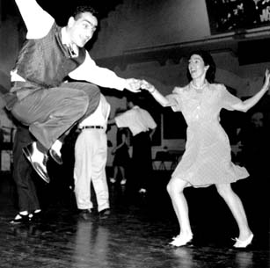
Java Swing
The very basics

Slide 4
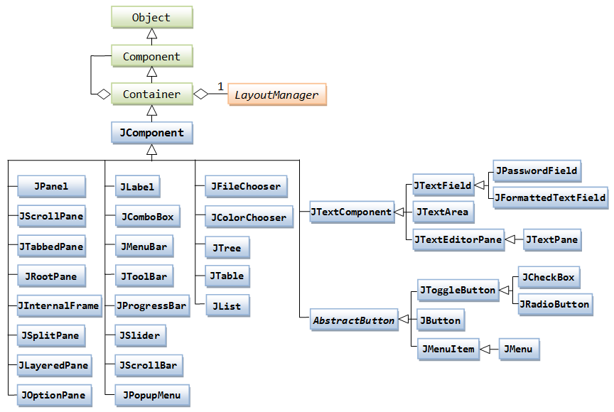
Java Swing
Java Swing is the library used to make Graphical user interfaces in Java
Notes:
Source: http://www.ntu.edu.sg/home/ehchua/programming/java/images/Swing_JComponentClassDiagram.png

Slide 5
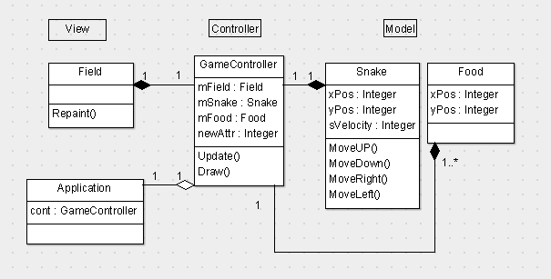
MVC in Java Swing

Slide 6
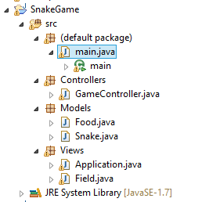
MVC in Java Swing

Slide 7
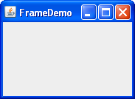
Swing Basics - JFrame
A JFame object is your window

Slide 8
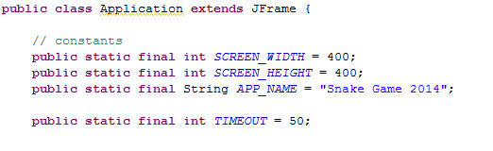
Swing Basics - JFrame

Slide 9
Swing Basics - JPanel
A JPanel is the Square area inside your window. Think of this as your Canvas.

Slide 10
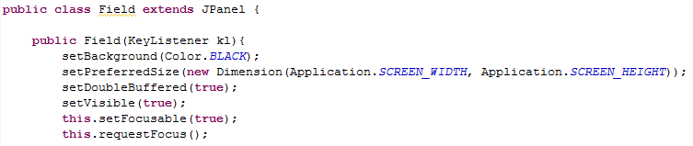
Swing Basics - JPanel
Need to add JPanel to JFrame:

Slide 11
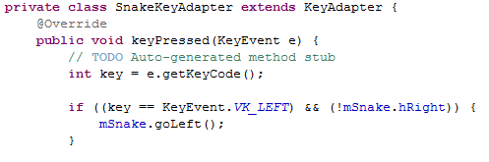
Swing Basics - KeyListeners
A KeyAdapter Implements keyListener

Slide 12
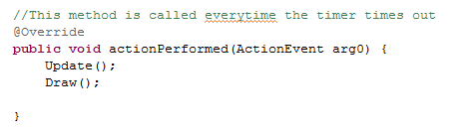
MVC Basics - Controllers
All Games have the basic update and redraw method called every frame.

Slide 13
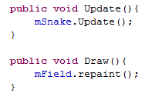
MVC Basics - Controllers
Update: updates the business Logic (Model)
Draw: Refreshes the sprites on screen (View)

Slide 14
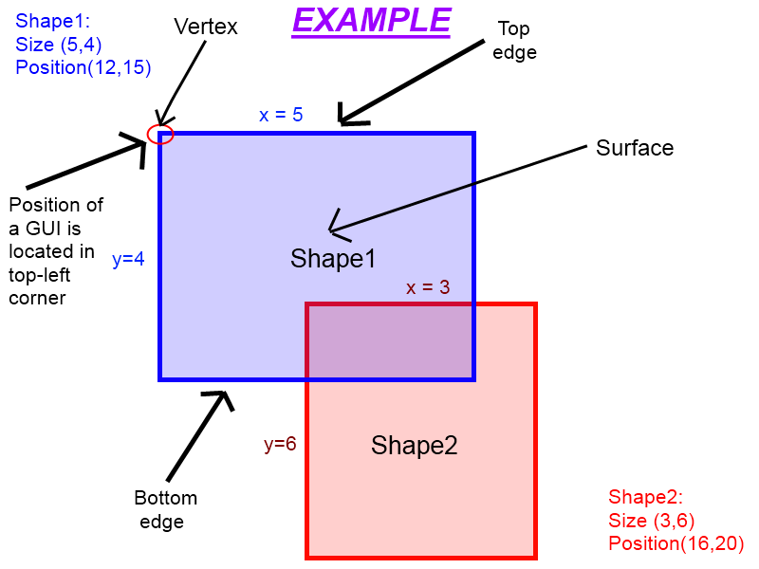
Collision Detection
Detect Two shapes touching by checking if they overlap
Notes:
Source: http://wiki.roblox.com/images/0/0e/Gui_example_1_dot_1.png

Slide 15
Exercise
Add Collision detection vs Snake and food
Make snake’s body length longer
Add 2 pieces of food

Slide 16
Extra Credit
Finish the Snake game

Slide 17
References
Java Game Tutorial: http://zetcode.com/tutorials/javagamestutorial/
Collision detection: http://wiki.starling-framework.org/tutorials/basic_collision_detection

